Slide 1
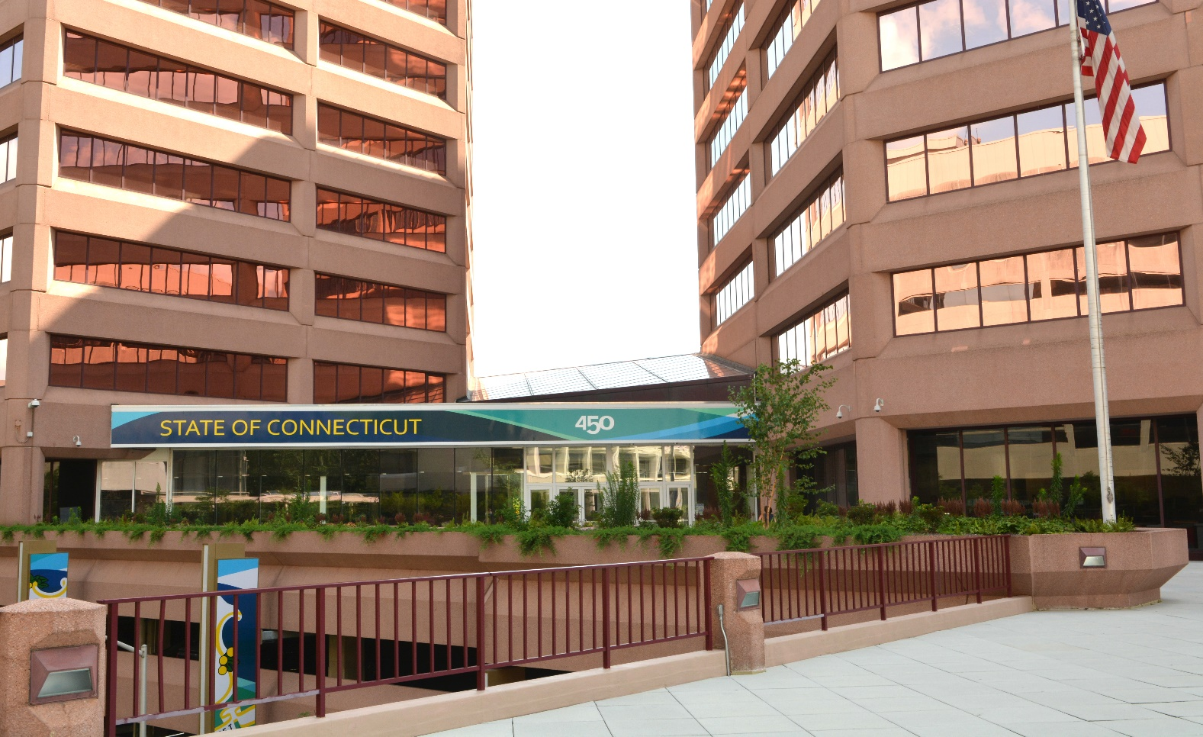
DAS Statewide Leasing/Property Transfer Overview
June 15, 2023

Slide 2
DAS Statewide Leasing/Property Transfer
Overview
AGENDA
June 15, 2023
WELCOME AND THANK YOU FOR JOINING US TODAY
COMMENTS FROM DAS COMMISSIONER MICHELLE GILMAN
COMMENTS FROM DAS DC DARREN HOBBS
PURPOSE OF SESSION
MEET THE TEAM
ASSIGNMENT OF SPACE (NEW TOPIC)
TELEWORK (NEW TOPIC)
STATEWIDE CAPITAL AND FACILITIES PLAN (FACCAP) – Effective 7/1/2023 (2023-2028)
  REQUEST FOR SPACE PROCESS (Leased and State Owned)
  INTERIM SPACE PROCESS
  YOUR AGENCY’S RESPONSIBILITIES
  GENERAL PARAMETERS REGARDING LEASES
DISCUSS 4B27
DISCUSS LEASE COMPLIANCE
DISCUSS ANNUAL INSPECTIONS of EMERGENCY EQUIPMENT AND FIRE SYSTEMS
DISCUSS STATE’S/AGENCIES RESPONSIBILITIES TO REPORT TO LESSORS
QUESTION/ANSWER

Slide 3
DAS Statewide Leasing/Property Transfer
Overview
PURPOSE OF SESSION IS;
To ensure you are fully informed about the leasing/property transfer AND assignment of space process
To reduce the amount of time the process takes
To ensure all of us are in compliance with statutes
To help DAS meet your agencies’ real estate needs so you can meet your agencies’ objectives

Slide 4
DAS Statewide Leasing/Property Transfer
Overview
Meet the Team
Tom Pysh- Supervising Property Agent
Tom Piacenza- Property Agent 2
Samantha McLaughlin- Property Agent 2
Gary Bonaldi – Property Agent 2
Joey Guest – Compliance Officer
Anne Peterson – Staff Attorney 3 (DCS Legal)
Mary Taylor – Paralegal (DCS Legal)

Slide 5
DAS Statewide Leasing/Property Transfer Overview
Assignment of Space
Overview:
  DAS Commissioner has the statutory authority to assign space with the approval of OPM and SPRB.
  OPM has the statutory authority for space planning.
  Applicable to all Executive and Judicial branch space, not only space controlled by DAS. Excludes DOT, DOL and UCONN.
  The process is in place to ensure a coordinated effort to efficiently use state real estate and more recently due to teleworking, to reach the on-going goal of reducing the state’s real estate footprint thereby reducing costs.

Slide 6
DAS Statewide Leasing/Property Transfer Overview
Assignment of Space
When an agency wants to “re-do” their space:
  Many state employees telework (Judicial is not teleworking at all). Agencies are being asked to review their real estate space needs based on less employees in the office. For projects you may be involved in, even if there is no apparent change in the amount of space itself, telework must be reviewed by us with the user agency to ensure that all their current space is still necessary.
  In 2013 DAS, SPRB and OPM established a space standard of 220 square feet per employee for (1) state owned space, (2) new leases, (3) expansions of existing leases, or (4) relocating existing leases. This does not mean each employee gets a 220 square foot office or cubicle!
  The 220 square foot figure, in addition to employee cubicles and offices, includes areas such as storage, kitchens, standard waiting rooms, common areas, primary and secondary circulation space, etc. If an agency has a unique space requirement such as a very large waiting room, hearing rooms, etc., additional square footage may be approved; however, this is considered by DAS and OPM on a case-by-case basis.

Slide 7
DAS Statewide Leasing/Property Transfer Overview
Assignment of Space
State Approvals:
        When an agencies’ current assignment of space changes:
Call us, discuss the project:
We can determine if state approvals by OPM (pursuant to CGS §4-67-G F (4)) and SPRB (pursuant to CGS §4b-29) are necessary.
To determine we review the following:
  Are any employees moving from building to building?
  Is the user agency teleworking and if so, what effect will this have on their final square footage?
  How large of a project is it, number of people moving?
  Is a request for space (RFS) form necessary?
If not, then project can proceed
If so, then:
  We will need a description of the project, who’s moving where, costs involved, timing, effect of telework.
  A completed RFS signed by user agency head, Shane, Darren and OPM (discussed in next slide).
  Shane submits a memorandum to OPM first and upon their approval one to SPRB.
  Upon those two approvals Shane sends a memorandum to you stating that state approvals are received and the project can proceed.

Slide 8
DAS Statewide Leasing/Property Transfer Overview
Assignment of Space
REQUEST FOR SPACE FORM (RFS)
State Owned Space
The agency must fill out the RFS form as a rough draft and return it to Leasing for basic review. We will call you back to discuss any details and explain what other information is required to complete the form.
The form is both a planning document (current staffing and needs projected out 3 years) and an approval document. Upon approval by the user agency, Shane, Darren and OPM, the project can progress to design, costing, etc.
Then a memorandum requesting approval to proceed is sent by Shane to OPM and if approved then to SPRB. If approved then project may proceed, Shane will notify the user agency by email.
YOUR RESPONSIBILITY:
Contact us as soon as you have a request for a project regarding space
Do not proceed until:
It has been determined no approvals are necessary or
Approvals are received

Slide 9
DAS Statewide Leasing/Property Transfer Overview
State Facility Plan
&
Surplus Real Property
Paul Hinsch, Policy Director, Asset Management
Office of Policy & Management
Bureau of Assets Management

Slide 10
DAS Statewide Leasing/Property Transfer Overview
WHAT IS THE STATE FACILITY PLAN?
Mandated by CGS 4b-23 - “The state facility plan shall be used as an advisory document for the leasing of property for use by state agencies & departments & for related capital projects.”
Any agency wishing to lease space must be approved for both the necessary costs and square footage under the Plan before DAS can begin the space acquisition process.
Information submitted to OPM (copied to DAS) is reviewed by Assets Management Unit and Budget Division who make recommendations for costs and square footages for each request which forms the basis of the State Facility Plan.
The State Facility Plan is in effect for a 2-year period, so the upcoming Plan will cover the July 1, 2023, to June 30, 2025, timeframe.
There is no action necessary from agencies until the summer of 2024.

Slide 11
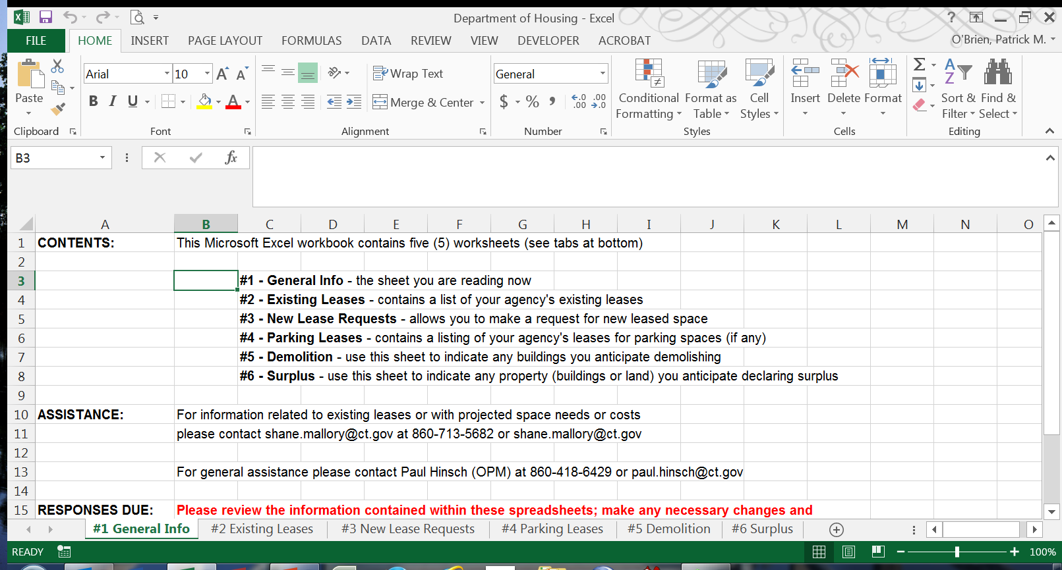
DAS Statewide Leasing/Property Transfer Overview
STATE FACILITY PLAN SPREADSHEET
Agencies will receive a spreadsheet from OPM which looks similar to this:
All information on each of these tabs must be complete and accurate.

Slide 12
DAS Statewide Leasing/Property Transfer Overview
DATA SUBMISSION
Agencies will receive blank spreadsheets from OPM Assets via email in mid-July (even years).
These blank spreadsheets will require each agency to input all your existing leases.
You must:
  Request any new leases or proposed expansions
  Make sure all information is complete and accurate

Slide 13
DAS Statewide Leasing/Property Transfer Overview
STATE FACILITY PLAN – SQUARE FOOTAGE ESTIMATES
In 2013 DAS, SPRB and OPM established a space standard of 220 square feet per employee for (1) new leases, (2) expansions of existing leases, or (3) relocating existing leases.
Due to COVID-19 many state employees have worked from home since 2020. This has dictated that we receive the square footage and the need for the current square footage for owned and leased. Agencies are being asked to review their real estate space needs based on telework. This will evolve over the next 6-12 months. This does not mean each employee gets a 220 square foot office or cubicle!
The 220 square foot figure, in addition to employee cubicles and offices, includes areas such as storage, kitchens, standard waiting rooms, common areas, primary and secondary circulation space, etc.
If an agency has a unique space requirement such as a very large waiting room, hearing rooms, etc., additional square footage may be approved; however, this is considered by DAS and OPM on a case-by-case basis.
When preparing State Facility Plan submissions, agencies should base their square footage needs on 220 square feet multiplied by the number of approved employees.

Slide 14
DAS Statewide Leasing/Property Transfer Overview
STATE FACILITY PLAN DATA SUBMISSION – COST ESTIMATES
The spreadsheets you will receive will include, among other items, information related to annual rental and additional rent costs for existing and proposed leases.
This information must be complete and accurate.
For existing leases, actual costs must be used.
For proposed expansions at existing locations, use existing actual costs per square foot.
For new lease requests or relocations, reasonable per square foot estimates are:
  Electric $2.50 * Janitorial $1.50
  Gas $1.25 * R.E Taxes $0.25 (above base year)
  Security $0.25 Window Cleaning $0.10
  Trash $0.10 TI (check with your DAS property agent)
  * will need to be checked due to higher utility rates.

Slide 15
DAS Statewide Leasing/Property Transfer Overview
STATE FACILITY PLAN - AREAS OF CONFUSION WHEN SUBMITTING DATA
Requesting additional space for an existing lease
  On the “Existing Leases” tab enter the total anticipated square footage need in the “Anticipated Square Footage Required” column
Requesting that an existing lease be relocated to a new location
  On the Existing Leases tab, simply set the “Anticipated Action” to “New Lease”
Informing OPM that an existing lease will no longer be required
  On the Existing Leases tab, set the “Anticipated Action” to “Cancel Lease”
Informing OPM that one of the leases listed has already been canceled
  On the Existing Leases tab, set the “Has Your Agency Cancelled This Lease?” to “Yes”

Slide 16
DAS Statewide Leasing/Property Transfer Overview
WHAT IF MY REQUEST IS NOT FULLY APPROVED IN THE STATE FACILITY PLAN?
If the agency is not fully approved for the necessary costs and/or square footage under the State Facility Plan, then DAS may not legally enter into a lease or even begin the process to find a lease.
However, CGS 4b-23 does allow agencies to submit “interim requests” for funding and/or square footage.
If your agency is not approved for sufficient costs and/or square footage in the State Facility Plan, you may submit an Interim Request to DAS, which is then reviewed by OPM.
If (and only if) DAS and OPM approves the Interim Request, the space acquisition process can move forward.
This is true for new requests, proposed expansions, relocations and existing leases.

Slide 17
DAS Statewide Leasing/Property Transfer Overview
INTERIM SPACE AND FUNDING REQUESTS
If your agency is not approved for sufficient costs and/or square footage in the State Facility Plan, you may submit an Interim Request to OPM (via DAS).
Interim Requests require your agency to fully justify the need for additional square footage and/or reallocating your existing fiscal resources to cover any unanticipated costs.
Interim Requests do not provide your agency with additional funds but rather represent OPM’s approval of your agency’s plan to reallocate your existing fiscal resources to cover the costs of the lease for the entire term of the lease.
Basically, you must already have sufficient funds to cover all of the costs and are seeking OPM permission to shift funds in order to spend them on the lease in question.
Agencies are now required to work with their OPM Budget analyst on a plan to reallocate existing fiscal resources prior to submitting an interim funding request (*** New ***).
Sample interim request submission letters are available on the OPM Assets website.

Slide 18
DAS Statewide Leasing/Property Transfer Overview
INTERIM SPACE AND FUNDING REQUESTS
OPM Budget will review interim requests to make sure that anticipated staffing levels are accurate and that the agency’s proposed plan for reallocating its existing fiscal resources is appropriate, feasible and acceptable.
OPM Assets will review interim requests to make sure that the square footage being requested is appropriate, whether there are any unique agency needs which would result in the need for additional square footage, evaluating whether the costs being requested are adequate and identifying alternate low/no cost alternatives to leasing.
Once those reviews are complete, the request is approved/disapproved/modified by the Assets Management Unit.
Please note that interim request submissions are not “FYI” or “done deals”. OPM will review each submission and make an independent determination as to the square footage and cost approvals.
As the State is actively seeking to reduce costs wherever possible, interim space requests will be scrutinized closely and agencies are strongly advised to make sure that their State Facility Plan submissions are complete and accurate.

Slide 19
DAS Statewide Leasing/Property Transfer Overview
COMMON MISCONCEPTIONS
  “Its an existing lease, so I don’t need to report it.”
  “Everyone knows we’ve been at this location for years so I don’t need to report it.”
  “My budget analyst knows we have this location so I don’t need to report it.”
  “I was approved for this space under the old Plan, so I don’t need to request it again.”
  “I won’t be using State funds to pay for the lease so I don’t need to submit it for the Plan.”
  “I’m not sure of my needs so I’ll just submit an interim request later.”
  “The lease has no cost so I don’t need to report it.”

Slide 20
DAS Statewide Leasing/Property Transfer Overview
MAJOR PROBLEM AREAS
Agencies don’t submit all of the required information.
Agencies don’t fact check and/or update the information they submit.
Agencies don’t submit the information by the required deadlines.
Agencies add, delete or rearrange columns in the spreadsheets.
Agencies add or delete the tabs in the spreadsheet.
Agencies rely on interim requests rather than proper planning.
Agencies use previous versions of the spreadsheet or make up their own.

Slide 21
DAS Statewide Leasing/Property Transfer Overview
STATE FACILITY PLAN TIMELINE
July-September (even-numbered years) – Agencies prepare & submit requests to OPM (with a copy to DAS). Spreadsheets must be submitted no later than September 1st.
September – OPM Assets works to ensure that submissions are complete & accurate
October–January - Agency submissions are forwarded to OPM budget analyst who is responsible for making cost and square footage recommendations in conjunction with preparation of the State Budget.
February 15th (odd-numbered years) – OPM is required to submit to the State Properties Review Board (SPRB) a Proposed State Facility Plan.
March 1st – SPRB required to makes recommendations regarding the Plan to OPM.
March 15th – OPM required to present the Plan to the General Assembly.
March-June – General Assembly passes an operating and capital budget
July 1st – State Facility Plan goes into effect.

Slide 22
DAS Statewide Leasing/Property Transfer Overview
SURPLUS STATE REAL ESTATE
CGS 4b-21, “Any agency having custody & control of land, an improvement to land or interest in land, belonging to the state, shall inform the Secretary of the Office of Policy and Management and the municipality where the land is located, in writing, not less than six months before the date when the agency anticipates such land, improvement or interest or any part thereof is not needed.”
Once a property is declared surplus, OPM will solicit reuse proposals from State agencies.
Reuse proposals must include an explanation as to how the property will be used and your agency’s plan to not only pay for the programs which will be housed on the property but also your plan to pay for the operation and maintenance of the property itself.
Agencies have 30 days to respond. OPM evaluates agency reuse proposals and determines if the reuse proposal should be accepted and the agency be given the property or if the State, through DAS, should divest itself of the property.

Slide 23
DAS Statewide Leasing/Property Transfer Overview
SURPLUS STATE REAL ESTATE
CGS 4b-21 allows OPM to require the agency which declared the property to be surplus to continue to oversee the care of the property during the disposition process.
While there are some exceptions, any agency declaring property to be surplus should anticipate being directed to continue to oversee the property during the disposition process.
While CGS 4b-21 requires agencies to notify OPM at least 6 months prior to the agency no longer needing the property, agencies may declare property to be surplus as far in advance as they wish (but no less than 6 months).
We strongly recommend that agencies declare property surplus as early as possible so that the disposition process can run concurrently with agency operations.
This will dramatically reduce the time your agency is caring for property after you have vacated it.

Slide 24
DAS Statewide Leasing/Property Transfer
Overview
STATE FACILITY PLAN – QUESTIONS?
Paul Hinsch
Office of Policy and Management
Bureau of Assets Management
(860) 418-6429
paul.hinsch@ct.gov
www.ct.gov/opm/property

Slide 25
DAS Statewide Leasing/Property Transfer
Overview
REVIEW REQUEST FOR SPACE PROCESS

Slide 26
DAS Statewide Leasing/Property Transfer
Overview
REQUEST FOR SPACE FORM
Existing Leases
  18 month notice letter is sent to agency stating lease end date. The old RFS form is included (if available) in this package.
  The agency must fill out the RFS form as a rough draft and return it to Leasing for basic review. We will call you back to discuss any details and explain what other info is required to complete the form.
  If the amount of space or cost is less than 10% over the amount in FACCAP, we can proceed with the commissioner signatures. If it is more than 10% over the amount in FACCAP – an interim space request is needed.
  The interim space request form ----- Paul Hinsch
  When the existing lease is NOT in FACCAP (happens when the agency fails to submit space request in each even year to OPM!) the agency must follow the Interim Space Request Process outlined earlier.

Slide 27
DAS Statewide Leasing/Property Transfer
Overview
REVIEW INTERIM SPACE REQUEST PROCESS
These cover letters are required when the agency is seeking more square footage than it is approved for under the current State Facility Plan. They are on the OPM website.
Sample ISR Letter #1 - To be used when an agency needs to exceed State Facility Plan square footage approval by more than 10%.
Sample ISR Letter #2- To be used when the space request was not submitted for inclusion in the State Facility Plan.
Sample ISR Letter #3 - To be used when a space request was submitted for inclusion in the State Facility Plan, but not approved.
Required Cover Sheet - To be used as a cover sheet when submitting an interim space request submitted to OPM.
Interim Funding Requests (IFR)
Required when the agency is seeking lease funding beyond what it is approved for under the current State Facility Plan.
Sample IFR Letter

Slide 28
DAS Statewide Leasing/Property Transfer
Overview
GENERAL PARAMETERS REGARDING LEASES/PROPERTY TRANSFER:
Leasing/Property Transfer does not solicit bids, but rather request for proposals
Once advertised we can look at anything
A new lease is necessary if an existing lease is expiring and there is no renewal option or it is a new location
A purchase and sale agreement will be necessary on a transfer
The leasing process, and to a lesser extent property transfer, is based on statutes, policies and procedures
The leasing/property transfer process is not negotiable, it must be followed

Slide 29
DAS Statewide Leasing/Property Transfer
Overview
DISCUSS 4B27
Discussing your agency’s real estate needs with anyone outside your agency and DAS, jeopardizes the leasing/property transfer process
Can result in the elimination of a prospective site
Will result in slowing everything down
May result in having to start over again
Confuses prospective lessors/buyers/sellers
Violation of 4B27 is a class A misdemeanor

Slide 30
DAS Statewide Leasing/Property Transfer
Overview
YOUR AGENCY’S RESPONSIBILITIES:
Provide timely accurate information throughout entire process
Sign all documents correctly
Deliver all documents to DAS directly
Please do not discuss your agency’s real estate needs outside of DAS or your Agency
Read your lease (s), understand your obligations and the lessor’s obligations, CALL US WHEN IN DOUBT
Agencies only have leasehold rights to their demised premises
If you don’t hear from DAS, call us

Slide 31
DAS Statewide Leasing/Property Transfer Overview
Discuss Lease Compliance
Ensures Lessor is in compliance with lease
Ensures user agency is in compliance with lease
Ensures both parties are in compliance with life/fire safety, codes, etc.

Slide 32
DAS Statewide Leasing/Property Transfer
Overview
Annual Inspections of Emergency Equipment and fire systems
Agencies must:
Perform fire drills – a minimum of two per year
Self inspect fire extinguishers, date and initial tag, monthly (if installed)
Self inspect emergency lighting, monthly

Slide 33
DAS Statewide Leasing/Property Transfer
Overview
AGENCIES’ RESPONSIBILITIES UNDER STATE STANDARD LEASE
Notify Leasing:
  Give prompt notice of damage or other casualty to Leasing so we can inform lessor
  of any water penetration IMMEDIATELY
  Of any matter/issue regarding the lease (i.e., lessor not performing duties, etc…)

Slide 34
DAS Statewide Leasing/Property Transfer
Overview
Annual Inspections of Emergency Equipment and fire systems
LESSORS must:
Annual alarm testing by licensed alarm equipment contractor (annual is minimum, may need to be more frequent, depending on type of occupancy)
Annual inspection of sprinkler systems by licensed contractor
Annual fire extinguisher service by licensed contractor

Slide 35
DAS Statewide Leasing/Property Transfer
Overview
REVIEW PROPERTY TRANSFER PROCESS

Slide 36
DAS Statewide Leasing/Property Transfer
Overview
QUESTIONS/ANSWERS
THANK YOU FOR COMING!

