Slide 2
May 25-29, 2016 Ozone Exceptional Event Analysis for Connecticut
Michael Geigert

Slide 3

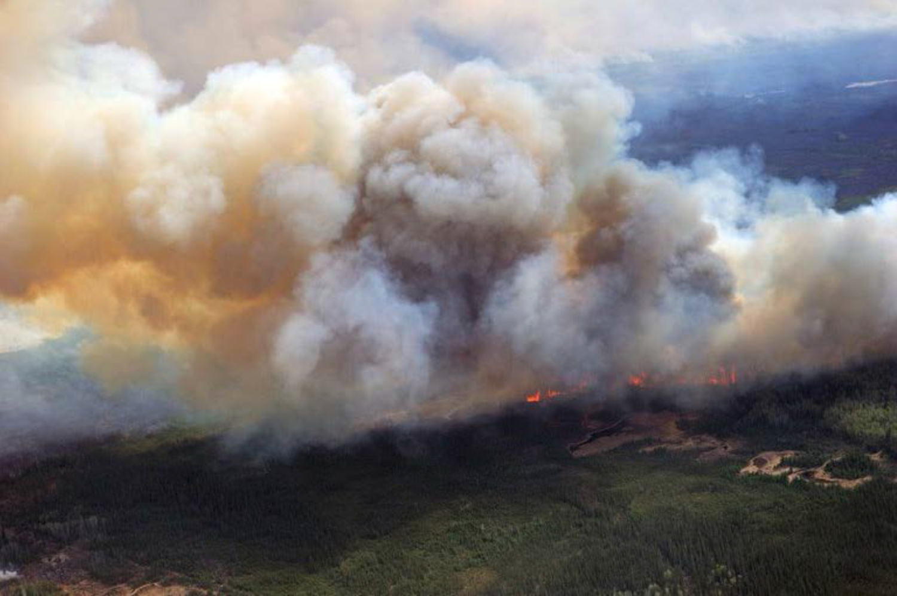
Fort McMurray Wildfire
On May 1, 2016, a wildfire began southwest of Fort McMurray, Alberta, Canada
On May 1, 2016, a wildfire began southwest of Fort McMurray, Alberta, Canada.
On May 3, it swept through the community, destroying approximately 2,400 homes
and buildings and forcing the largest wildfire evacuation in Albertan history.
The fire spread across approximately 590,000 hectares (1,500,000 acres) before
it was declared to be under control on July 5, 2016.

Slide 4
Available Tools for Analysis
Satellite animation with AOD estimations;
Analyzed plume coverage by NESDIS ;
Calipso satellite aerosol analysis;
Airnowtech Navigator trajectory analysis;
Hysplit trajectory analysis;
NOAA Model Forecasts;
NWS archive surface analysis;
Airnow AQI maps;
CTDEEP PM2.5, BC, and Ceilometer data.

Slide 5


Exceptional Event Guidance
Maps and tables of the wildfire event information including location, size, and extent.
Characteristics and description of the monitor with the request for data exclusion.
A brief explanation and identification of the cause and point of origin for the event.
Examples of media coverage of the event, including special weather statements, advisories, and news reports.
Smoke forecasts based on meteorology and burn conditions;
Description of meteorological data from or near the affected monitor and how this relates to the transport of the wildfire emissions.
Description of the route of the wildfire emissions to the influenced monitor, including meteorological information regarding the transport of wildfire emissions to the monitor.

Slide 6
Exceptional Event Guidance
Non-event O3 formation characteristics of the area normally influencing the monitor (i.e., the non-event conceptual model).
Discussion of the differences observed between the non-event conceptual model and event related conditions causing high O3 concentrations at a particular location.
A summary of spatial and temporal O3 patterns on the day of interest, and days before and after the event.
Description of the regulatory determination anticipated to be influenced by the exceptional event, including a table of the monitor data requested for exclusion
NAAQS attainment and classification information, including O3 State Implementation Plan (SIP) status.

Slide 7
Weight of Evidence
We intend to show :
Effects of the exceptional event on the regulatory determination on the Westport monitor;
The route of the wildfire emissions to the influenced monitors, including meteorological information regarding the transport of wildfire emissions to the monitor;
Satellite imagery and smoke plume analysis that shows the Fort McMurray plume settling over the Great Lakes area producing high concentrations of ozone that subsequently gets transported to Connecticut;
Why, at the onset of the event, meteorological conditions were not conducive for producing the high levels of ozone that were observed at our monitors;
That the NOAA operational ozone model, which did not incorporate real time wildfire emissions into the inventory, was under predicting ozone levels at the onset by at least 10 ppb;
Monitoring data at our sites was showing black carbon, PM2.5 and other parameters that concur with the presence of a smoke plume during the ozone event.

Slide 8
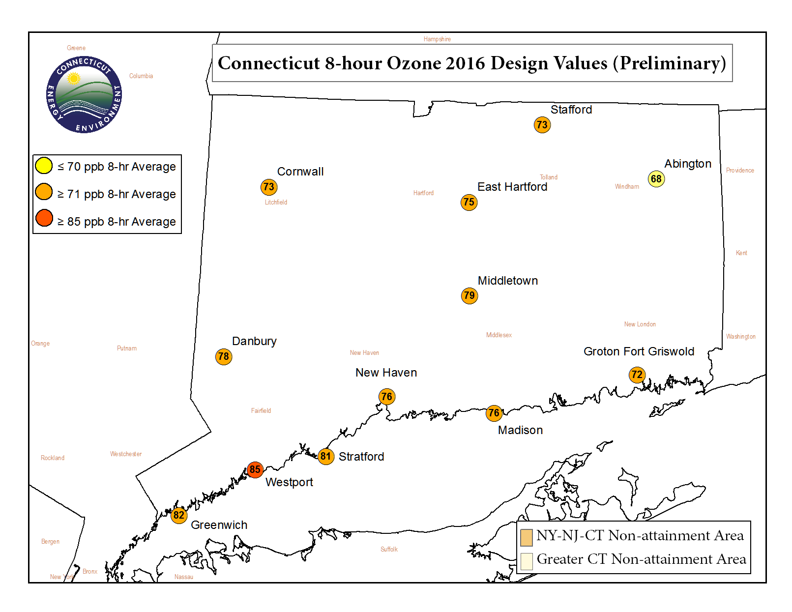
Elevation: 513 m (1683 ft)

Slide 9
Attainment Status Affected

Slide 10
Attainment Status Affected
May 25-26 had the most impact on current design values

Slide 11
Attainment Status Affected
Westport 2016 DV would drop to 83 ppb!

Slide 12
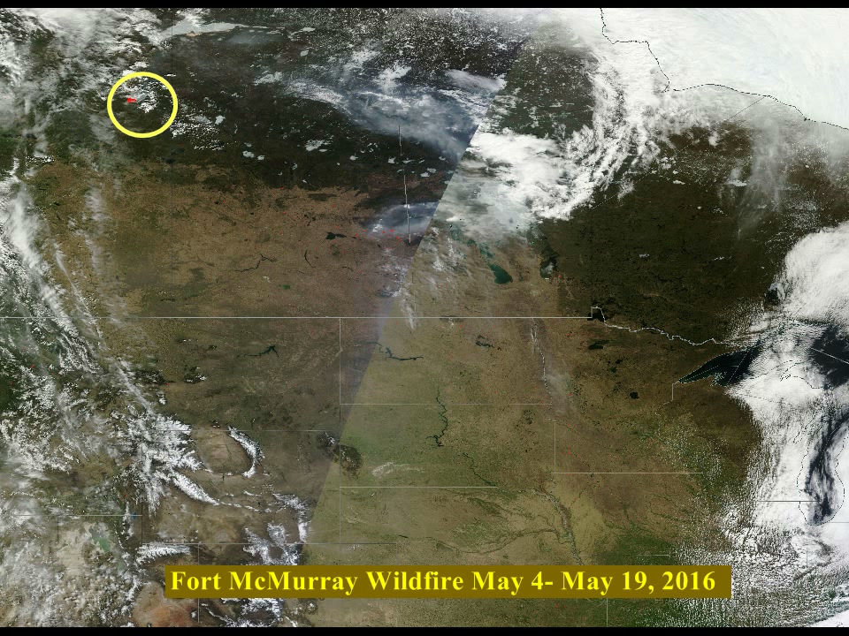
Video of Wildfire evolution since May 4th, 2016
Click to animate

Slide 13
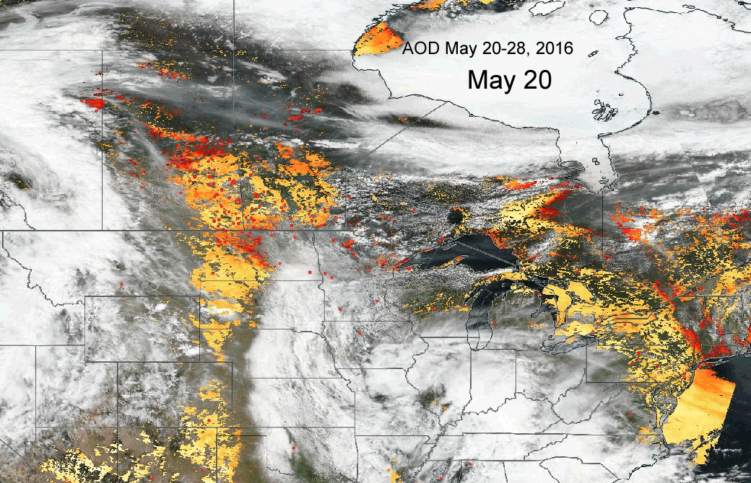
May 20-28 AOD Satellite Animation
Orange and red AOD signify
Higher aerosol concentrations in
Total vertical column (not surface)

Slide 14
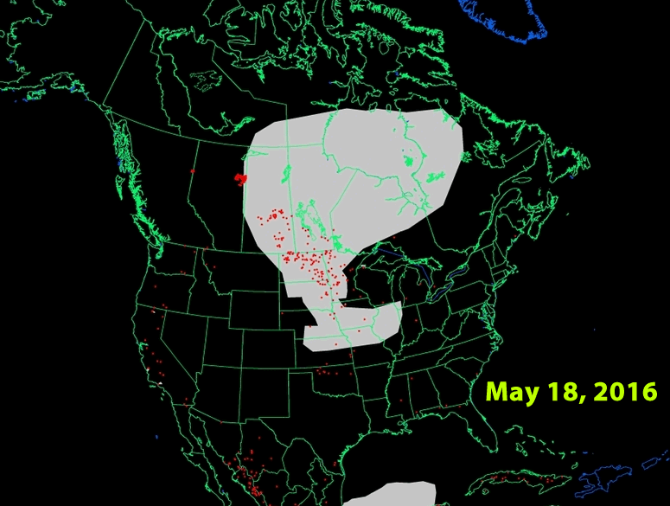
Smoke Plume Animation from May 18th- May 25th

Slide 15
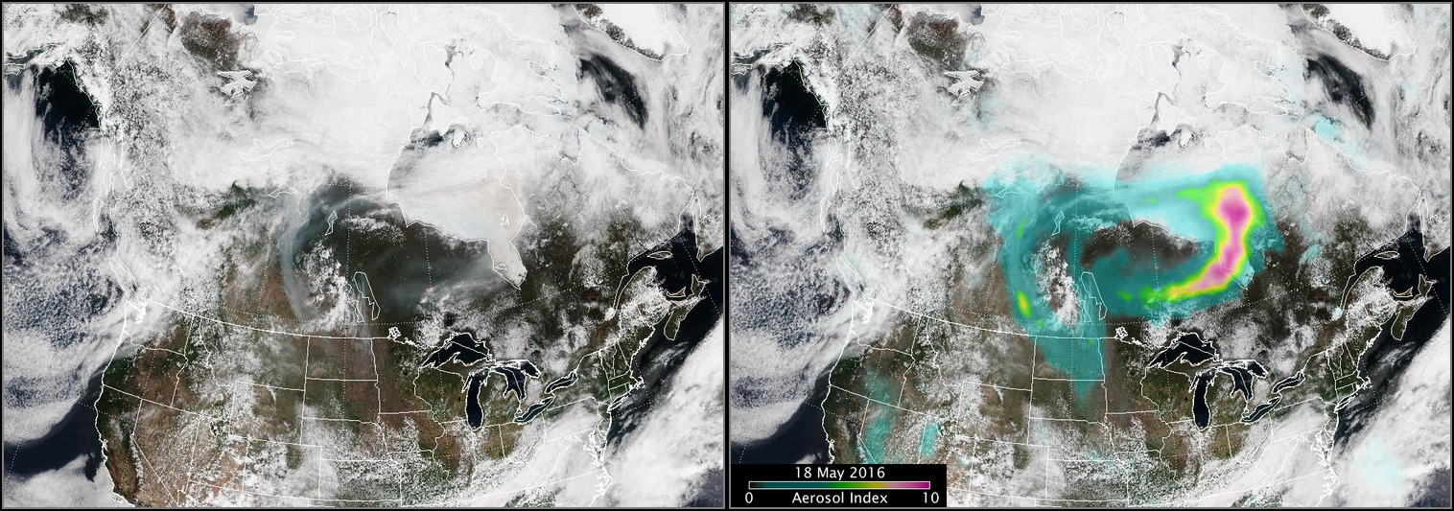
Plume and Aerosols on May 18, 2016
On May 18, 2016, the plume began dispersing towards the upper Midwest and Great Lakes, where it was trapped beneath a dome of high pressure

Slide 16
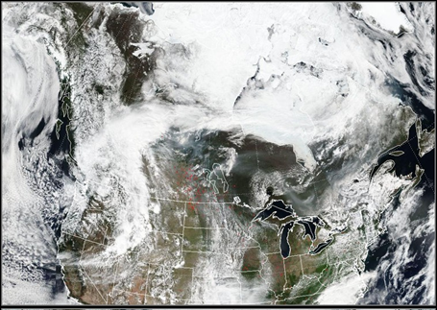
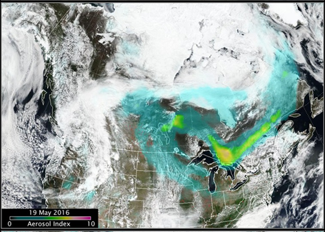
Plume and Aerosols on May 19, 2016
On May 19, 2016, the plume was over the upper Midwest pushing toward New England.

Slide 17
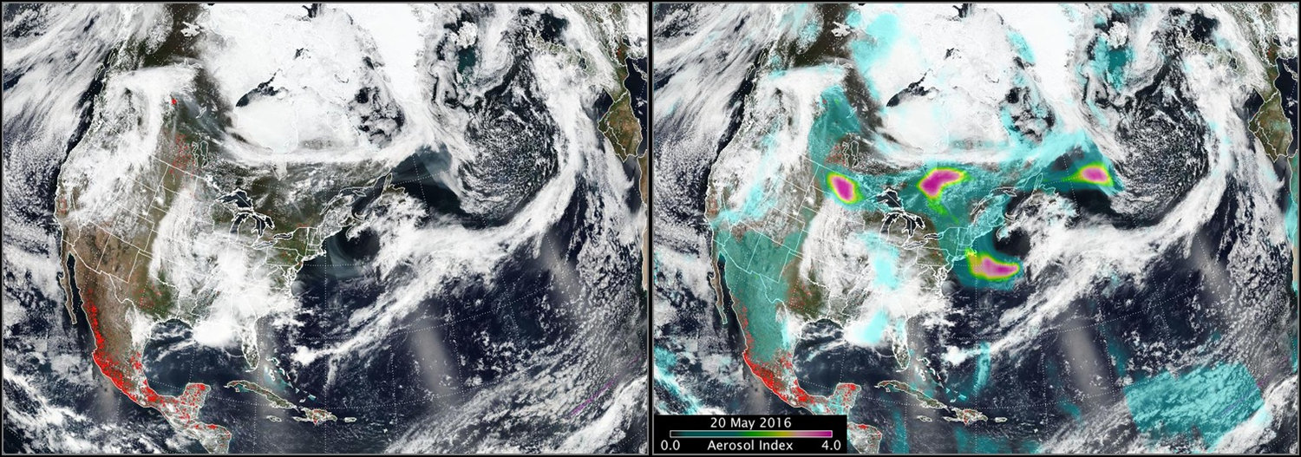
Plume and Aerosols on May 20, 2016
On May 20, 2016, a lobe of the plume crosses New England, but stays aloft.

Slide 18
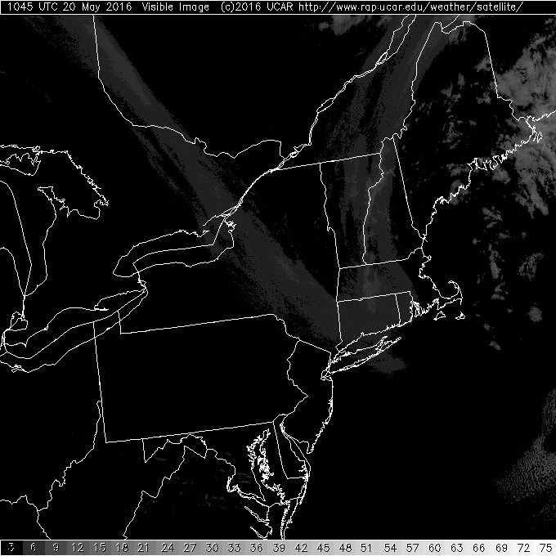
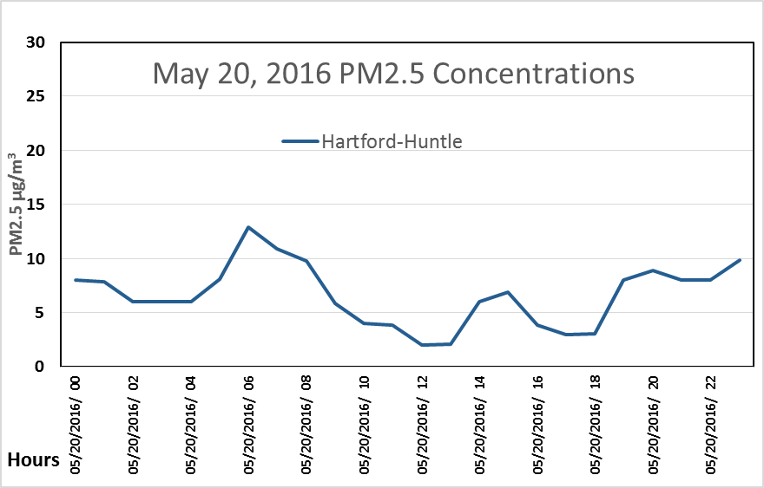
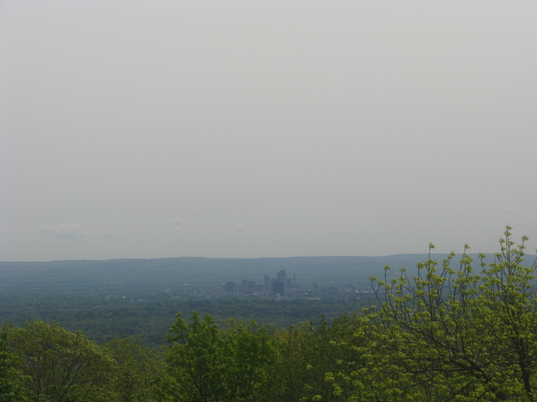
Smoke Plume Appears over CT on May 20th
Skies became ‘hazy’ for several hours, but PM2.5 remains ‘GOOD’

Slide 19
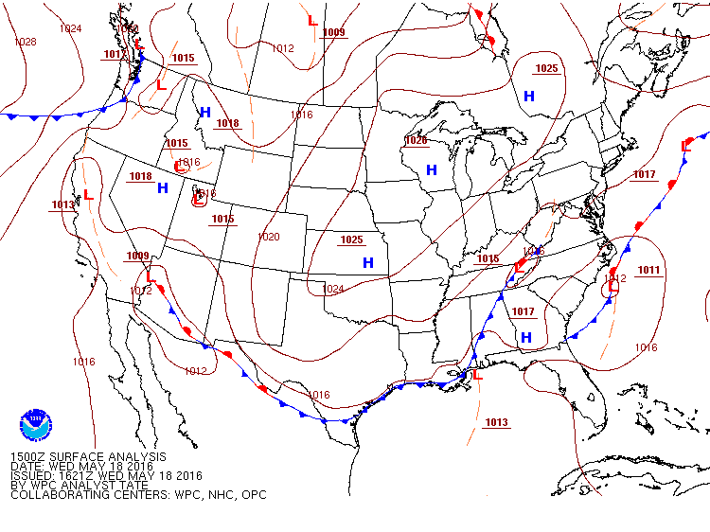
Surface Animation May 18-24, 2016
On May 18, 2016, the plume began dispersing towards the upper Midwest and Great Lakes, where it was trapped beneath a dome of high pressure

Slide 20
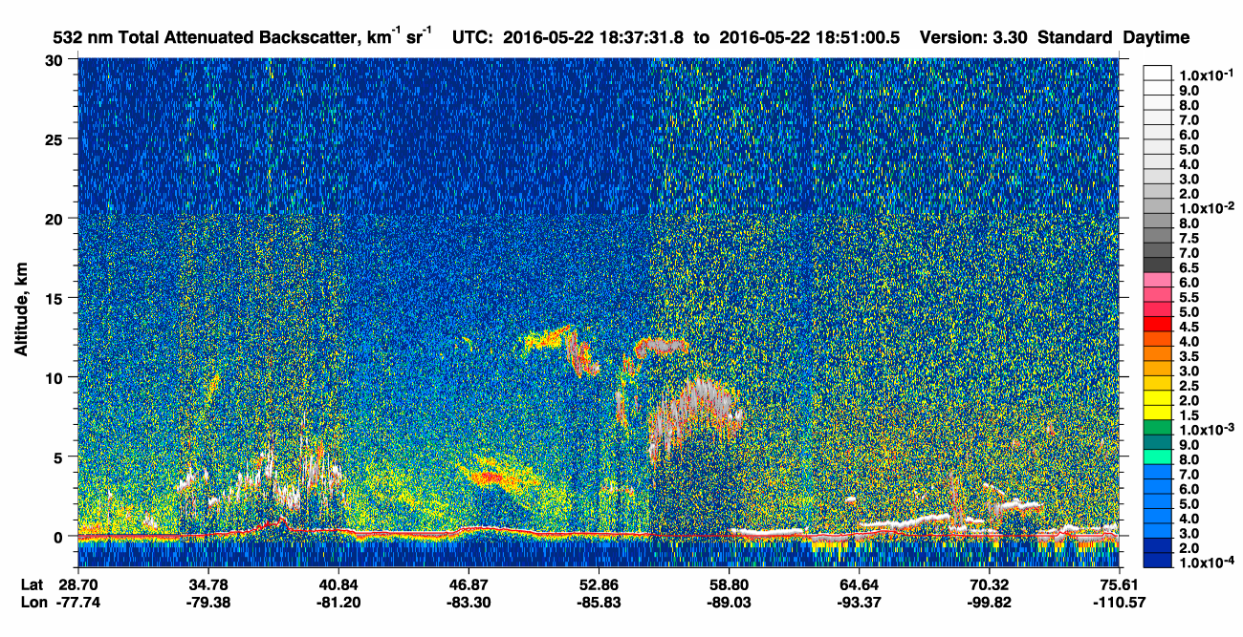
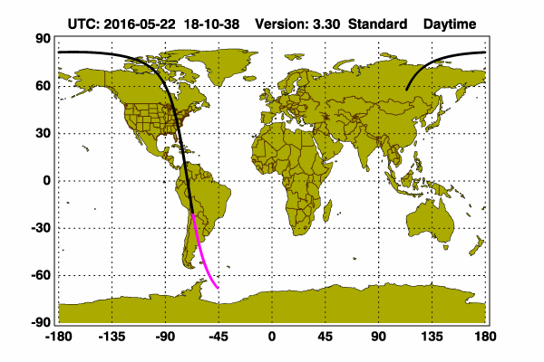
Calipso LIDAR 5/22/16
U.P. MI

Slide 21
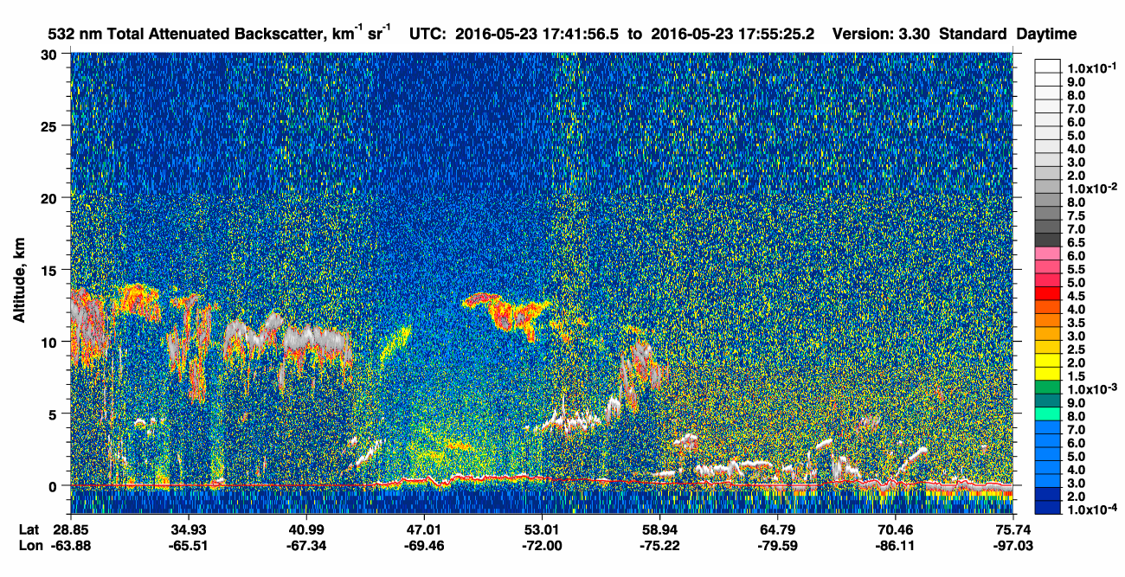

Calipso LIDAR 5/23/16
Quebec, Canada

Slide 22
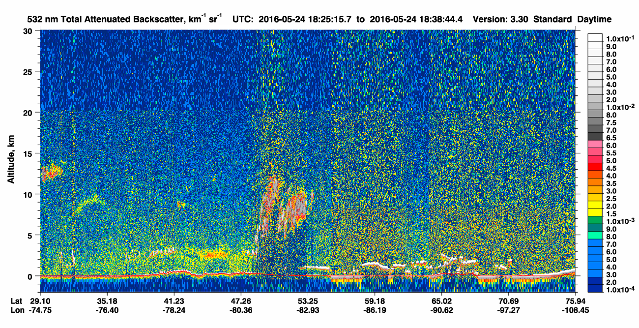

Calipso LIDAR 5/24/16
Ontario, Canada

Slide 23
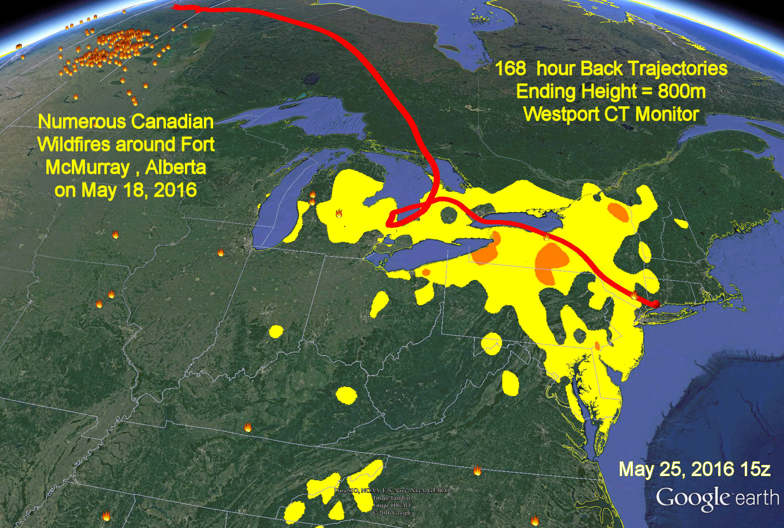
Back Trajectory Animation

Slide 24
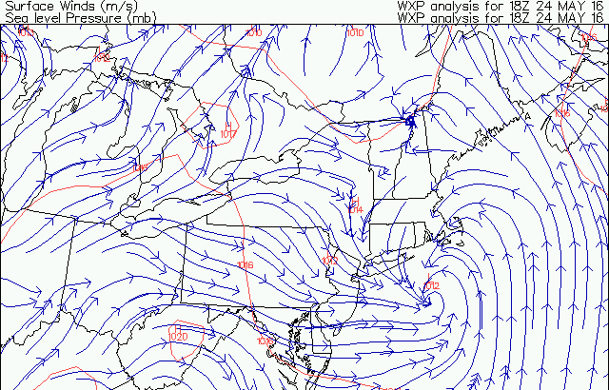
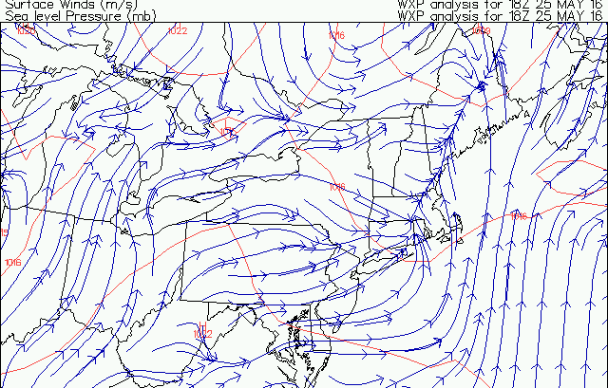
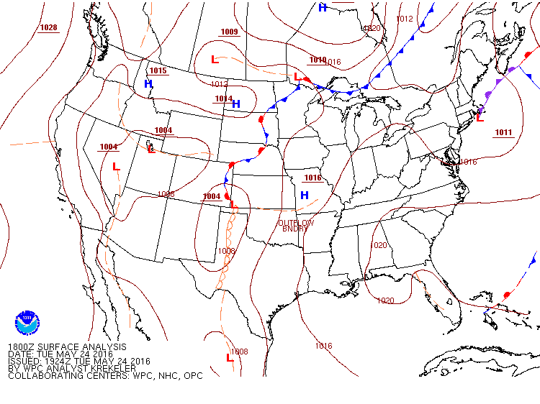
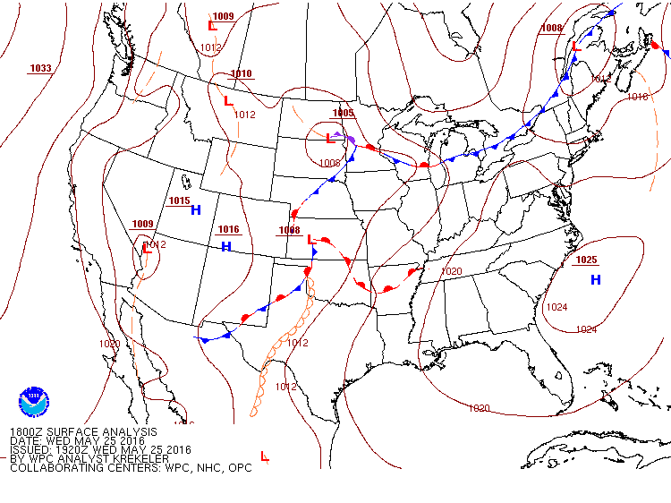
May 24-25, 2016 Surface Map and Winds

Slide 25
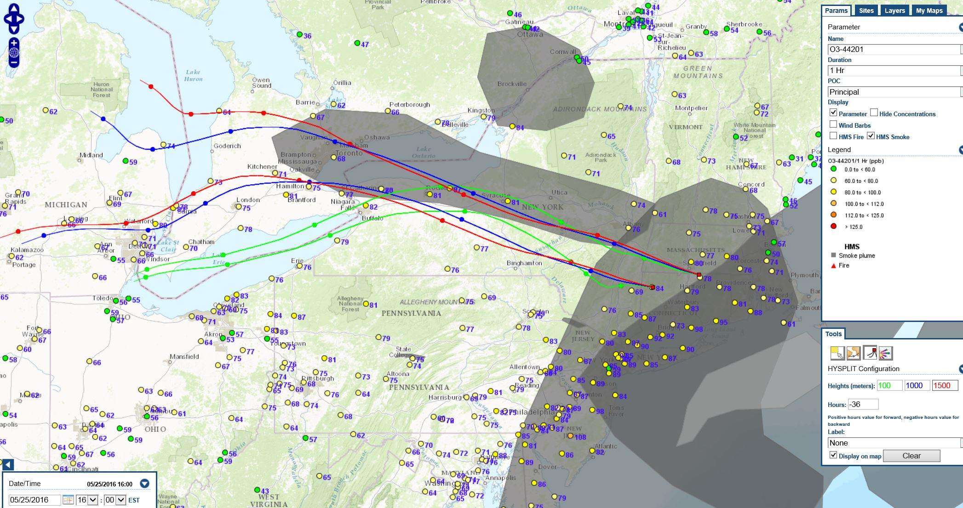
May 25th 36-hr Back Trajectories
This was the beginning of a ‘smoke enhanced’ multi-day ozone event for Connecticut, which lasted 5 days

Slide 26
Hysplit Back Trajectories
Hysplit offers several meteorological models to use for trajectory analysis;
I have illustrated the differences between the NAM(12km); NAMs-hybrid and the NARR (reanalysis);
All three models shows similar back trajectories on those days.

Slide 27
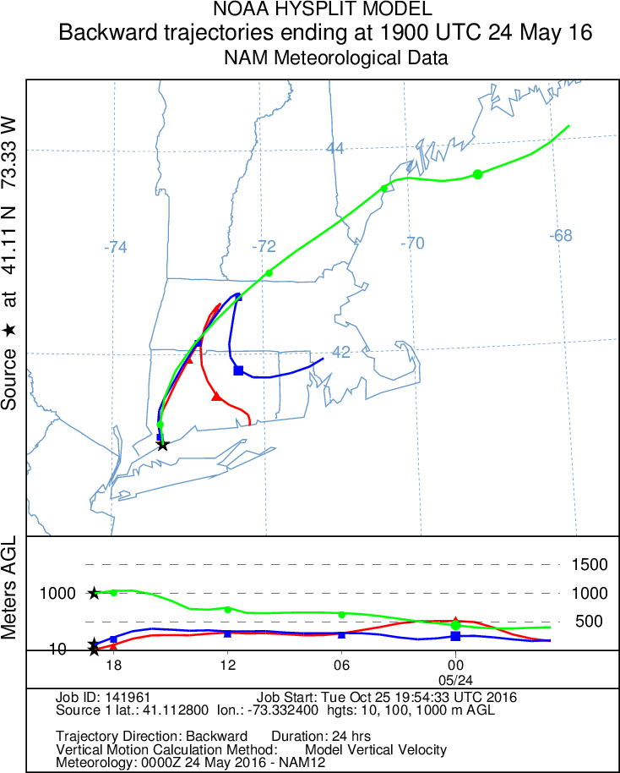
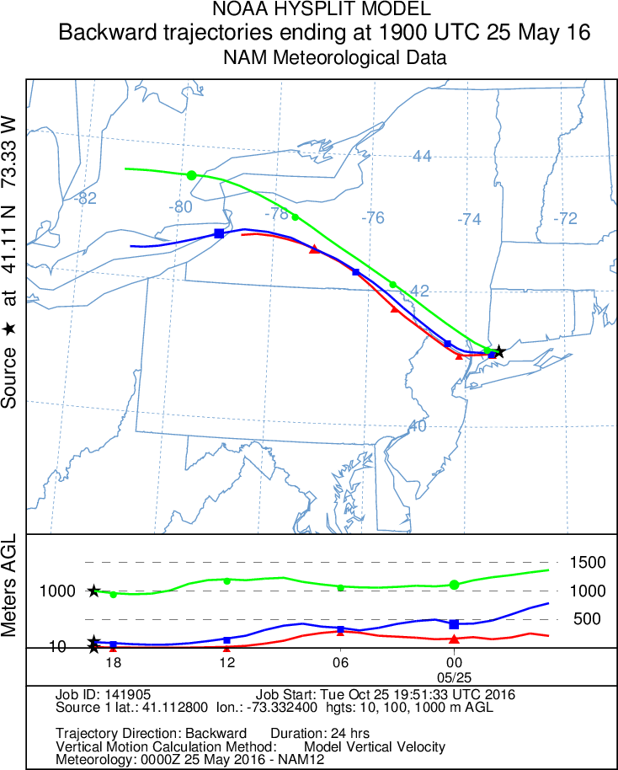
May 24 -25 Back Trajectories (NAM)

Slide 28
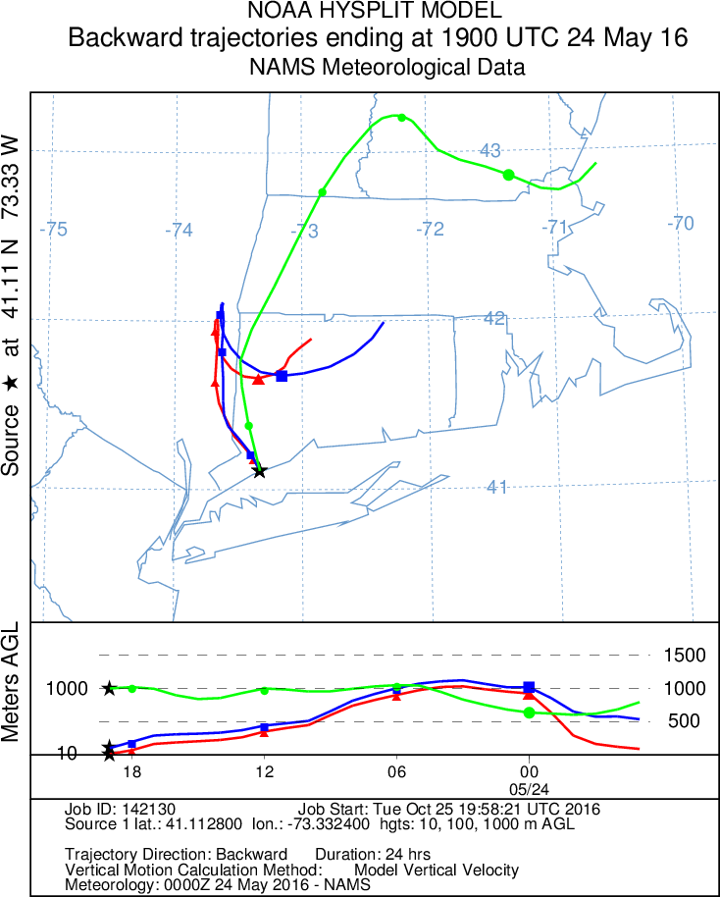
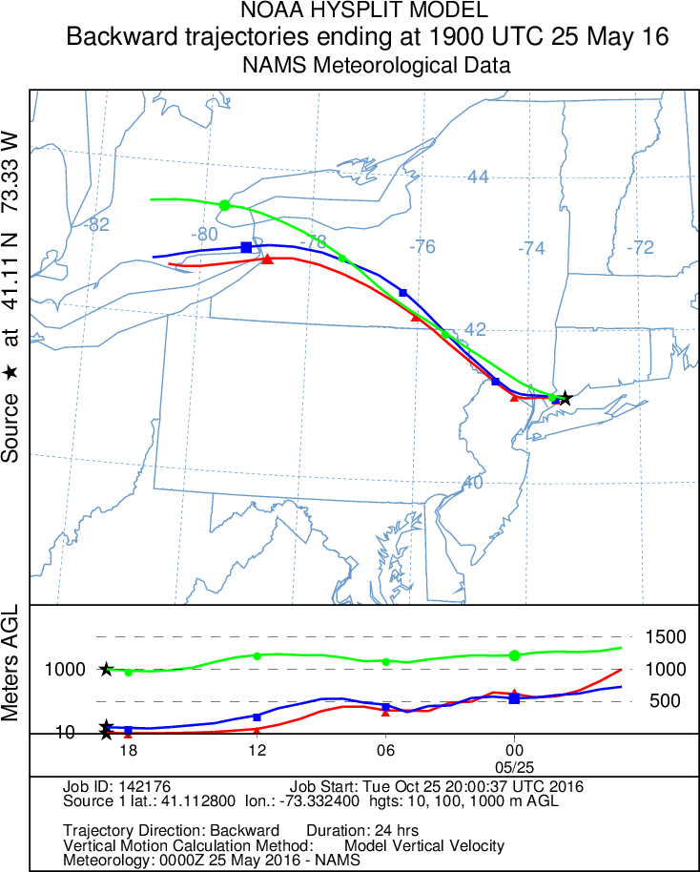
May 24 -25 Back Trajectories (NAMs)

Slide 29
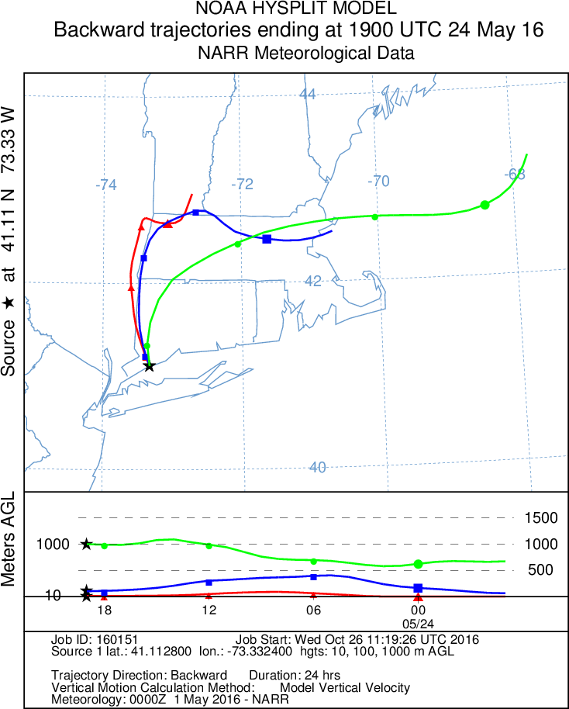
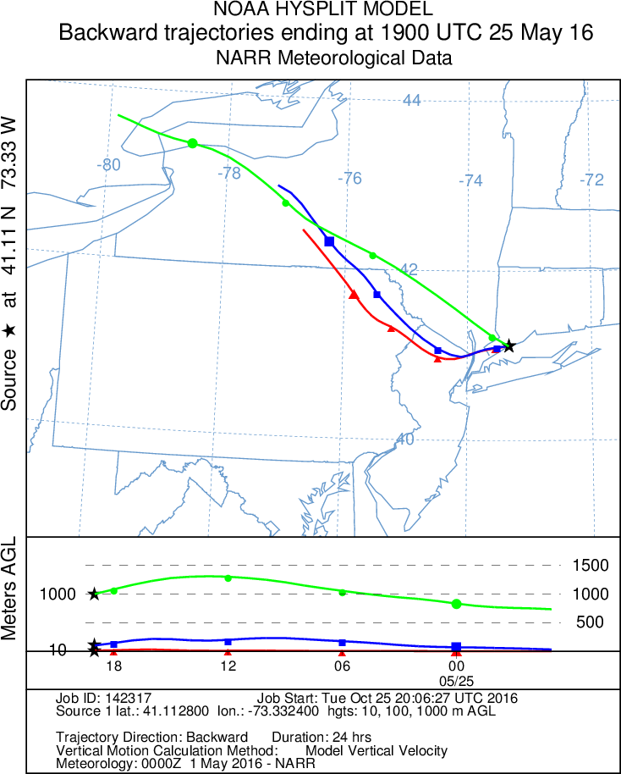
May 24 -25 Back Trajectories (NARR)

Slide 30

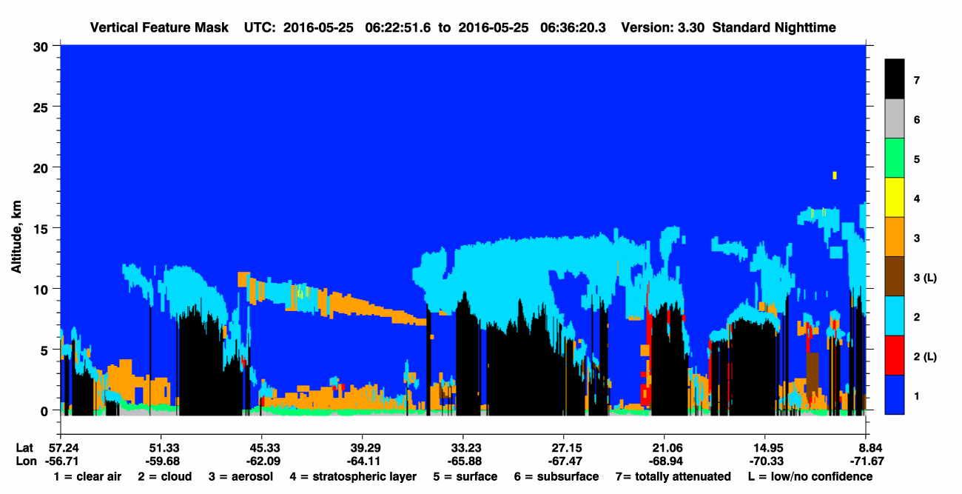
Calipso Aerosol Cross Section May 25th
CT latitude to east
(Aerosols from 0-2 km)

Slide 31
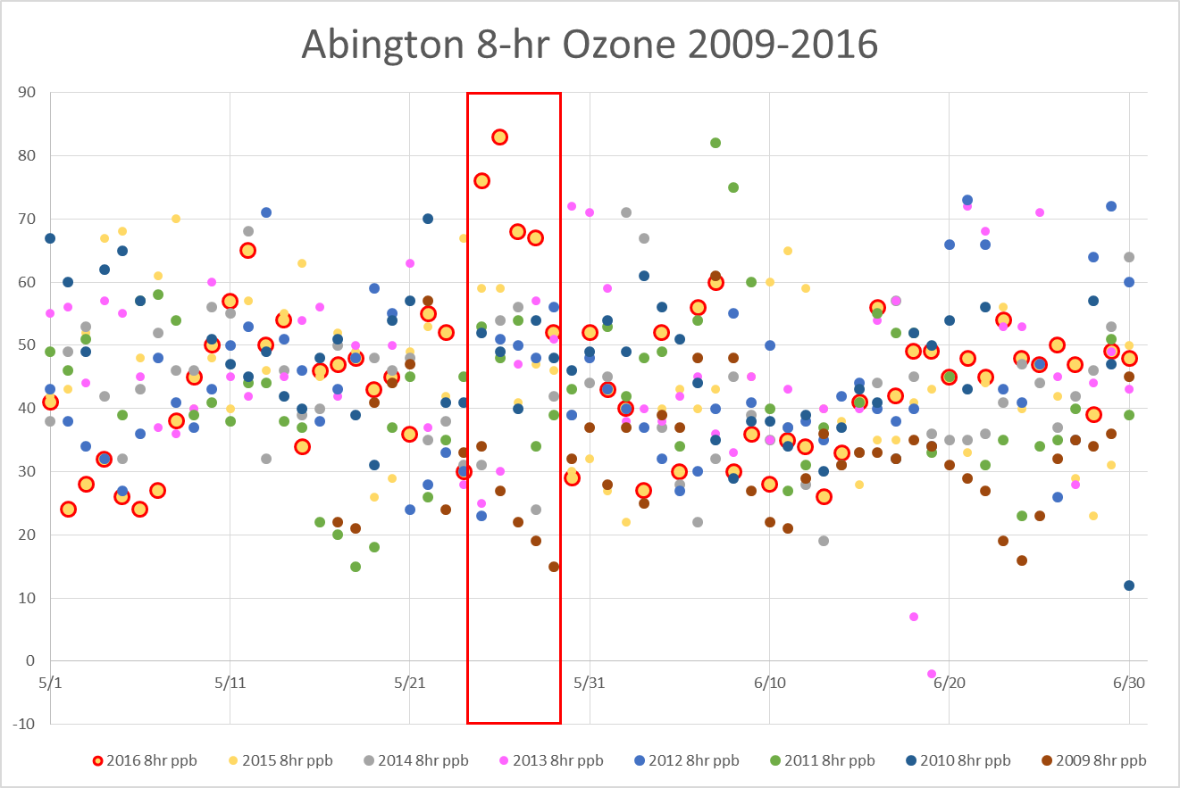
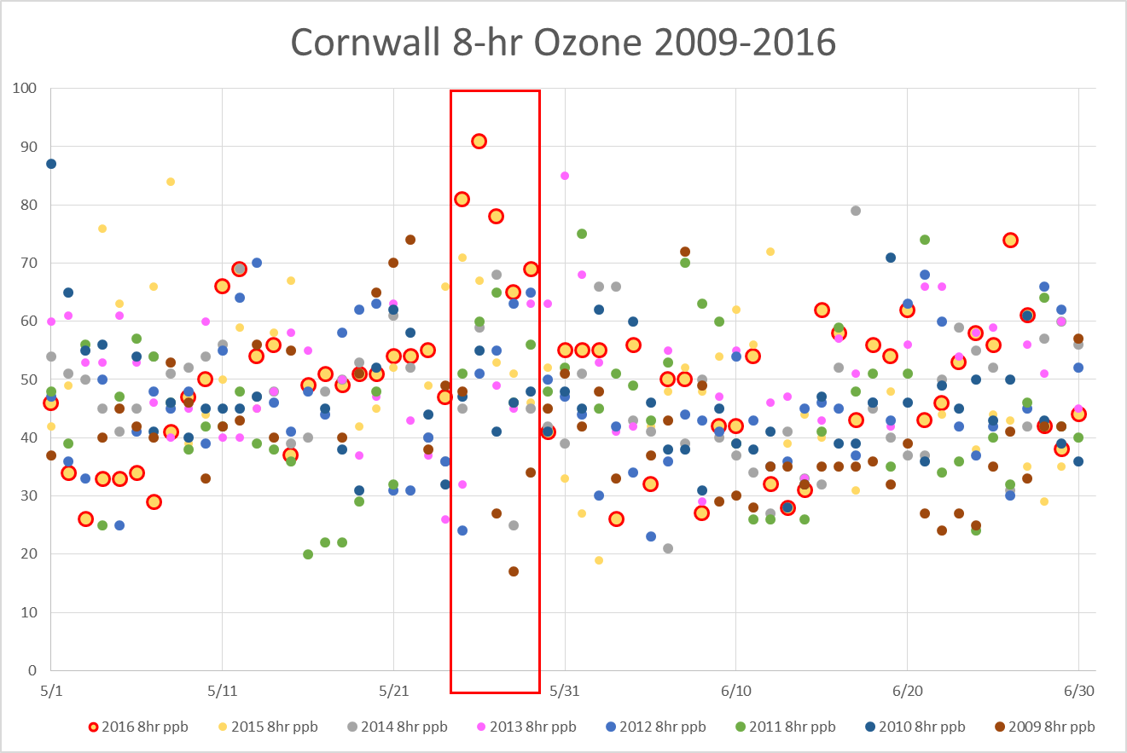
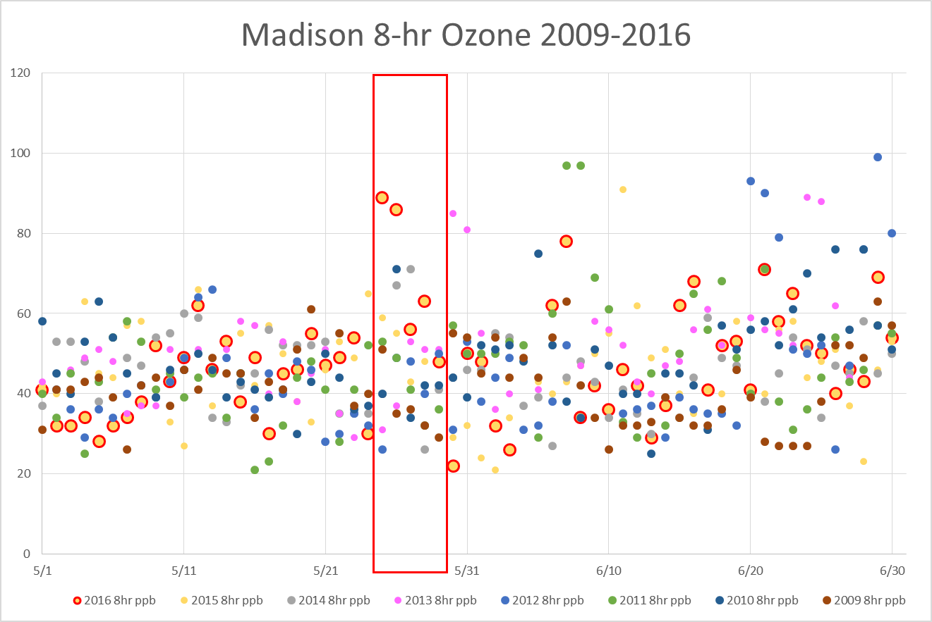
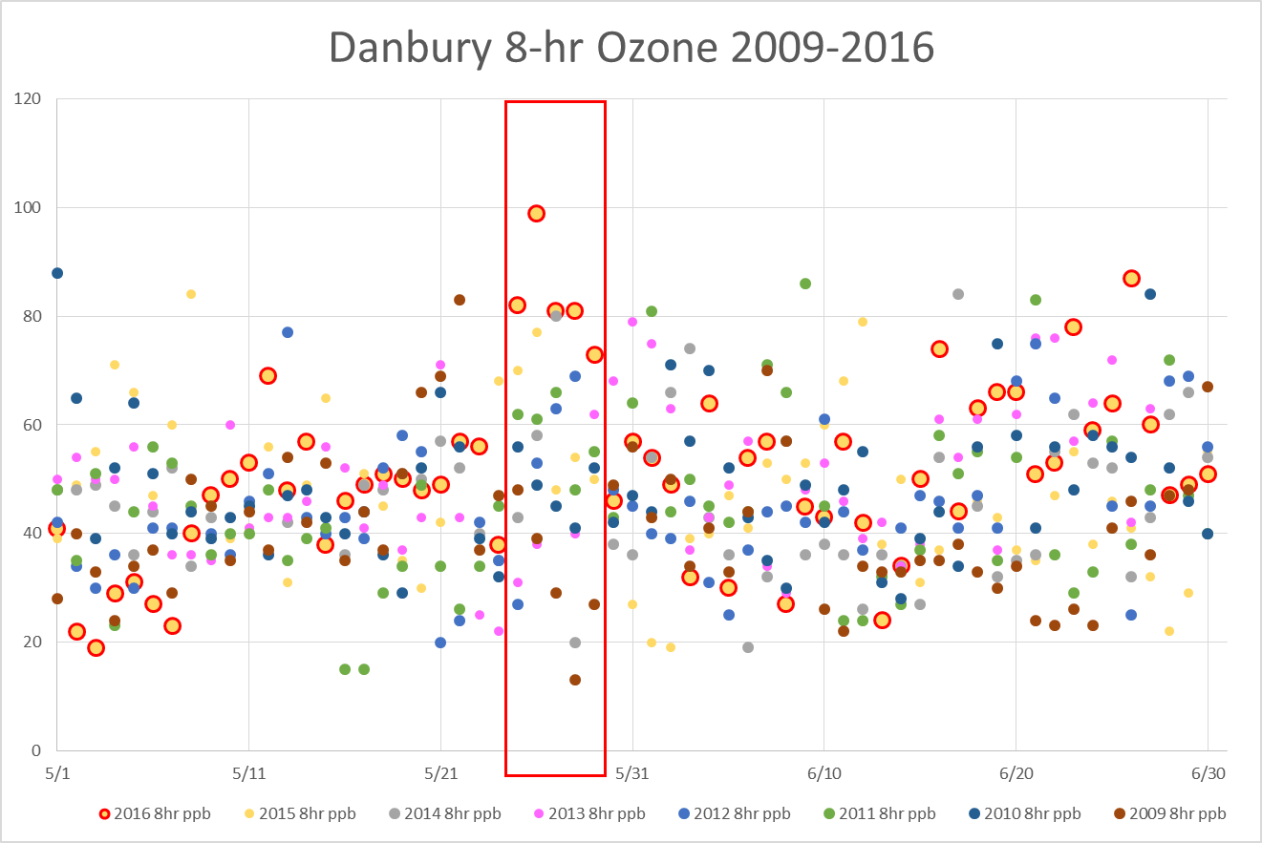
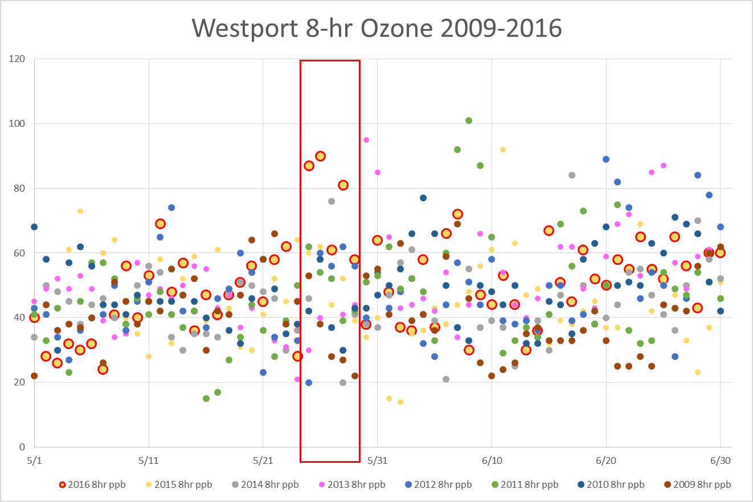
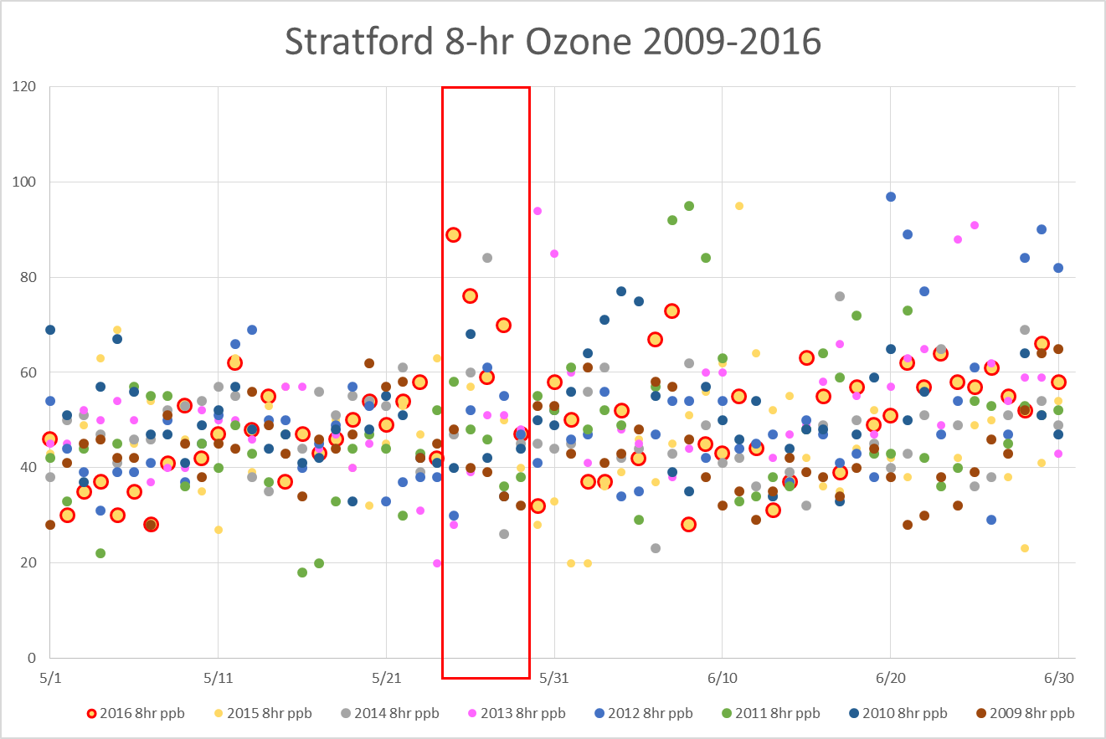
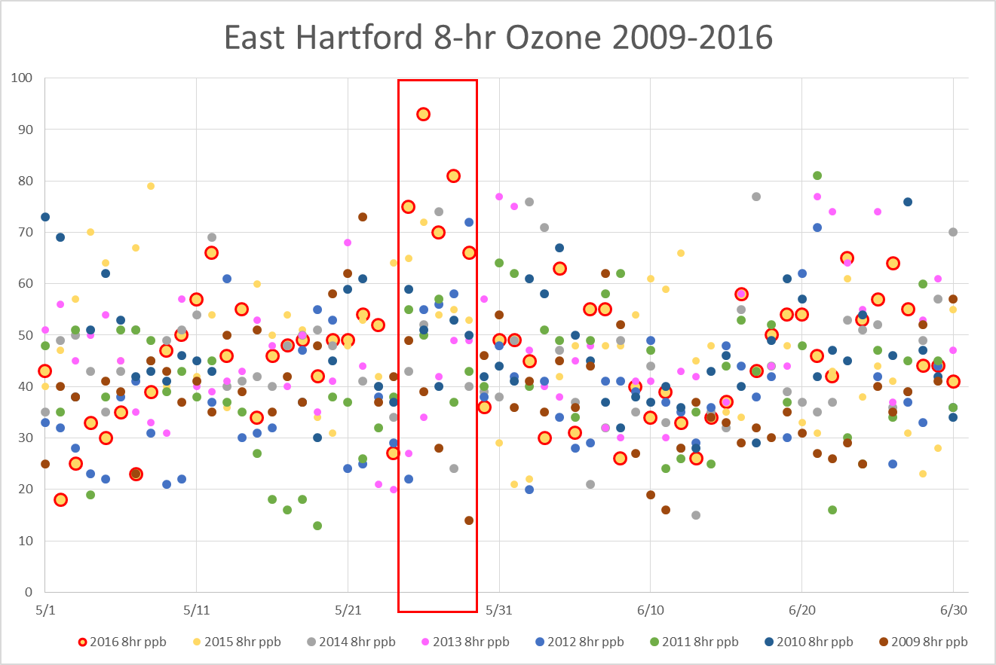
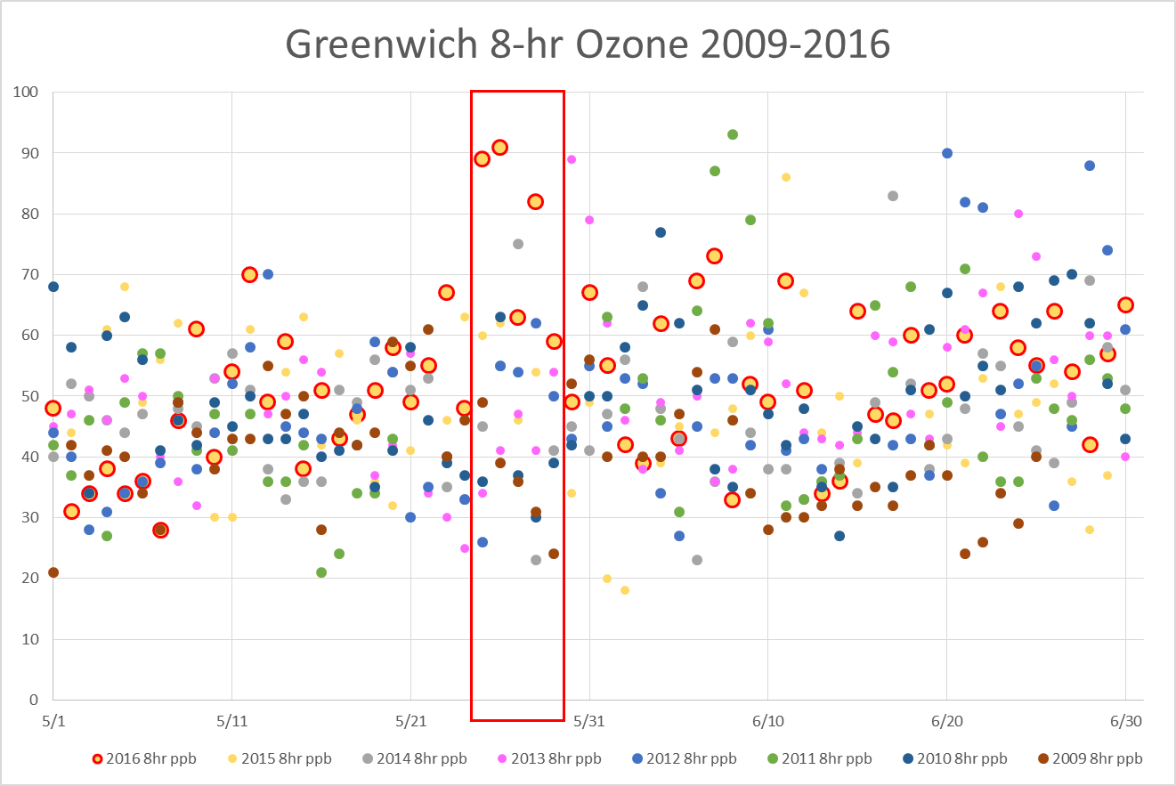
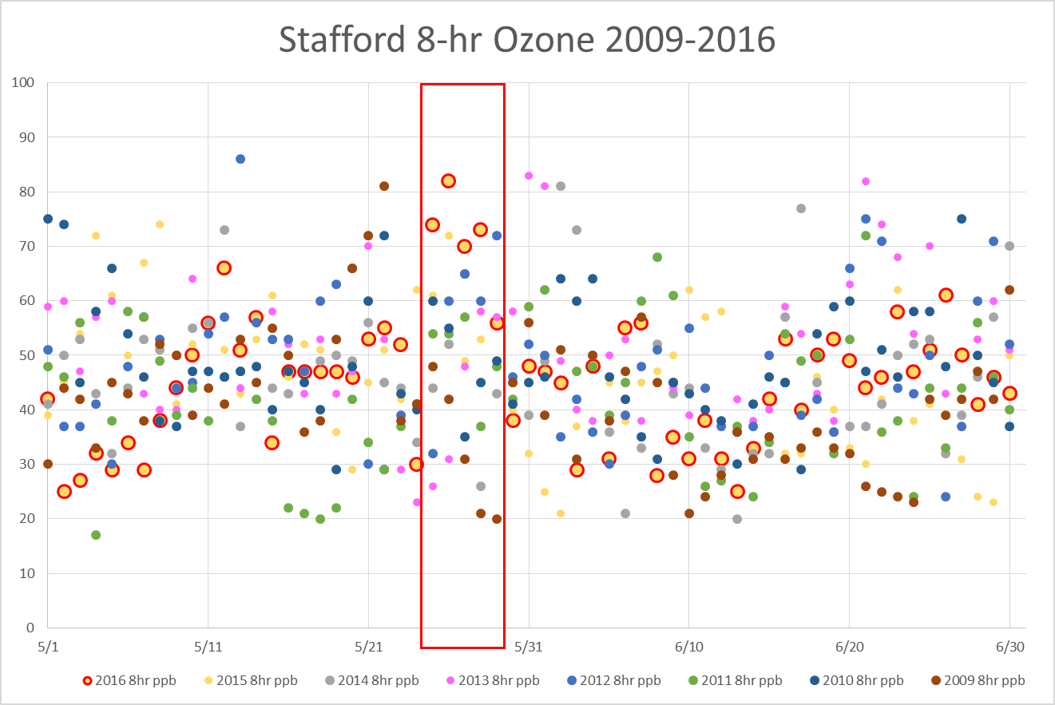
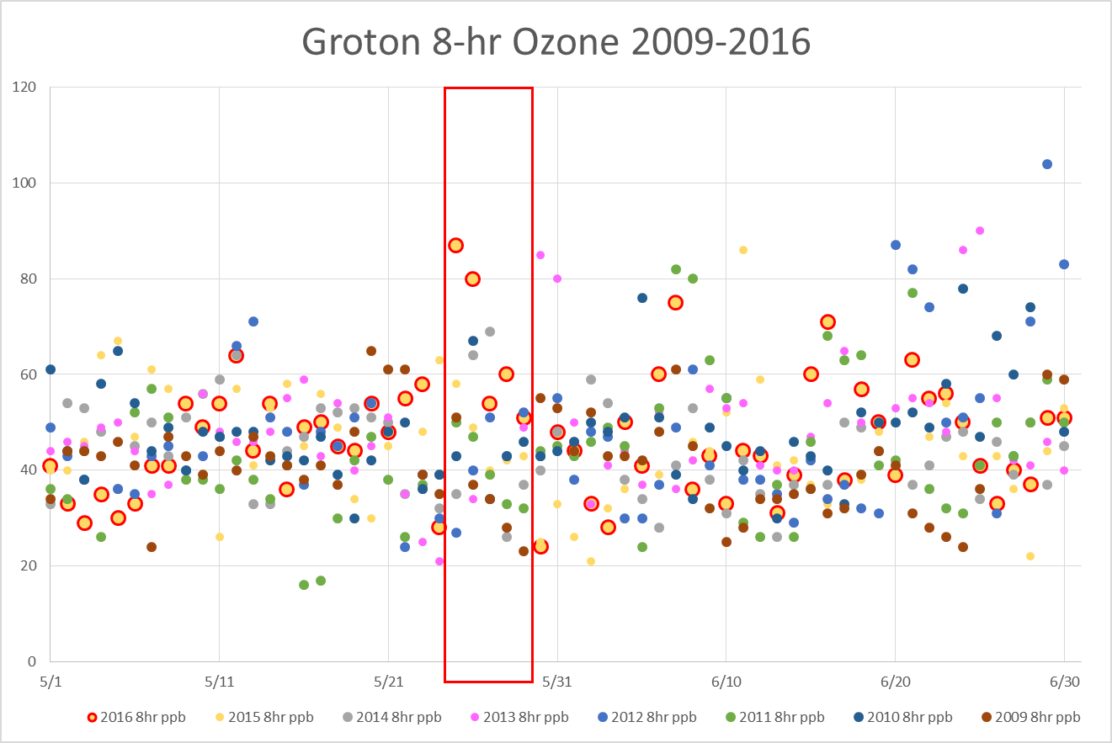
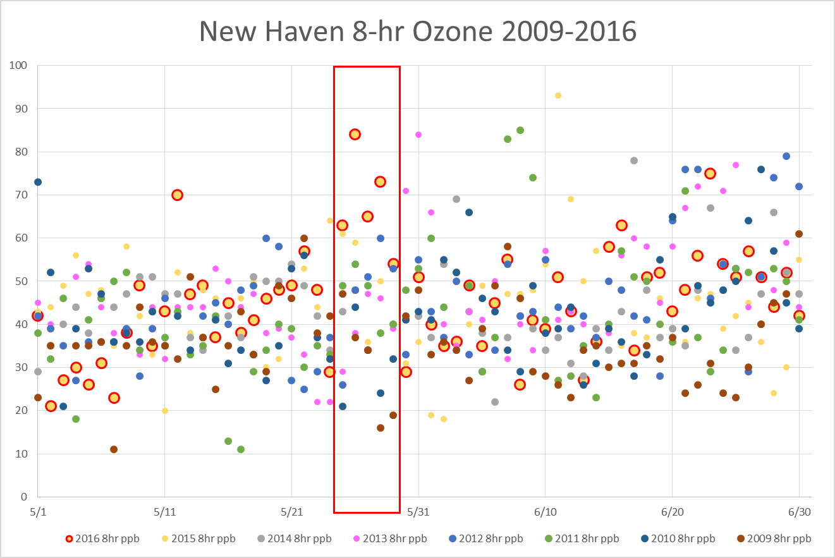
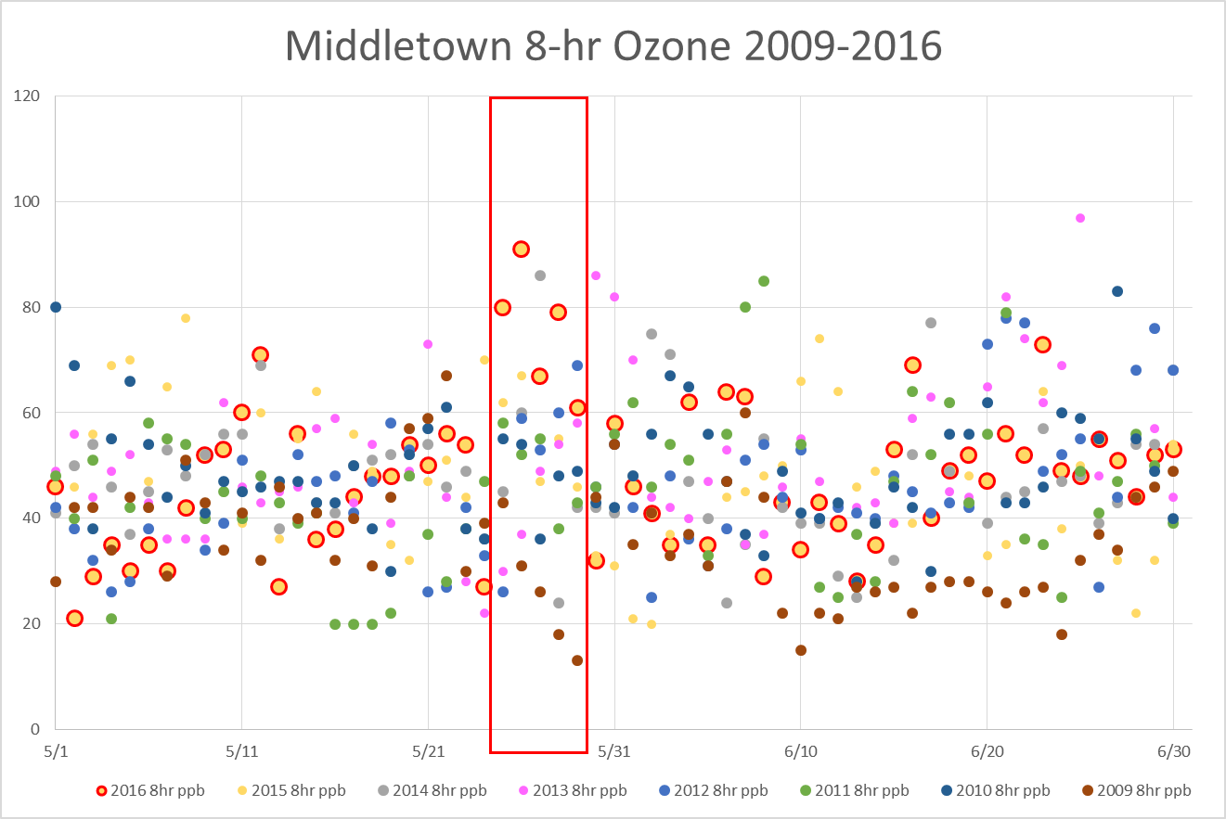
Max 8-hour Ozone May-June, 2009-2016 Animation
Event was an outlier under these meteorological conditions.

Slide 32
Surface Wind Rose Cornwall May-June 2016
Hourly wind directions vs. ozone concentrations were plotted for the years 2013,2015 and 2016;
May-June hours for each year were used to represent early season ozone patterns;
2016 exhibits the most elevated ozone of any year from the northwest quandrant;
49/56 of the 2016 exceedance hours occurred during the May 25-29 timeframe

Slide 33
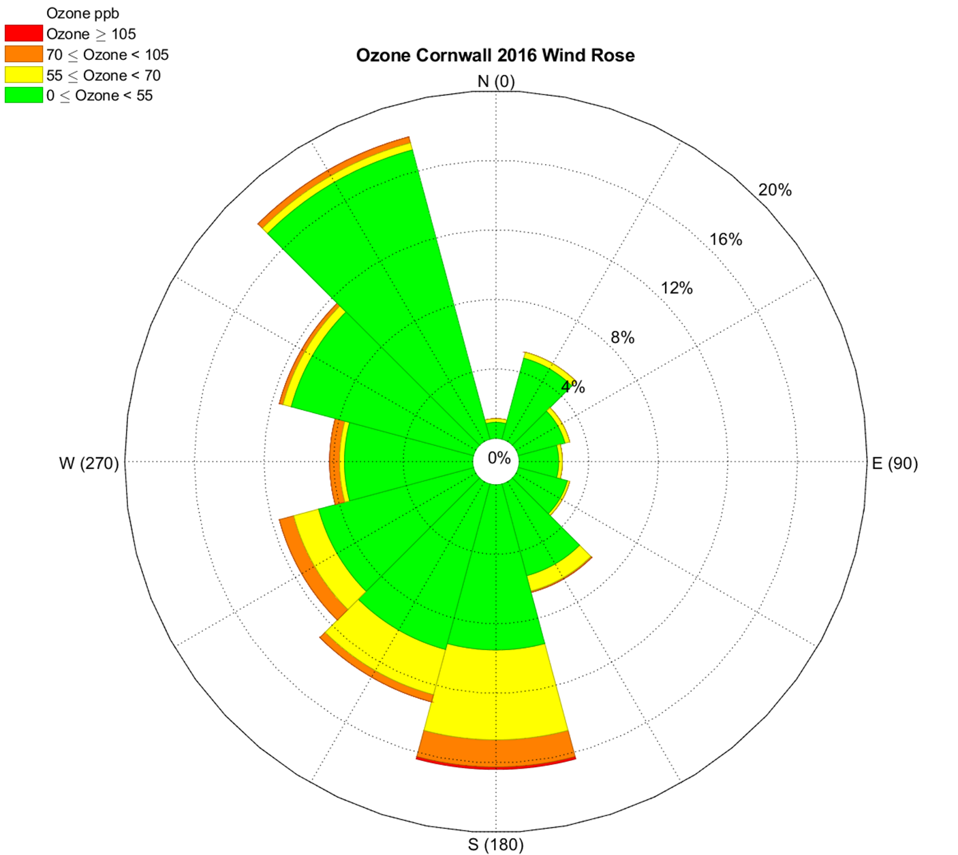
Surface Wind Rose Cornwall May-June 2016

Slide 34
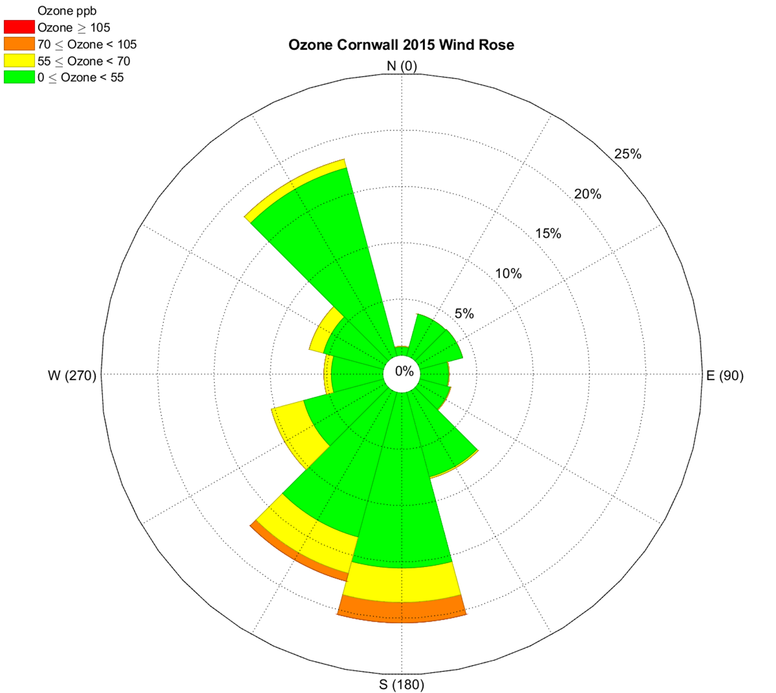
Surface Wind Rose Cornwall May-June 2015

Slide 35
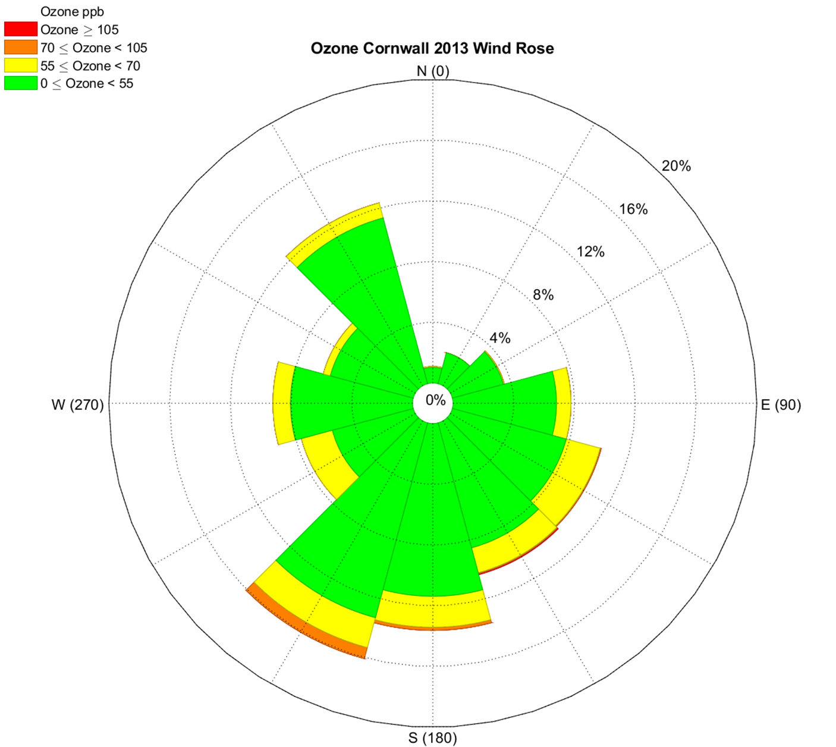
Surface Wind Rose Cornwall May-June 2013

Slide 36
Cornwall Pollutant Charts: May 20-30, 2016
Plots of Cornwall ozone data with Black carbon, PM2.5, ‘Delta C’ PM2.5 and CO show coincident increases in these species from May 25-May 29th;
The Cornwall monitor sits at an elevation of over 1600 feet (500+m), making it the best indicator for long range, out of State pollutant transport;
The pollutant data has been ‘normalized’ by multipliers for a direct comparison with the ozone concentrations.
It was after 6:00am on May 25th that the ‘event’ began at the Cornwall monitor, with PM2.5 levels on the rise.
When HYSPLIT modeled mixing height reached 600 meters at 7:00 am LST, PM2.5 levels began spiking.

Slide 37
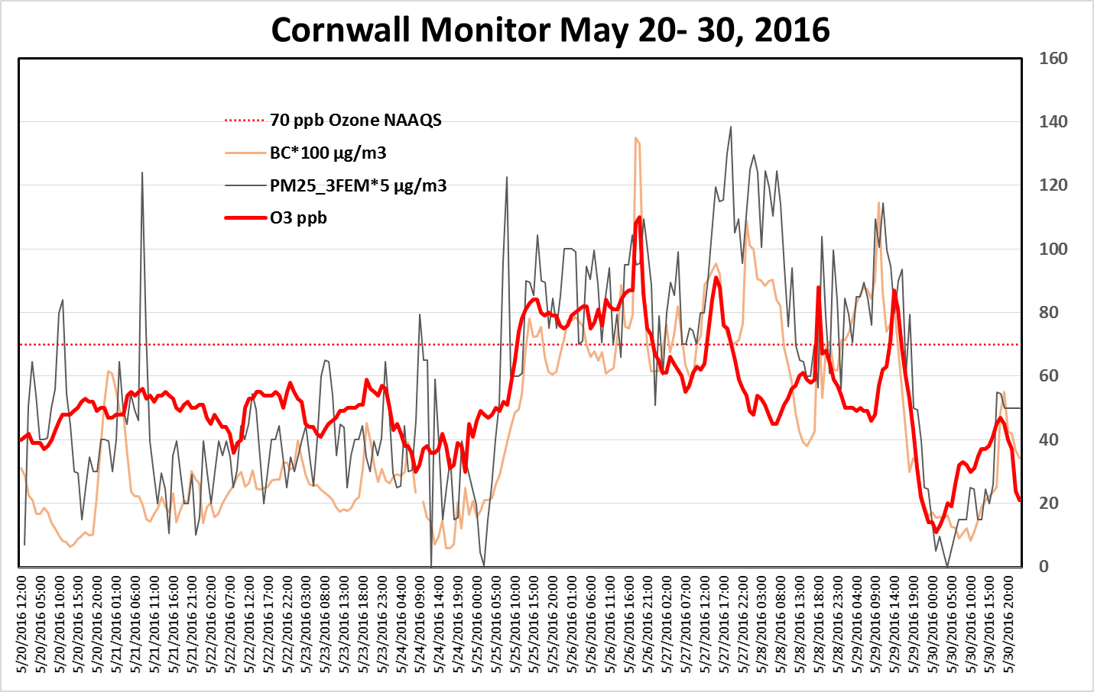
Cornwall Ozone, BC and PM2.5
Pollutants have been scaled to match range of ozone ppbs

Slide 38
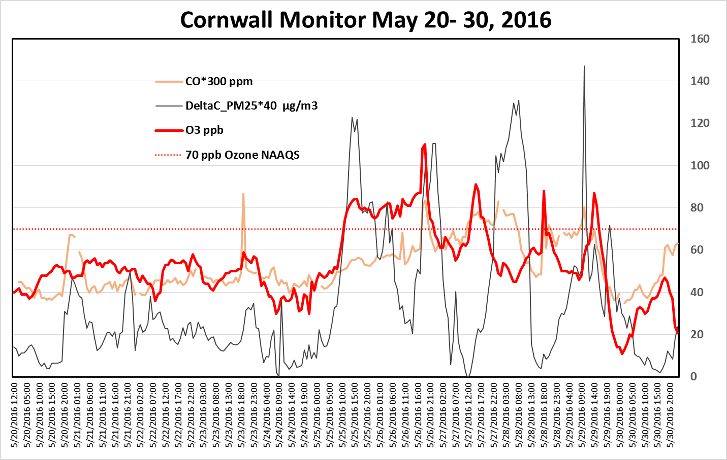
Cornwall Ozone, DeltaC and CO
Pollutants have been scaled to match range of ozone ppbs

Slide 39
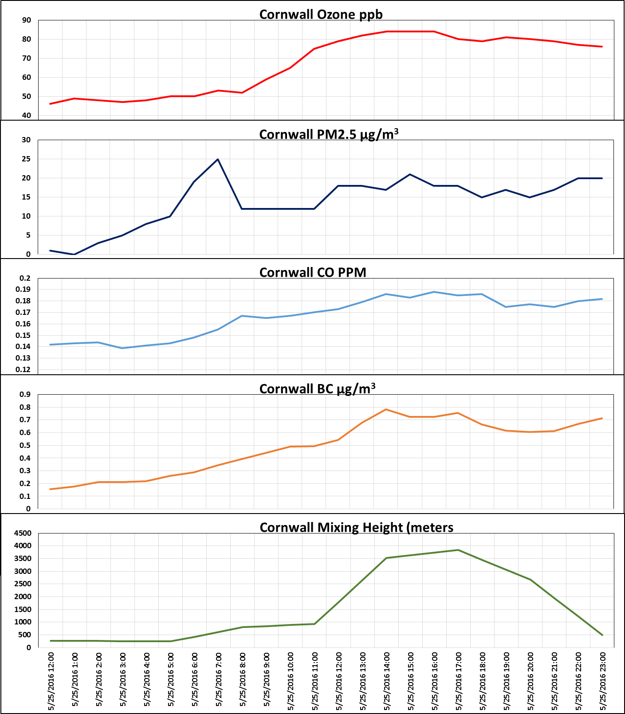
Stacked Charts with HYSPLIT Modeled Mixing Heights
Likely beginning of event
Note that as mixing height rises after 5:00am, so do the other parameters;
CO and particulate matter indicate an aerosol plume likely from a wildfire.

Slide 40
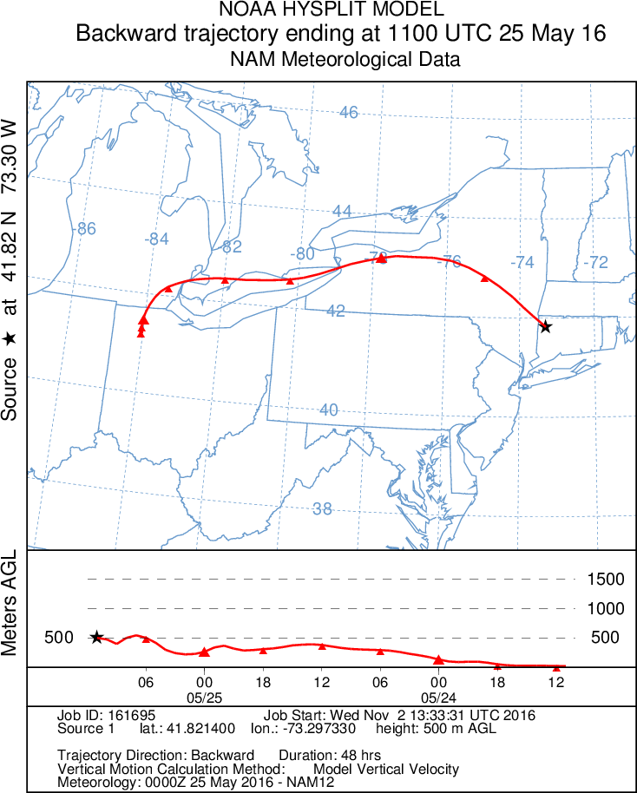
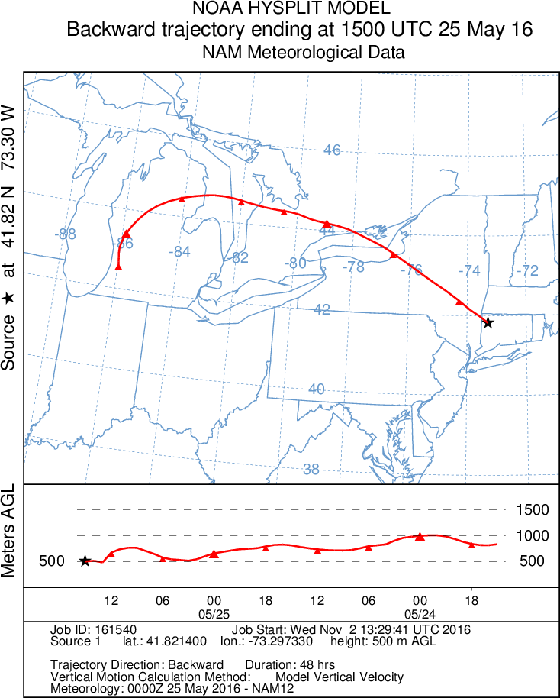
HYSPLIT 1100/1500 UTC Back Trajectories
Back Trajectories from 1100 UTC are below 500 meters and those from 1500 UTC are above 500 meters, which shows contributions from higher levels in the atmosphere where plume was more prevalent.

Slide 41

New Haven Ceilometer Back Scatter Aerosols
Thick aerosol layer moves over New Haven after 6:00 am LST with mixing layer exceeding 3000 meters during the afternoon. This agrees well with modeled mixing height over the Cornwall monitor.

Slide 42

NOAA Model vs. the AQI

Slide 43




NE States NOAA Model/ AQI Observed

Slide 44
Conclusion
There is no doubt that the Fort McMurray wildfire plume directly affected ozone production in the States surrounding the Great Lakes and that ozone, as well as residual pollutants from the plume, was transported to the southeast to enhance ozone production in the northeast States beginning on May 25, 2016
All evidence points to flagging some or all of the May 25-29th period as an exceptional event.

Slide 45
Michigan May 24, 2016 Ozone

