Slide 1
Briefing on
Statewide Hurricane Exercise
June 29, 2012

Slide 2
Agenda
Welcome and Introductions:
  State Emergency Management Director William J. Hackett
Opening Remarks:
  Deputy Commissioner William P. Shea
Exercise Overview
  DEMHS Principal Attorney Brenda M. Bergeron
Four Municipal Exercise Objectives
Participation is the Key to Success
Tools to Succeed
After Action Report

Slide 3
Statewide HurricaneExercise
July 28 or July 30 = Pre Landfall Preparation
July 29 or July 31 = Post Landfall Response and Recovery
Day 1: At least 8 am to 12 noon
Day 2: At least 8 am to 2 pm
To date, at least 161 Towns/Tribes are playing

Slide 4
Four Exercise Objectives:
Objectives One and Two
Town Emergency Operations Center/ Unified Command
  Municipalities active EOCs, actually convene Unified Command members, review/update/use plans
  Create an Incident Action Plan each day
Practice Local/State/Utility Communications Processes/Procedures
  Web EOC
  Interaction with DEMHS Regional Offices
  Communications Flow (ex., send a commodities request)

Slide 5
Exercise Objective Number 3
Mass Care Sheltering and Feeding
  All towns will review local shelter operations procedures and, at a minimum, conduct a sheltering table-top exercise/facilitated discussion with Unified Command and EOC staff, using the updated Mass Care sheltering guidance
  In addition, some towns will use their shelter procedures to open a shelter for simulated overnight
  In addition, some towns in each DEMHS Region will work with other towns to open a multi-town shelter and simulate an overnight operation.

Slide 6
Exercise Objective Number 4
Exercise “Make Safe” Scenario
  Some towns in each DEMHS region will actually drill their Public Works crews with utility crews
  All towns will work with their Unified Command and their utility liaison to review and update identified priorities, submit a work request, and receive a response

Slide 7
Participation is the Key to Success
We are providing the tools to succeed:
  DC Shea Exercise Update Memos
  DEMHS Web site: www.ct.gov/demhs
  CCM, COST, CEMA
The topics for Day 1 Pre Landfall will be provided at least two weeks in advance.
This is an exercise to identify gaps. If you participate and learn something, you succeed.

Slide 8
Tools for Success
Updated Mass Care Annex Template for Local Emergency Operations Plans (LEOPs)
State Commodities Distribution Standard Operating Procedure
All-Hazards Energy and Utilities Annex to State Response Framework (ESF 12--Energy)
  Communications Flow
  “Make Safe” or Blocked Roads Protocol
ESF 12 Annex for LEOPs

Slide 9
Tools for Success, Cont’d
Simplified Commodities Form
Incident Action Plan Forms and Explanations
Utility Damages Assessment Form
Web EOC
GIS Information
DEMHS Regional Office Enhancements
Sim Cell

Slide 10
Enhanced DEMHS Regional Offices and Support
Regional Information Manager for each DEMHS Region at State EOC
New at DEMHS Regional Office:
  Electric Utility Representative
  Public Health Representative
  Commodities Liaison

Slide 11
Purpose of the Sim Cell
A Sim (simulation)-Cell Organization will provide injects during the exercise.
The Sim Cell will simulate any non-playing parties that you would call in a real emergency.
The Sim Cell will provide guidance to you regarding the exercise. (for example, answer questions on the forms in use, Mass Care Annex, Incident Command System, etc..)
For other issues, proceed as you would during an actual emergency by contacting your DEMHS Regional Office/Coordinator

Slide 12
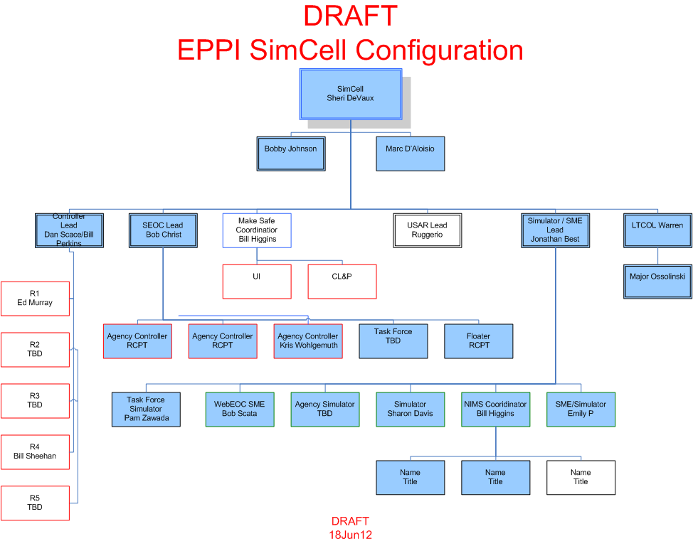

Slide 13
After Action Report
Specific, simple format will be used to collect comments
Meetings in all 5 regions to review comments

Slide 14
QUESTIONS?
demhs.eppi.questions@ct.gov

