Slide 1
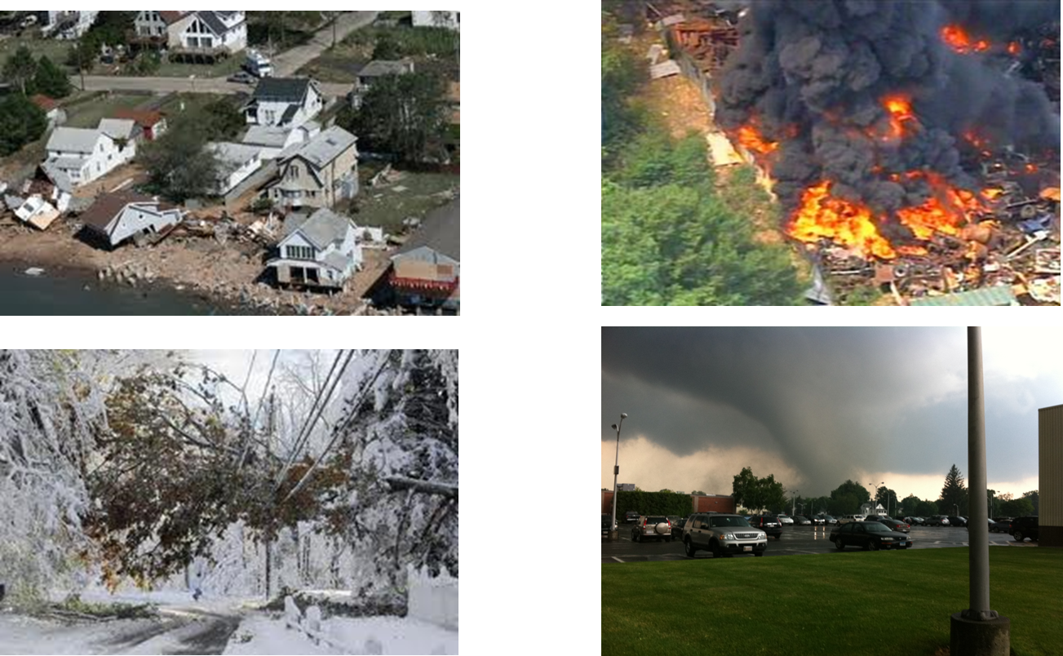

Overview of
Connecticut Emergency Management and Response
Notes:
This is to describe how local, state and federal response works together in CT
The National Incident Management System
ICS
MACS
State Response Framework – details responsibilities of DESPP/DEMHS and other state agencies, also details:
A MACS System
Resource Support
Emergency Support Functions (ESFs)
Local Emergency Operations Plans

Slide 2
NATIONAL RESPONSE FRAMEWORK:
How the Nation Conducts an All-Hazards Response Across Agencies and Jurisdictions
Connecticut operates
under the State Response
Framework:
Local
State
Tribal
Private Sector
Non Governmental
Federal
Emergency Management
Local
Tribal
State
Federal
Private Sector
Non Governmental Org
(e.g., Red Cross)
Notes:
NRF is how response to an incident is conducted.

Slide 3
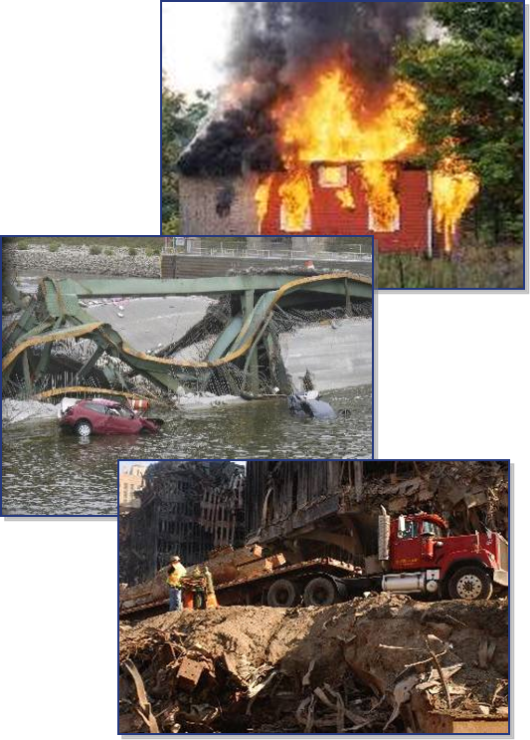
What Is an Incident?
An incident is . . .
  . . . an occurrence, caused by either human or natural phenomena, that requires response actions to prevent or minimize loss of life, or damage to property and/or the environment.
Notes:
What is an incident……. A natural or man made disaster requiring response to ensure life safety, mitigate environmental effects and property damage.

Slide 4
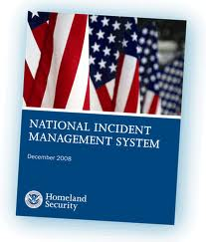
National Incident Management System
NIMS is . . .
  A flexible framework of:
    Concepts
    Principles
    Terminology
    Organizational processes
  Applicable to all hazards and jurisdictions
NIMS is not a operational incident management plan
Notes:
NIMS was established after the horrific events of 9-11. Elaborate…….

Slide 5
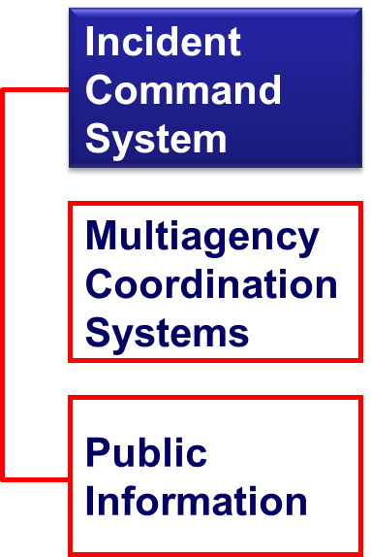
NIMS Components
Preparedness
Command and Management
Resource Management
Communications and
Information Management
On-going Management and Maintenance
Notes:
ICS is a component of NIMS, this structure aids in the response by providing the framework for the above……

Slide 6
The Incident Command System
  It is an on-scene, all-hazards incident management concept
  Is a standardized management system
  Allows its users to adopt an integrated organizational structure to match the complexities and demands of single or multiple incidents without being hindered by jurisdictional boundaries
Notes:
ICS is extremely useful; not only does it provide an organizational structure for incident management, but it also guides the process for planning, building, and adapting that structure.
Manchester Road Race
Sail Fest

Slide 7

Modular Organization
  Incident objectives determine the organizational size
  Is based on the size and
  complexity of the incident
  Only functions/positions that are necessary will be filled, not all positions need to be activated
Notes:
Its modular….. Built based on need

Slide 8
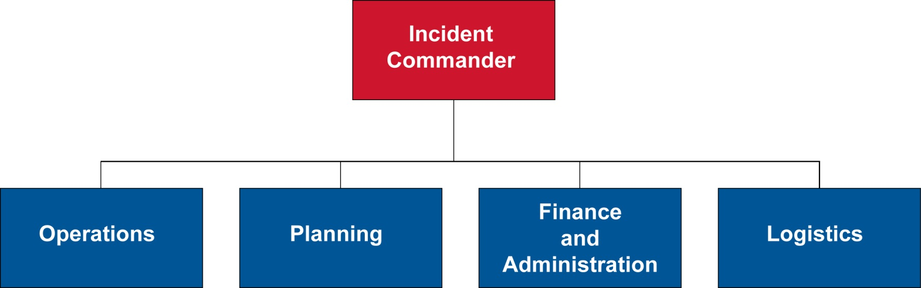
Incident Command System
Roles and Responsibilities
General Staff
Notes:
INSTRUCTOR NOTES:
There are often four functional areas that comprise the General Staff of an ICS and support the Command Section:
Operations Section
Planning Section
Finance and Administration Section
Logistics Section
Each functional area also may have additional staff.
This organization (or parts of it) can be how you structure your Multi Agency Coordination System (more on this later).
Additional organizational layers may be needed to help manage a potentially larger incident.

Slide 9
Operations
Develop operations portions of the Incident Action Plan
Directs all operational resources
Maintains close contact with the IC, subordinate operations personnel and other agencies involved in the incident.
Notes:
INSTRUCTOR NOTES:
The Operations Section is responsible to Incident Command for the direct management of all incident related tactical activities. Tactical is defined as the approach taken to achieve a specific objectives or to solve a specific problem.
Members of the Operations Section work with the Operations Chief to:
Direct and coordinate all facility operations
Monitor staffing and adjust staffing to respond to needs
Communication with subordinate ops personnel in key

Slide 10
Planning
Prepares and documents the Incident Action Plan
Collects and evaluates information
Maintains resource status
Maintains documentation for incident records
Notes:
INSTRUCTOR NOTES:
The Planning Section determines what resources will be needed and establishes the Incident Action Plan (IAP) that will be used to support the response to an emergency.
Members of the Planning Section work with the Planning Chief to:
Create an Incident Action Plan (IAP) that establishes goals and
actions that support the response to an incident
Ensure distribution of critical information to other ICS members
Compile scenarios and resource projections that can be used to
anticipate actual needs throughout the phases of an incident
Continuously review resources and actions and modify plans to ensure
objectives are met
Provide updates on the status of assigned resources

Slide 11
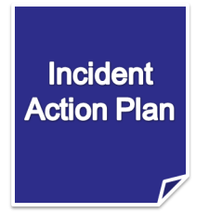
Reliance on an Incident Action Plan
The Incident Commander creates an Incident Action Plan (IAP) that:
  Specifies the incident objectives.
  States the activities to be completed
  Documents activities
  Covers a specified timeframe
    (operational period)
  Should be a written IAP
  Should include a Table of Organization
  Takes into account legal and policy
  considerations and direction.
Notes:
Present the following key points: (Share IAPs from previous storms)
Every incident, large or small, requires some form of an Incident Action Plan (IAP). For most incidents that are small, the IAP is developed by the on-scene Incident Commander and verbally passed on to subordinates and assigned resources.
The operational period is the period of time scheduled for completion of a given set of actions called for in the IAP. The length of the period is determined by Command and may be as short as 1 hour or as long as 24 hours, or even multiple days.
As incidents grow in size or complexity and/or as other agencies and resources are added, it is important to document vital information pertaining to the plan of action for the incident.
On large incidents, preparation of a written IAP is accomplished within the Planning Section. IC/UC establishes the objectives and strategy, based on needs of the incident and policy and guidance from the Executive/Senior Official.
The Incident Commander will hold a planning meeting involving, at a minimum, the General and Command Staff. The planning meeting is key to developing an effective Incident Action Plan.
Note that an IAP covers an operational period and includes:
What must be done.
Who is responsible.
How information will be communicated.
What should be done if someone is injured.

Slide 12
Finance and Administration
Tracks and manages spending during an incident
Handles the financial recovery of the facility
Notes:
INSTRUCTOR NOTES:
The Finance/Administration Section is responsible for tracking and managing spending during an incident and handling the financial recovery of the facility.
Members of the Finance/Administration Section work with the Finance/Administration Chief to:
Track all incident costs
Evaluate financial considerations of the incident
Perform needed administrative functions
Help restore financial stability after the incident
Work with vendors to procure supplies and emergency equipment and
determine payment methods

Slide 13
Logistics
Manages the materials and facilities used during the crisis
Notes:
INSTRUCTOR NOTES:
The Logistics Section manages the materials and facilities used during the crisis.
Members of the Logistics Section work with the Logistics Chief to:
Monitor and maintain adequate levels of food
Monitor and maintain adequate supplies that support incident objectives
Monitor and maintain all equipment

Slide 14
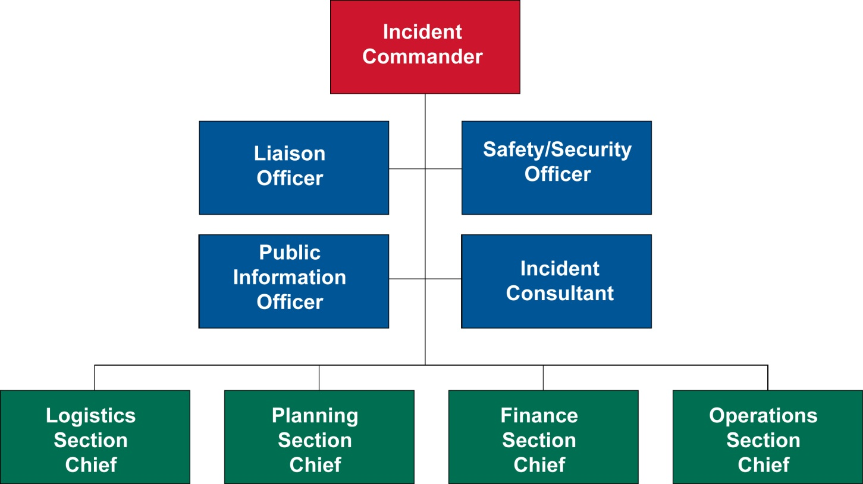
Command Staff
May be needed depending on the complexity of the incident
Incident Commander will determine which Command Staff positions are needed
Point of Contact for the SEOC to request services and/or goods in support of incident response.
Notes:
INSTRUCTOR NOTES:
Command Staff:
IC/UC – Incident Commander can be unified command depending on complexity of incident
PIO- Responsible for communicating with the public and media and/or other agencies with incident related information requirements
Safety Officer – monitors incident operations and advises IC/UC on all matters relating to operational safety, including the health and safety of emergency responder personnel. Safety officer has immediate authority to stop and/or prevent unsafe acts during incident operations.
Liaison officer – Incident/Unified command’s point of contact for representatives of other governmental agencies, ngos, and the private sector to provide input on their agencies’ policies, resource availability and other incident related matters.

Slide 15
Statewide or Widespread Emergency
When there is a widespread local emergency(ies) in either more than one municipality or of great severity in one municipality, it can become a emergency of statewide significance.
The Governor may declare a State of Emergency and/or activate the State Response Framework to begin the coordination and support of the local municipality(ies).
(Connecticut General Statutes Title 28)
Notes:
This is when your role may be activated

Slide 16
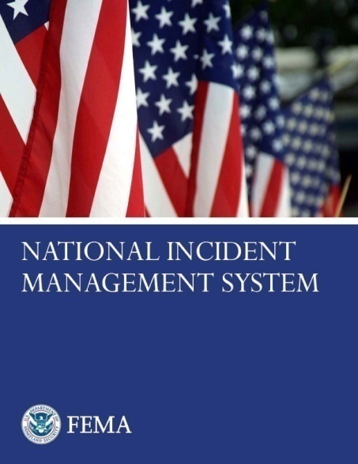
NIMS Components (cont’d)
Preparedness
Communications and
Information Management
Incident Command System
Resource Management
Multiagency Coordination Systems
Command and Management
Ongoing Management
and Maintenance
Public Information
Additional Information: www.fema.gov/emergency/nims
Notes:
Talk about how this is command and management, but NOT ON-SCENE. This is where the decision-makers and policy makers work together to respond to a complex emergency such as: Hurricanes, Tornadoes, Large Floods, Major Power Outages, Pandemic, etc.
Again, this level of coordination usually occurs in an open EOC: Town or local, Utility EOC or command center, State EOC, etc.

Slide 17
What Is a Multi-Agency Coordination System?
NIMS Element: Command and Management
Multi-Agency Coordination (MAC) Systems
MAC Systems provide the architecture to support coordination for:
  Incident prioritization.
  Critical resource allocation.
  Communications systems integration.
  Information coordination.

Slide 18
Multi-Agency Support and Coordination
Provide support and coordination to incident command by:
  Making policy decisions.
  Establishing priorities.
  Resolving critical resource issues.
  Facilitate logistics support
  and resource tracking.
  Collecting, analyzing,
  and disseminating
  information.
Local
Multiagency Coordination
(MAC)
State
Multiagency Coordination
(MAC)
Federal
Multiagency Coordination
(MAC)
Incident Command
Notes:
“You’re not putting out the fire, you’re making sure the responders have all the resources and information it needs to provide an appropriate response to our citizens.
DAS has provided:
Laptops
Cars
Extension Cords
EOC Network consultation
Etc.

Slide 19
NIMS: Coordination
Multiagency coordination is a process that allows all levels of government and all disciplines to work together more efficiently and effectively.
An entity/individual may have “command and control” over resources and policies without being in command of the incident.
Notes:
The entity or individuals referred to in this slide, and in this audience are : commissioners, chief elected officials, executive officers (of companies)

Slide 20
Unity of Command & Unity of Effort
Local
Emergency
Ops Center
(LEOC)
Reg. Coord. Center (RCC)
State
Emergency
Ops Center
(SEOC)
Federal Emergency Ops Center (FEOC)
Unity of
Effort
Policy, Coordination, and Support
Unity of
Command
Agency
Incident
Commander
1
Agency
Incident
Commander
2
Agency
Incident
Commander
3
Multi-Agency Coordination System
Notes:
With the last two storms: there are multiple emergencies going on: it was complex; Extensive power outages (including state buildings), citizens with special needs, sheltering, flooding with the first storm…... Unity of Effort is supporting the Unity of Command of all these incidents within the context of the larger incident.

Slide 21
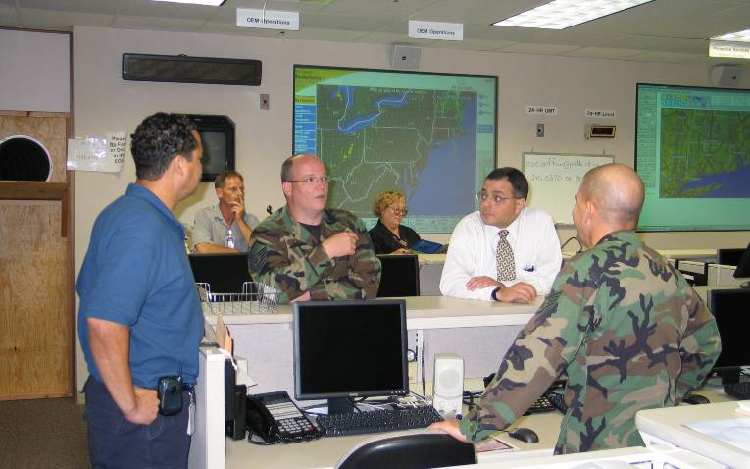
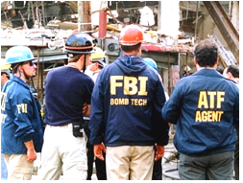
Multi-Agency Coordination System Activation
  Activated when . . .
  An emergency situation threatens, significantly impacts, or involves multiple agencies and/or political subdivisions.
  Pre-established threat levels are reached.
Notes:
For Example: In the SRF, the SOP for a Hurricane details EOC activation and/or preparatory activities up to 3 days ahead of expected impact.

Slide 22
State Emergency Management
State Emergency Operations Center
  DEMHS as coordination lead
  Governor’s Unified Command
  Emergency Support Functions
State Response Framework
  Outlines roles and responsibilities
  Plans, Resources, and Assets
  Pre-Activation Framework
  State Emergency Operations Center
  Standard Operating Procedures (SOPs)

Slide 23
Multi-Agency Coordination at the State Level
Unified Command at the State Emergency Operations Center (SEOC)
  Governor
  State Agency Heads
  State Emergency Management Director
  Private Sector Subject Matter Experts/Leaders
SEOC Liaisons
State Emergency Support Functions
  SEOC Task Forces
Notes:
Liaisons, as previously mentioned, are the SEOCs point of contact for agency resources to support the response/recovery efforts. Provide situation status periodically as outlined in the IAP.

Slide 24
State Response Framework (SRF)
Section 1: General Concepts Emergency Operations
Includes:
Governor’s Authorities
Mutual Aid
Mobilization of Emergency Forces
Local Government
  Requests
  Local Situation Reports
State Government Line of Succession
State Agencies Tasks and Responsibilities
  Agency specific Procedures for Emergencies
  Staffing SEOC (and State Emergency Support Functions)
  Advise Governor
Notes:
DAS mission assignments can be found on pages 10 and 11 of the SRF.

Slide 25
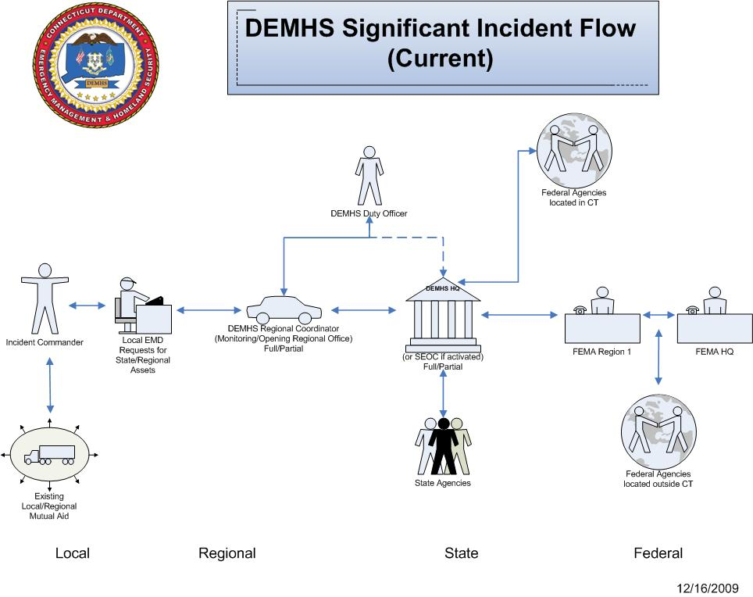
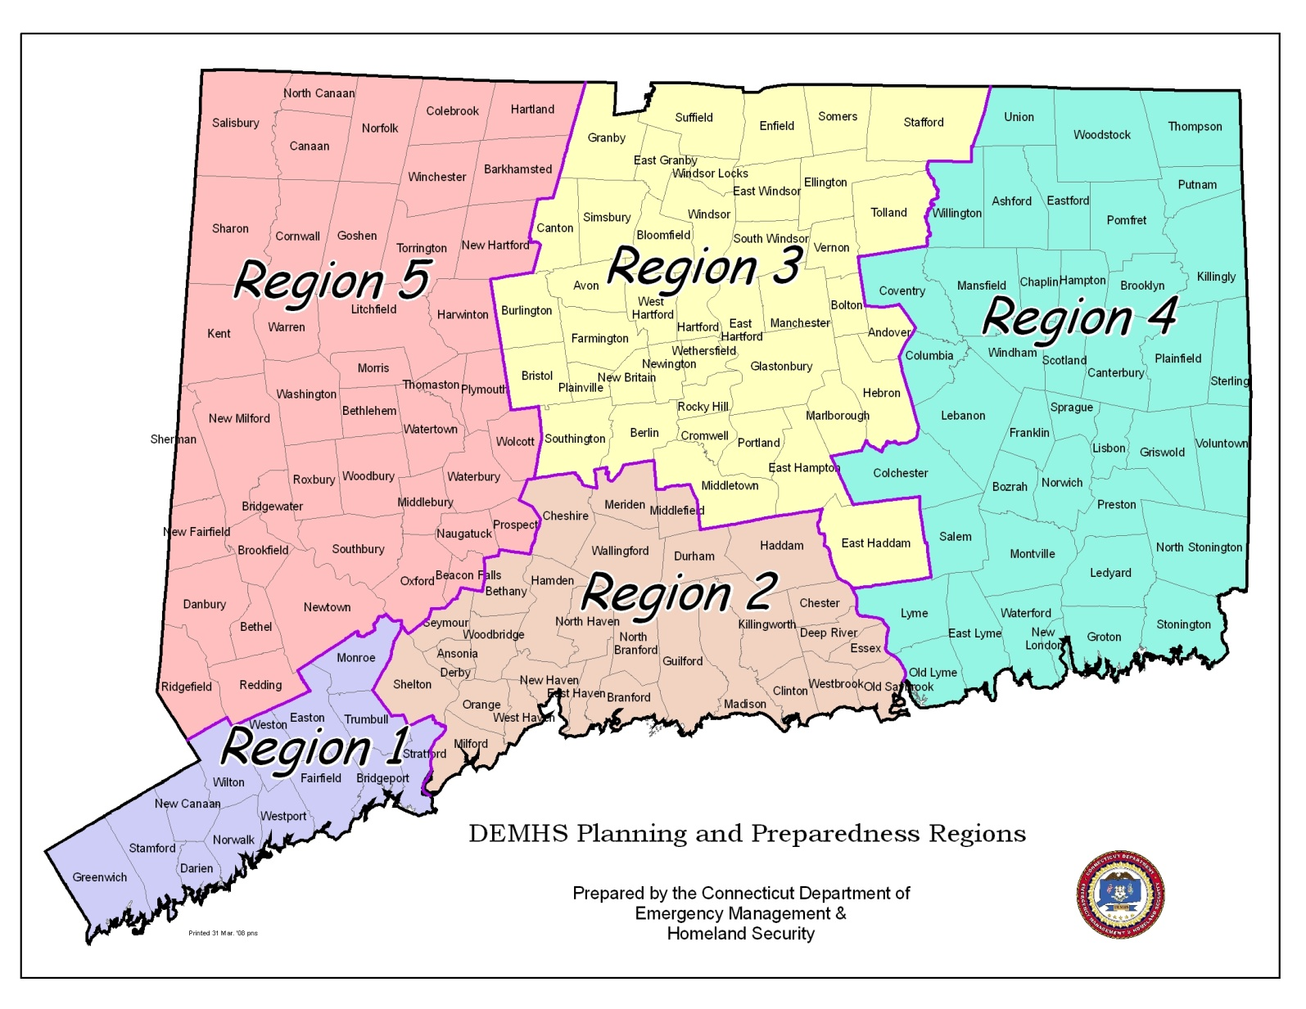
Notes:
Flow is from IC to Local EMD, who can request state assets through the DEMHS Regional Coordinator, or regional assets through the Regional Emergency Support Plan, if activated, which is really an enhanced mutual aid system. Towns can also use the Intrastate Mutual Aid System, which allows them to request any type of resource from any town in the state, without the need for a written agreement. Towns should keep the Regional Coordinator informed of all asset requests, in order to keep track of available resources.

Slide 26
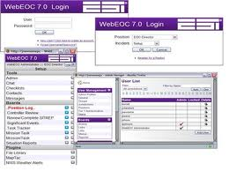
Web EOC
Web EOC is a State funded web-based application
that allows agencies to communicate during incidents
It can coordinate response and recovery operations in a
secure, real-time, online environment
It allows state, municipal and federal agencies to
share information during an emergency and
provides a common operating picture for all,
enhancing situational awareness and improving
interoperable communications
Notes:
Contained in the SOP

Slide 27
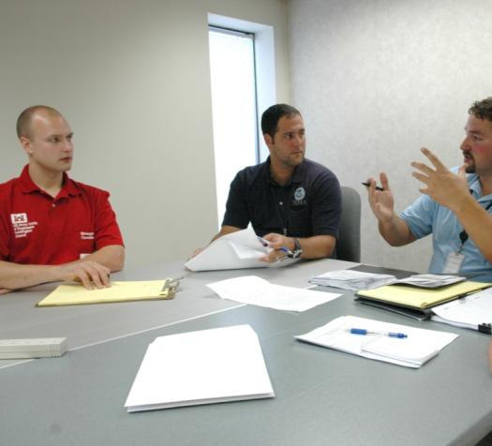
Post Incident Assessment
Assessment is an important leadership responsibility. Assessment methods include:
  Corrective action report/
  after-action review.
  Post-incident analysis.
  Debriefing.
  Post-incident critique.
  Mitigation plans.
Notes:
Present the following key points:
Management is an important leadership responsibility.
Assessments should be conducted after a major activity in order to allow employees and leaders to discover what happened and why. A Debriefing with all SEOC Liaisons who served during the event is held.

