Slide 1
Every Drop Counts: WaterSense for GreenerGovCT – Lead by Example
Lynn Gilleland
US EPA Region 1
January 10, 2020

Slide 2
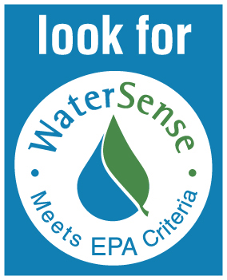
Why WaterSense?
Water shortages expected in 36 states
Identify high-performing technology
Communities face
major infrastructure investments
2006
Promote water efficient
behavior/action
Help consumers save money
Consumers challenged by rising utility bills
Reduce need to expand infrastructure capacity
Much of water used outdoors is wasted
Save water for critical needs
No ENERGY STAR like program for water
Notes:
Looking back to before WaterSense began…in 2003 the Government Accountability Office released a report that noted that 36 states expected shortages in some part of their states over the next 10 years (a 2014 update saw that number increase to 40).
Communities were facing big infrastructure costs and consumers were seeing their bills increase because of it. So if there was a way to reduce the need for new capacity, it could help decrease the impacts. And we knew that there was a lot of water being wasted, especially outdoors.
The WaterSense program started at the request of about 100 cities, water utilities, NGOs and manufacturers of water using products. They wanted the EPA to help bring some order and credibility to the marketplace for water efficient products – basically by starting “Energy Star” like program for water-using products.
In the plumbing sector, for example, problems with first-generation “low flow” toilets were infamous in the early 1990s. Almost everyone remembers toilets that clogged and showers with no power. Although later generations of products resolved these issues, misconceptions persisted and kept many consumers from saving both water and money. Utilities tried to reverse this image by developing their own performance test methods for products, but each individual utility had different tests and different lists of approved products. Many utilities felt that it was taking up a lot of valuable staff time to develop criteria, test products and maintain approved lists for their individual jurisdiction. Manufacturers felt it was hard and expensive to make products that met all those different requirements.
WaterSense has been able to help the plumbing industry overcome the poor reputation of “low flow” products by including performance requirements in its specifications and using independent organizations to certify that those products meet our criteria. Consumers know the WaterSense label signifies both efficiency and performance, taking the risk out of buying a water-saving product. Third-party product certification backed by the credibility of EPA has transformed an industry and created opportunities for new business and better environmental outcomes.
Note for TODAY audience: (per Natl Conference of State Legislatures website) Connecticut enacted the first state water efficiency standards in 1989. This legislation set maximum flow rates for fixtures manufactured, sold, and installed in the state after 1990. A handful of other states followed suit, and the federal government enacted national standards in the U.S. Energy Policy Act of 1992 (EPAct 1992). This comprehensive legislation set minimum efficiency standards for all toilets, showers, urinals and faucets manufactured in the United States after 1994. For example, a low-volume toilet flushes at 1.6 gpf as compared to 3.5 gpf that was common for residential toilets prior to EPAct 1992.

Slide 3

Saving Water Saves Energy
Every gallon of water has an energy footprint needed to pump, move, heat, and treat water
8% of energy is used to heat water
Evaluating both together results in the greatest savings
Water projects save enough to be part of an energy portfolio
Notes:
Every gallon of water has an energy footprint. Energy is needed in both water and wastewater treatment and distribution. It is also needed to pump, move, and heat water within a facility. On the flip side, every Kwh has a water footprint since a significant amount of water is needed for power generation.
The contribution of hot water can be a significant portion of the energy used in a facility. In fact, approximately 8% of energy in a commercial building is used to heat water according to the Commercial Building Energy Consumption Survey done by the Dept of Energy. This is about the same amount of energy used in a building for cooling and ventilation. Because of this savings, water efficiency projects actually save enough energy to be part of your energy portfolio.
The largest savings come from reducing hot water usage in mechanical systems, commercial kitchen equipment, and in laundry and sanitary systems so those areas are usually good targets.
If you haven’t included water savings in your improvement projects, you may be leaving money on the table. Including both energy and water can provide a more accurate picture of the potential savings and a more realistic payback period and ROI. To maximize savings, facilities should also contact both energy and water utilities to see if rebates are available to offset the costs of improvement projects.
Sources:
http://www.eia.gov/consumption/commercial/data/archive/cbecs/cbecs2003/overview1.html
http://www.eia.gov/consumption/residential/ RECS 2009

Slide 4
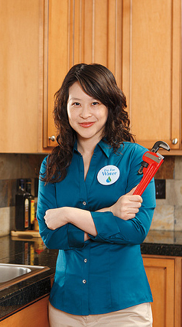
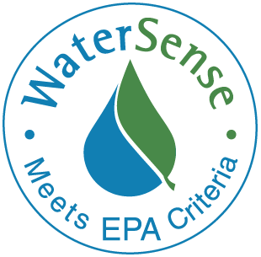
WaterSense Can Help
WaterSense is a voluntary partnership program launched by EPA in 2006 that provides a simple way to identify water-efficient:
Products
Programs
Practices
Homes
Products are independently certified for water efficiency and performance
Notes:
WaterSense was launched by EPA in 2006. WaterSense works to promote water efficiency so we can help organizations and consumers save water for future generations.
The WaterSense label, pictured here, provides a simple way for consumers and businesses to identify water-efficient products, programs, practices, and homes.
Products earning the WaterSense label have been independently certified for water efficiency and performance.
The label is reserved for products that reduce water use by at least 20 percent and perform as well or better than standard models.

Slide 5
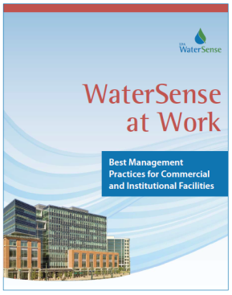
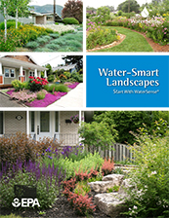
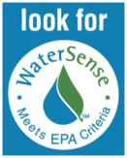
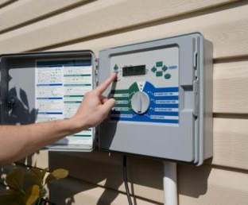

WaterSense Focus – 3 Ps
Guides and BMPs for all areas of buildings
Practices
People
Products
Water-saving fixtures and technologies
Partners reach users to change behavior
Notes:
Many Ways to Use WaterSense:
Facility Improvement - use the tools and materials to reduce water use
Engage your employees to reduce water use at work and at home
Promote water efficiency in your activities and outreach to communities and partners

Slide 6
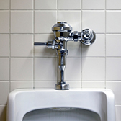
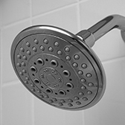
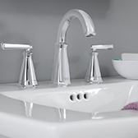
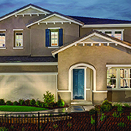

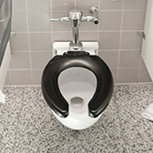
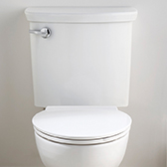
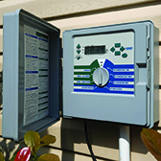
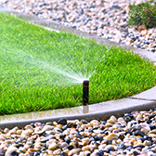
WaterSense Labeled Products
More than 35,000 product models have earned the label. Water
factors are included in many ENERGY STAR certified products.
Pre-Rinse Spray Valves Sunseted due to new DOE standard
Flushing
Urinals
Showerheads
Lavatory
Faucets
Homes
Flushometer
Valve Toilets
Tank-Type
Toilets
Irrigation
Controllers
Spray Sprinkler Bodies
Notes:
There are a variety of residential and commercial products eligible for the WaterSense label that can be used in all types of commercial and institutional facilities.
The label is generally reserved for products that use at least 20 percent less water and perform as well or better than standard models. To date, more than 35,000 product models have earned the WaterSense label.
Through 2018, WaterSense labeled products have helped consumers save more than 3.4 TRILLION gallons of water and more than $84 billion dollars in water and energy costs.
In addition to these product categories, we also work closely with ENERGY STAR to include water factors in their specifications and to consider energy savings in ours.
WaterSense is also developing or considering specifications for other C&I-related products including soil moisture sensor-based irrigation controllers.

Slide 7
Improve Your Facilities -Just Add Water
Adding water into existing energy efficiency work can help facility managers:
  Identify leaks and other operational malfunctions to correct immediately
  Develop and evaluate a comprehensive list of water savings projects
Continued water use tracking helps quickly identify problems
Incorporate water efficiency into standard O&M procedures and procurement policies like with ENERGY STAR
  Changes to SOPs can sometimes be done at low/no-cost and reduce water use significantly
Notes:
Saving water is not much more difficult than saving energy. It often just requires some focused attention. Most of you have been managing energy for many years, so you already have protocols, procedures, and systems for monitoring and managing energy throughout your facility.
Continuous water use monitoring can identify leaks and other operational malfunctions so they can be corrected immediately instead of waiting for a monthly bill. It can also help develop and evaluate a comprehensive project list of water-saving opportunities. This will help you focus your water saving efforts.
In many cases, adding water just requires the addition of water efficiency practices to your standard operating procedures so employees are aware of water use and can work towards managing both energy and water together. Sometimes, water management just requires someone to pay attention to water waste instead of writing it off as insignificant. ----Examples?
Often simple changes to your SOPs can reduce water use without incurring any renovation or retrofit costs, sometimes for no cost at all. For example, facility managers should make sure all appliances and equipment are being operated on their most efficient settings at which they can still operate effectively. Also small-scale retrofit or replacements for fixtures such as showerheads and faucets can result in significant reductions with a minimal capital cost.

Slide 8
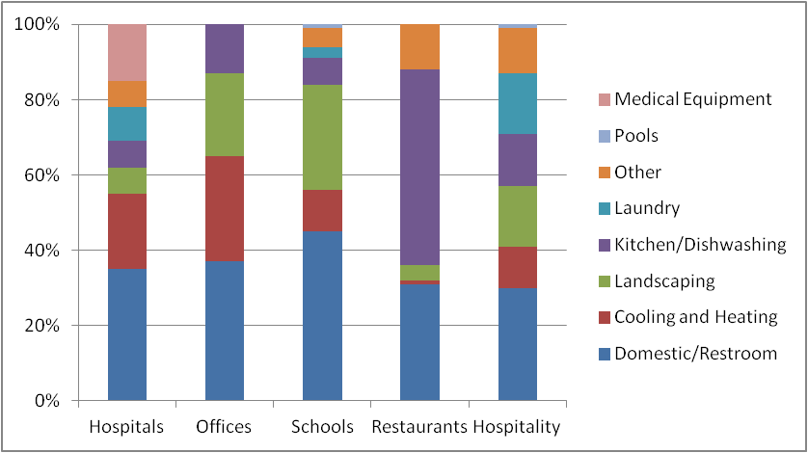
Water Use Profiles of Institutional Facilities
Created by analyzing data from: New Mexico Office of the State Engineer, American Water Works Association (AWWA), AWWA Research Foundation, and East Bay Municipal Utility District
Notes:
Within institutional buildings, water use varies depending on building type and use. We’ve pulled together some basic water use profiles, but keep in mind that other factors like age of equipment and occupancy rates can significantly change water use patterns. Mixed-use buildings may also present a challenge since they combine so many different systems. The only way to know exactly how your building uses water, and where it consumes the most is to conduct a water assessment and develop a water balance. This will also help you identify potential efficiency projects and prioritize your efforts. We’re going to go into details about how to do this today, as these are some of the most important steps in water management.

Slide 9
Institutional Buildings are Complicated
Facilities with multiple uses or tenants need to be broken down
Occupancy patterns and specialized equipment skew usage and savings
Facilities with additions or renovations from different times will have different equipment
Evaluate all of the separate estimates when prioritizing projects
Notes:
Institutional buildings can be complicated. Facilities with multiple uses or tenants will need to be broken down into sections when evaluating water use to make sure that specific characteristics aren’t lost in the analysis. Different occupancy patterns and specialized equipment can also skew usage and savings calculations especially in mixed use buildings.
In particular, facilities with additions or renovations from different times should be considered separately since there will likely be differences in the ages and efficiency of equipment and fixtures.
While these factors can be cumbersome in calculations, the savings estimates used to evaluate of potential projects will be much more accurate. You will also be more likely to achieve the expected results as well.

Slide 10
Prioritize Facilities –
Factors Indicating High Water Use
Age of facility and equipment
Older equipment uses more water
Efficiency of mechanical systems
Presence of single-pass cooling, cooling tower cycles of concentration
Areas with 24/7 occupancy
Multifamily, hotels, hospitals, dormitories, correctional facilities, etc.
Presence of a water intensive function
Commercial kitchen, in-house laundry, surgical suite, or laboratory
Size of landscaped and irrigated area
Local climate conditions v. amount of water plants need
Notes:
There are several constant factors we have found to indicate high water usage. These can be good places to start when looking for savings.
The age of the facility and equipment is a very good indicator. Generally, the older the equipment or fixture, the more water it uses. Plumbing and building codes have become more stringent over time so older equipment will always use more water.
Next, the size of a facility’s landscaped and irrigated area can affect the water use depending on the type of plants used and the climate conditions. Anywhere where the watering needs of the plant exceed the amount of precipitation will require irrigation and will use more water to keep the plants alive. Irrigation systems are not always wasteful, but they do result in more water usage compared to a facility without irrigated areas.
Another big factor is the efficiency of any mechanical systems in the facility. Mechanical systems are large users of both energy and water so they are a great place to look for savings. We’ll get into the details of this later in the presentation, but single-pass cooling systems where water is used once and then discharged to the sewer can be very wasteful. Cooling towers always need to be actively managed so they are also a good place to look for savings.
Occupancy patterns can greatly affect the water usage. Any area of a facility with 24/7 occupancy use more water in sanitary fixtures and to run major mechanical systems.
Finally, the presence of a water intensive function is always an indicator. In particular, commercial kitchens, in-house commercial laundry, surgical suites in medical facilities, and specialized laboratory equipment can indicate lots of water use.

Slide 11
Steps For Assessing Water Use
Gather
info on water sources (metered and unmetered), collect/review water bills
Establish
a baseline using water use data from a typical year
Inventory
all water-using fixtures, equipment, systems, and processes
Verify
performance of fixtures, equipment, systems, etc.
Identify
specific projects and opportunities to save water, energy and money
Notes:
To truly find out how much water your facility is using, you will need to do a water assessment. There are basic levels as well as more advanced assessments just like energy audits. Assessing a facility’s water use may seem like an involved step of water management planning, but it’s a critical step. Before you can begin to make your facility more efficient, you need to get the full picture of where you’re using water and how.
To properly assess your facility, you’ll need to gather readily available information on sources of water, review recent water bills, establish a water use baseline, inventory all water-using fixtures, equipment, systems, and processes, verify the performance of existing equipment and fixtures, and identify specific projects and opportunities to save water, energy, and money.
We’re going to discuss all parts of this process today in more detail to give you a better understanding of each step and the tools and resources available to help you.

Slide 12
Tools for Getting Started
WaterSense Simple Water Assessment Checklist
Writable PDF to help quickly identify and target potential projects and best management practices
Water assessment worksheets to organize information
  Building Water Survey, List of Water Meters, Water Consumption History; Equipment and Water Use Inventory
City of Boulder Commercial, Industrial, and Institutional Water Assessment Tool
To evaluate retrofit and replacement options https://www.brendlegroup.com/actions-insights/resources/
  https://www.epa.gov/watersense/tools-ci-facilities
Notes:
WaterSense has created several free tools to help facility managers and building owners get started saving water in a facility. Sample worksheets and checklists can help create an building inventory of all fixtures and water-using equipment. Users can also create a list of water meters and compile the facility’s water consumption history. These pieces of information are vital to assessing a facility’s water use and creating a baseline to measure water savings over time.
WaterSense also worked with the City of Boulder to create an excel-based Water Assessment Tool based on our Best Management Practices Guidebook. created a Water Use Savings and Evaluation Tool or the WaterUSE Tool, as an excel based version of these worksheets. They were originally developed for hospitality facilities, but other facilities can use them too by completing the tabs that apply to the different parts of their facility. The WaterUSE tool and associated worksheets can provide some suggested improvements and calculate potential water, energy, and cost savings that could be achieved with each project.
Each of these tools are available on the WaterSense website.

Slide 13
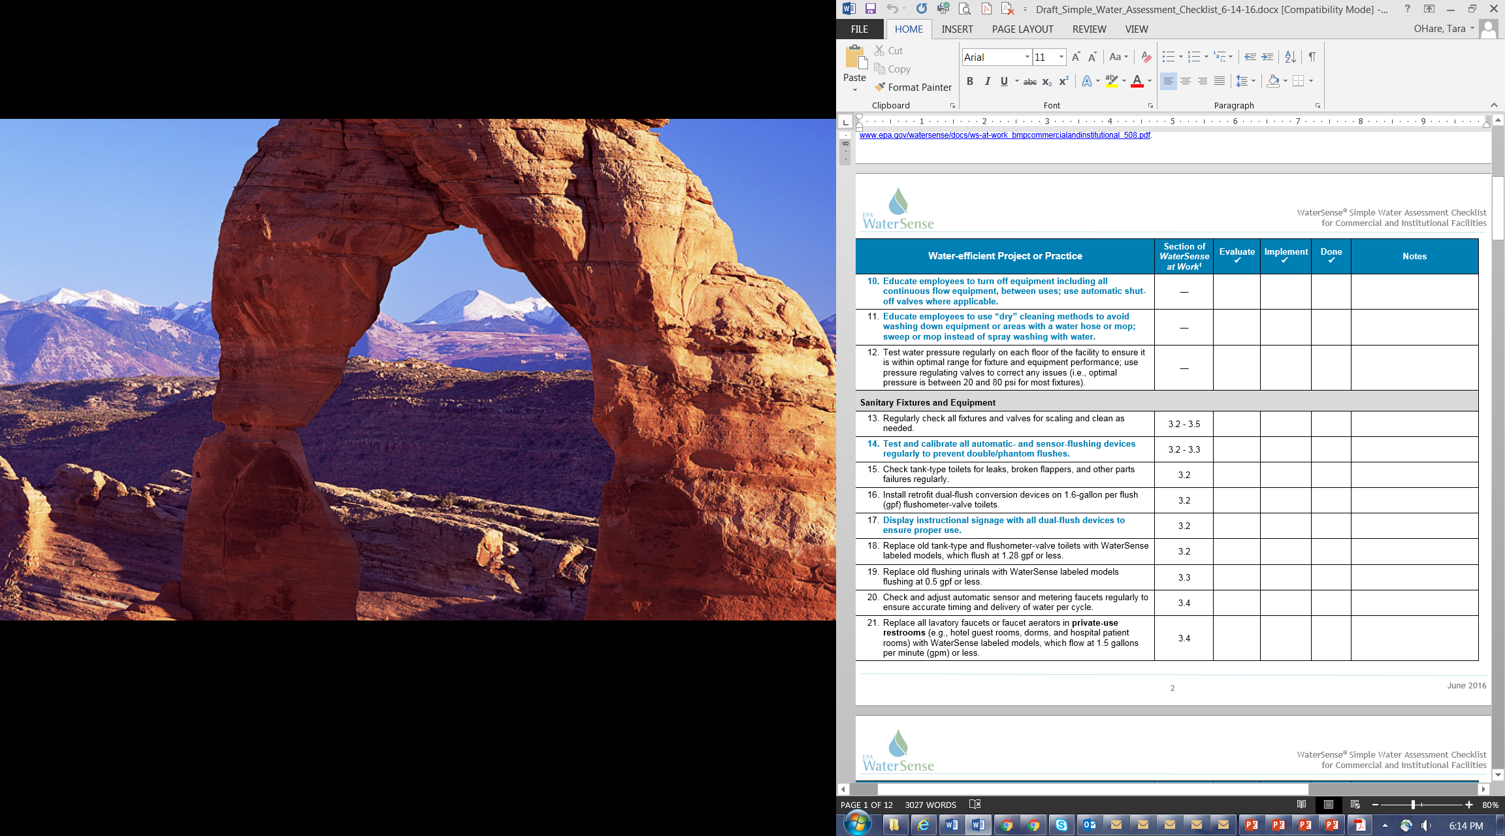
Simple Water Assessment Checklist
Notes:
WaterSense developed a Simple Water Assessment Checklist that can be used to quickly identify and target project and best management practices that a facility may be interested in to save water, energy, and utility costs. It is very thorough, including 145 water-efficient or projects that you can undertake.
Anyone can use this Simple Assessment Checklist in any commercial or institutional facility to walk through and quickly mark which BMPs have been implemented and which should be evaluated for future projects. Each project or practice refers directly to a corresponding best management practice in WaterSense at Work guide, so users can learn more.
This is a preview of the checklist available on the WaterSense website.

Slide 14
Gather Information to Assess
Identify water sources and how they are measured
Municipally supplied potable or reclaimed water
Alternative sources – rainwater, air-cooling condensate, greywater
Collect usage data on all sources to establish a baseline
Review two years of water and sewer data
Estimate unmetered sources
Surface water or groundwater
Pumping rates
Storage tank sizes
Are they metered, unmetered, or submetered?
Notes:
To begin, you need to gather information.
First, identify all of the water sources for your facility and determine how they are measured. The main sources are usually municipally supplied potable water used for drinking or reclaimed water used for irrigation. You may also have an independent source like surface water such as lakes or streams or groundwater wells. You may also be using alternative sources like rainwater catchment systems, air-handler condensate, or greywater recycled on-site.
For each source, pinpoint and record basic meter information, including location, end use, and billing account numbers, if available. This would include submeters or water monitoring devices if you have them.
And similar to identifying metered sources, you should also determine if any of your water sources are not metered—where water use is not tracked.
Next, you’ll want to gather and review water bills from the past couple of years to understand use patterns and the cost of water and wastewater services. At a minimum, you’ll want to collect a years worth of utility bills to help you establish a baseline, but ideally you’ll have a couple of years on hand so you can see how your water use has changed from year to year.
Some facilities handle and pay their utility bills in a central office or accounting department, so some facility managers don’t see them unless there is a problem. If this is the case, you can contact your water utility to request copies of your bills so you can keep track of your water use.
For unmetered sources, gather any data that would help estimate water use, such as pumping capacities and rates or storage tank sizes.
If you don’t have access to a year’s worth of utility bills, you can calculate your water use baseline by adding the total estimated annual water use for each piece of equipment or system to determine the total annual water use for these sources combined. Or contact your water utility to request copies of bills from previous years to get the most accurate information.

Slide 15
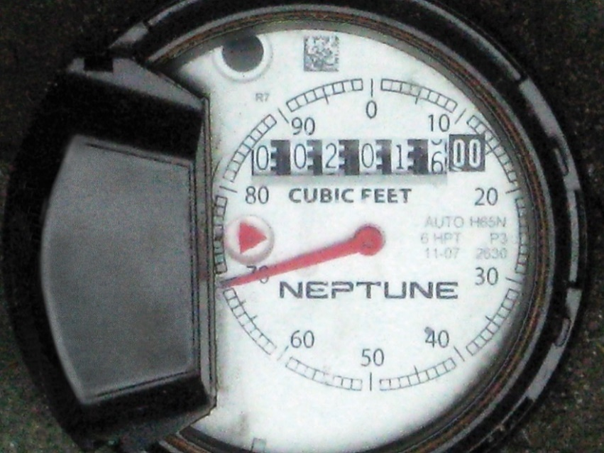
Metering and Submetering
Don’t wait for the bill to see problems
  Meter all sources of water to find problems
  Master meters cover whole buildings or multiple buildings
  Meter all sources to target reductions
Submeter specific end uses for data on-demand
  Submeters do not need separate utility accounts
  Consider temporary flowmeters or monitoring devices
  Set up alerts
Notes:
Water meters are vital to tracking and measuring water use within a facility. Make sure that each source is metered and tracked separately. In some facilities, there is only one meter for the entire building (called the master meter), so it can be very helpful to install submeters on major water-using areas or systems. Submeters can also be used to measure tenant water use or outdoor water use. It’s easier to spot areas to reduce water when you’re accurately measuring and monitoring it.
One thing I want to clarify, submeters DO NOT have to be on separate utility accounts. They are mostly used for facilities to manage their water use internally instead of waiting for a bill. This can cut the response time significantly and save money.
During your review, identify areas you may want to install water meters to track your water use, or submeters to track the water use from an end use that uses a particularly large amount of water, such as a cooling tower or irrigation systems. You can also install temporary flow meters for certain pieces of equipment. For example, if you know your dishwasher has the same usage schedule every week, a temporary flow meter can help you assess its water use without having to invest in a submeter.
If it isn’t practical to install a meter or submeters to measure your system-level water use, you can also look at the difference between average water use during the summer versus winter for your facility. This added seasonal water use during the summer months is typically made up of water used for irrigation and water used for cooling tower systems, so it’s a good indicator of how much water is going to those seasonal uses.

Slide 16
Submetering Recommendations
Rule of thumb: Submeter any system expected to use more than 1,000 gallons per day or 100,000 gallons per year
  Tenant spaces
  Individual buildings
  Cooling towers (make-up supply line and blowdown line)
  HVAC systems
  Steam boilers
  Single-pass cooling systems
  Irrigation systems
  Roof spray systems
  Ornamental water features
  Pools and spas
  Industrial processes
  Alternative water sources
    Graywater system
    Rainwater capture system
    Air handler condensate collection system
Submeters DO NOT need separate utility accounts
Notes:
When identifying areas where water submeters should be installed, a good rule of thumb is to submeter any system with an anticipated water use that exceeds either 1,000 gallons per day or 100,000 gallons per year.
This can include independent tenant spaces or individual buildings if your on a campus. It can also include large systems, such as cooling towers, steam boilers, irrigation systems, pools and spas, or certain industrial processes. We also recommend submetering alternative water sources, such as graywater systems or rainwater collection systems, so you know how much water you’ve collected and used.
If you’re a commercial property owner with many different tenant spaces, by submetering tenant water use, there is the added benefit that the water and sewer costs can be charged to those who use it.

Slide 17
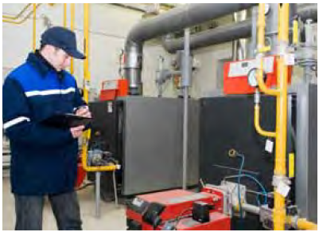
Inventory Equipment
Tour the facility where water is used
  Interview personnel
  Capture detailed equipment/fixture info
  Estimate daily water use
  Check drain lines plumbed to floor drains
Verify water use when possible
  Manually check flow rate
  Install temporary water meters or flowmeters to monitor electronically
Notes:
Next, you’ll need to do an in-depth tour of your facility to inventory all your equipment and processes. During your inventory and facility walk-through, note any obvious areas for improvement, such as leaking fixtures, single-pass cooling, or outdated equipment.
Be sure to interview the specific personnel in charge of managing water using systems or equipment. This will help you understand day-to-day operation patterns and to verify water use estimates. It can also be helpful to ask personnel for improvement suggestions, since they work closely with the technologies.
Make sure to capture detailed equipment and fixture information to help estimate daily water use later in the process. For example, you’ll want to record the flush volume of toilets, flow rate of faucets, and make and model of ice machines and laundry equipment so it will be easy to interpret the data later.
Look for drain lines that are plumbed to floor drains. This will help identify mechanical equipment and processes that should be included in the inventory, which may not be immediately visible in the walk-through.
When possible, verify water use of certain equipment or fixtures. Consider using a bucket to manually check flow rate over a short time period, such as 30 seconds or a minute. For some larger water-using equipment or processes, consider installing a temporary water meter or flow meter to monitor water use.
And from experience, I know how important going through your facility can be. You can look at your utility data and trends all day, but without actually going out into your facility and looking in mechanical spaces and drains, you may be missing an important water use area or a significant leak.

Slide 18
Always Verify Water Use
Water can continue flowing during equipment or fixture failure
  Plumbing products fail open and leak, unlike energy products
  Water-using equipment have physical components that break down
  Broken parts may not stop water flowing - reduce efficiency or cause leaks and property damage
  Leaking or continuously-running water has no added value
  Can add up to approx. 6% of building water use
Notes:
Water doesn’t stop! Fixtures appear to be working, but may be very inefficient. Leaks can be the greatest source of water waste within a facility so make sure you identify and fix leaky plumbing fixtures and equipment as soon as you can.
One of the key differences in managing water v. energy is that water usually continues flowing if there is an equipment or fixture failure
Energy stops flowing if a circuit is broken, but water continues flowing and/or leaking
Water use must be verified at the end use to check for leaks
Most fixtures and equipment have physical components that can break down including valves, flappers, pipes, and gaskets
Broken parts may not stop the fixture from working, but they can significantly reduce efficiency while leaking
While it doesn’t seem like much, a leaky faucet dripping at one drip per second can waste nearly 3,200 gallons of water per year, which is equivalent to the amount of water needed to take more than 180 showers. A running toilet can waste up to 4,000 gallons a day or 21,600 gallons of water per month at an approximate cost of $2,100 per year. Faucets, showerheads, and toilets are notoriously leaky, so fixing leaks is the one of the most important O&M practice you should keep your eye on.

Slide 19
Potential Losses From Water Leaks
Malfunction | Leaking Flow Rate (gpm) | Water Loss | Estimated Cost of Water Loss
Leaking Toilet | 0.5 gpm | 21,600 gallons per month | $2,100 per year
Drip Irrigation Malfunction | 1.0 gpm | 43,200 gallons per month | $4,300 per year
Unattended Water Hose at Night | 10.0 gpm | 5,400 gallons per day | $16,000 per year
Broken Distribution Line For: One Night One Day One Week One Month | 15.0 gpm 15.0 gpm 15.0 gpm 15.0 gpm | 8,100 gallons 21,600 gallons 151,200 gallons 648,000 gallons | Up to $64,000 per year
Tempering Water Line on a Steam Sterilizer Stuck in the On Position | 2.0 gpm | 86,400 gallons per month | $8,600 per year
Stuck Float Valve in a Cooling Tower | 5.0 gpm | 216,000 gallon per month | $21,000 per year
Notes:
ROBBIE

Slide 20
Savings Calculations
Include all direct and indirect costs in calculations
  True cost of water = (water rate + sewer rate) x volume of water used + fees + other associated costs
  Energy savings from hot water
  Associated materials, detergent, cleaning supplies, etc.
  Fewer maintenance calls, less depreciation and wear, etc.
Check for rebates - water and energy utilities provide rebates to reduce costs of water-efficient fixture replacements and other efficient projects
Project costs and benefits will be more realistic and provide a better ROI or shorter payback period
Notes:
There are a few things to keep in mind when you start tracking water use and evaluating potential improvement projects. The first big one is that the cost of water is deceptively low. Many utilities also use increasing block rates, where the incremental cost goes up with increased usage.
Facilities pay for water twice so water waste adds up fast
= water supplied + water discharged to the sewer
Doesn’t include the cost of energy needed to pump and heat water
Other costs with higher volume usage
additional detergent and chemical costs
increased equipment maintenance with higher usage
increased energy costs for heating and pumping extra water
Check for rebates - water and energy utility rebates to reduce costs of fixture replacements and other projects
National rebate/incentive database - http://www.dsireusa.org/
WaterSense partner rebate finder - https://lookforwatersense.epa.gov/rebates/
Contact your water and energy utilities directly
Some don’t have formal rebate programs but give technical assistance or customized rebates or credits for larger retrofit/replacement projects
May be able to connect you to other programs

Slide 21
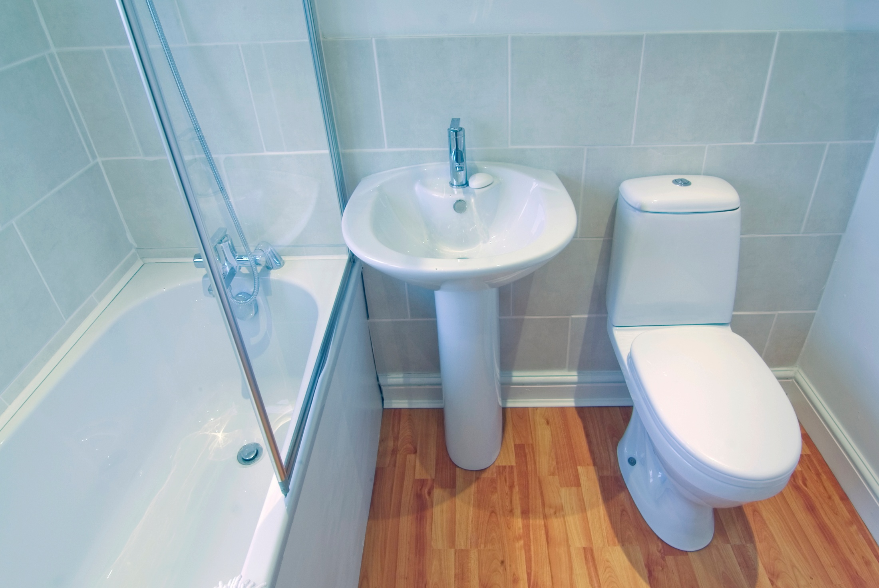
Water Savings in Restrooms
Restrooms can account for up to 40% of water use
Older fixtures installed before 1994 use 3-5 times more water than newer efficient models
Small scale – replace faucet aerators or laminar flow devices ($5-$10 each) and showerheads
Large scale - Replace toilets and flushing urinals with WaterSense labeled models
Occupancy data vital since savings based on usage
Target women’s restrooms for toilet replacements, combine toilet and urinal replacements in men’s restrooms
Notes:
One of the biggest uses of water within any facility occurs in restrooms. In many facilities, restroom water use can be up to 40%. If your facility has older fixtures installed before 1994, they could be using 3 to 5 times more water than newer efficient fixtures. Replacing those older fixtures would be a good place to start. It is very important for maintenance staff to regularly check systems and fixtures for leaks and make sure that sensors are calibrated correctly to avoid phantom toilet flushes or faucet discharges.
Like most energy products, water savings often depend on user behavior. Employees and visitors must be educated on both water and energy efficient best practices to achieve the greatest savings.
Occupancy data is vital to accurate savings calculations because water consumption for restrooms is based on usage, not the number of fixtures
The male-female ratio is key when calculating toilet savings Womens’ restrooms should be prioritized for toilet retrofits or replacements since women use toilets 3 times more than men do on average.
Women’s restrooms have a high potential for water savings so prioritize them in phased projects
A combo of toilet and urinal replacement may yield greater savings in male restrooms than if installed separately

Slide 22
General Restroom Maintenance
Test the water pressure serving each floor to achieve expected fixture performance – optimal pressure is between 20 and 80 psi
Ensure proper toilet, faucet, and urinal operation
  Annually inspect valves and replace worn parts
  Adjust automatic sensors on fixtures to avoid double or phantom flushes and faucets running longer than necessary
Check for tampering – dissatisfied users can disable sensors, remove aerators, or otherwise damage fixtures
Regularly inspect for and remove scale build-up on all fixtures especially faucets and showerheads
Notes:
Water efficient products aren’t the only way to save water in your building. Proper operation and maintenance procedures centered around water-efficiency can also reduce water use significantly. Many of the possible O&M changes are often found it easy to implement and require little to no capital cost.
Check that the water pressure serving each floor meets the minimum requirements specified by the fixture manufacturer optimal pressure is between 20 and 80 psi. If pressure is too low or too high, it may impact performance.
At least annually, inspect your diaphragm or piston valves in your urinals and flushometer-valve toilets and replace any worn parts.
One of the major pieces is to ensure that all toilets, faucets, and urinals are functioning properly. Be sure to inspect all fixtures and valves annually and replace any worn or broken parts.
If you are going to replace any valve inserts, make sure the replacement part has a rated flush volume consistent with the rating on the existing toilet bowl or urinal fixture
Check fixtures for tampering - dissatisfied users can disable sensors, remove faucet aerators, or or damage fixtures. check the water pressure on each floor or consider replacing components. If aerator removal is a common problem, consider installing vandal-proof aerators to prevent occupants from removing them.
Finally, inspect your faucets and showerheads for scale build up, especially if you live in an area with hard water. Removing scale will ensure there isn’t anything impeding flow or performance in your fixtures.

Slide 23
Water Efficient Restroom Fixtures
 | Private Restrooms or Patient Rooms | Public Restrooms
Toilets | Tank-type ≤ 1.28 gpf | Flushometer Valve ≤ 1.28 gpf
Faucets/Laminar Flow Devices | Lavatory ≤ 1.5 gpm | 0.5 gpm OR 0.25 gpc
Showerheads | ≤ 2.0 gpm
Urinals | Flushing Urinals ≤ 0.5 gpf
Notes:
To summarize, here are each of the flow and flush rates for WaterSense labeled products. Identifying water efficiency practices in the restroom is easy, as WaterSense labels a suite of products suitable for commercial restrooms.
Please note that Faucets in public restrooms should flow at no greater that 0.5 gallons per minute, which is suitable for handwashing, whereas faucets in private bathrooms should flow at 1.5 gpm or less. Because this is the lowest effective flowrate, there is no WaterSense specification for public faucets.

Slide 24
Mechanical Systems
  Mechanical systems can account for up to 30% of water use
  Eliminate single-pass cooling systems
  Regularly check for systems for leaks especially in steam systems
Maximize cooling tower cycles of concentration
Check solenoid and shutoff valves often to maintain efficiency
Notes:
Mechanical systems can account for up to 30% of water use in a commercial facility. Because of the water and energy used, these systems can be a great place to look for significant savings.
The first thing to do is to eliminate single-pass cooling systems whenever possible. These systems use water once before it is discharged to the sewer and can be inefficient. In fact, single-pass cooling systems use 40 times more water than cooling towers to cool the same heat load.
Regularly check all systems for water and steam leaks since the magnitude is so much greater than leaks in other equipment.
Overall, operate and maintain heating, cooling, and steam systems properly to maximize energy and water efficiency.
The water-efficiency goal for cooling towers is to maximize the cycles of concentration – an indicator of the number of times water has been recirculated before it is discharged to the sewer.
Facility managers can submeter make-up and blow-down water to detect leaks and measure evaporation losses to better understand and optimize water use in both cooling towers and boilers. There are many qualified contractors and vendors who specialize in cooling tower management that can help achieve your water and energy efficiency goals.

Slide 25
Single-Pass Cooling
Single-pass or once-through cooling systems use water to remove heat and cool equipment
– Uses 40 times more water than a cooling tower
Types of equipment that could use single-pass cooling include:
  Ice machines - Air conditioners
  Refrigeration systems - Air compressors
  Vacuum systems
Minimize single-pass cooling
  Replace with air-cooled equipment
  Reuse water in a closed-loop recirculation system
  Use the minimum flow rate required by manufacturer
Notes:
Single pass cooling water, if present, has the potential to be the single greatest water waster in a commercial facility.
Single pass cooling is a situation where city water is plumbed to a piece of equipment to remove heat, typically from a motor or a compressor. After use, the water goes right down the drain.
Single-pass cooling is commonly used to cool medical and laboratory equipment, vacuum pumps, air compressors, and refrigeration systems.
Often the flow of water is controlled with a solenoid valve so the water flows when a motor or compressor is running, but in older models or in cases where those valves fail and the water flows continuously.
If possible, eliminate all instances of single-pass cooling. You can do this by either replacing water cooled equipment with air cooled equipment, or providing cooling water from an existing chilled water loop.
We’ve worked with several facilities that have replaced single-pass, water-cooled air conditioning units with energy efficient air cooled units and the resulting water and cost savings have been significant.
In cases were you can’t eliminate single pass water use, make sure you’re using the absolute minimum quantity needed. Check the equipment specifications and make sure you are getting maximum temperature rise in the water you are applying. Also, make sure the water turns off when the motor or compressor is not running. If the system does not have a water control valve, you can install one to shut off cooling water when there is no heat load. Solenoid valves that typically control this can often times need maintenance, so verify they are working and perform maintenance periodically.
In some cases single pass cooling water could be reused for another purpose – but it is best to eliminate it if you can.

Slide 26
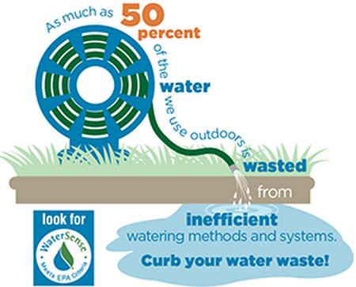
Outdoor Water Waste
20-30% of a building’s water can be used outdoors
Losses caused by:
  Poor irrigation system design or installation
  Lack of maintenance
  Improper scheduling
Audit the system using a professional certified by a WaterSense labeled program
https://lookforwatersense.epa.gov/pros/
https://www.epa.gov/watersense/outdoors
Notes:
As we saw earlier in the chart, outdoor spaces can be 20-30% of a building’s water use.
The biggest use water on the exterior of a facility is typically irrigation for landscape. If you’re installing new landscape, be sure to include regionally-appropriate and drought tolerant plants that will be less likely to require irrigation. Also, avoid planting strip grass, as these areas are difficult to maintain.
Experts estimate that up to 50 percent of water used for irrigation is lost due to wind, evaporation, and over-watering.
These losses are usually caused by poor irrigation system design, improper system installation, lack of maintenance, and improper scheduling.
If your landscape does require irrigation, utilize a WaterSense labeled weather-based irrigation controller or a rain or soil-moisture sensor to control irrigation events. These types of equipment will by-pass a scheduled irrigation event if the smart controller determines it’s not needed. Track your irrigation water use so that abnormal trends and leaks can be identified. Finally, consider alternative sources of water for irrigation, such a collected rainwater.
Get help from an irrigation professional certified by a WaterSense labeled program to make sure your irrigation system is designed, installed, and audited correctly. This will help to minimize performance issues and keep the system running efficiently over time.
You can find a list of certified professionals near you, using the Find A Pro tool on the WaterSense website. https://www.epa.gov/watersense/irrigation-pro
NOTE: Landscaping Guide and Sprinkler Spruce-Up information can be found online along with other outdoor water tips https://www.epa.gov/watersense/outdoors

Slide 27
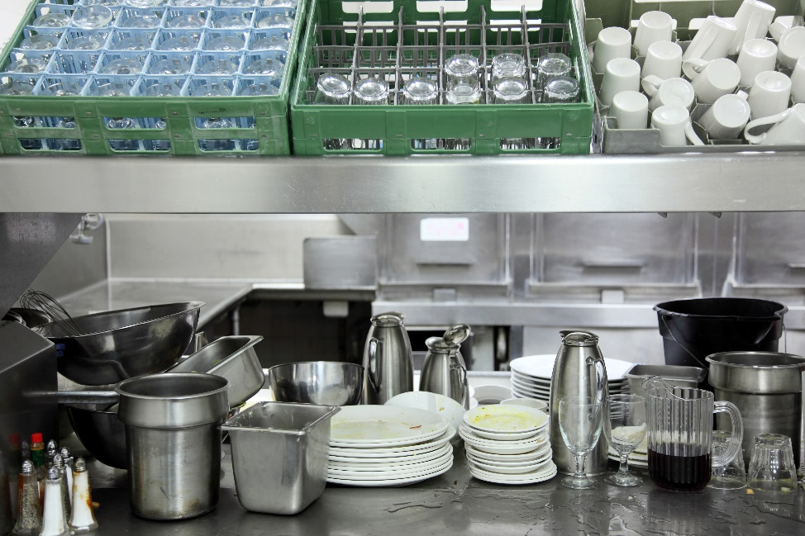

Water Use in Commercial Kitchens
Some ENERGY STAR certified kitchen equipment are 20-90% more water-efficient
Retrofit food disposal systems to avoid continuous water flow (2 to 15 gpm) or avoid using water by scraping food off dishes for composting
Monitor steam cooker and steam kettle systems to repair leaks and reuse condensate water
ENERGY STAR Commercial Kitchen Equipment Calculator
Notes:
Main take-away here is that where EnergySTAR has already labeled a water-using product, WaterSense does not create a duplicative label since EnergySTAR now has a water use criteria included for those products. So by looking for the EnergySTAR label, water savings are also found.

Slide 28
Conduct Outreach with WaterSense
WaterSense main outreach national campaigns with materials and tools
Fix a Leak Week – March
Sprinkler Spruce Up - May
When in Drought – July/Aug
Your Better Bathroom/Shower Better – Sept./Oct.
  Many tools can be customized or changed to fit your needs
  Adapted to Commercial/Industrial facilities or used to educate employees for use at home
  Can be co-branded and used year-round
  Must be a WaterSense partner to have access to the tools
Notes:
Ties back to one of the WaterSense “P’s” = people. Outreach and behavior change.

Slide 29
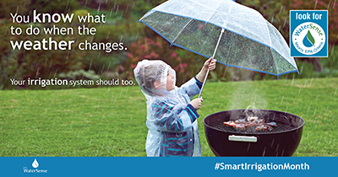
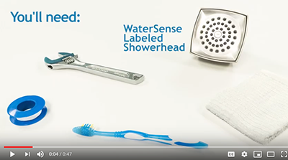
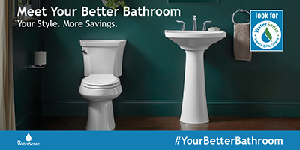
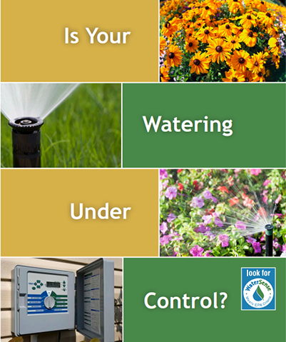
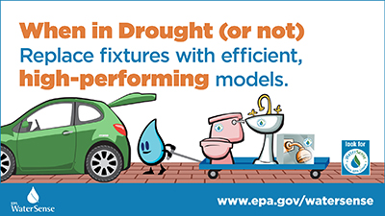
Customizable Tools
Infographics
Videos
Sample web text
Sample press release/
newsletter text
Social media posts
Pledges
Case studies
Spanish Tools
Notes:
Here are the types of tools that we make available to partners through a dedicated website. We make it easy - if you want a bill stuffer, you can pull it off of our partner site, add your logo, and send it out!
Also partners use our product lists to rebate products.
Partners sometimes learn best from each other. You can get ideas by checking out our “Partners in Action” listings, attending our bi-monthly partner webinars, or reading our quarterly newsletters.
You can also mine our quarterly Current newsletters for stories to help your customer communication/outreach.

Slide 30

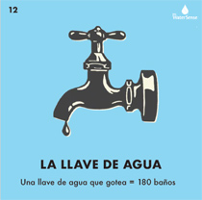
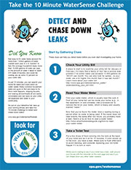
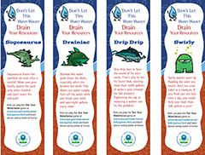
Example Materials - Fix a Leak Week
WaterSense tools
  Handouts, bag stuffers, billstuffers
Leak checklists – home and work
Social media content
  Video (Spanish too)
  Infographics/sample posts
Giveaways and games for events
  Loteria, dye tablet card, social posts
Kids’ materials and bookmarks
Notes:
Fix a Leak Week is one of our longest-running national campaigns, and is right around the corner! These tools offer many different ways you can promote it.
We have many tools you can customize and send or distribute to customers, including a new checklist for how to detect and chase down leaks!
We have videos in two languages you can post to your website or social media networks.
And if you missed it last webinar, we have a whole new suite of tools that have been “transcreated,” or translated and redesigned to appeal to the Hispanic community. For example, we designed social media graphics and dye tablet cards to represent loteria cards, which is a popular game in Mexico.
And you can always use our kids’ activity sheets, bookmarks, and other materials to partner with schools.
Plumbers and affordable housing organizations also make good partners for Fix a Leak Week, when you want to improve plumbing fixtures in communities that can benefit most from the water and dollar savings.

Slide 31
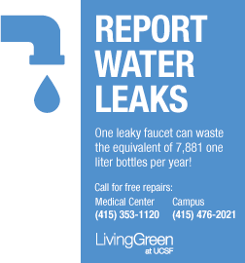
Use BMPs to Educate Employees and Visitors
Train custodial and maintenance staff to identify and fix leaking or malfunctioning fixtures and equipment
Post signage in restrooms with:
  water saving factoid or call to action
  contact info for repairs
  Post instructions with new technologies especially dual flush fixtures
Notes:
Employees can be eyes and ears on the ground. Sometimes they can be the fastest way to find out there’s a problem so make sure there are many signs and displays with the phone number or email address to report problems. You can also use these signs to encourage visitors to report leaks too.
Train cleaning and maintenance staff to identify and report leaky or continuously flushing fixtures
Respond quickly to all reports of leaky or continuously flushing fixtures
Place signage in restrooms with instructions for reporting leaks so employees, visitors, and guests can help
Signage can also help discourage people from misusing toilets and urinals, such as by flushing inappropriate objects. Finally, you can also post instructions for using new technologies to maximize savings.

Slide 32
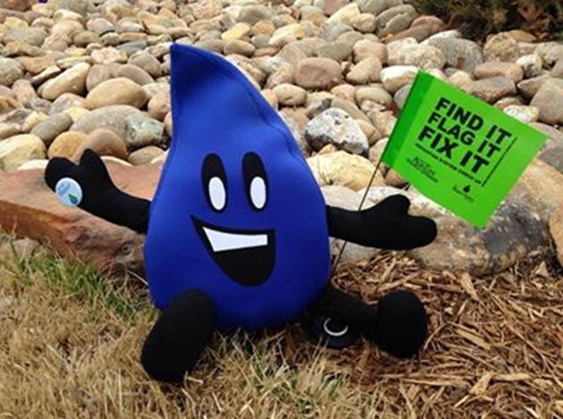
Examples from State and Local Partners
Fix a Leak Week –
  Hold a leak detective contest – prize for finding and reporting leaks in office building or for using materials with their kids at home
  Hold an event to teach employees to fix leaks at home – changing a toilet flapper, fixing a leaky faucet
  Fix leaks in public housing – City of Dallas – partnered with plumbers clear to fix leaks in public housing
  Partner with a municipality or utility to table at their event
  Borrow Flo, our Spokesgallon, for media events
  Use activity sheets and leak detection checklists at
  student events or Take Your Child to Work Day
Notes:
EPA R1 worked with the City of Boston some years back to promote bathroom retrofits work they did at HUD housing in the city there, with the help of local volunteer plumbers. Also, Delta chipped in and donated some of the products used in the retrofits.

Slide 33
NH Dept Environmental Services (NHDES)
Case Studies
    Used Fix a Leak Week and Shower Better Materials with Employees
    Created the Silent Toilet Leak Challenge for Fix a Leak Week
    Display in lobby with dye tablet postcards and instructions
    Daily emails to participants with tips, leak facts, and challenge updates
    Participants entered to win prizes (showerhead, faucets)
    Approx. 300 dye tablets distributed, 127 toilets tested, 15 leaks found
Notes:
The Silent Toilet Leak Challenge was created for Fix a Leak Week and challenges participants to test their toilets for silent toilet leaks using dye tablets or food coloring and to repair those leaks. Results and feedback related to messaging are encouraged to be reported using the NH We’re for Water website. All participants are entered to win prizes. The website also includes additional information on how to check for all common household leaks and repair those leaks. A display was set up in the lobby including Silent Toilet Leak Challenge postcards with dye tablets, and daily emails sent to employees with WaterSense messages, leak facts, and challenge updates. In 2013, approximately 300 dye tab postcards were distributed, 72 people responded to the survey, respondents reported testing 127 toilets, and discovering 15 leaks discovered. In summary that is approximately 2 leaks for every 10 households tested, which is consistent with the findings of the 2014 Silent Toilet Leak Challenge. In 2014, 344 dye tab postcards were distributed, 77 people responded to the survey, and the findings were equivalent to 2013 with 2 leaks found for every 10 households.

Slide 34
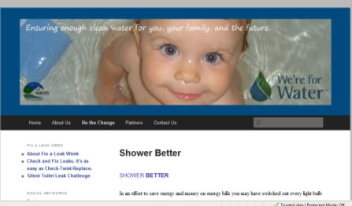
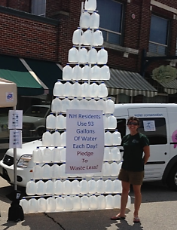
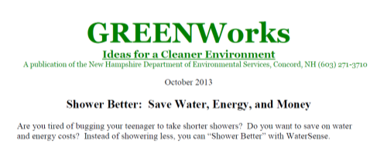
NHDES Marketing Methods
We’re for Water website
Employee Emails
GreenWorks Press Release
Electronic bulletin board
Display in lobby
Spokesperson: DES staff member
80 showerheads sold, 143,080 gallons saved per year
Notes:
Showerhead sale in the lobby
Included Dept of Housing Services and also partnered with Dept of Transportation to expand sale to include showerheads, faucets, and kitchen faucets
Setup a display of gallons of water to stand for amount of water used per person per day in the summer months
Gave out postcards to employees for subscription to daily water saving tips emails
Added announcements to employee newsletters and e-bulletin
80 shower heads sold
143,080 gallons saved per year = 8,942.5 more showers

Slide 35

WaterSense Institutional Resources
Water use information by facility type
Best management practices
Water-saving tips
Assessment tools
Worksheets and checklists
Live and recorded training webinars
Case studies and more!
    https://www.epa.gov/watersense/commercial-buildings
Notes:
WaterSense keeps all of our resources for commercial facilities on the Commercial Tools and Training section of the WaterSense website. This section of our website houses the WaterSense at Work guidebook, but it also has a lot of other helpful tools to help commercial facilities learn about ways to reduce water use. There are tools for conducting a water assessment, including walk-through checklists. We also have case studies and links for recorded or other upcoming live webinars.

Slide 36

Institutional Best Management Practices
WaterSense at Work is an online guide facilities can use to manage water use:
  Water management planning
  Water use monitoring and education
  Sanitary fixtures and equipment
  Commercial kitchen equipment
  Outdoor water use
  Mechanical systems
  Laboratory and medical equipment
  Onsite alternative sources of water
Notes:
Our Best Management Practices Guidebook—WaterSense at Work.
This guidebook includes best management practices on topics including: water management planning and water use monitoring and education, as well as BMPs for sanitary fixtures and equipment, commercial kitchen equipment, outdoor water use, mechanical systems, laboratory and medical equipment, and onsite alternative sources of water.
Product- and equipment-specific chapters in each of those main water-use areas cover water-efficient operation and maintenance, retrofit, and replacement recommendations.
Similar versions are currently in use by the States of California and Texas – same contractors wrote all 3 guidebooks

Slide 37
Use Federal Building Resources
Federal buildings have similar requirements for facility water reductions (2% per year) so their resources can help too
  Tons of Guidance – Metering, Measurement and Verification, Net-Zero Water and Energy - https://www.energy.gov/eere/femp/water-efficiency-federal-buildings-and-campuses
  Advanced Technology Studies - https://www.energy.gov/eere/femp/water-efficient-technology-opportunities
  On-demand Training Programs with CEUs – https://www7.eere.energy.gov/femp/training/
  Case Studies - https://www.energy.gov/eere/femp/federal-energy-management-program-case-studies
  Conference Proceedings with presentations - https://www.energy-exchange.com/training-agenda/
Notes:
Federal Agencies are required to reduce their water use by 2% per year from a 2007 baseline. Federal resources will apply to almost every institutional building so you can also use a ton of other free tools, trainings, and case studies. WaterSense has collaborated with Department of Energy to create some of these and others over the years so they work well with our resources too.

Slide 38
Thank you
  WaterSense
www.epa.gov/watersense
www.facebook.com/epawatersense
www.twitter.com/epawatersense
  Email: watersense@epa.gov
  Helpline: (866) WTR-SENS (987-7367)
Notes:
Also, have several more specific water savings resources (including some outside of EPA) if anyone is interested, feel free to contact me. OR I can just share those with Doug to have.

Slide 39
Other Resources
South Florida Water Management District Water Efficiency and Self-Conducted Water Audits at Commercial and Institutional Facilities Guide
  https://www.sfwmd.gov/documents-by-tag/waterefficiency
Environmental Defense Fund, AT&T, & GEMI
  Water Efficiency Toolkit with Scorecard and Cooling Tower WaterMAPP Tool http://business.edf.org/projects/featured/water-efficiency-and-att/water-efficiency-toolkit-2/
DOE Federal Energy Management Program Water Project Screening Tool - http://energy.gov/eere/femp/downloads/water-project-screening-tool
City of Boulder Commercial, Industrial, and Institutional Water Assessment Tool and User’s Guide
https://www.brendlegroup.com/actions-insights/resources/
Notes:
In addition to the WaterSense resources presented today, we’d like to direct you to some other useful tools and resources for commercial and institutional facilities that may be helpful in conducting facility water assessment and establishing a facility water balance.
Several of our partners have also developed tools and resources including the City of Boulder, Colorado, which has developed a CII Water Assessment Tool for users without a technical background to conduct a basic water assessment and identify water conservation opportunities. The CII tool is an Excel-based tool based on the WaterSense at Work Best Management Practices.
The South Florida Water Management District has recently updated its Water Assessment and Self-Guided Water Audit Guide, which provides helpful information on how to perform both basic and more advanced water audits.
The Environmental Defense Fund, AT&T, and the Global Environmental Management Institute, or GEMI, developed an Excel-based WaterMAPP Tool with: a Water Scorecard, a Water Efficiency Calculator, and a Cycles of Concentration Estimator for cooling towers. This tool outlines water efficiency improvements you can make by implementing free cooling and optimizing cooling tower performance.
Similar in function to WaterSense’s Simple Water Assessment Checklist is a Water Project Screening Tool developed by the U.S. Department of Energy’s Federal Energy Management Program. This tool is intended for federal agencies, but can be used by any facility to identify water efficiency opportunities. Based on some facility-specific information that is added to the Excel-based tool, the screening tool provides qualitative water savings potential for nine different equipment areas, including: Plumbing fixtures, Cooling towers, Steam systems, Single-pass cooling, Laboratory equipment, Irrigation, Commercial kitchen equipment, Vehicle washing stations, and distribution leaks. This tool is a great way to quickly identify if there are certain end-use areas that have significant potential for water savings.

Slide 40
Outdoor Water Resources
WaterSense Water-Smart Landscaping Guide https://www.epa.gov/sites/production/files/2017-01/documents/ws-outdoor-water-efficient-landscaping.pdf
Regionally-appropriate Plant Lists – What to plant and where https://www.epa.gov/watersense/what-plant
Micro-irrigation – drip irrigation guides https://www.epa.gov/watersense/watering-tips#smarter-tech
Expert assistance with irrigation system design, install, audit: Directory of Certified Irrigation Professionals https://www.epa.gov/watersense/irrigation-pro
NEW

Slide 41
Water Reuse Guides
William J. Worthen Foundation - Water Reuse Practice Guide https://www.collaborativedesign.org/water-reuse-practice-guide/
  Onsite non-potable reuse guide – covers all aspects of planning, technical details, along with permitting and communications
EPA Office of Water
  https://www.epa.gov/ground-water-and-drinking-water/potable-water-reuse-and-drinking-water
  2017 Potable Reuse Compendium
  2012 Guide for Water Reuse – indirect potable, non-potable

