Slide 1
Food Advisory Group
Don Casella, Contract Team Leader

Slide 2
Background
The creation of the commodity “Food Advisory Group” goes back to 1959 when the CT Statute Sec. 4a-56. “Purchasing Standards and Specifications” was codified.
In the late 1990’s a “standards committee” which was solely focused on establishing standards was disbanded.
DAS continues the Food Advisory Group to give using agencies the opportunity to provide feedback and input for product needs on the current and future contracts.
The purpose is to have a contract in place that meets the needs of the using agencies. Without the Food Advisory Group, DAS may have a lesser quality contract.

Slide 3
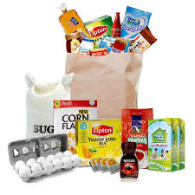
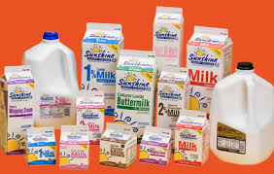
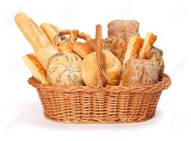
Food Contracts Administered by DAS
Food Distribution and USDA Warehousing, Program SYSCO
Milk, Milk Products, Cream and Related Products Guida Seibert Dairy
Wades Dairy, Inc.
Purchase and Delivery of Fresh Bakery Products Bimbo Bakeries

Slide 4
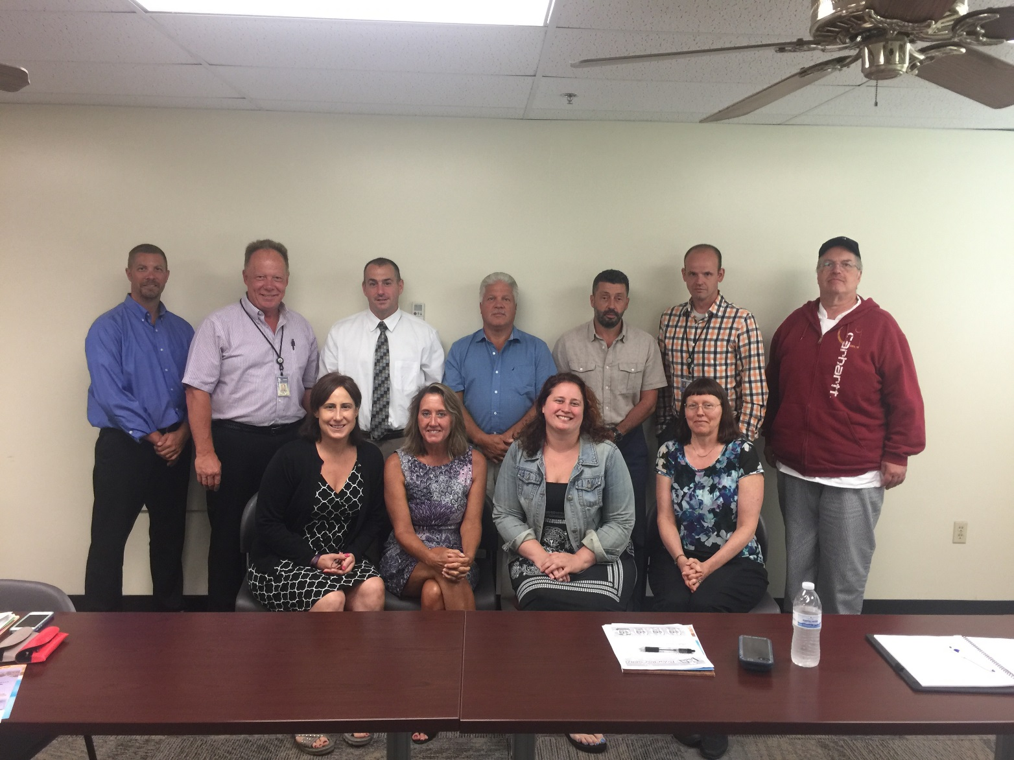
Food Advisory Group
Food Service Directors and staff for each using agency
Business Office Staff
Sysco Customer Service Representative
Bakery and Dairy Contract Customer Service Representatives
DAS Contract Specialist

Slide 5
Food Advisory Group
Meets on a quarterly basis.
Evaluates food and related items and views presentations by brokers, manufacturer's representatives, etc. that pertain to the contract (example, top sellers and new or comparable items that may positively affect pricing).
Contractor’s Account Executive is required by contract to attend meetings
To discuss savings opportunities, new products, standards, current industry trends, etc.
Recommend product offerings and discuss the latest ideas and culinary trends
Provides an in-depth variety of product offerings and special programs designed to meet the needs of the using agencies.

Slide 6
Savings
Working together, DAS and the Client Agency Users:
Negotiated some of the most advantageous pricing for food distribution in state government.
Prompt Payment Discounts (Since November 1, 2015 through May 1, 2017, agencies received over $200,000.00 in rebates)
Deviations and GPO (Group Purchasing Organizations) Initiatives ( Deviations: January, 2017 through June, 2017 $431,314.14) (HPSI Rebates: $12,275.83)
Branded Products (Percentage discount of total food purchases)

Slide 7
Benefits
Fosters relationships and consistent communication with users and DAS Contract Specialist.
Able to utilize opportunity buys across agencies which helps to save the state money.
Users are able to interact with contractors
Performance issues are addressed
Increases the State’s buying power
Creates better communication with Vendors
Collectively addresses contract and food quality issues
Supports conformity in operations of Food services throughout agencies
Gives the agencies a platform to see new products that may help reduce costs
Gives the State the availability to increase rebates and other cost saving methods
Open discussion of ideas to better improve services
Allows users to be informed about current issues/problems users may be having, as well as what corrective action/possible solutions are available.
Allows users to provide input collectively as a group regarding upcoming bids and/or contract renewals that affect Food Service operations.

