Slide 1
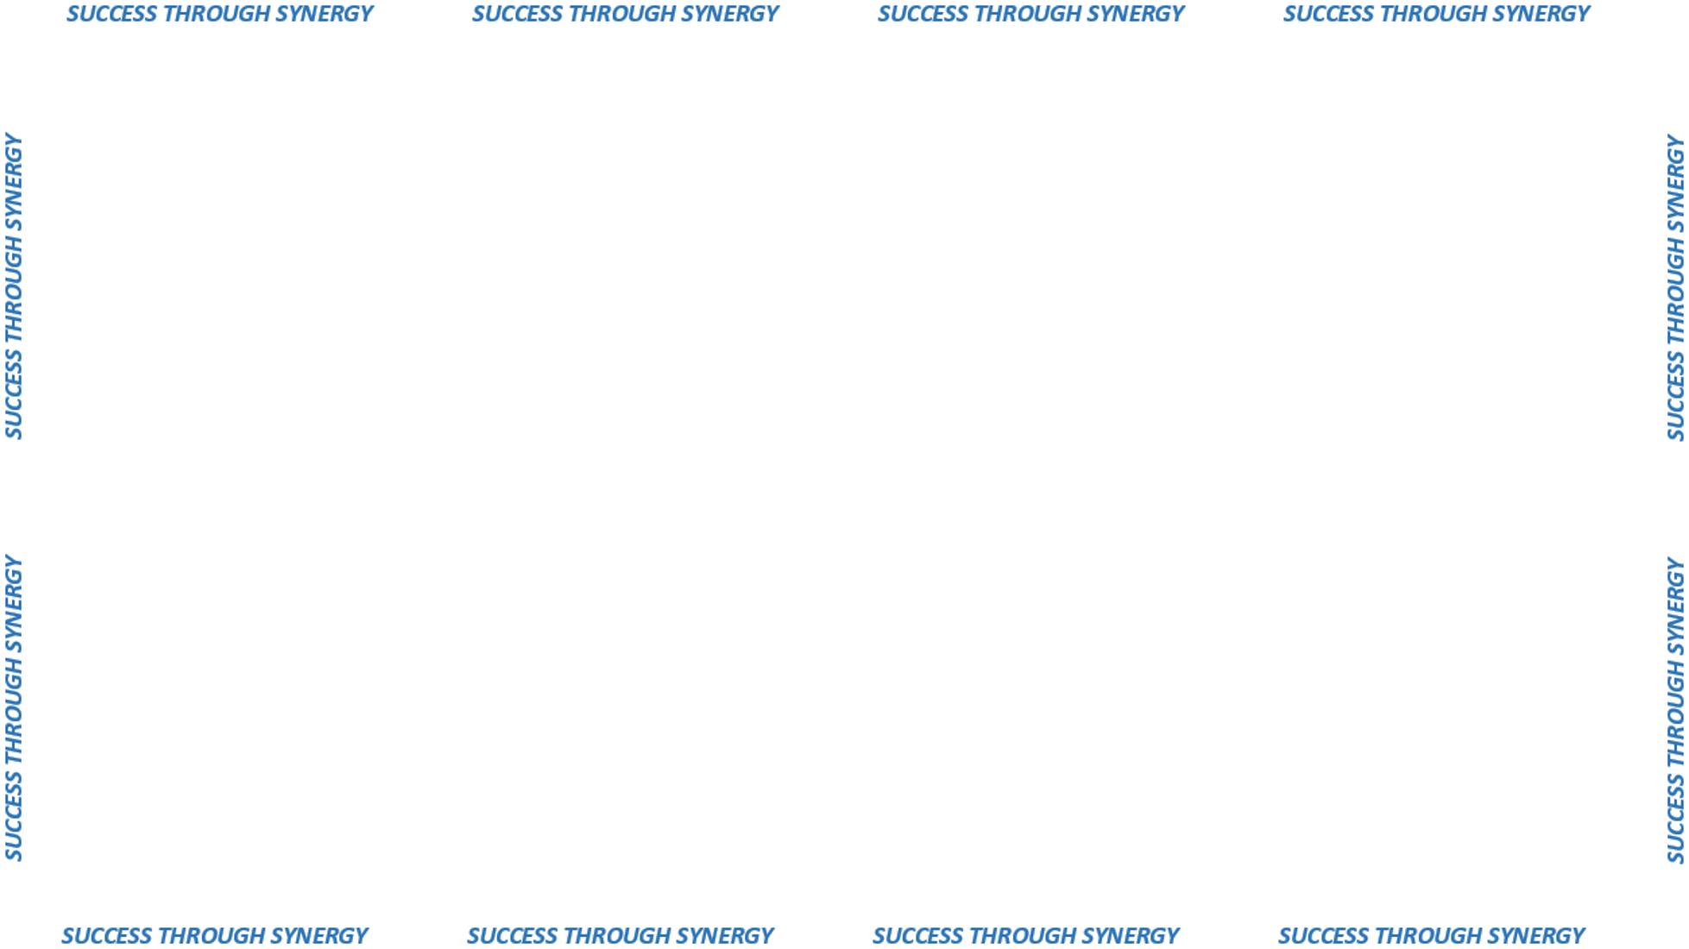

E-SOURCING
SOLUTION

Slide 2



Can our current technology
support our future?
MAINTENANCE
AND
DEVELOPMENT
SUPPORT
SERVER
CAPACITY
AND
PERFORMANCE
FUNCTIONALITY
AND
USER NEEDS

Slide 3

DEVELOP A
NEW APPLICATION
OFF-THE-SHELF
SOLUTION
MODIFY OUR
CURRENT
APPLICATION
STRATEGIC BUSINESS PLAN

Slide 4



ISSUED NOVEMBER 2016
AUGUST 2017
BUDGET ?

Slide 5




BUSINESS
REQUIREMENTS
DOCUMENT
MANAGEMENT
SYSTEM
STATE AGENCIES
MUNICIPALITIES
VENDORS
HELP DESK
SUPPORT
MOBILE APP

