Slide 1
Alternative Living Options Community Companion Homes (CCH)
What is CCH?
Who can live in a CCH?
Why CCH makes sense!
ARPA Presentation
October 2022
Joanne Malise, LCSW

Slide 2
CCH Community Companion Home
Statewide Residential Service
Most “Home Like” personalized option
No changes of shift or staff turnover
Choice of Home

Slide 3
How Do People Get Referred to a CCH?
The DDS Case Manager can make a referral to a CCH
The person’s team can make a recommendation to DDS
The family or guardian can make a request for a CCH
DDS operates some CCH
Some private agencies support CCH

Slide 4
About CCH
Each home is individually licensed by DDS once they meet a rigorous approval process
Each CCH provider must be licensed to provide care
Each CCH provider must contract directly with DDS before a person can move into the home

Slide 5
How Are People Approved to be CCH Providers?
Extensive application process and interviews
Numerous background checks
Professional training (CPR, First Aid, Medication, swallowing, etc. )
Intensive home inspections
Approval from State/DDS Licensing
Contracting with the State of CT to become Licensed CCH provider
Regular home visits, State monitoring and recertification

Slide 6
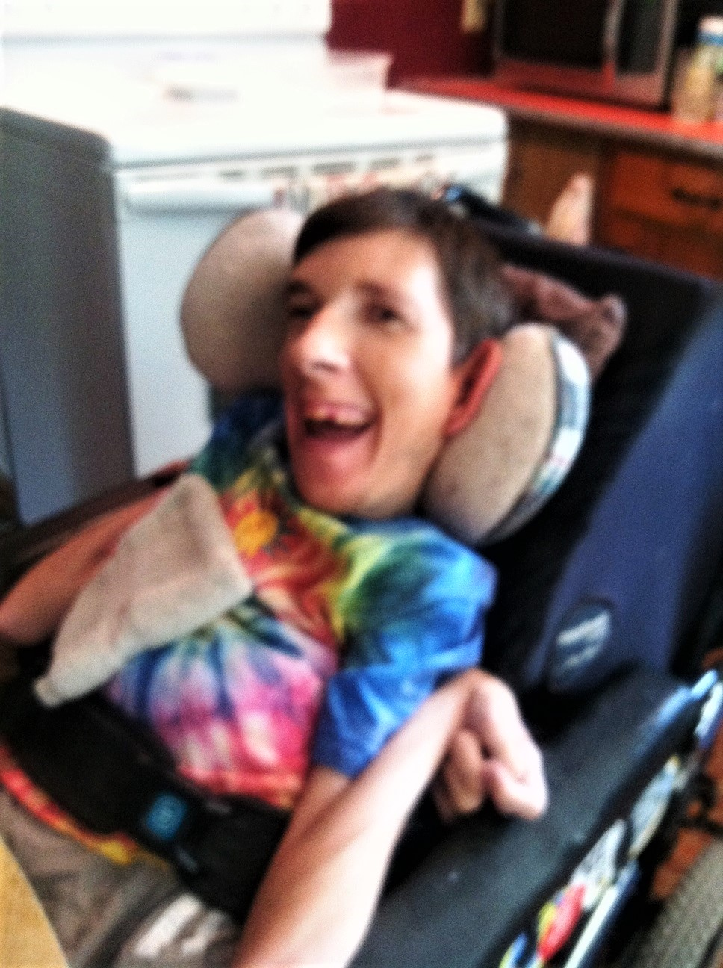
Who Can Live in a CCH?
Anyone if we can find a match!

Slide 7
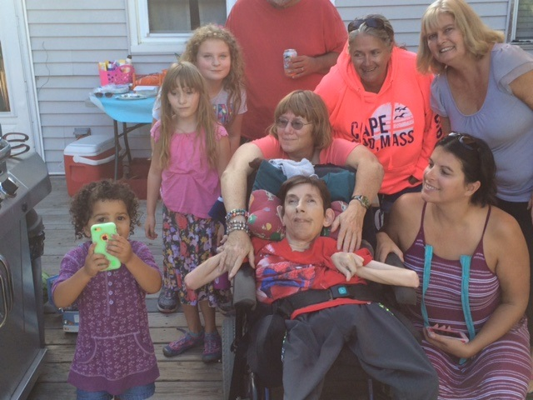
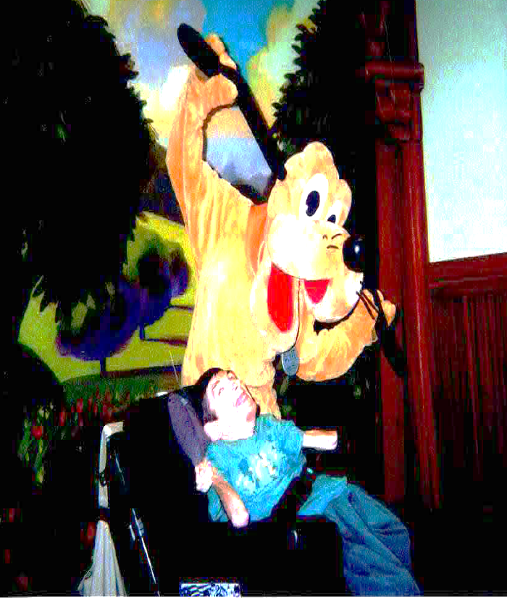
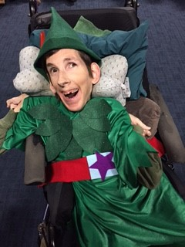
24 Years as a Beloved Member of the Family & Community!

Slide 8
Matching vs. Placement ( The “P” Word)
People are introduced to each other and decide if they want to live with each other
Family can be involved in the matching of the CCH
It must be a choice by all parties
Often the first time in a person’s life that they have a choice about where to live

Slide 9
Why CCH Works
It is personalized
It is a choice
More integrated into the community
Partnership with family and friends
There is consistency and Love

Slide 10
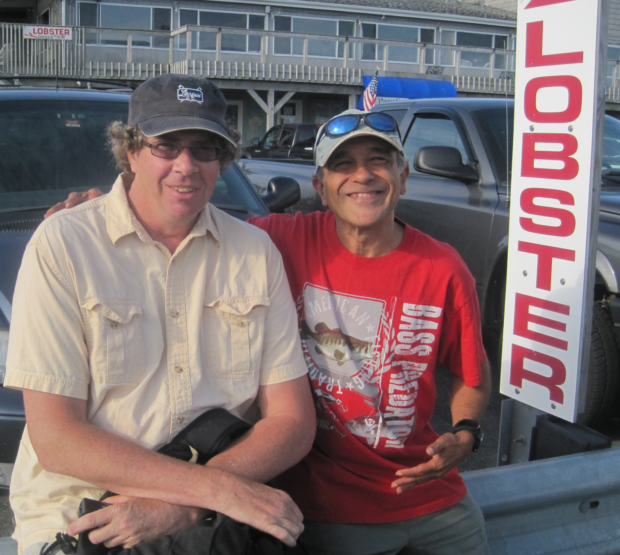
In Their Own Words
“It is quiet”,
“No one is yelling”
“It is all about me”

Slide 11
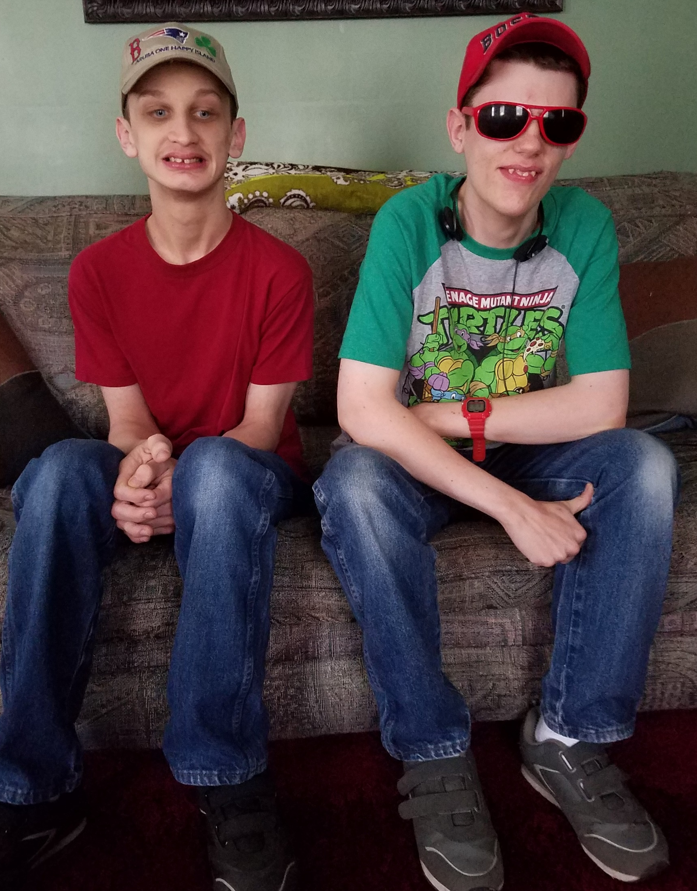
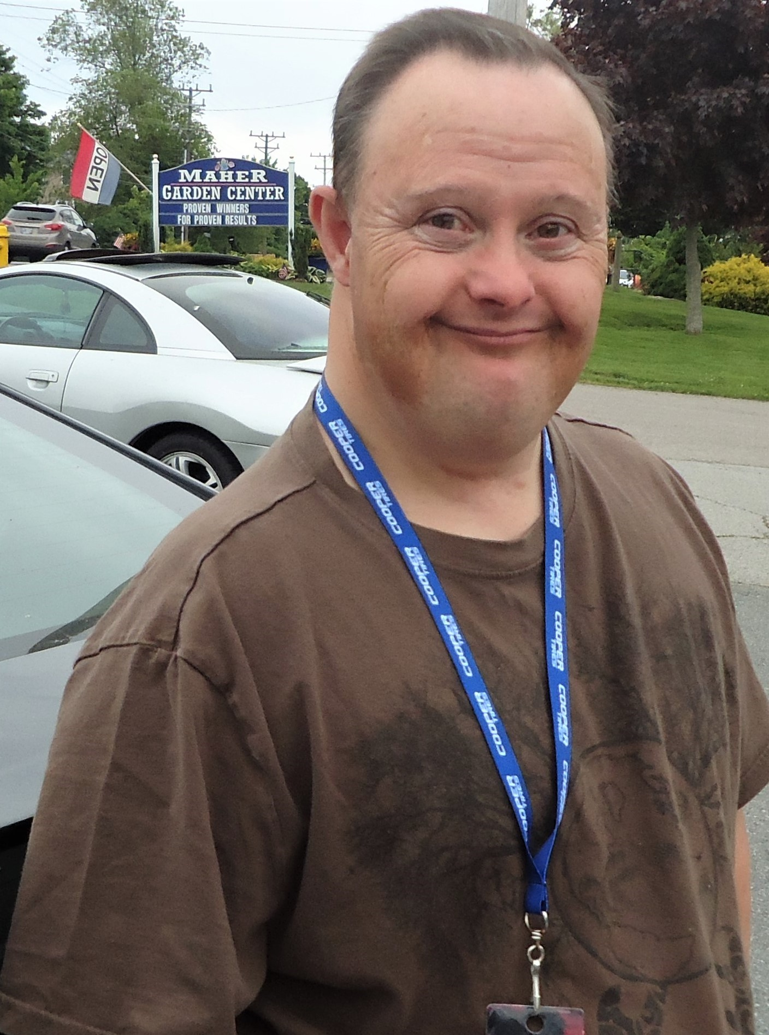
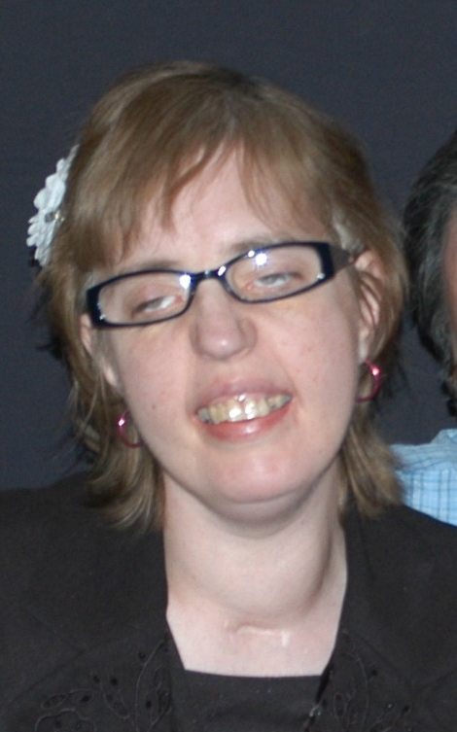
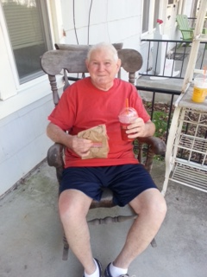
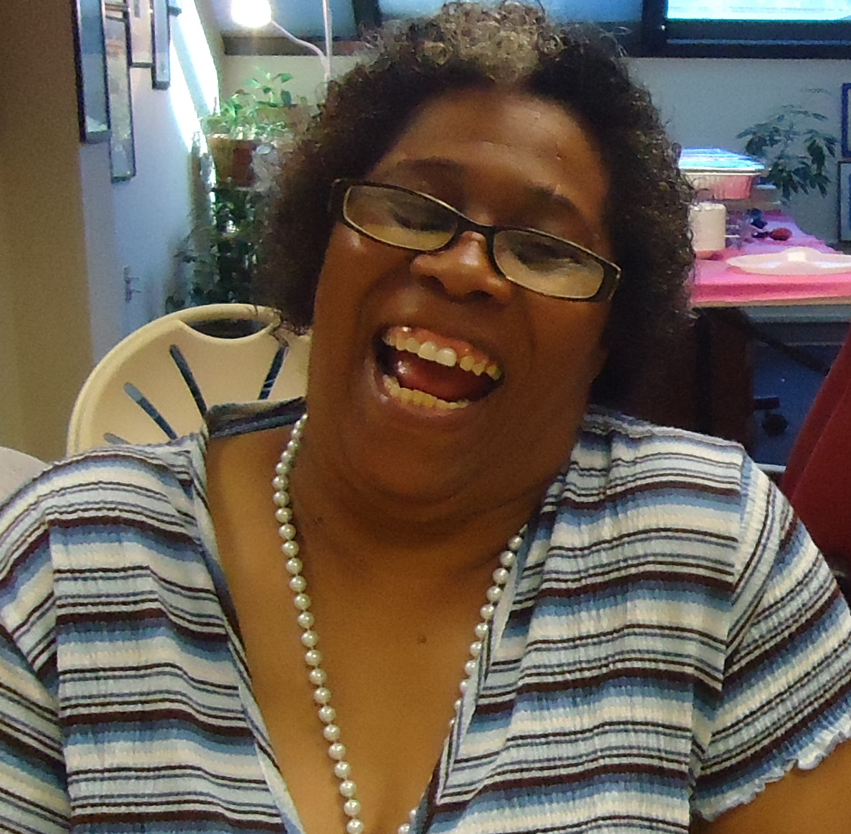

Slide 12
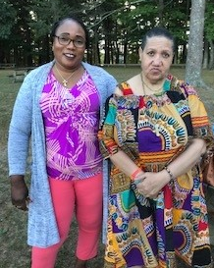
How do We Know That CCH Are Safe?
Rigorous approval process (Background checks, training, inspections)
Frequent communication with agency or DDS
Regular home visits
Extensive state regulations about quality of care
Regular financial audits
Medical monitoring by an RN
Behavioral supports in the home as needed
Licensing of each home and relicensing annually
Regular team meetings and reviews
Coordination of all supports by case managers

Slide 13
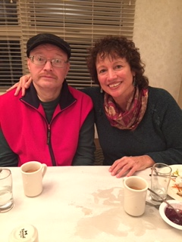
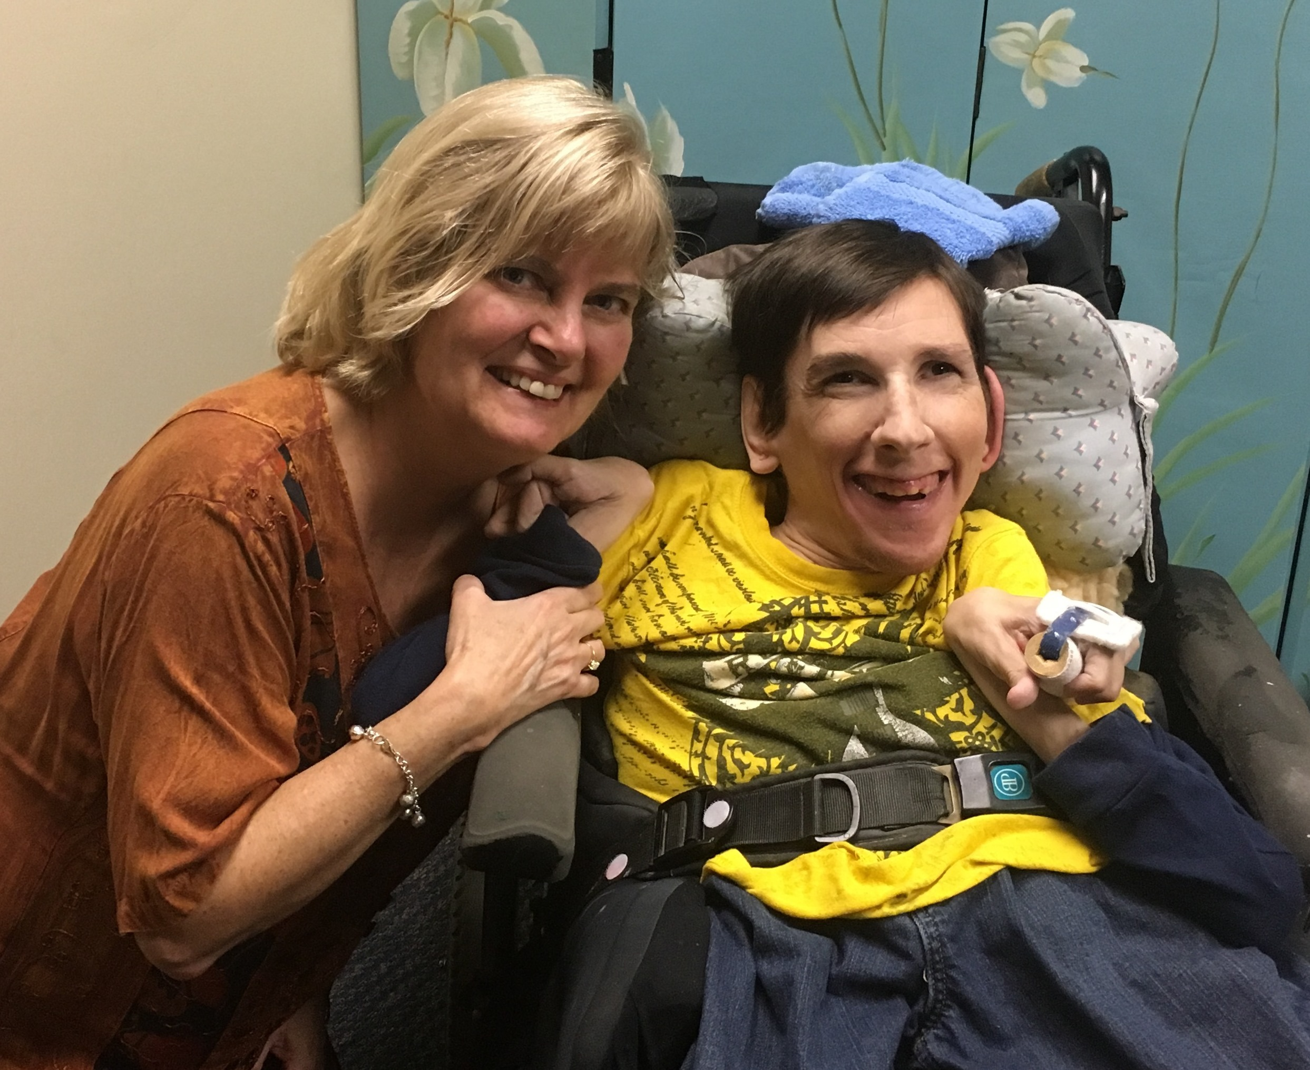
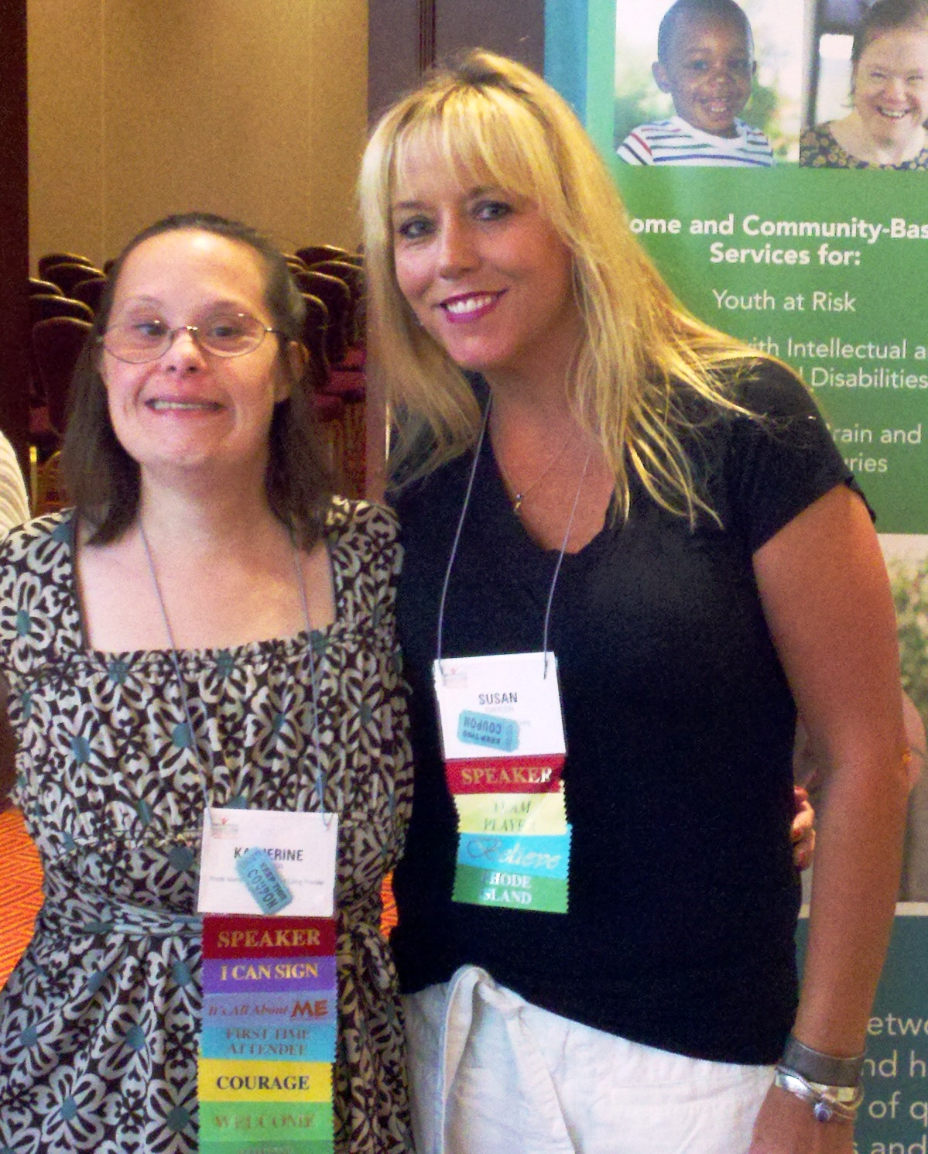
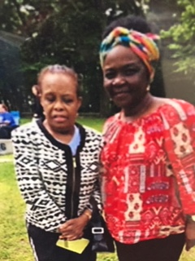
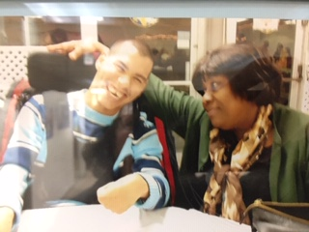
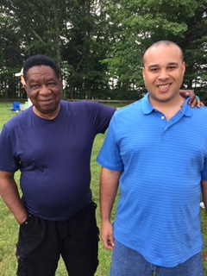
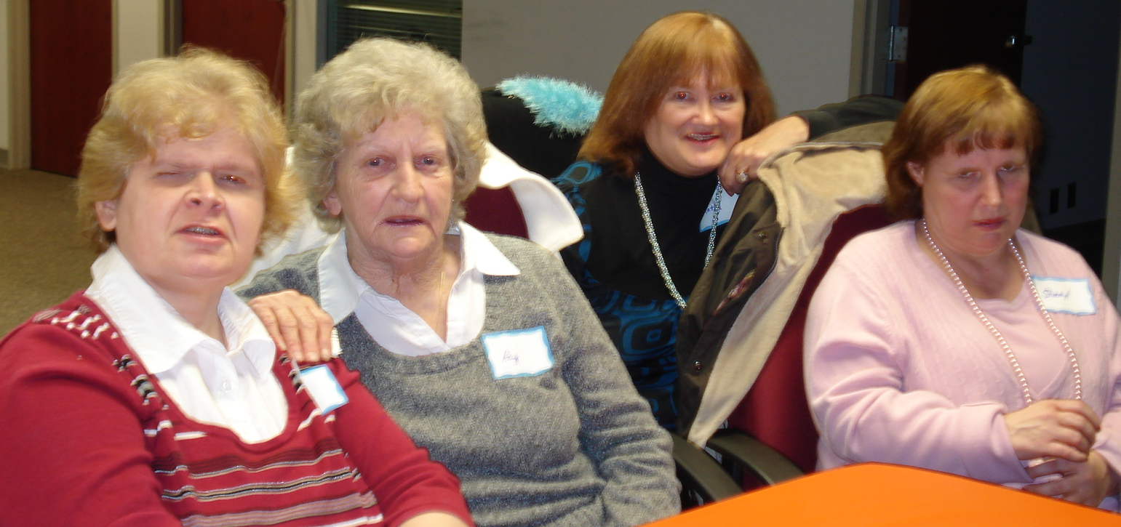

Slide 14
Who Can Live in a CCH –Anyone!

Slide 15
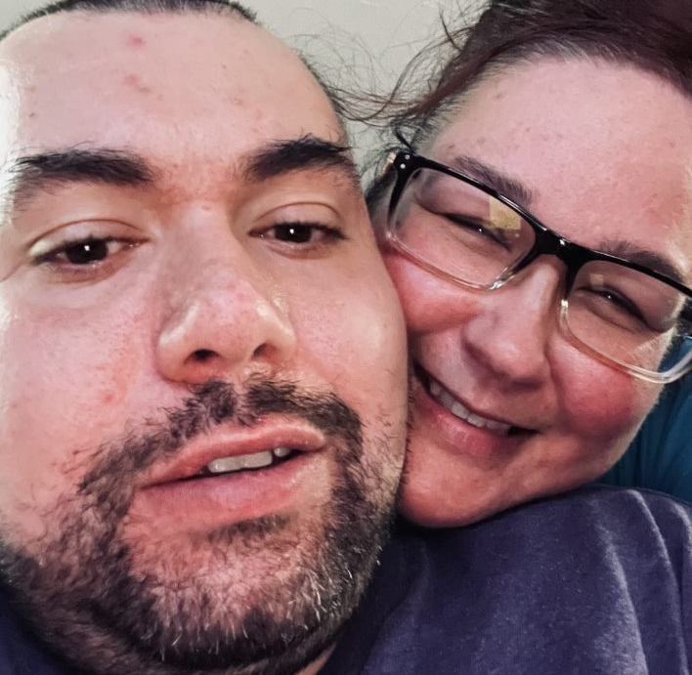
Challenges of CCH
No one knows about it!
People think Group Homes are the only option
Historic reliance on congregate care
People think GH are safer (not so)
People think CCH is foster care (not so)
Families think “If I can’t do it how can someone else”

Slide 16
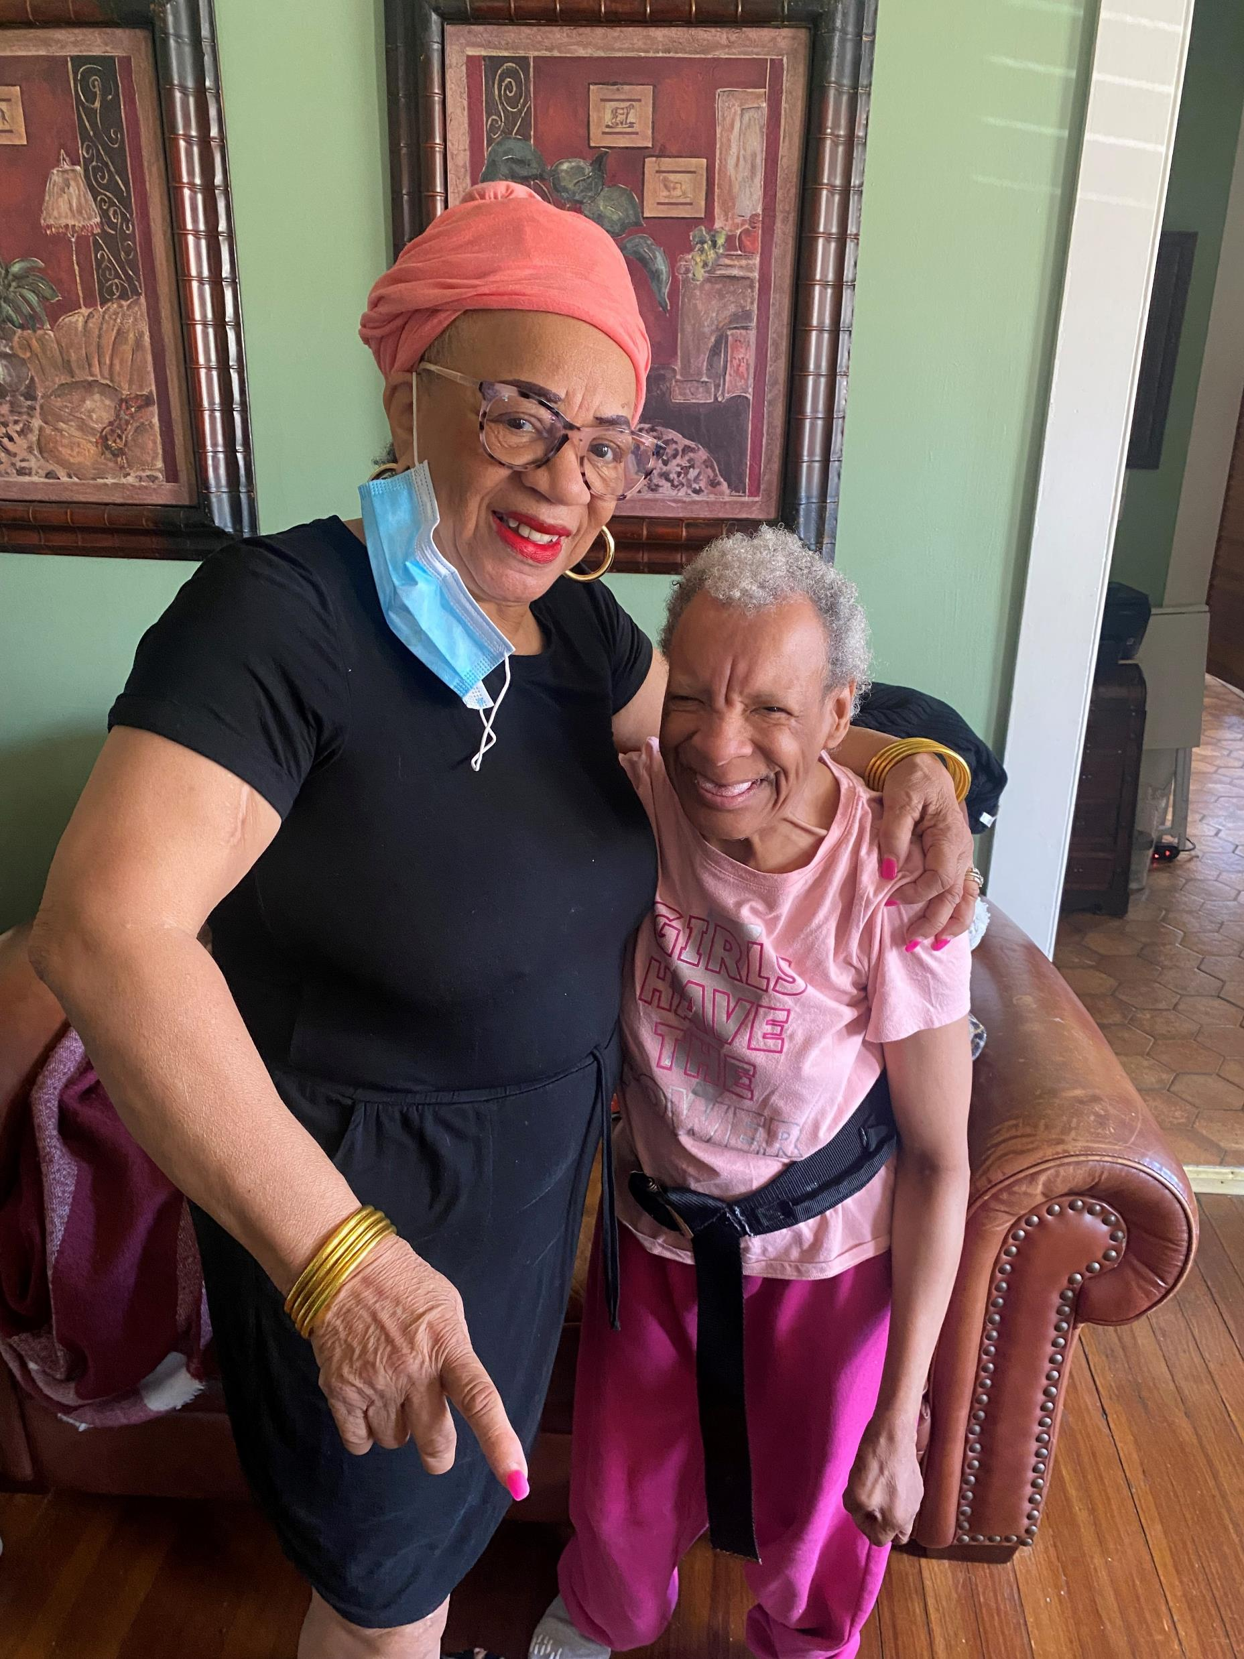
Challenges of CCH
Lack of information
Fear of unknown
Misconceptions i.e. – people with disabilities can only live with other people with disabilities “Peers”

Slide 17
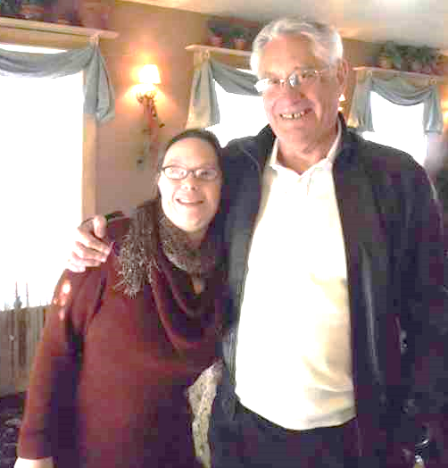
If The Family Can’t Do it How Can Someone else Provide Care?
Because you have done a great job!
Because adult children move from their parent’s homes
Because it is time for you to be a parent/family member not a care giver
Because your adult child will now learn from someone else
Because all CCH are licensed, qualified and trained by or to DDS Standards. They are closely monitored, compensated for care and have respite

Slide 18
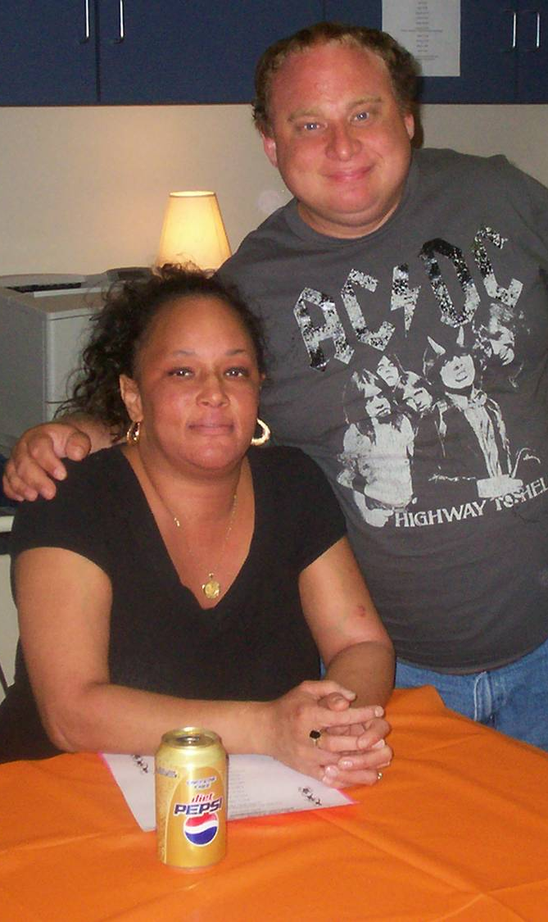
CLA vs CCH?
When asked why he liked living with Lisa (in a CCH) over living in a group home he stated;
“When I go to bed at night, Lisa is there. When I wake up in the morning, Lisa is there.”

Slide 19
Questions?

