Slide 1
Employment & Day Services
Connecticut Department of Developmental Services

Slide 2
Employment & Day Services - Overview
Day
Pre-Employment
Employment
Group Day Supports (DSO)
Senior Supports
Individualized Day Supports (IDS)
Vocational
Non-Vocational
Employment Transition Services (ETS)
Project SEARCH
Individualized Supported Employment (ISE)
Customized Employment (CE)
Group Supported Employment (GSE)
Notes:
Here is an overview of the different Employment & Day Services. I organized them into Day, pre-employment, and employment options. I did not include small business enterprises, but will briefly review that in the presentation as well.

Slide 3
Day Support Options
Group Day
Facility-based or appropriate community location
Services and supports provided in a facility-based program or appropriate community locations leading to the acquisition, improvement and/or retention of skills and abilities to prepare an individual for work and/or community participation, or support meaningful socialization, leisure and retirement
activities.
Senior Supports
Any community setting, including place of residence
Pre-retirement service designed to prevent isolation, assist in maintaining skills, and stimulate social interaction with others.
Notes:
Here are two of our day services, group day (DSO) and Senior Supports. Group Day Services are provided in a facility-based program or appropriate community locations. Group day supports are meant to lead to the acquisition, improvement and/or retention of skills and abilities to prepare an individual for work and/or community participation, or support meaningful socialization, leisure and retirement
activities.
Senior Supports is a pre-retirement service designed to prevent isolation, assist in maintaining skills, and stimulate social interaction with others. Participants in this service are generally 65 or who desire a lifestyle consistent with that of the community's population of similar age. The service can be provided to individuals under 65 when it best fits their needs.

Slide 4
Individual Day Supports
Individualized Day Supports (IDS) are offered in two forms: Vocational and Non-Vocational
Vocational (IDV)
Non-Vocational (IDN)
Overcoming barriers to employment
Maintaining skills
Community Participation
Meaningful retirement activities
Community -based, not in home or facility
Notes:
Two of our individualized day support options are Individualized Day Vocational and Individualized Day Vocational Non-Vocational. Both services are provided within the community or with a community partner and is not provided at a facility or home.
IDV - An individualized day service that enables you to overcome barriers to accessing, maintaining, or returning to employment.
IDN - An individualized day service centered around community participation and/or meaningful retirement activities.

Slide 5
Employment Transition Services (ETS)
Employment Transition Services is a time limited, community-based, vocational service with a focus on:
Providing career discovery and exploration
Skill development
Self-advocacy
The goal of ETS is to help individuals become equipped and ready for integrated competitive employment
100% Community Based utilizing:
Internships
Volunteer Opportunities
Participation in community activities
Where people may spend their time:
Employment exploration sites
Adult Ed Sites / Post-Secondary Schools
Job centers / Workforce Centers
Community Locations such as: libraries, health clubs, banks etc.
Time limited: 3 Year Max
Notes:
One of our newer services is Employment Transition Services (ETS). The service is time limited at three years and is meant to help individuals become equipped and ready for competitive integrated employment with different activities such as career discovery and exploration, skill development and Self-advocacy. The service is completely community based and uses a variety of formats such as internships, volunteer opportunities, and participation in community events.

Slide 6
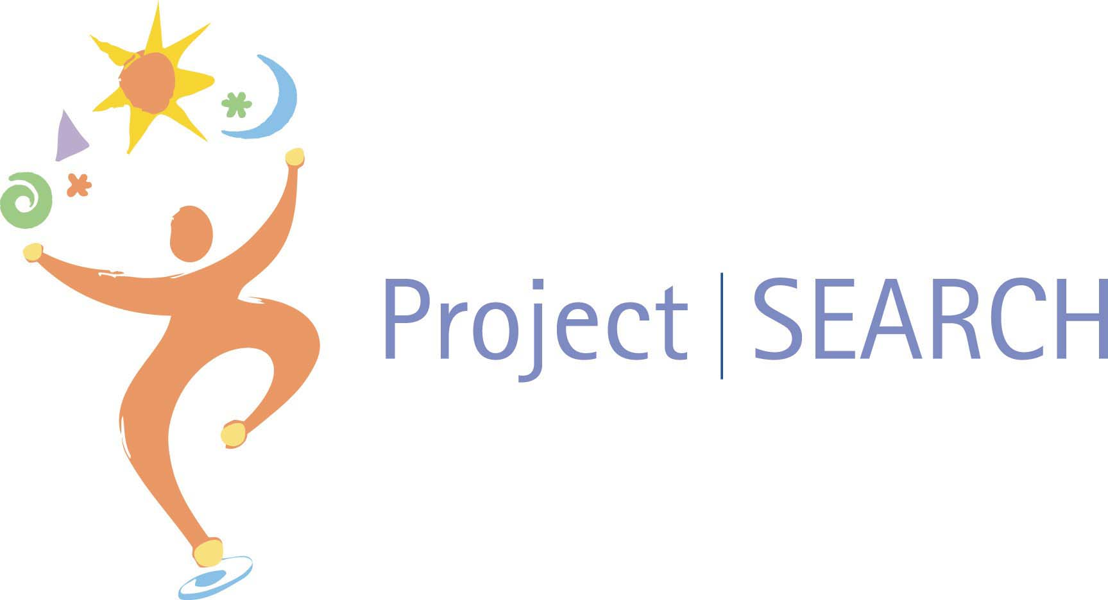
Project SEARCH
Project SEARCH is an internship training program, available to school transition age students and young adults eligible for DDS services, who need more intensive employment skills training.
Businesses across the state serve as Project SEARCH host sites with programs run by DDS provider agencies and school partners. The host business provides access to an on-site training room and access to business departments to provide 3 separate internship rotations.
The site is staffed by a special education teacher and up to three skills trainers to meet the educational and training needs of the interns.
There are 10 Project Search Sites in Connecticut.
9-Month Program
Notes:
Project SEARCH is a nationwide internship training program for school transition age students and young adults. There are 10 Project SEARCH sites in CT offering services to imndivdiuals who need more intensive employment skills training.
The Project Search model has different host businesses that serve as the host site and offers internship rotations in three different departments. The program gollows the school year and runs for nine months, allowing interns adequate time to rotate through each of the three departments at the business.
Connecticut has Project Search Programs at hospitals, universities, and other businesses such as a YMCA and Mohegan Sun.

Slide 7
Employment Supports
Individual Supported Employment (ISE)
Customized Employment (CE) Services
An employment specialist (job coach) helps find competitive employment through a job discovery process, provides training and support, and then gradually reduces time and assistance at the worksite.
An alternative method of finding competitive integrated employment that is highly structured, focusing on the strengths, skills, and abilities of the individual and the unmet needs of employers.
Group Supported Employment (GSE)
Small Business Enterprises
Supported employment in a competitive employment environment in which a group of participants are working under the supervision of a permanent employment specialist (job coach).
Individuals supported by DDS start their own small business enterprise, become competitively employed with a small business enterprise or receive on the job training from a small business enterprise.
Notes:
Here are the different employment supports offered by the division. The first, Individual Supported Employment (ISE) is a service designed to help an individual achieve employment through developing skills and interests, job procurement and ongoing maintenance support in keeping individuals employed.
Group Supported Employment (GSE) is a group employment model where individuals work in a competitive employment environment under the supervision of a job coach.
Customized Employment (CE) Services is an alternative method of finding competitive integrated employment that is highly structured and focuses on finding a job that meets both the likes, strengths, skills, and abilities of the individual and the unmet needs of employers.
Small business enterprises allow individuals to start their own small business enterprise or become competitively employed at a small business enterprise.

Slide 8
Resources
DDS Employment & Day Services Document
EDS Pathways Document
EDS Division Brochure
EDS Services Overview PowerPoint

Slide 11
