Slide 1
Navigating the Journey to Independence:
Assistive Technology at its Best

Slide 2

Shifts in Supports from group home living to living independently
Notes:
Pam

Slide 3
The Personal Support Team for the person drives the process
  works with the person to identify the community they want to live in
  Identifies the staffing supports needed in order to make sure this life choice is successful for them
  requests assessments including but not limited to an Independent Living Assessment; an Assistive Technology ; medical assessment by a health care coordinator; transportation and behavioral/clinical.
  Reviews outcomes of Assessments
  Makes recommendations
  Reviews programs
  Revises services as needed

Slide 4
What Options are currently available
Community Living Arrangement
Community Living Arrangement Apartments
Continuous Residential Supports
Shared Living
Cluster – Individual Home Supports
Individual Home Supports- own Apartment
Individual Home Supports – Family Home

Slide 5

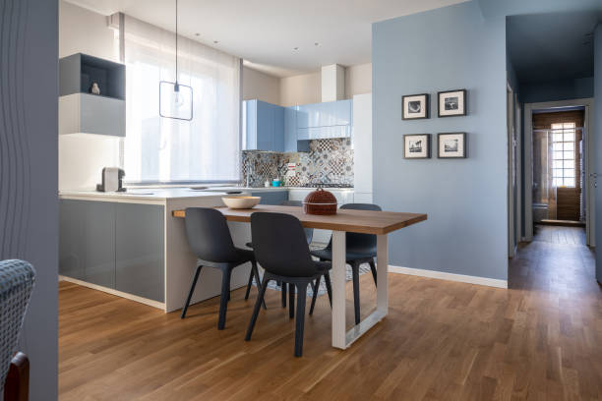
In Home Supports
Own
Apartment
Family
Home
Cluster Apartments
Notes:
A support provided to people living in their own apartments or in their family home or in a cluster

Slide 6
Own Apartment
Notes:
In the community they choose
In an apartment that is available and they can afford
All supports are designed around the person using the information from the assessments, person, family and team input
Supports can included
Direct Support Staff
Assistive Technology
Community Resources (home health care aide)
Natural Supports (families and friends)
Can have a roommate or live alone
Depending on their Level of Need each person is provided a set number of direct support hours – these hours are set by the same indicators just mentioned the assessments, person, family team input and by need. These set hours can be changed at anytime to meet a new need identified.

Slide 7
Family Home
Notes:
Provided in the family home
All supports are designed around the person using the information from the assessments, person, family needs and the individuals needs with some team input
Supports can included
Direct Support Staff – the staff must work within the family dynamics
Assistive Technology
Community Resources (home health care aide)
Natural Supports (families and friends)
Respite Supports
Family Grants
Depending on their Level of Need each person is provided a set number of direct support hours – these hours are set by the same indicators just mentioned. These set hours can be changed at anytime to meet a new need identified.

Slide 8

“Cluster”
Notes:
Is located in the “Cluster Setting”
Cluster living is when people are living in individual apartments located throughout an apartment complex or a close geographic area.
The Cluster Service provides each person with the right amount of supports based on their level of need including an overnight staff located within the complex/area to monitor all the apartments through the use of assistive technology and respond to their needs either in person or through virtual supports (audio and/or video).
All supports are designed around the person using the information from the assessments, person, family and team input
Supports can included
Direct Support Staff
Big difference from living in your own apartment is that an overnight Staff is available in the vicinity/complex to monitor all the apartments through the use of assistive technology
and respond to their needs either in person or through virtual supports (audio and/or video).
Assistive Technology
Community Resources (home health care aide)
Natural Supports (families and friends)
Can have a roommate or live alone

Slide 9
Assessments
An Independent Living Assessment
An Assistive Technology Assessment
A medical assessment by a health care coordinator
A transportation assessment usually done by the Kennedy Center
A behavioral/clinical assessment if needed
Risk Assessment
Notes:
Independent living process includes a series of assessments including but not limited to an Independent Living Assessment and an Assistive Technology Assessment, medical assessment by a health care coordinator, transportation and behavioral/clinical.

Slide 10
How are Supports Provided
As with any independent living program the intent of the program is not to do things for the person but to encourage them to be as independent as possible and to connect them to the resources needed to enable and encourage them to be as independent as possible. The staff is to be a resource, mentor and community connector.
Notes:
Kat explain
Take away their label “disability” and they would be making their own choices and taking risks, it shouldn’t be any different
It is the little things that we take for granted everyday that the people we serve want to feel and experience as well
It is their home, respect their privacy and space
We are their to aide them, teach them, support them where they may struggle. We are not there to do tasks for them, or take away their abilities and rights
We are their to help them be as successful and independent as possible
Nothing about them without them

Slide 11
Benefits, Resources and Funding available for independent living?
Rent Subsidy/Housing Subsidy
DSS Snap/Cash benefits
Heating assistance, if needed
Food assistance such as food banks.
Transportation training
Identification of security deposit funding (including loan requests)
Identification of furniture and household needs funding $1,500 one time available
Pharmacy and doctors if needed to be relocated from their previous residence
Hiring and training of staff
Procurement, installation and training of assistive technology
DDS Waiver $, Community First Choice or other funding for staff and services
AT Assessment
Assistive Technology and monthly fees
Notes:
There is a series of services and supports that must be set up for each person entering into this service model. These services and supports are individualized and take time to be set up properly. These Services include

Slide 12
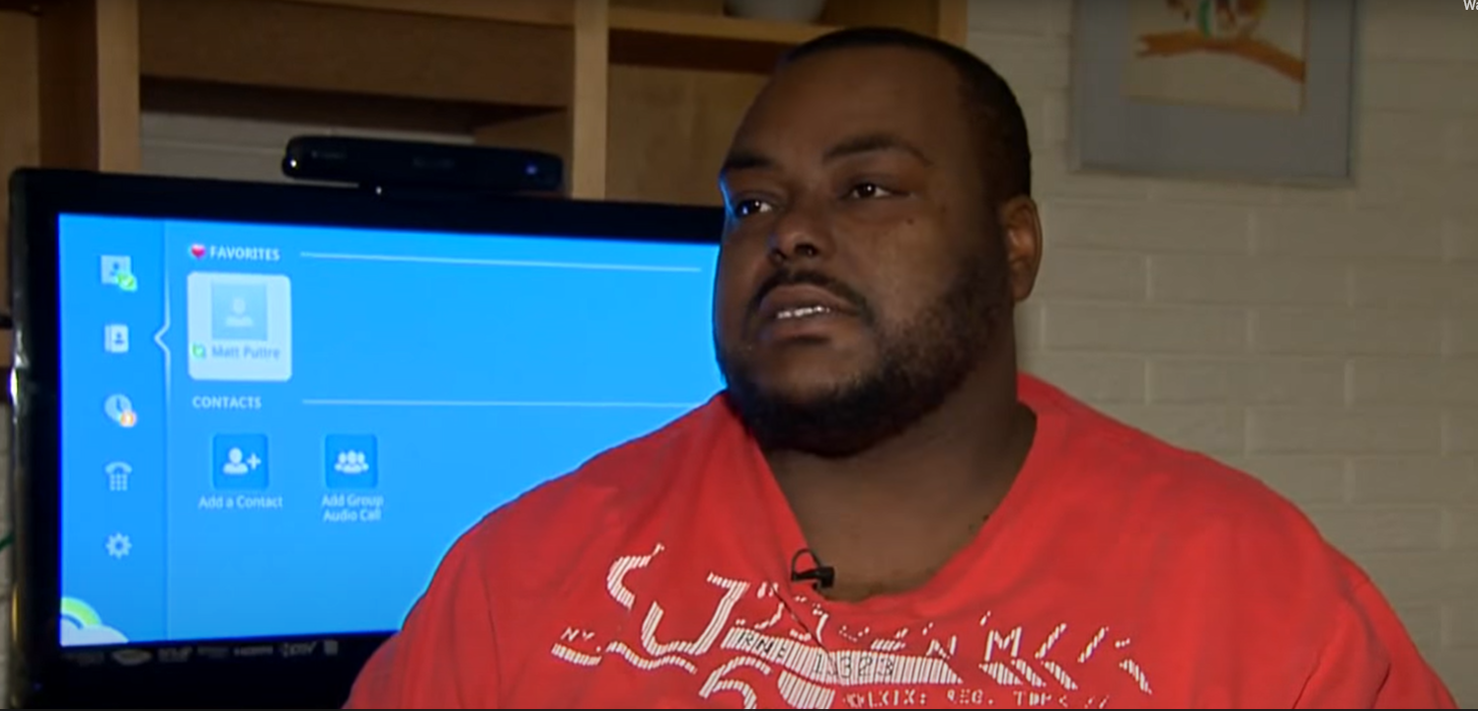
Raymond
Notes:
Pam,
So we got started on this journey in 2014 with Raymond
Tell his story
Raymond’s services in a group home setting was costing 110k per year. Once it his apartment including the assistive technology his service costs decreased to 43k
Play his video once you hit play hit the button for closed captioning.

Slide 13
Assisted Technology
refers to any "product, device, or equipment, whether acquired commercially, modified or customized, that is used to maintain, increase, or improve the functional capabilities of individuals with disabilities."

Slide 14
High Tech
to
Low Tech
Notes:
Jar opener
Pencil grip
To eye gaze systems

Slide 15
The types of Technology used to support independent living
Remoter monitoring systems such as the ARMS system
  Sensors
  Camera
  Door locks
  Video doorbells
  PERS
  Smart lights
  Thermostat
  Smoke/carbon detector
  Smart blinds

Slide 16
AT Continued
Med minders/Livi
Cook stop/iGuard
Safe-T-Sensor – for the microwave
Claris companion/continuum
GPS Tracking
Voice assistance such as Alexa and Google Nest.
Automatic door opener
ADA modifications
Kitchen and Bathroom assistive technology

Slide 17
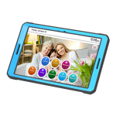
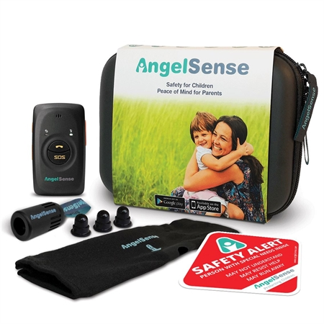
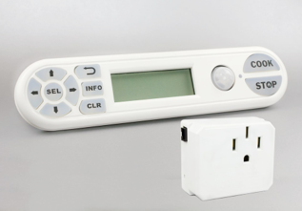
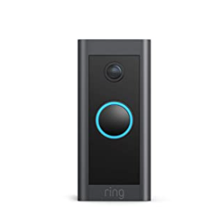
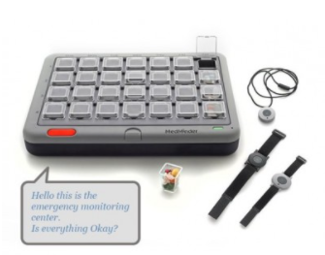
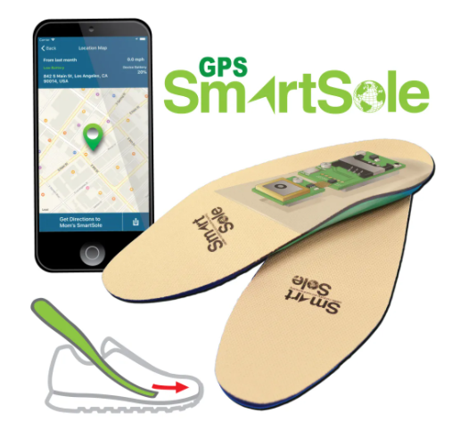
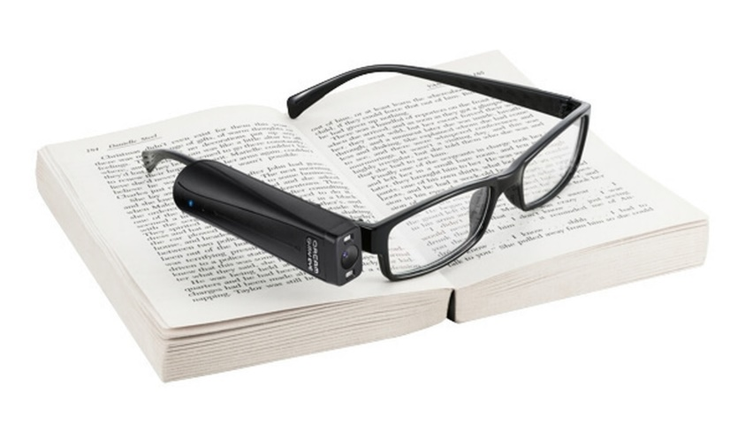
Types of Commonly Used Tools For Independent Living
Notes:
Pam
Remoter monitoring systems such as the ARMS system
Sensors
Camera
Door locks
Video doorbells
PERS
Smart lights
Thermostat
Smoke/carbon detector
Smart blinds
Med minders/Livi
Cook stop/iGuard
Safe-T-Sensor – for the microwave
Claris companion/continuum
GPS Tracking
Voice assistance such as Alexa and Google Nest.
Automatic door opener
ADA modifications

Slide 18
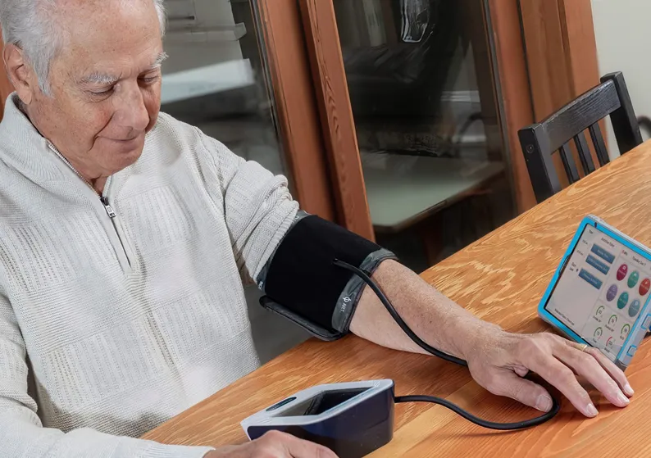
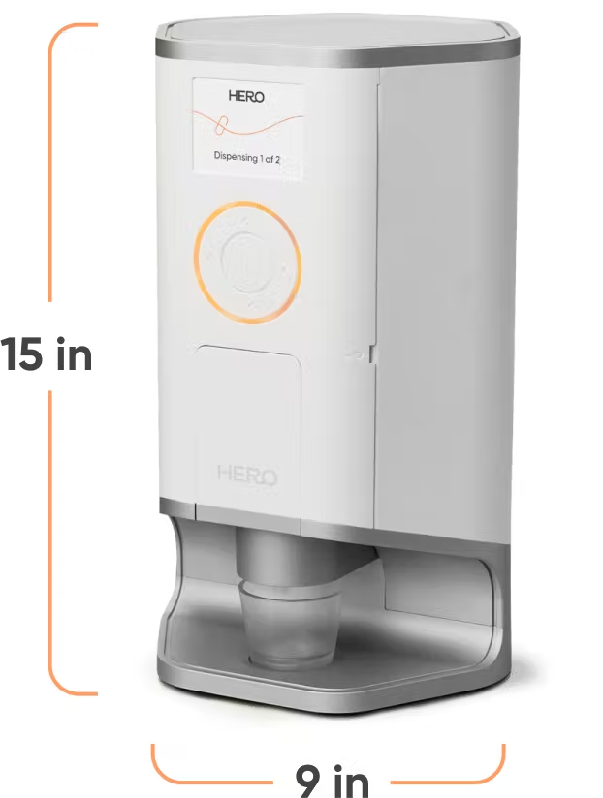
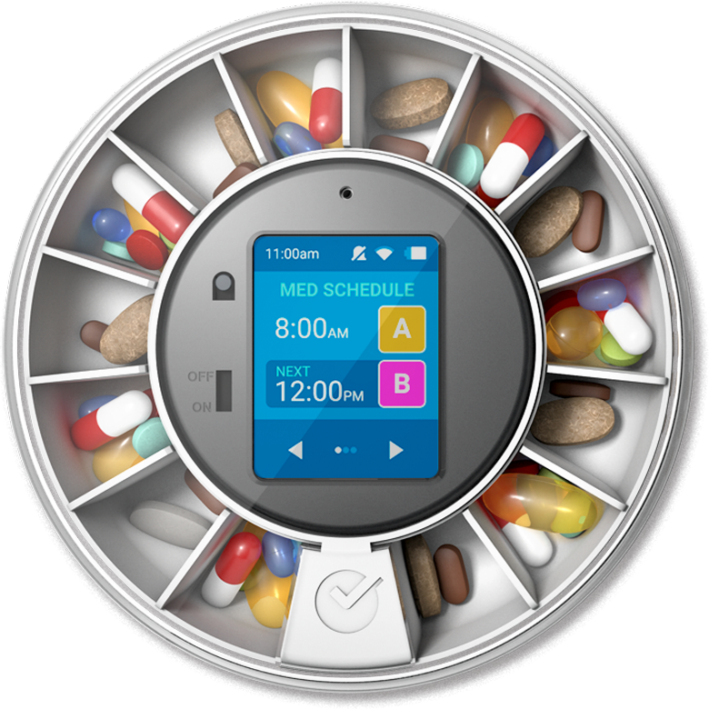
Health
Medication Administration Dispensing Devices
  Hero, Dose Flip, MedReady
Measuring Health Indicators – monitors for weight, BP, Glucose, and temperature;
Telehealth
Notes:
Pam
There are a variety of other med dispensing devices Hero, Dose Flip, Med Ready, Livi,
There are devices such as the
Claris Continuum
The Continuum has Bluetooth enabled devices such as a thermometer, weight scale, pulse ox, and BP machine. All the results are updated on the Admin Portal to review and export any data
This software allows you to create a button on the device for the next upcoming telehealth medical appointment to make telehealth easier.
Tele health is set up on any smart communication devices, phones, tablets or computers they are individualized for the persons medical provider.

Slide 19
Food/diet control a continuum of service options
Hestan Cue Cookware
Cooking Classes and smart pans
June Oven
Meals
-on-
Wheels
Independent Cooking
Notes:
Pam

Slide 20
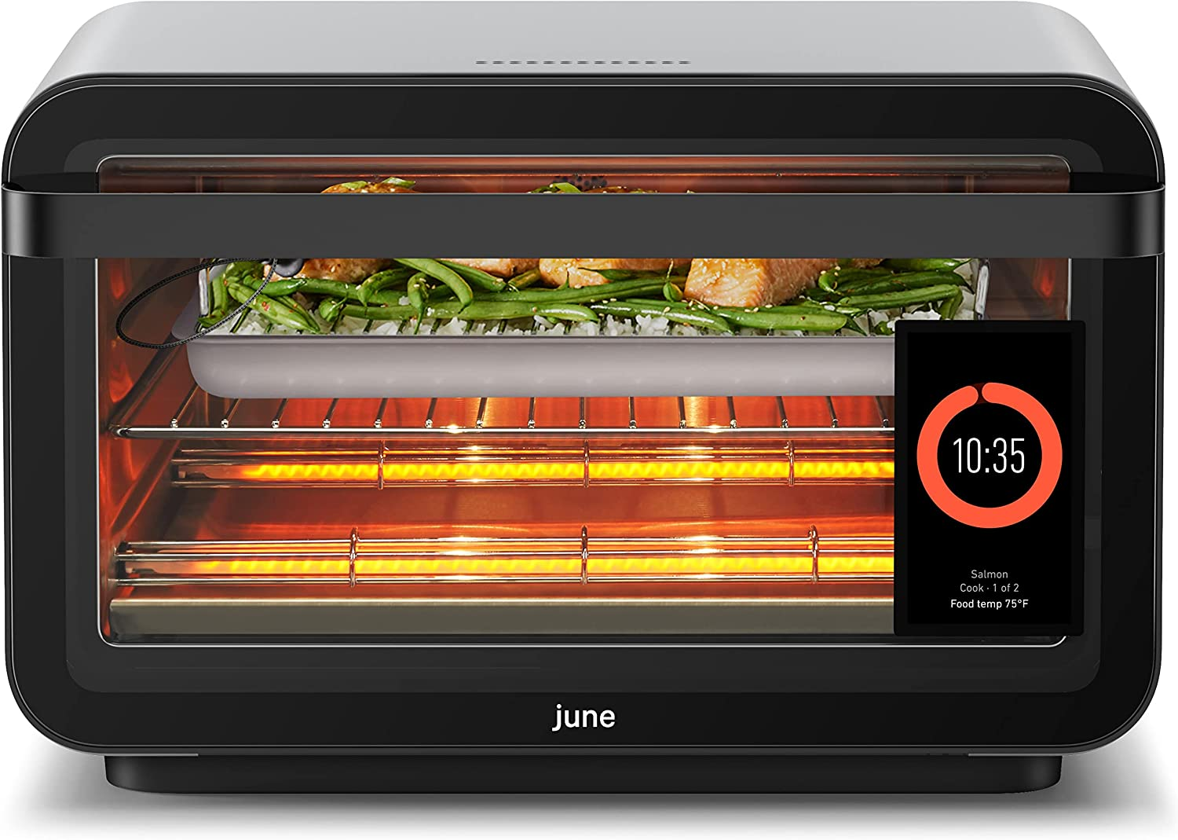
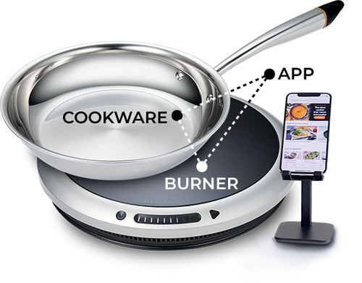
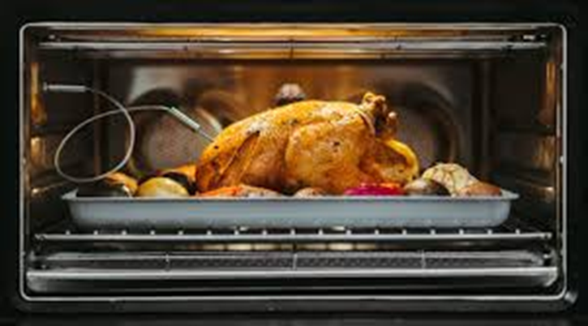
Food/diet control a continuum of service options
June Oven
Hestan Cue Smart Cooking System
Notes:
Pam

Slide 21
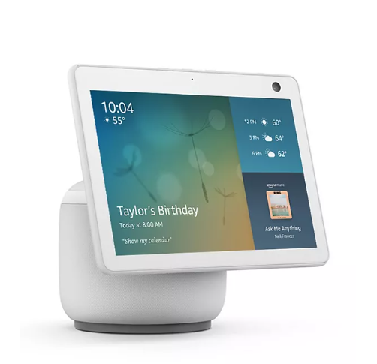
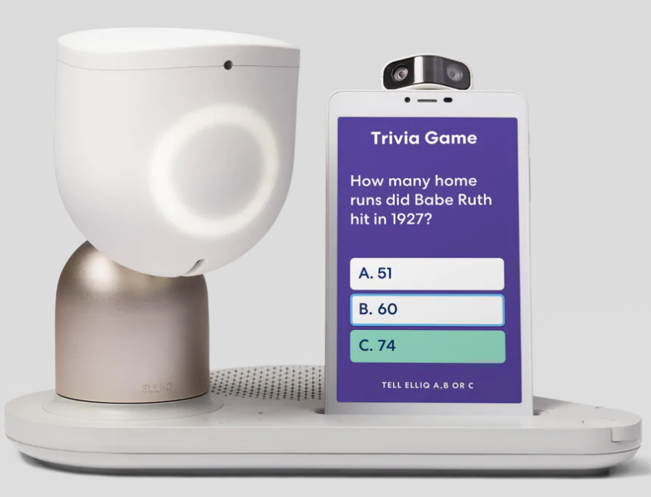
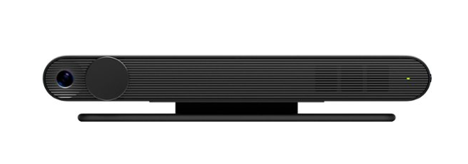
Social Communication
Being able to connect with others
Notes:
Pam
For social communication there are a variety of APPs:
Meet up app…..
Whats app
Face time
imessage
Video Communication Devices
Claris Continuum
it’s known for its easy to use video calling feature that has been a great option to reduce social isolation during this these tough times. It has been updated to include a Zoom meeting option as well to allow someone to join a zoom meeting with the press of one button.
Facebook Portal
Smart Speakers – some have safety controls or avoid risks
Echo Show (Drop in)
Nest Hub
Zoom
Skype
Face book portal
ElliQ – companion app for people 65 and older (hopefully soon to be for all) engages people throughout their day, learns about them and incorporates that knowledge in questions and check ins. Does regular health check ins and will alert someone if things don’t seem right.

Slide 22

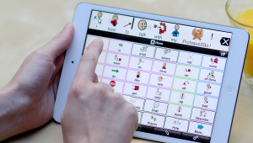
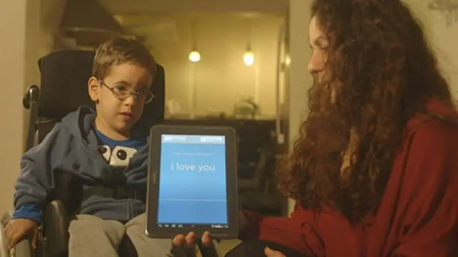
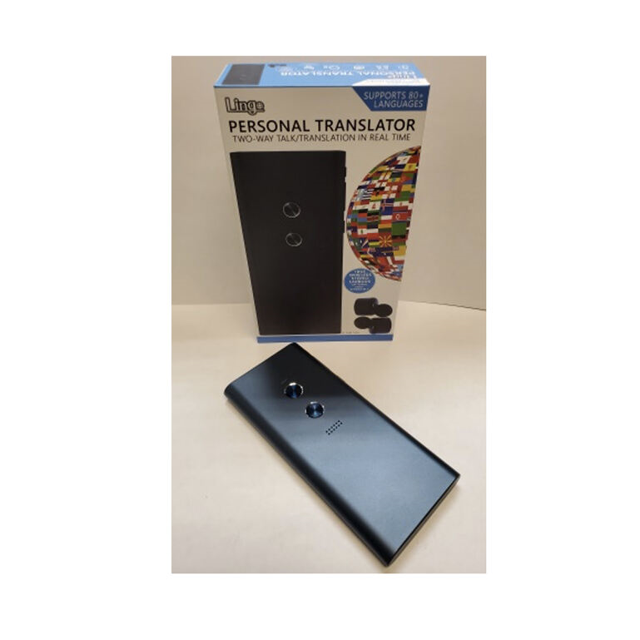


Communication barriers/ speech issues
Voiceitt
Proloquo2go
Google Relate
Look to Speak
Eyegaze APP
Lingo Personal Translator
Text to voice
Notes:
Amy
GoTalkNow
ProloQue2Go
App for eyegaze ability….Look to speak
Eyegaze Edge
Captel phone
Voiceitt
Google – Laurie Dale

Slide 23
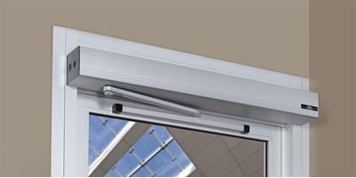
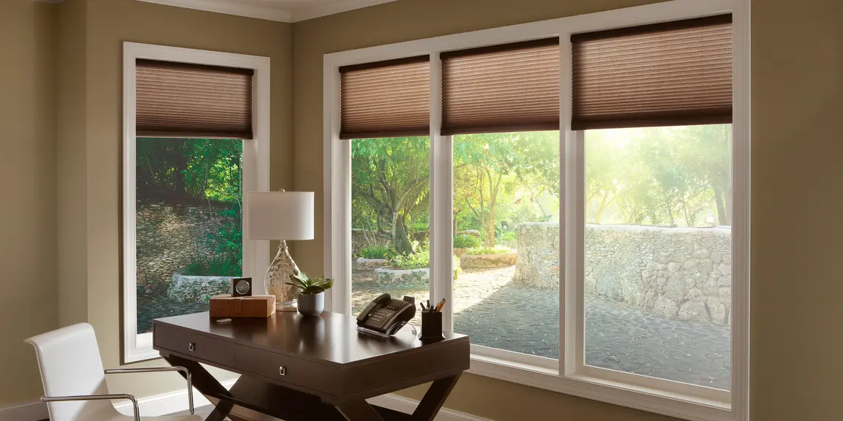
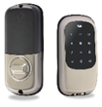
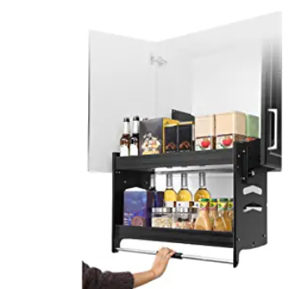
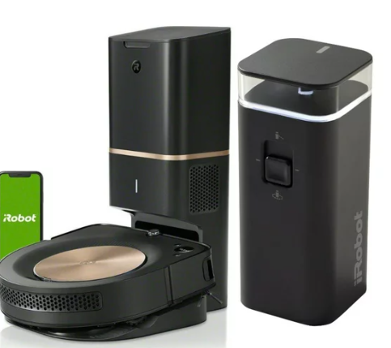
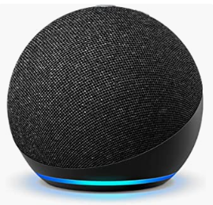
Physical barrier issues
Smart locks
Automatic door opener
Smart blinds
Smart speakers to control your home
Smart vacuum
Pull down shelves
Notes:
Amy
Entry solutions
Automatic Door Openers
Key fob
Verbal and eye gaze control of environment
Smart speakers
Eye gaze system
Typical AT to Address barrier issues
Low cabinets/heights of devices and items
Roll in showers
Wider doorways and hallways
Safety rails etc….

Slide 24


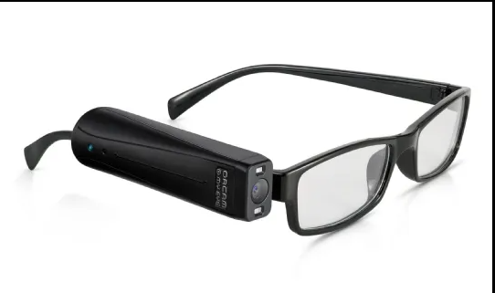
Vision
Blindsquare navigation app
OrCam My Eye
Notes:
Amy
OrCam My Eye
OrCam Read
Cyber eyes
App for eyegaze feature Lookout
Typical AT such as
Specialized keyboards
Built in accessibility features on devices

Slide 25
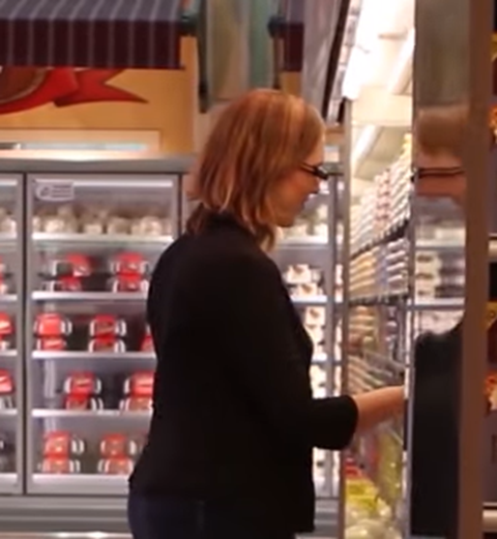
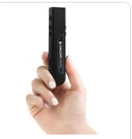
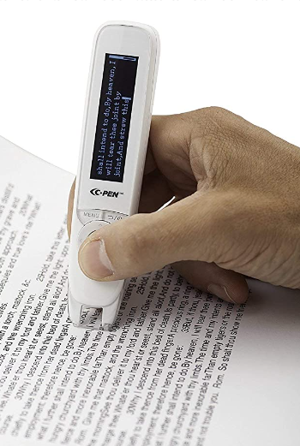
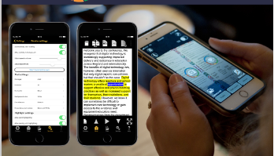
Literacy
OrCam MyEye
And OrCam Read
Reading pens
KNFB Reader
Notes:
Amy
Orcam read
Translation devices
KNFB reader
Electronic books
Audible
Library for the blind
Kindle
Bookshare
Reading rockets
Cooking Apps that are verbal
Accessibility features on devices to read out loud

Slide 26
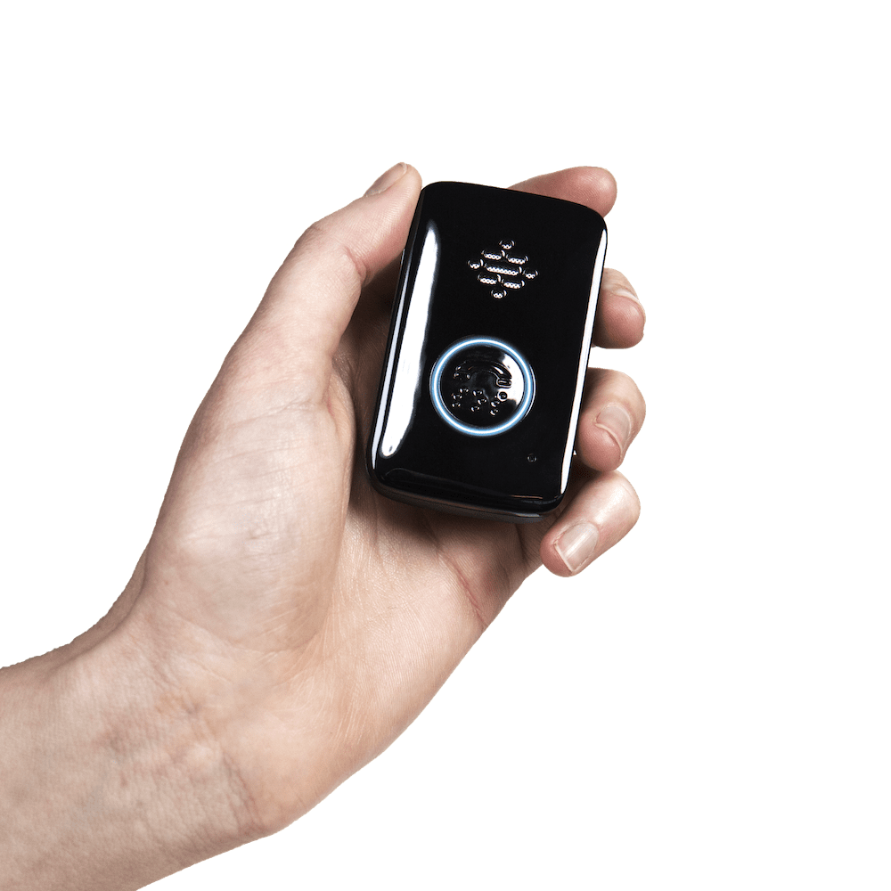
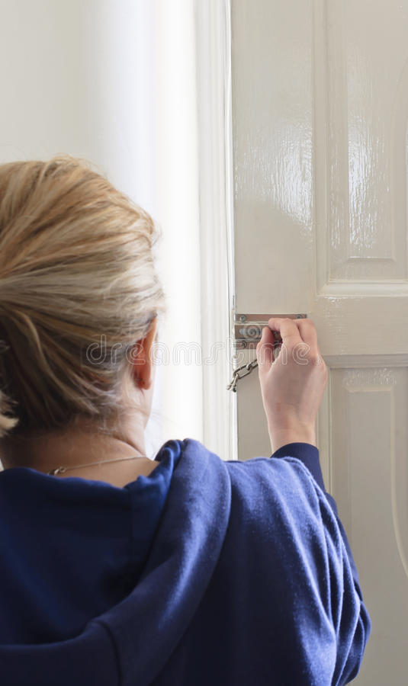
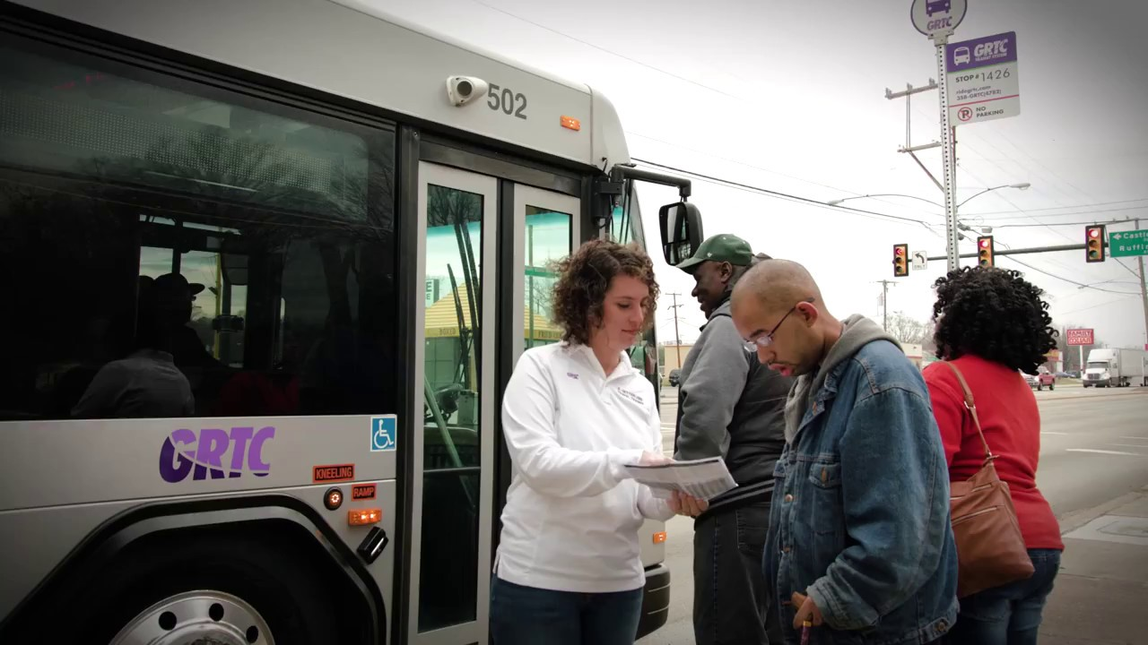
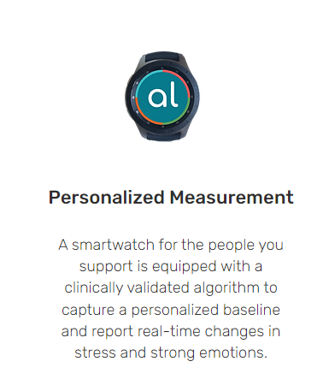
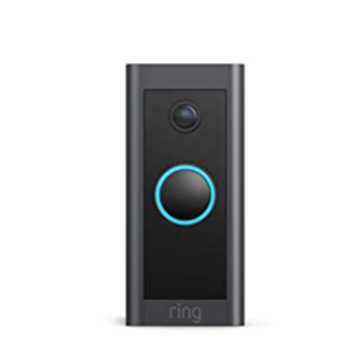


Risks
PERS
Notes:
pam
PERS:
Belle
Stranger Danger
Video doorbells
Role playing/education
Angel sense – listening in
GPS Tracking – This device allows you to know someone's location, it has a call feature to call anyone connected to the device, and an SOS feature that allows us to help someone when they are in the community or at home
AngelSense/
gps soles/
watches, phones..
Smart B,ZT Clothing and Patches
At this point Cyber Safety (exploitation, stalking) is extremely difficult to “TECH UP”
Parental Controls
Training and education
Role playing

Slide 27
Remote Monitoring services
ATECH Remote Monitoring Service - ARMS
Assistive Living Technologies
Rest Assured
GrandCare
Sengistix
Night Owl Support Systems, LLC (NOSS)
Simply Home
SafeinHome Used in Mass Now.
THS
Ladd
Medforall
WYNN-REETH, INC.
NextGenAT
Notes:
Pam
There are many different remote supports options for independent living not all are available in every state
Most RMS are similar in what they offer and the devices used. During this presentation We are going to walk you through the ARMS system which we are familiar with

Slide 28

Notes:
Pam
ATECH Remote Monitoring Service
This unique solution gives agencies and/or families the choice of contracting out for the entire remote monitoring process or using a system and providing the staff to monitor the alerts and respond to them themselves

Slide 29
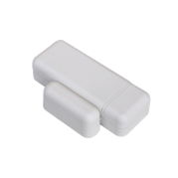
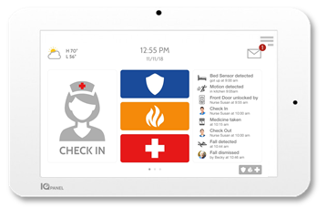
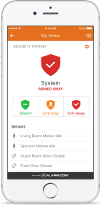
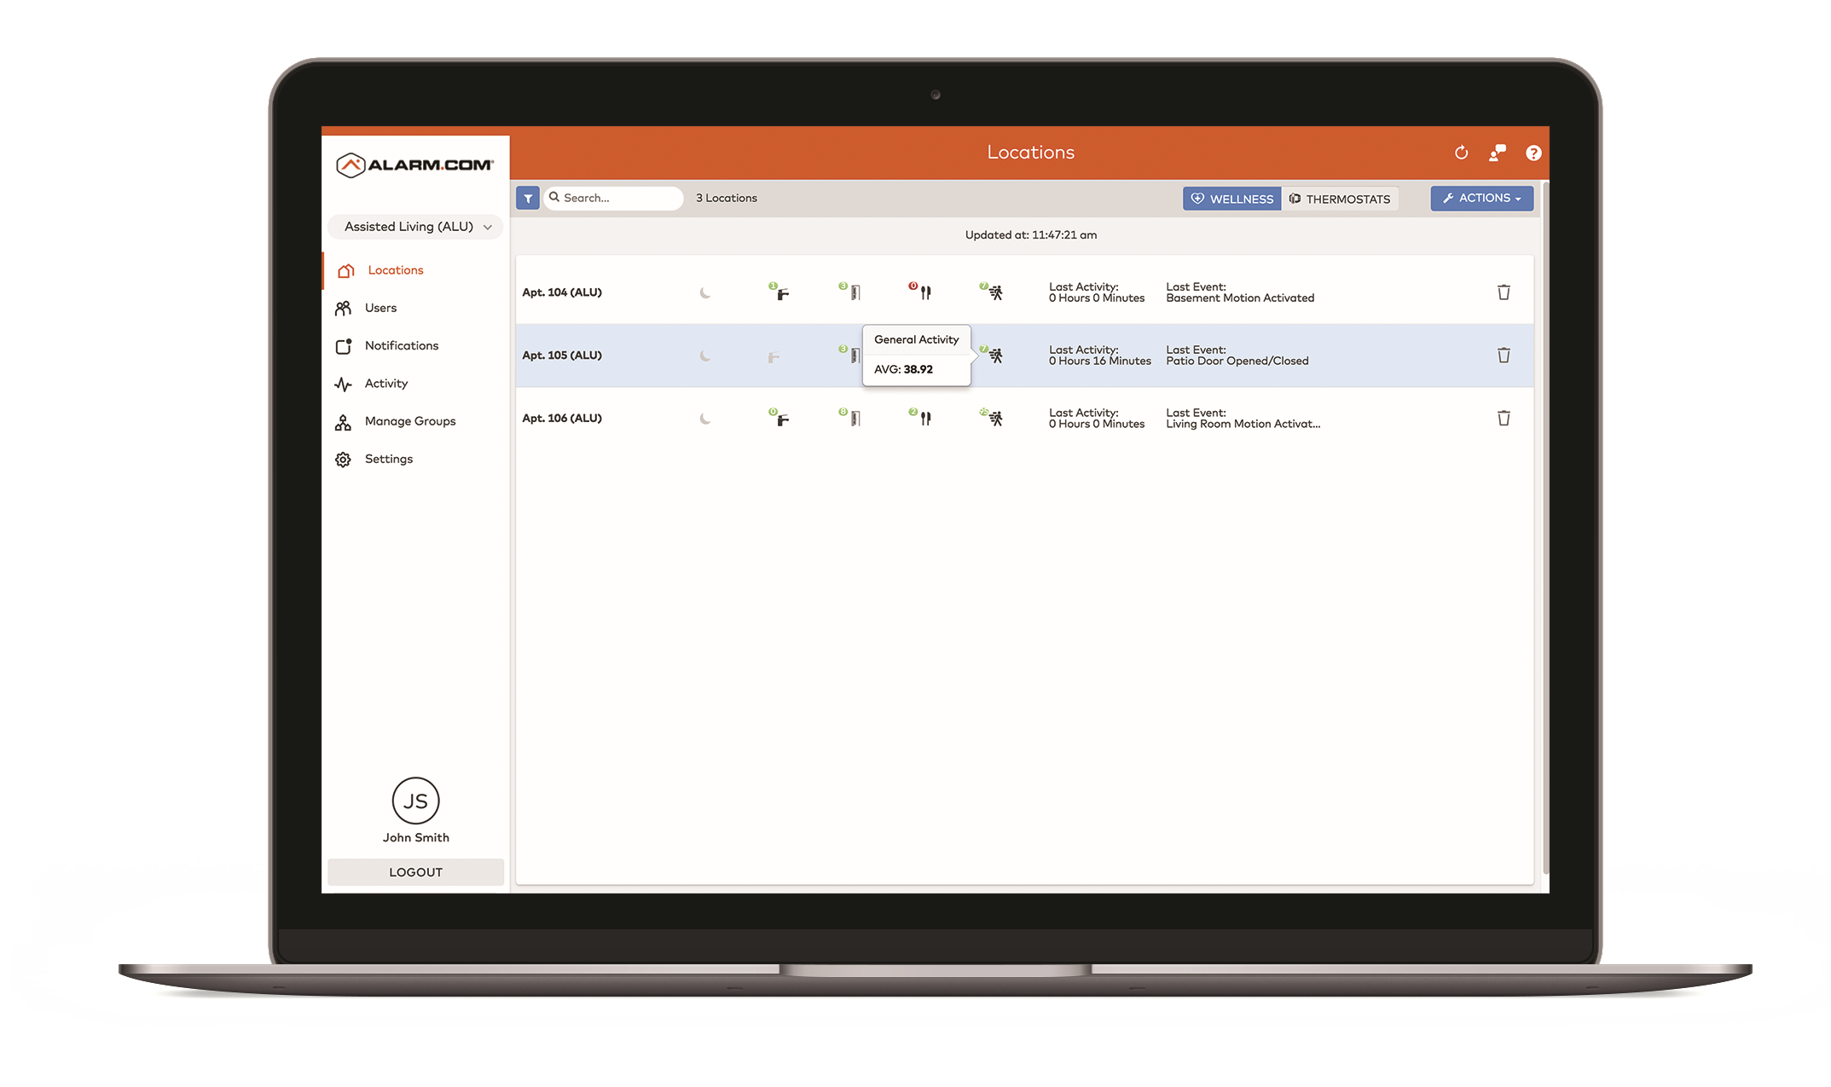
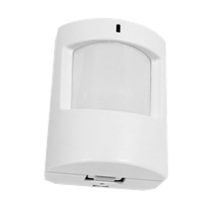
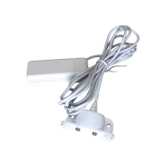
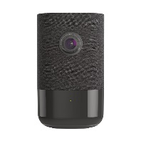
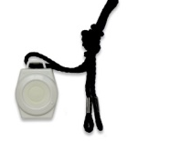
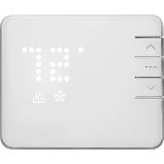
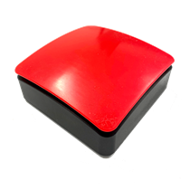
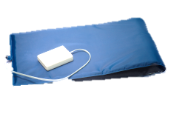

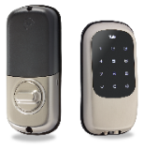
Independent
Living
Solution
Fundamentals/Base Bundle
Security and Awareness
Door/Window Sensor (x2)
Touchscreen Panel (x1)
Wireless Sensor
Motion Sensor (x1)
Wireless Sensor
Mobile app and
Enterprise Dashboard
Asset Protection:
Energy and Water
Additive Services: Personal Emergency, Peace of Mind and
Concierge Care
Water/Flood Sensor (x1)
WellcamTM 180°
(x1)
Fall Detection
Emergency
Wearable
Wireless Sensor
Smart Thermostat (x1)
Stationery Emergency Button ( x1)
Bed
Sensor (x1)
Smart Light Bulb (x1)
Smart Door Lock (x1)
Notes:
Pam
The system is pretty simplistic – and utilizes artificial intelligence fed from a multitude of sensor or touchpoint devices
These are the devices that connect directly to the system as stated before there are others that work along side the system

Slide 30
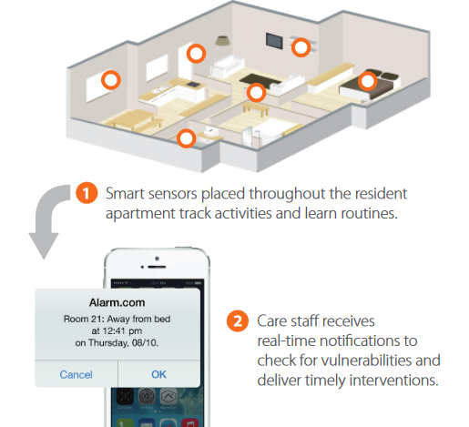

How System Works
How Enterprise Wellness
Notes:
Marisol
For the Arms system A Security company that is contracted through ATECH Installs the devices that have been identified; ATECH sets up the dashboard and trains the staff and management on how use the system; The person who is responsible then receives the alerts and the dashboard is available for management, clinical staff and administration to track trends for level of care planning

Slide 31










ONE PLATFORM SUPPORTING YOUR ENTIRE Independent Living DEPARTMENT
One Platform, Secure & Private
Lock
Light
Thermostat
Camera
Garage
Water
Security
Wellness
BRAND A
BRAND B
BRAND C
BRAND D
BRAND E
BRAND F
BRAND G
BRAND H
Notes:
CLICK TO ANIMATE
Pam
For the pieces that work inside the arms system you only need a single platform ( hit the button to merge the slide ) to manage and control the products and they can be controlled from any device (phone, table or computer)
For an agency you can control multiple systems and people from the same software

Slide 32




Wellness Trends and Behaviors
Routines and Trending Analysis
How Enterprise Wellness Works
See activity trends
in the homes
Behavior profiles
compare each day
Colors indicate changes in behavior
Notes:
Pam
Administration and clinical staff can access different views and reports to analyze trends and behaviors

Slide 33

Sabrina and Mom

Slide 34

Assistive Technology can help us stay healthy and safe, all while living the most independent lives possible.
Notes:
Amy
…. ATECH is one of the resources to ensure agencies are positioned to achieve these outcomes
What we can do for you
Members
Consultation
Assessments –
Teaching and training

Slide 35
Q & A - Reach Out To ATECH
    Amy@AssistiveTechTraining.org
    Pam@AssistiveTechTraining.org
    Visit
    www.assistivetechtraining.org
Notes:
Amy
Thank you for your time today. We hope that you will reach out if you have any questions or would like to learn more about how you can help increase independence for the individuals you support.

Slide 36





SUCCESS
STORIES
*10 people living independently with Assistive Technology
*1 person in the family home with Assistive Technology
Notes:
Pam
We talked about Raymond…he is more someone you would expect to live independently…Now lets talk about Morris….Morris & Annie
Both individuals lived in in a 24 hour setting
Morris In the group home he stayed in his room for the most part and just came out to ruffle feathers and see who was on shift
Since he did not have any behaviors that would prevent independent living the team felt he may be able to learn to live independent
We met with the family and team and after great discussions and a through mapped out plan
We install assistive technology into his group home to begin a series of trials Trials that addressed all the issues that his family and team thought would prevent him from being successful.
Arms system, artificial intelligence that learns a persons movement through a series of sensors on doors, windows cabinets, pads on the bed to detect if they are in or out of bed, cameras in the common areas, cook stop for the stove, med minder and a Claris companion for video chatting;
Did 6 months of trials starting when he came home from the day program. Did evenings, then overnights and then weekends
Part of the process was to make a list of all the concerns the team had and test those and more.
Visitors,
Phone calls
Meal times
Emergencies like smoke alarms
And other things that the team wanted to know
During the trials we added a video door bell since he would not answer the door
After 6 months he moved into an apartment complex that had a number of other people living in their own apartments. There was an overnight staff that monitored the apartments through the technology and could respond to any issues
Once he was in his apartment we added gps tracking shoes for a short period of time since he began roaming around the community
Its been over two years, he has moved once and is successfully living on his own with 36 hours of staffing residentially and the overnight staff on call staff
Annie was a little different…had several behavioral incidents each week requiring physical takedown. We again put the Arms Systme and other devices in and began a series of trials. She is now living with about 56 hours of staffing and has not had any physical intervention in 3 years.
MidState currently has 10 people living independently with Assistive Technology

