Slide 1


Fixed Asset Procedure
Fixed Asset Contacts
Name Phone # Email Address Title_______Area______
Starrlett Liistro (860) 418-6084 Starrlet.Liistro@ct.gov FAS CO
Araceli Paulino (860) 418-6101 Araceli.Paulino@ct.gov FAO CO
Deborah Wrogg (860) 418-6052 Deborah.Wrogg@ct.gov FAA CO
***All asset requests must be processed via email to:
North Region - DDS.NR.Fixed Asset Transfer-Surplus
Central Office - DDS.CO.FixedAsset Transfer-Surplus
South Region - DDS.SR.Fixed Asset Transfer-Surplus
WR-STS Region - DDS.WR-STS.Fixed Asset Transfer-Surplus
***Fixed Asset Forms: J-Drive DDS-Common > Fixed Assets
***Loss Report Forms submit to: DDS.Accident-Loss.Reports@ct.gov
3/7/2023

Slide 2
FIXED ASSET MANAGEMENT
Introduction
Fixed Assets Overview (Controllable, Capital)
Receiving New Assets – What is my role?
  Receiving – packing slip
Tagging New Assets
Inventory Audits – What is my role?
  Types
    Annual Inventory
    Semi-Annual Inventory
    Quarterly Spectrum Audits by Central Office (CO)
    Auditors Of Public Accounting (APA) Annual Audits
  Location Manager Responsibilities
  Asset Management Responsibilities
Surplus and Transfers of Assets
Fixed Asset Related Forms (see Exhibits A – E)
Information Technology - Roles & Responsibilities
Fixed Asset Policy and Procedures:
  DDS Policy and Procedure– Appendix 1
  Cannibalization Policy and Procedure – Appendix 2
Fixed Asset Related Forms (Exhibits)
  Exhibit A – Add Form
  Exhibit B – Transfer Form
  Exhibit C – Surplus / Disposal Form
  Exhibit E – Loss or Stolen Report (CO-853)

Slide 3
Fixed Assets Overview
Fixed Asset Definition:
All items purchased by the State of CT following the guidelines of the State Capitalization Policy set forth by the OSC.
Fixed Asset Categories:
  Capital Equipment:
  All personal property items with a useful life of five years or more and a value or cost of $5,000 or more must be capitalized. Included are all types of data processing equipment, office machinery, furniture and other machinery and equipment necessary to the particular use of the building or property that are purchased outright or through an installment purchase plan.
  Controllable Equipment:
  Property with a unit value less than $5,000, an expected useful life of one or more years and/or, at the discretion of DDS requires identity and control. DDS has identified the following items as controllable: audio/visual equipment over $500 (for use by Staff Development only - DVDs, TVs, and other A/V equipment in residential units are not deemed controllable); maintenance equipment over $500; EDP (computer equipment) over $500; and medical/laboratory equipment over $500. These assets must be identified and controlled because of their sensitive, portable and theft-prone nature. They must be tagged and maintained on the fixed asset database in the same manner as capital equipment.

Slide 4
Receiving New Assets
What is my role?
Receiving - packing slip
  When the order is delivered, check to see if all items ordered are listed on the packing slip.
  Make note of any discrepancies (i.e. returned, missing, backordered items).
  Mark “received” on the packing slip
  Make sure to sign and date (with receipt date of goods or services)
  Send the original packing slip to the Business Office A/P unit and/or send via email/Fax or interoffice to:
460 Capitol Ave, Hartford, CT 06106
  If you do not get a packing slip, a copy of the purchase order can be used in place of the packing slip. The Purchase Order will be treated the same as a packing slip (checked, signed and dated – with discrepancies, etc. noted).
  Please submit packing slip within 1-2 days of receipt of goods or services.

Slide 5

Tagging New Assets
Tagging New Assets – Once asset is paid by A/P, new tags will be sent to the Location Manager.
  An Additions Form will accompany the new tags. The form is prefilled from Asset Management with tag information for each item received.
  Please be sure to fill in serial #, model, manufacturer, location of tag on asset, sign and date.
  *Accuracy is very important for Asset identification in Core-CT.*
  When multiple tags are sent for assets, it is extremely important tags assigned to the assets are placed specifically as noted on Additions Form. Failure to do so will result in audit write-ups and cause confusion during inventory.
  All original forms are to be email or sent back to Central Office within a 5 day period
  In the event a tag has fallen off, please contact the BO for replacement.

Slide 6
Inventory Audits - What is my role?
Inventory Audits –
Asset Management will schedule the state mandated Inventory Audit in order to complete the annual reporting as required by OSC (Office of State Comptroller).
Throughout the year it is very important to maintain communication with Asset Management staff and report any changes made to the assets using proper forms. To ensure a flawless inventory, occasional Semi-Annual Inventories will be performed for locations with a large volume of assets .
Types of Audits:
  Semi-Annual Inventory – Preparation for the Annual Inv. starting Mid-December
  Annual Inventory – Year End Inventory set forth by the Asset Management starting Mid-April
  Quarterly Spectrum Audits – Completed by CO Audit Staff to ensure compliance with DDS and OSC guidelines.
  Auditors of Public Accounting (APA) Annual Audits – Yearly audits by APA Audit Staff
Location Manager / Responsible Person
Ensure assets are in correct locations and identifiable
Ensure all assets have a visible asset tag or written asset # for ID
Ensure all required paperwork is utilized throughout the year for accurate record keeping for Core-CT
Ensure that assets selected by auditors can be located and identified
Fixed Asset Responsibilities
Ensure accurate reporting
Ensure locations have proper safe-guards over assets
Meet State accountability requirements.
Your Role

Slide 7
Surplus/Disposals
Surplus/Disposal - Removing property owned by the State that an agency no longer needs to support its operations. This includes property in various conditions ranging from excellent to scrap, tagged or not tagged bought by state funding ONLY.
  The process for disposing of an asset:
    The Location Manager is to send a completed Surplus/Disposal form to the regional Mailbox.
    Please Do Not Send via interoffice mail, the form will not be processed.
    A picture must be attached for each asset disposal/surplus, per DAS policy.
    Asset Management will notify the Property Distribution Center (PDC), for disposal, or post the Surplus item on the Surplus Property Auction Website.
    All items must be kept until you have been given approval by Asset Management!
    If the asset has a condition other than scrap, the location manager will hold the asset until the asset has gone through the 2-week auction period on the Surplus Property Auction Website.
    Asset Management will notify the Location Manager or requestor with authorization to remove the asset once received from DAS.
    The Location Manager will ensure that the asset is properly disposed.
    An e-Maintenance workorder can be submitted if needed for disposal or transfer once approved by DAS/DDS.
NEW

Slide 8
Information Technology (IT) Roles and Responsibilities:
  The IT Manager has the responsibility to inform Asset Management
  of any new IT equipment to be added to regions’ fixed asset schedule
  via an Add Form submitted to the Business Office with all the required
  identifying information (i.e.. purchase order, serial number, model, etc.).
  The IT Manager has the responsibility of informing Asset Management when IT equipment is moved and will require a change in the asset inventory schedule. The information required is the location that it is moved out of, the location moved into, and tag number, by submitting a Transfer Form.
  IT equipment should never be moved by regional staff. Changes, Transfers and Disposals are only handled by IT staff.

Slide 9
Quarterly Spectrum Audits by Central Office
Completed by Central Office Audit Staff to ensure compliance with DDS and OSC policy and procedures
  Location Managers /Designee Responsibilities
  their availability if their location is selected for audit
  the ability to locate all the assets in their location(s) upon request
  that all assets have a visible asset tag or written asset number for identification
Auditors Of Public Accounting (APA) Annual Audits
Completed annually by APA Audit Staff to ensure compliance with OSC policy and procedures
  Location Managers /Designee Responsibilities
  their availability if their location is selected for audit
  the ability to locate all the assets in their location(s) upon request
  that all assets have a visible asset tag or written asset number for identification
  Asset Management
  fixed asset inventory schedule is complete and accurate
  all assets on the fixed asset schedule can be located and identified upon request
  Report CO-59 (Asset Management/Inventory Report/GAAP Reporting Form) is complete, filed timely with OSC, and reports all Capital assets with supporting documentation.

Slide 10
Fixed Asset Related Forms
Addition Form (Exhibit A) - used in adding new assets to the Fixed Asset Database and are only completed by the Business Office or the IT Manager. The business office will send the location manager the add form with an asset tag for proper identification. When the asset is received, the location manager is responsible for tagging the asset, signing the Add form, then promptly sending the Add form to the Business Office for processing. The Business Office maintains an aging report of all add forms sent to locations for tagging of new assets.
Transfer Form (Exhibit B) – is used in transferring an asset from its current location to a new location. The receiving Location Manager is to complete the Transfer Form and submit it to the Business Office for processing. Processing the form will move asset in CORE to new location. The completed form can be submitted to the Business Office via Fax, Right Fax or E-mail.
Surplus/Disposal Form (Exhibit C) – used when a location would like to surplus or dispose an asset.
    Assets must be approved by Asset Management and/or DAS prior to asset removal. Once asset is authorized for disposal, no asset can be removed or taken for personal use.
    Assets waiting for authorization should not be placed in a location they can be damaged. Weathered or damaged Assets will require a Loss Report form within 5 days or occurrence.

Slide 11
Loss or Damage to Real and Personal Property – CO-853 (Exhibit E) – This form is used to report losses within the Department. The form is to be completed by the location manager and signed by their respective Assistant Regional Director. Once completed and signed, the form is sent to the DDS.Accident-Loss Reports mailbox for review and approval. When approved, the form is then submitted to Central Office for a final review before being submitted to APA and OSC for record.
  Location Managers will report losses/damages within 24 hours
  Pursuant to Section 4-33a of the General Statutes, all losses/damages to state property (including theft of individual funds and/or assets) must be reported within 24 hours by submitting form CO-853, Report of Loss or Damage to Real and Personal Property (other than motor vehicles), to the Office of the State Comptroller and the Auditors of Public Accounts.
  The regional business manager shall coordinate the completion of form CO-853 and ensure the form is distributed as required. If the loss of damage appears to have been caused by criminal action or under mysterious circumstances, local or State police must also be contacted.

Slide 12
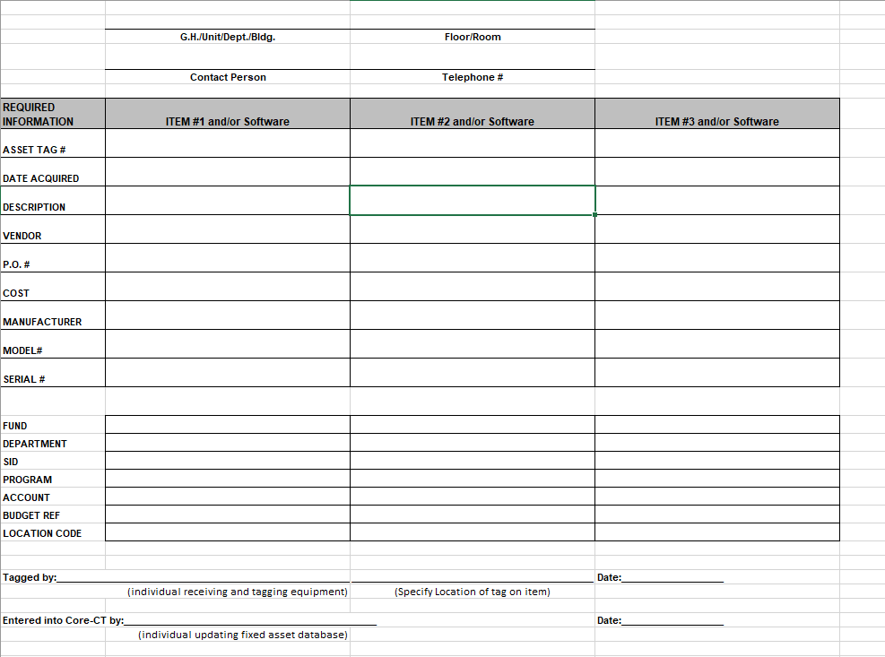
Exhibit A - Fixed Asset Additions Form

Slide 13
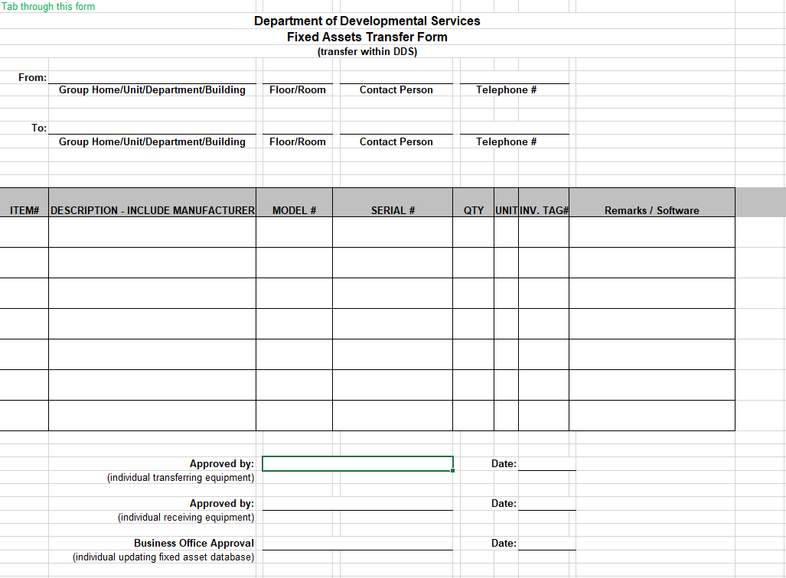
Exhibit B – Fixed Asset Transfer Form

Slide 14
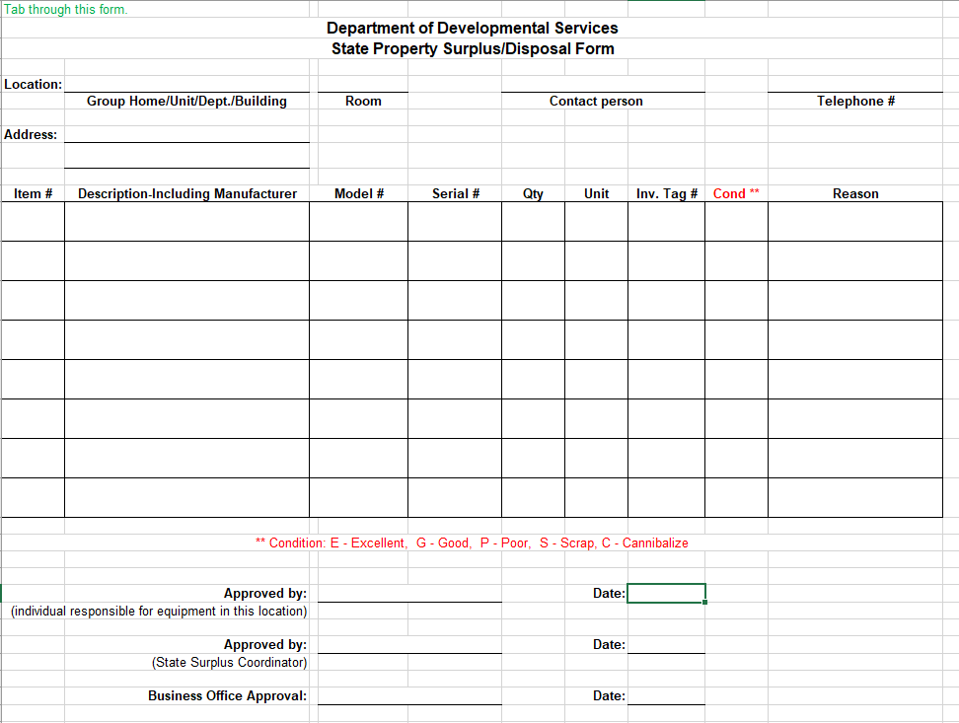
Exhibit C – Fixed Assets Surplus-Disposal Form

Slide 15
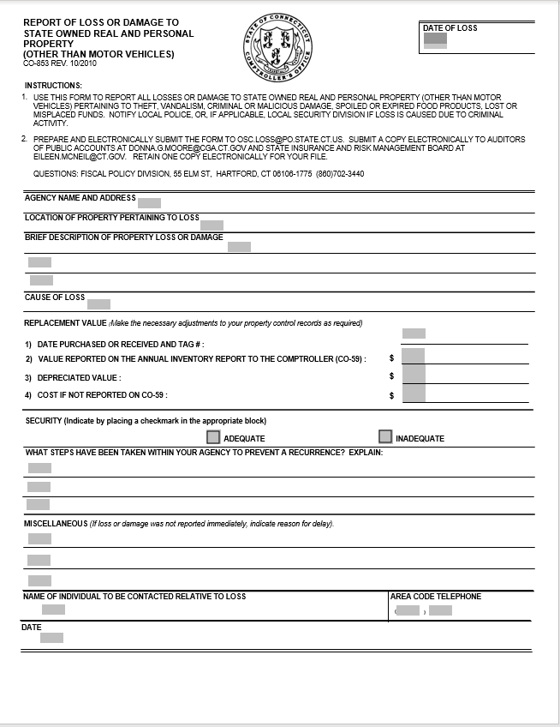
Exhibit E – CO-853 Loss Report

