Slide 1
AT and Me
A train-the-trainer program where Information and Communication Technology (ICT) and digital media will be taught to individuals with intellectual disabilities by their peers.

Slide 2
Summary
This project will support individuals with intellectual disabilities and provide training to their peers in a peer-to-peer learning and teaching experience. The curriculum will teach individuals how to use digital media and ICT independently and safely. One one-hour virtual course with a maximum of 5 students to be held weekly and at least one virtual individual one-on-one class per month. Our goal is to educate 600 people.

Slide 3
Problems Targeted
People with intellectual and developmental disabilities are becoming part of a growing digital divide due to a lack of exposure and knowledge of ICT and digital media. The ability to use digital media safely and ICT independently has become necessary. An increasing number of needs can only be achieved online, including applying for a job, scheduling a COVID test, ordering a Uber or Lyft ride and even ordering a cup of coffee at Starbucks.

Slide 4
Individuals participating in each training will be asked to complete the survey before and after training to assess their progress.
What do you wish you were taught in school about technology? Example: Computers, social media, internet, and cellphone usage?
What technology or tech skills did you find you needed during the Pandemic but didn’t have?
What did you learn through the Pandemic that will benefit you moving forward?
Is there a particular skill set that you haven’t mastered that you feel would be helpful to learn?
Are there things that you do more efficiently now due to the pandemic experience?
What do you think would be beneficial to teach your self-advocacy groups, friends, community, and peers about technology?

Slide 5
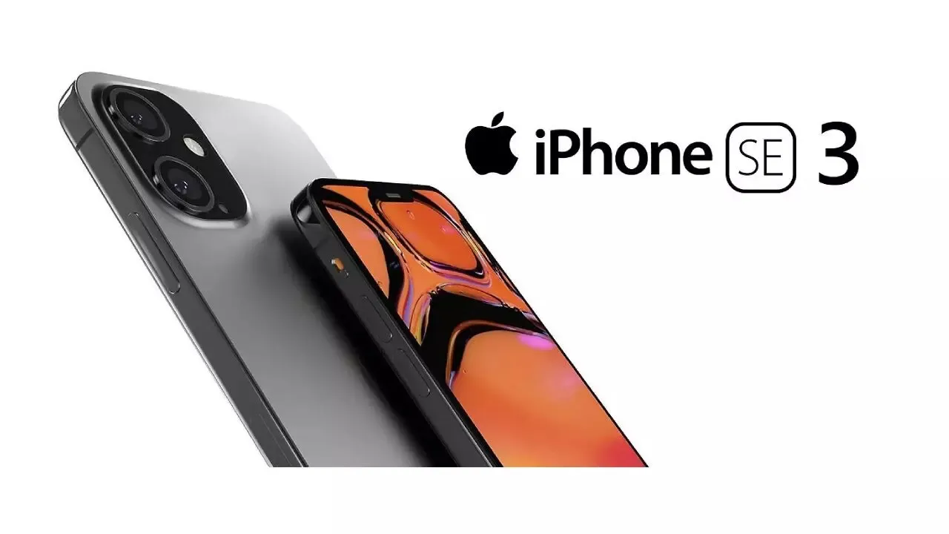

Slide 6
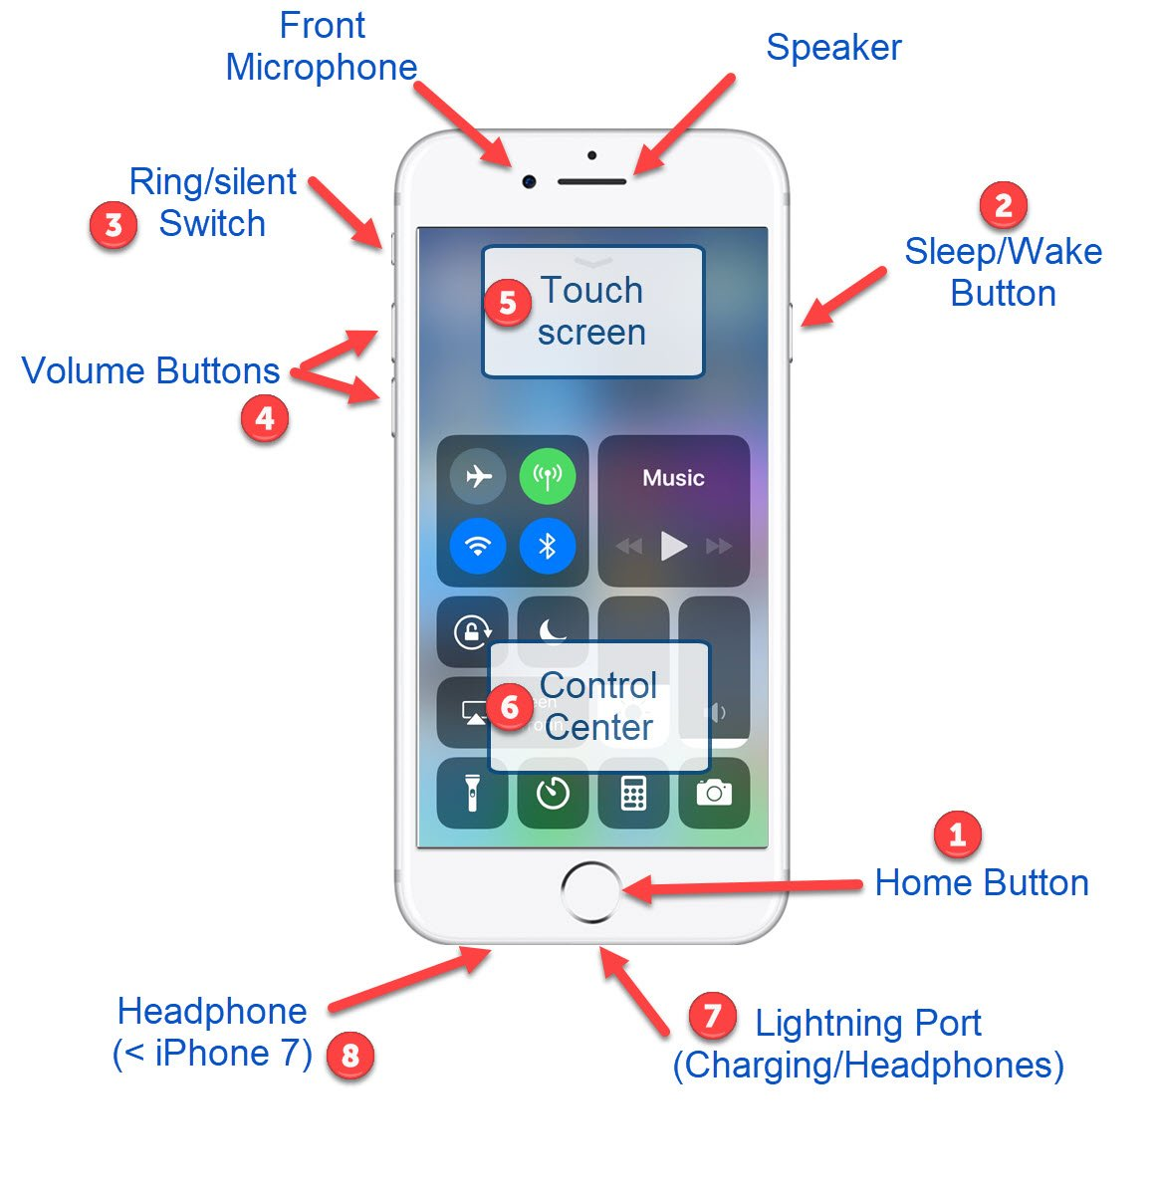

Slide 7
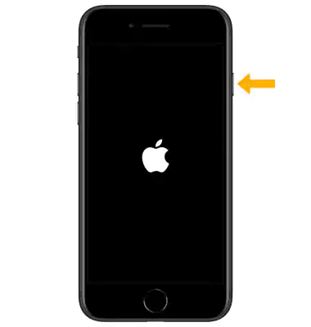
How To Set Up Your New iPhone
To turn on iPhone:
press and hold the Side button until the Apple logo displays.

Slide 8
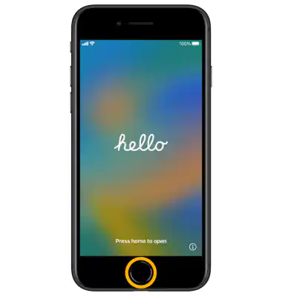
Step 2
You'll see "Hello" in different languages. Press the Home button to continue.

Slide 9
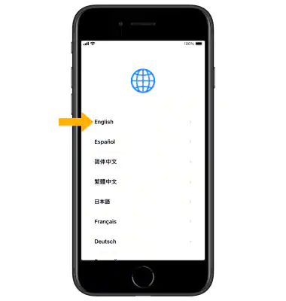
Step 3
Select your language

Slide 10
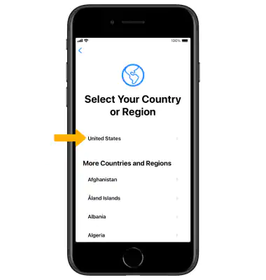
Step 4
Select your country or region

Slide 11
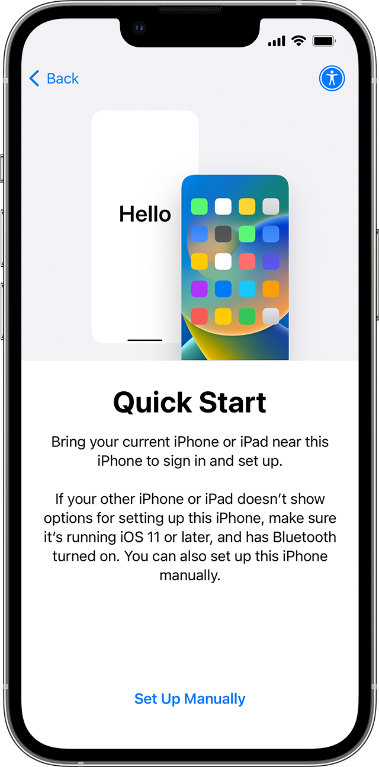
Step 5
Review the Quick Start prompt. Select Set Up Manually to set up your iPhone manually.

Slide 12
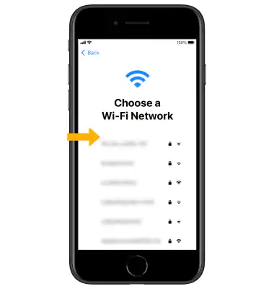
Step 6
Select a Wi-Fi network to connect.
Or if you're setting up iPhone with active cell service, you can select Use Cellular Connection.

Slide 13
Step 7
Review the Data & Privacy prompt then select Continue or Learn More.

Slide 14
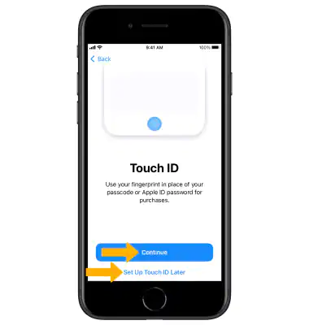
Step 8
Select Continue and follow the prompts to set up Touch ID now or select Set Up Touch ID Later to skip this step.
Note: You'll need a passcode for features like Touch ID and Apple Pay.

Slide 15
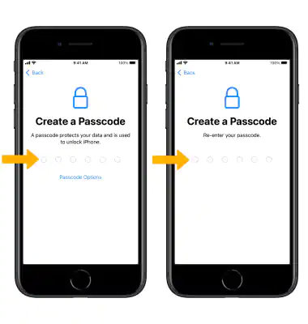
Step 9
Enter the desired Passcode then re-enter your passcode to confirm.

Slide 16
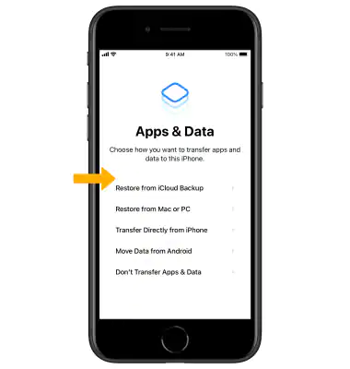
Step 10
You can set up your device as new, restore it from an iCloud or iTunes backup ( if you already have an iPhone or iPad) , or move data from Android Select the desired option and follow the prompts.
Click here to go to a tutorial on transferring data

Slide 17
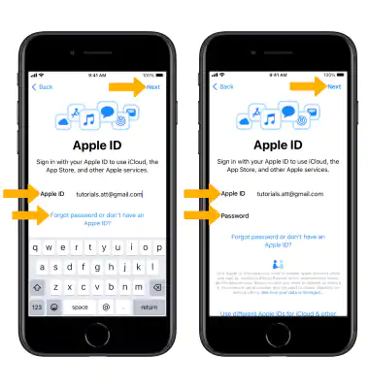
Step 11
Enter your Apple ID then select Next. Enter your password, then select Next again.
If you don't have one, select Forgot password or don't have an Apple ID? and follow the prompts.

Slide 18
Steps 12 and 13
12. Review the Terms and Conditions prompt then select Agree.
13. Review the Keep Your iPhone Up to Date, Siri, and Screen Time prompts then select Continue and follow the prompts for setup.

Slide 19
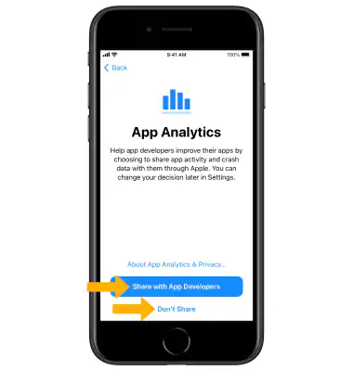
Step 14
Review the App Analytics prompt then select Share with App Developers or Don't Share.

Slide 20
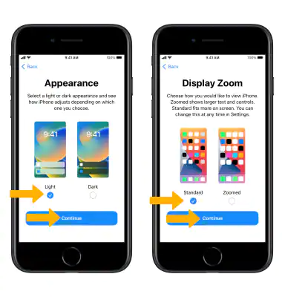
Step 15
Select the desired Appearance and Display Zoom then select Continue to proceed.

Slide 21
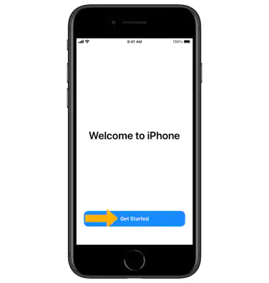
Step 16
Select Get Started to begin using your device.

Slide 22
Part Two: Using Your iPhone

Slide 23
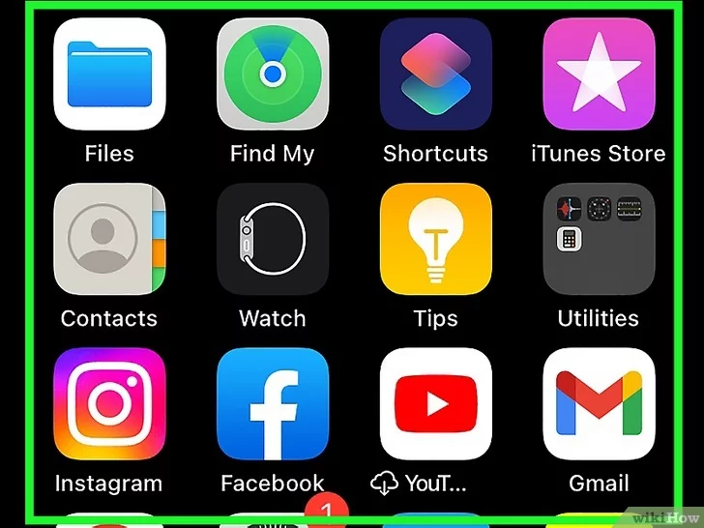
Learning The Home Screen
Review your iPhone's Home Screen.
You'll see several square icons here; these are your iPhone's applications, or "apps" for short.
All of your iPhone's "stock" apps, meaning apps that come pre-installed on the phone, are listed here.
As you add apps to your phone, the Home Screen will gain additional pages.
You can scroll through these pages by swiping from the right side of the screen to the left side of the screen.

Slide 24
Some of the crucial apps that come installed on a standard iPhone include the following:
Settings - This is a grey app with gears on it. If you want to change anything from your ringtone, to your wireless network settings, you'll find the options to do so in this app.
Phone - It's a green app with a white phone icon. You can make calls manually (by dialing) or by tapping a contact's name and then tapping the phone icon below their name at the top of the screen. You can also access your voicemail using the Phone app.
Contacts - This app has a grey silhouette of a person's head on it. Tapping it will bring up a list of your contacts--the store from which you bought your iPhone should have synchronized your last phone's contacts with your iPhone, but if they didn't, you may want to import your old contacts to your iPhone. You can add these contacts to your Favorites so they can contact you even if] your phone is on Do Not Disturb Mode.
FaceTime - A green app with a white video camera icon on it. You can make face-to-face calls with your contacts using FaceTime.
Messages - A green app with a white speech bubble. This is where you'll send and receive text messages.
Mail - The blue app with a white envelope icon on it. You can check your Apple ID email here (it will be called your iCloud account), or you can add an email account to this app.
Calendar - This app will display an up-to-date calendar. You can also set events for specific dates and times by tapping the pertinent date and filling in the information fields.
Camera - A grey app with a camera icon on it. You can take photos, videos, and different types of visual media (e.g., slow-motion videos) with the Camera app.
Photos - This multicolored pinwheel app is where all of your iPhone's photos are stored. Any time you take a picture, the photo will appear here. Share photos via AirDrop or iCloud to all your friends and family.
Safari - Safari is a blue app with a compass icon on it. You'll use Safari to browse the web.
Clock - The clock-shaped app. You can change or manage your iPhone's saved time zones, set alarms, set a timer, or use a stopwatch with this app.
Notes - The yellow and white notepad-shaped icon on the Home Screen. This app is useful for writing down quick notes or making a list, though the Reminders app is also a good choice for lists.
Maps - The Maps app allows you to plan trips and will give you step-by-step directions like a GPS if you enter a starting point and a destination.
Wallet - You can add credit or debit cards and gift cards to your iPhone's Wallet. Doing so will allow you to use your iPhone to pay for online items as well as at supported retail stores.
App Store - This blue app with a white "A" on it is where you'll download new apps.
Music - A white app with a musical note on it. This app is where you'll find your iPhone's music library.
Tips - This yellow app with a light bulb will provide you with insights that can help you get the most out of your time with your iPhone.

Slide 25
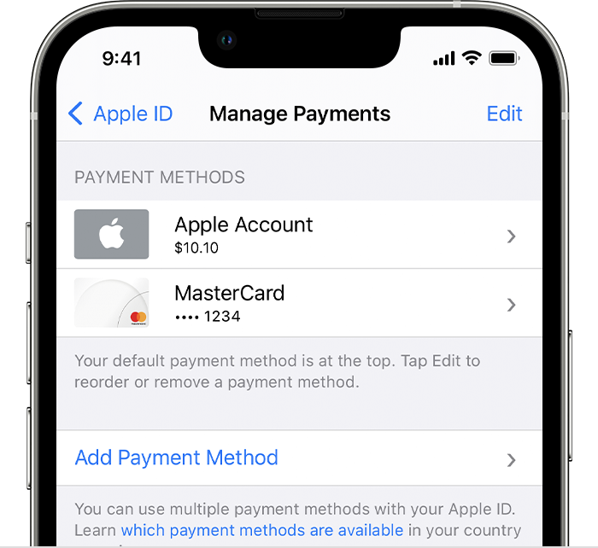
Adding A Payment Method To Your Apple ID
Open the Settings app.
Tap your name.
Tap Media & Purchases, then tap View Account. You might be asked to sign in with your Apple ID.
Tap Manage Payments.
Tap Add Payment Method.

Slide 26
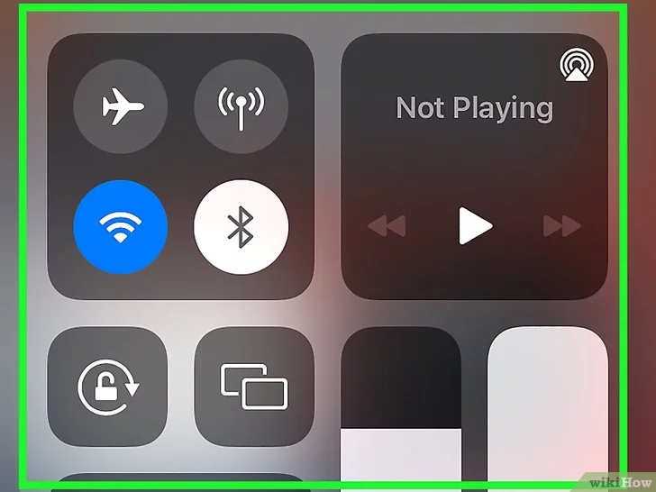
The Control Center
Swipe the very bottom of the screen up.
Doing so will bring up the Control Center, which houses the following options:
Airplane Mode - The airplane icon at the top of the Control Center window. Tapping it will enable Airplane Mode, which prevents any cellular or wireless internet emissions from your iPhone. Tap it (or anything else on this list) again to disable it.
Brightness- Drag the slider to the right if you want your phone's screen to display brighter. Drag it to the left if you want it darker. The brightness will automatically dim if you don't use your iPhone in a certain amount of time. That's a feature used to save battery.
Wi-Fi - The rippling arcs icon. Tapping this will enable wireless internet (if it's blue, Wi-Fi is already enabled) and connect you to the nearest recognized network.
Bluetooth - The center icon at the top of the Control Center window. Tap this to turn on your iPhone's Bluetooth, which will allow you to connect your iPhone to speakers or other Bluetooth devices.
Do Not Disturb - The moon-shaped icon. Tap this to prevent calls, text messages, and other notifications from causing your phone to ring.
Rotation Lock - The padlock icon with a circle around it. Tapping it while it's red will disable screen lock, meaning you'll be able to rotate your iPhone 90 degrees to view photos and other media in landscape mode.
The bottom row of options from left to right include a flashlight, a timer, a calculator, and a shortcut to your iPhone's Camera app.

Slide 27
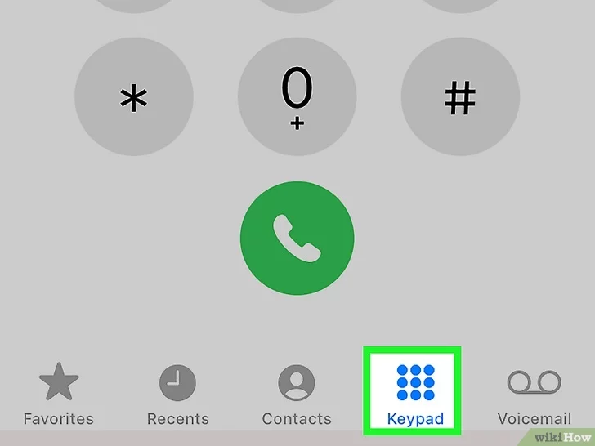
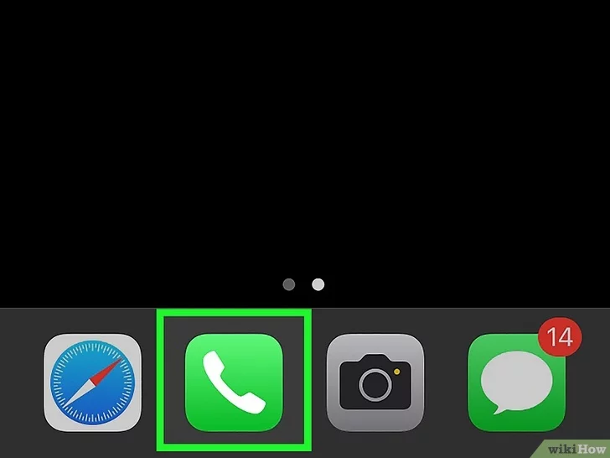
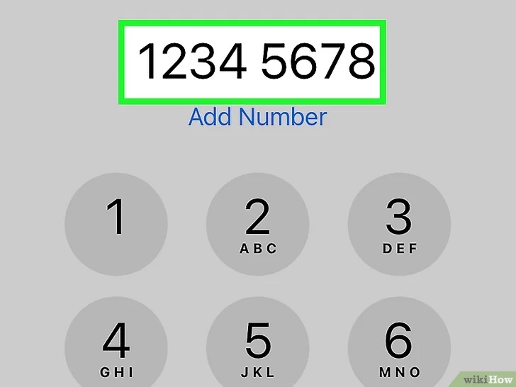
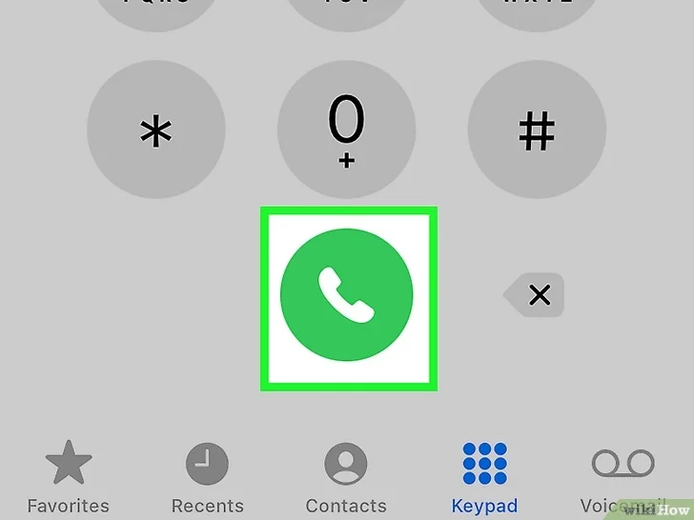
How To Make A Call

Slide 28
How To Make A FaceTime Call

Slide 29
How To Text

Slide 30
How To Use Siri

Slide 31
How To Charge Your Phone
Connect iPhone to a power outlet using the charging cable (included) and an Apple USB power adapter
Note: you can also charge your phone by plugging the charging cable into the USB port on your computer

Slide 32
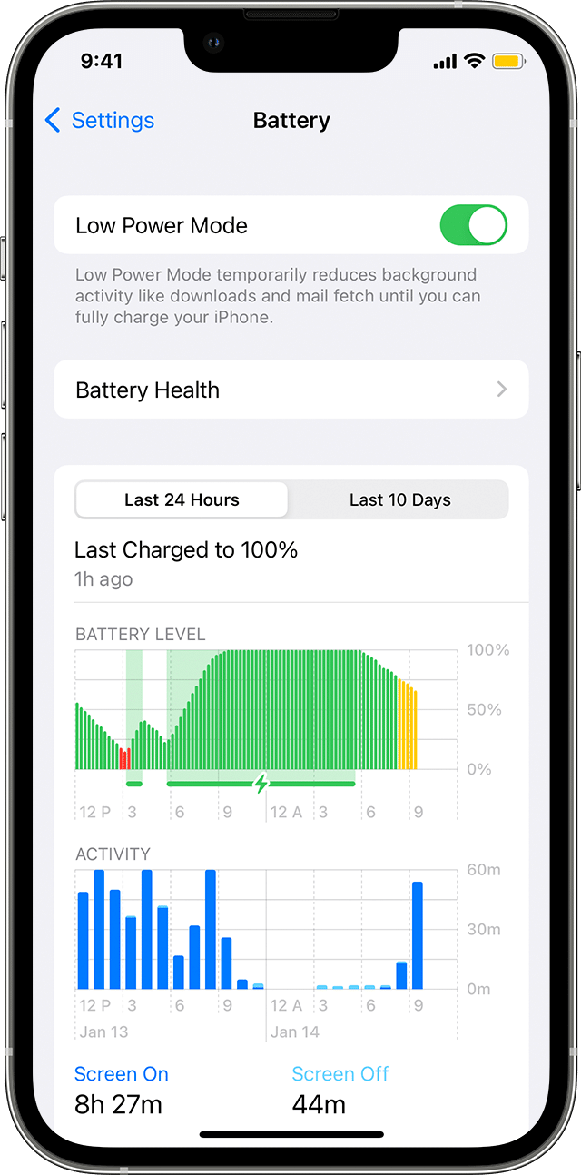
More Charging Basics
Low Power Mode: Low Power Mode reduces the amount of power that your iPhone uses when the battery gets low. It optimizes performance for essential tasks like making and receiving calls; sending and receiving email and messages; accessing the internet; and more.
Access Low Power Mode through your settings.

Slide 33
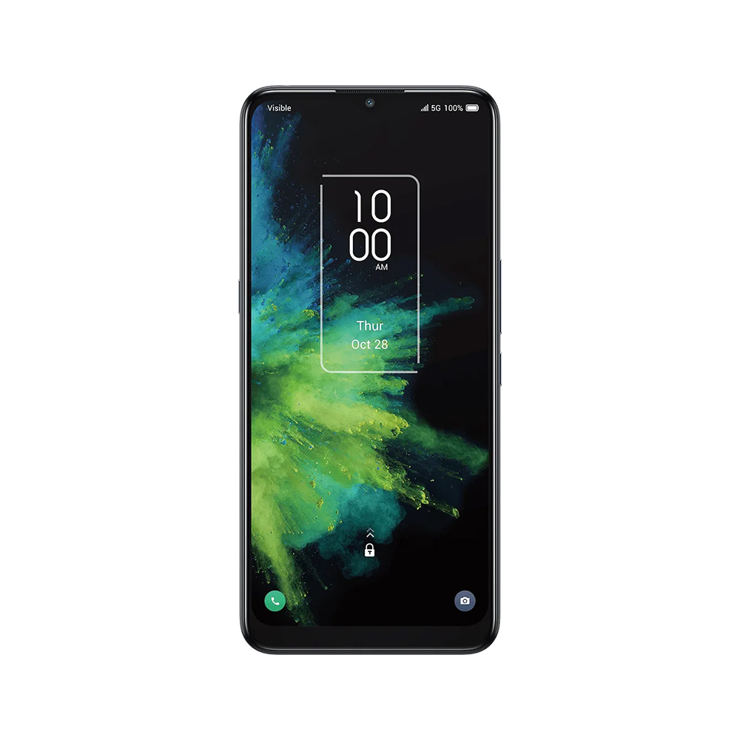
AT And Me Curriculum
https://tinyurl.com/2rejud5c
How to Use an iPhone: An Easy Guide for Beginners (wikihow.com)
Easily Connect a Wired or Wireless Headset to a Windows PC (wikihow.com)
Kevin Arce
First Look: T-Mobile 5G Hotspot by Quanta D53 - YouTube
How to Connect a Wireless Mouse: Guide for Windows or Mac (wikihow.com)

Slide 34
Earbuds/ Headsets

Slide 36
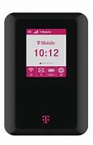

Slide 38
Thank You
Happy Surfing!!!
Kevin Arce
Yana Razumnaya

