Slide 1
Individualized Home Supports
Mallory Valdez, Case Manager Supervisor
Notes:
Thank you (mention previous presenter) My name is Mallory Valdez, I am a CMS and today I will be talking to you about IHS.

Slide 2
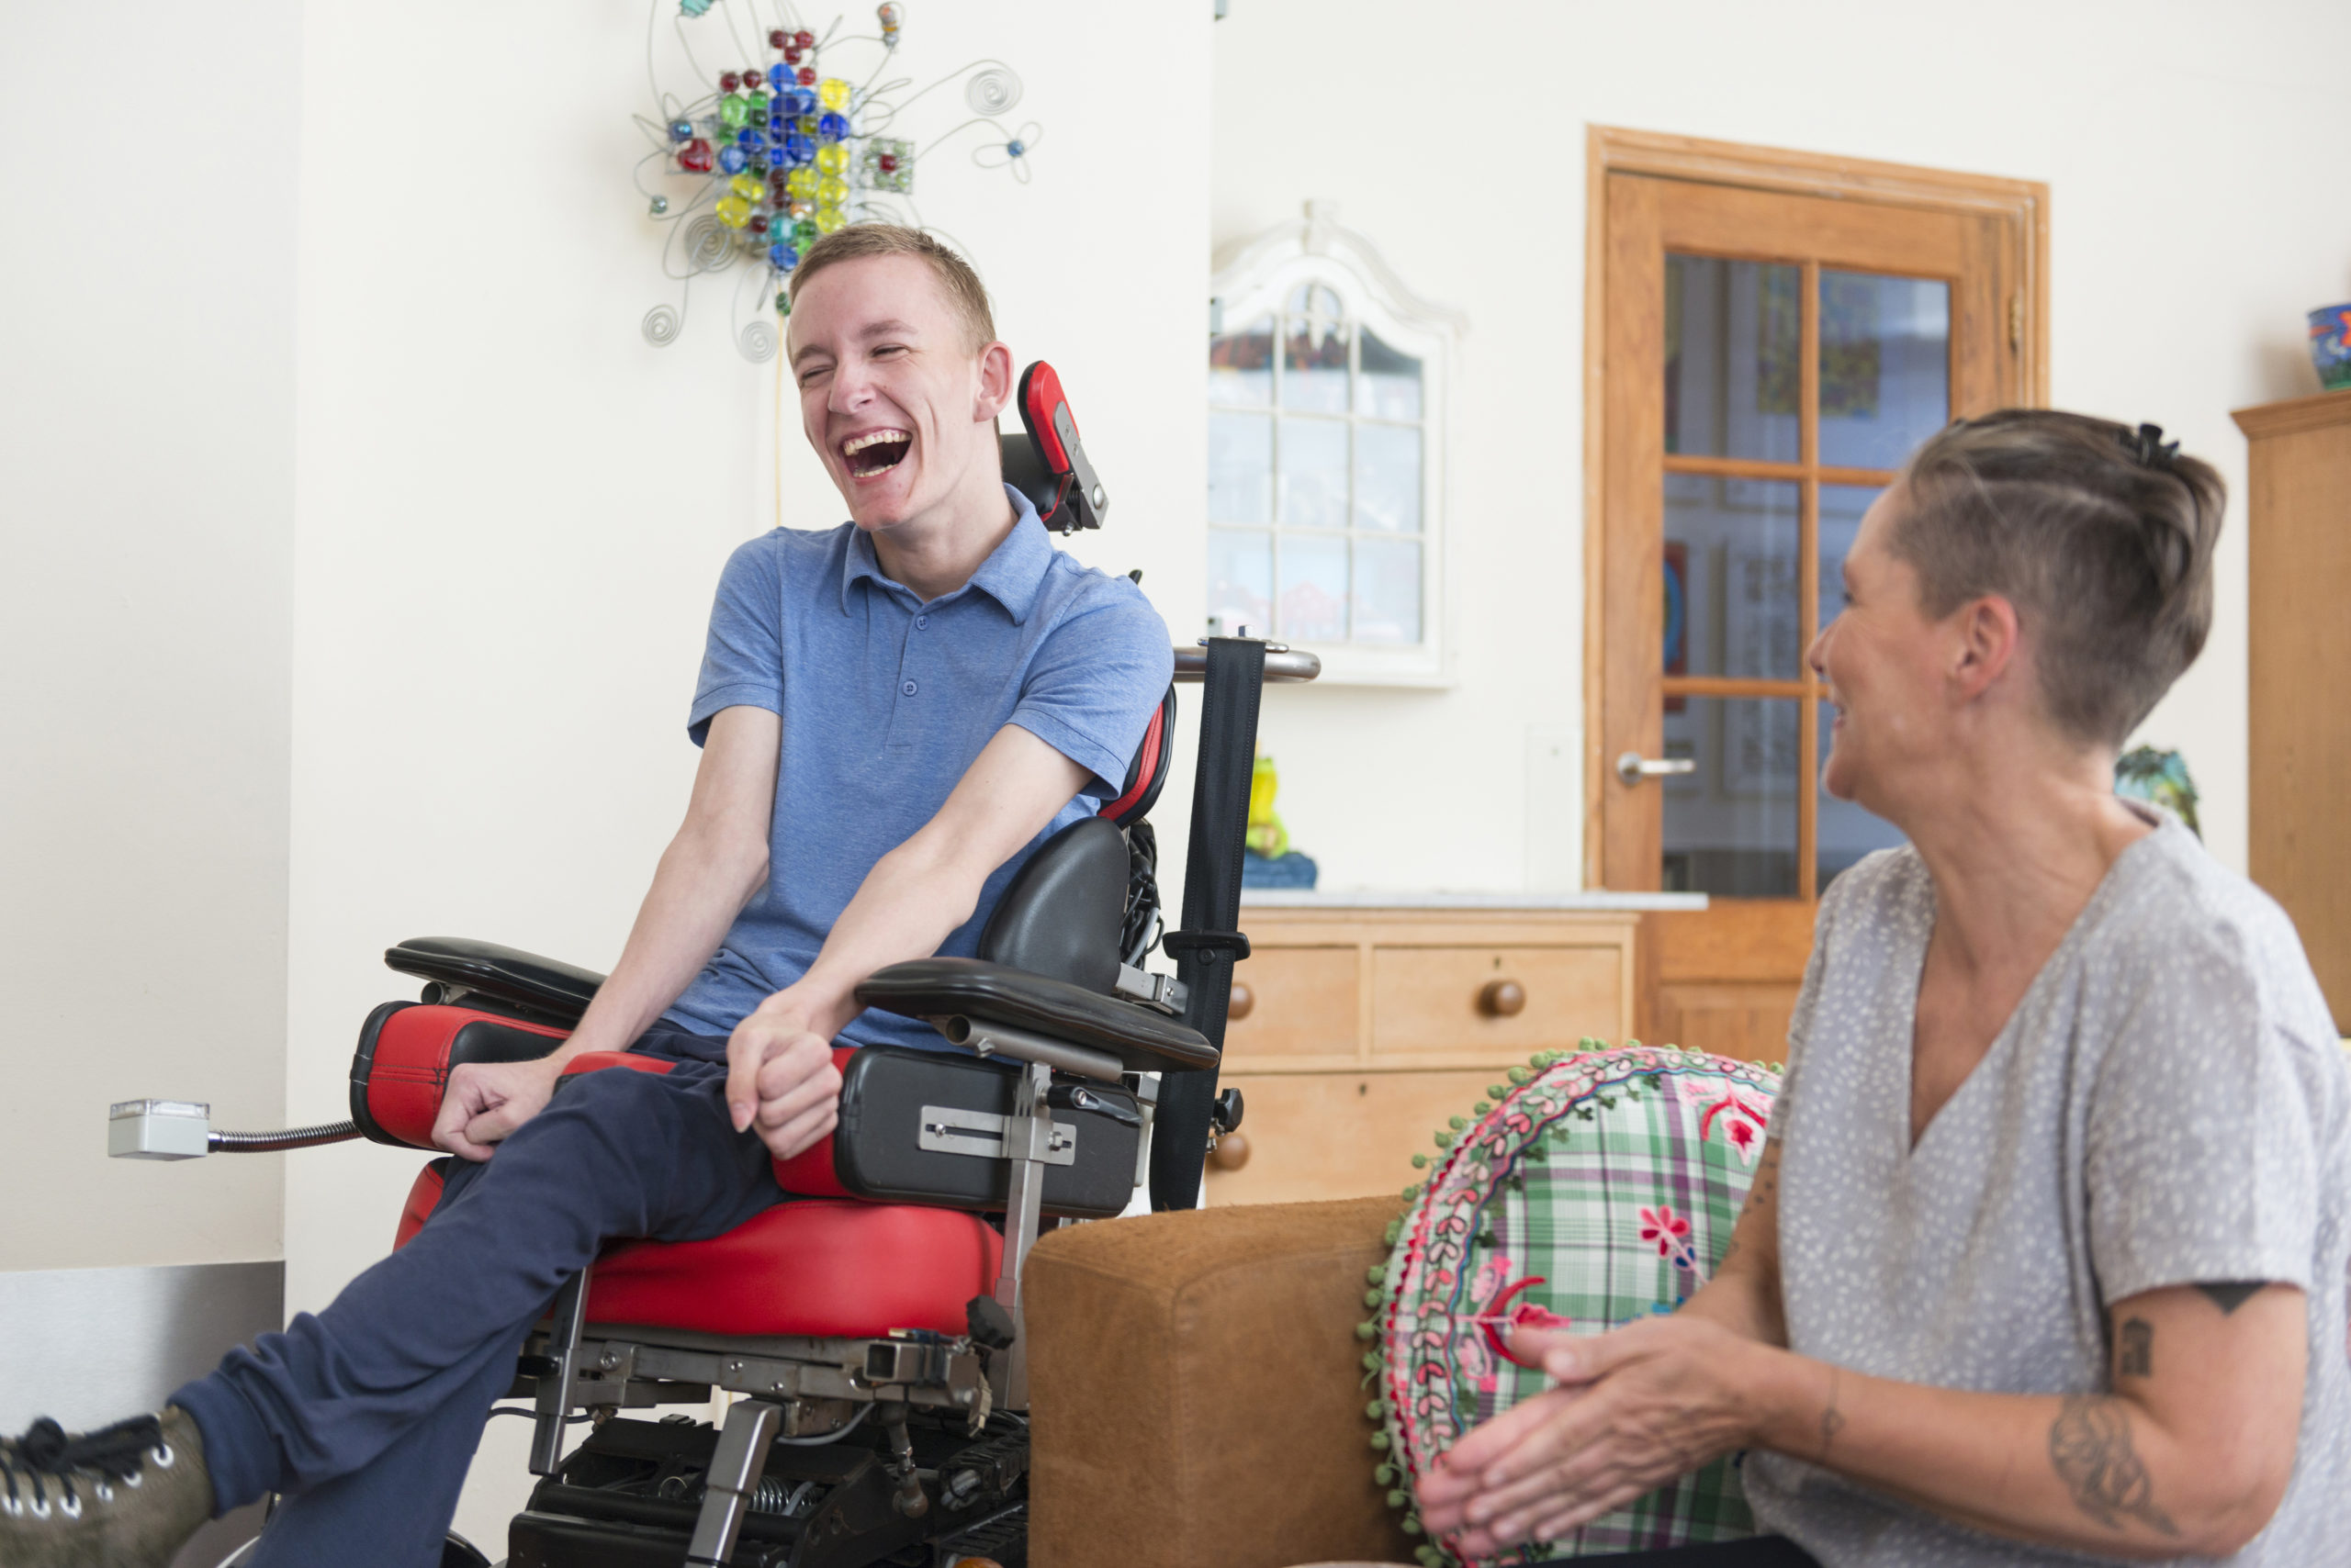
What is Individualized Home Support?
I.H.S. Delivery/Support Options:
Using a DDS Qualified Provider
Using the model of Self Direction
I.H.S. Customized Options of Support:
Within a Clustered Support setting
Use of Assistive Technology
Notes:
So, what is individuated home supports? In home Supports, also know as IHS can be delivered by a qualified vendor with DDS or through self directed supports. IHS can also be used in Clustered Living Setting and through the use of AT. We will go over all the different support option a little further into the presentation.

Slide 3
What is Individualized Home Support?
Staffing is intermittent and support is based on the needs of the individual using the Level of Need tool to determine the number of support hours each week.
This supportive service may be delivered in a family home, an individual’s own home and within their community.
This supportive service provides assistance with the acquisition, improvement and/or retention of skills and provides necessary support to achieve personal outcomes that enhance an individual’s ability to live in their community as specified in the Individual Plan.
Examples may include: budgeting/money management, have a greater role with managing medical needs and exploring ways to expand their circle of friends.
This is not a 24 hour support service.
Notes:
IHS does not provide 24 hours support, the support hours are intermittent, and person centered. As each person is different and has different needs the hours of support for each person will vary. The hours are determined from a tool that we use, called a Level of Need (LON). Where can IHS be provided? Again as this is a person centered approach, the location of where the support is provided will vary. Some examples of where support has been provided is in a family home, an individuals own home, or within the community such as the library, a career fair or grocery store. What is the purpose of IHS? IHS are used to improve skills and develop new skills, reach personal/identified goals, gain/increase independence, and enhance community involvement and integration. Some example include, budgeting and money management, optimizing health, wellness and safety, increase skills for employment and develop and expand on relationships that are meaningful and important to the individual.

Slide 4
I.H.S. Delivery and Support Options
1) Individuals and Families can choose to use a DDS Qualified Provider (Agency) who offers I.H.S support.
The DDS Qualified Provider would hire the staff person (Direct Support Professional) and work to “match” the staff person’s interests, skill set and personality to the individual seeking the support.
Participation in the development of the Individual Plan and implementation of desired personal outcomes.
Notes:
These kinds of supports are provided by an agency that has already been identified as a qualified vendor with DDS. Agency staff who are supporting the individual are considered part of the team. They will participate in the IP annual as they are the staff who support and assist the individual with progressing towards or achieving identified goals.

Slide 5
I.H.S. Delivery and Support Options
2) Individuals and Families can choose to use the model of Self Direction
•Self-Direction means:
•You have the Choice to hire your own staff – a Direct Support Professional.
•You take control and authority for managing your own supports within your life
•You become the “Boss” or Employer of your Direct Support Professional
•You develop the supports you need to live the life you want
•You take responsibility for exploring all your available resources to support the plan you have for your life
Notes:
An individual can be their own Employer of Record (EOR) or they can have someone be the Employer. The EOR is responsible for advertising the position, interviewing, hiring and managing of their DSP. One may ask, where would I seek staffing supports if I don’t have anyone in mind? We offer a year free subscription to a site called Rewarding Work for individuals and families who decide to self direct. Explain site Other ways people have recruited staff are through advertisements at local colleges, libraries, religious affiliations. Discuss that there is support that can be provided to the EOR – Individual Goods and Service Supervisor. (INDGSS)

Slide 6
I.H.S. Within Clustered Supports
• Opportunities for individuals who require overnight and awake staff access, due to health and safety needs, to live independently in their own home, promoting independence and community social interaction.
• Offered specifically through a DDS Qualified Provider
• Individuals receiving clustered supports live in their own homes and the clustered setting consists of more than one (1) separate dwelling within one half (1/2) mile from the overnight, awake staff
• The DDS Qualified Provider can be funded to provide in person support to more than 1 person at the same time (2:1 or 3:1 ratio) for the purpose of shared community and/or social activities to foster companionship, relationship building and to engage in preferred community/social activities.

Slide 7
I.H.S. Within Clustered Supports
Examples may include:
Provide direct support during overnight hours (11:00 pm – 7:00 am) to ensure health and safety.
Engage in shared activities such as grocery shopping
Engage in shared and preferred recreational activities.

Slide 8
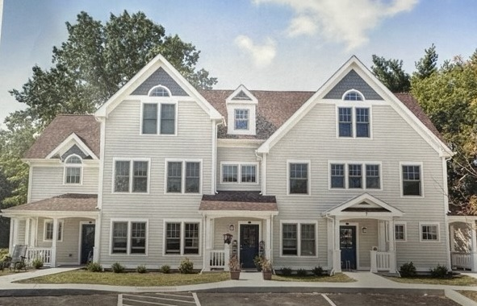
I.H.S. Within Clustered Supports
Orange Cluster Brochure.docx

Slide 9
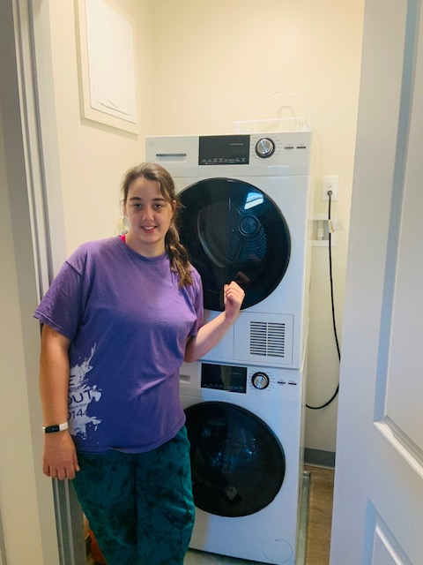
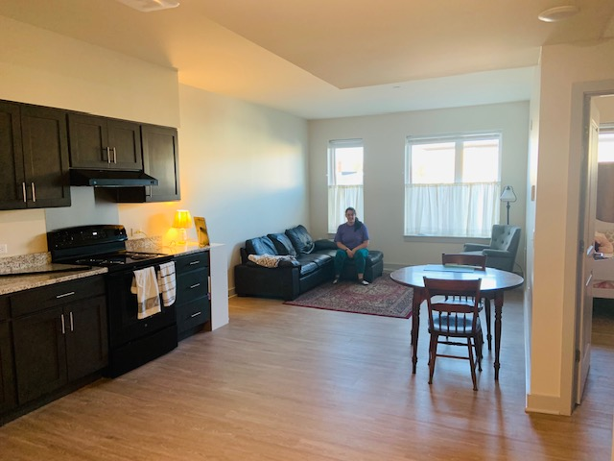
I.H.S. Within Clustered Supports
Notes:
Here is an individual who receives supports and services from DDS. She has successfully and happily been living in one of our Cluster Housing settings for several months and has already gained independence in many areas.

Slide 10
I.H.S. and Assistive Technology
Assistive technology (AT) is any item, piece of equipment, software program, or product system that is used to increase, maintain, or improve independence within the individual’s home and/or community.
Enhances communication, promotes inclusion and increases an individual’s overall independence.
AT is person-centered and an assessment should be conducted to determine recommendations.
AT can help individuals feel more secure, confident and can replace the need for in person support during a particular period of time/activity.
Notes:
An example of a remote support – Kiana is very independent in many areas of her life but she is still working on a few things (I mean, aren’t we all ☺). One thing Kiana is working on is optimizing her cooking skills. Jane and her staff schedule times where the remote support will be provided. Jane and her staff will face time and her staff will guide Jane through following directions for the recipe, assit/prompt with the stove settings and ensure that Jane successfully makes the desired meal of her choice.

Slide 11
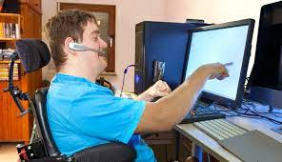
I.H.S. and Assistive Technology
Remote Support Animation – YouTube
Notes:
Thank audience, introduce next presenter.

