Slide 1
Facilitating Transition to Adult Services
Michael J. Soderlund, M.S., BCBA, LBA(CT)
Director of Adult Behavioral Services
Lotus Behavioral Services

Slide 2
Background
Our Experiences
Public Schools
Private center-based programs and RESCs
Home based programs
Discussions:
Dr. Lloyd, Dr. Duzant and Dr. Recinos
Educational Advocates
Residential Providers
Day program Service Providers
Families

Slide 3
Objectives
Identify some barriers to effective transitions for individuals with autism, intellectual disabilities and developmental disabiliities
1
Discuss Implications
2
Families
Schools
Day program
Residential programs
Short Term Goals
3
Long Term Goals
4
Preparation for life after school

Slide 5
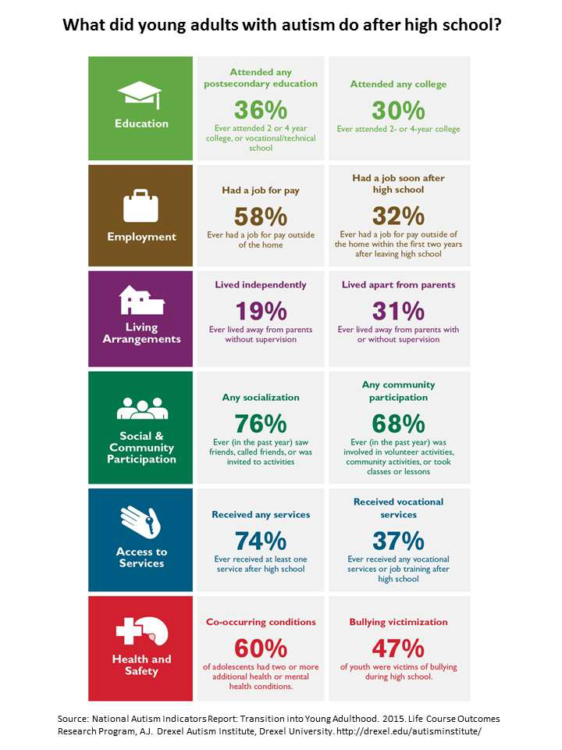
Post-21 Outcomes
“After analyzing data from the NLTS-2, Roux and colleagues reported “young adults with autism have a difficult time following high school for almost any outcome you choose - working, continuing school, living independently, socializing and participating in the community and staying healthy and safe. To complicate matters, many of these youth begin their journey into adulthood by stepping off a services cliff. Access to needed supports and services drops off dramatically after high school – with too many having no help at all .” Roux, et al, 2015, p. 8
Roux, AM, Shattuck, P, Rast, JE. Rava, JA, & Anderson, KA. (2015) National Autism Indicators

Slide 6
Post-21 Outcomes
Shattuck, et al, (2012) conducted a comprehensive literature review regarding original research on services and interventions aimed at supporting success in work, education, independence, and social participation among adults aged 18 and older with an ASD published between 2000 and 2010.
Shattuck concluded that the evidence base about services for adults with an ASD is underdeveloped and can be considered a field of inquiry that is relatively unformed.
Shattuck, P., et al, (2012). Services for adults with autism spectrum disorders. Canadian Journal of Psychiatry, 57, 284-291.

Slide 7
The Adult Services Cliff

Slide 8
More on Implications
Families
Frustration
Receiving Agencies and Day Programs
Case Management
Behaviorists
Direct Care staff

Slide 9
Service Providers
Most service providers in public and private school settings are special education teacher, board certified behavior analysts, occupational therapist, physical therapist and school psychologist that are specialists
When working with adolescents and young adults you don’t get to be a specialist
You need to be more of a generalist.
You need a good working knowledge of ABA, positive behavior support, government services and resources, mental health concerns, medication side effects, sexuality, menstrual care, job development, job coaching, community-based instruction, generalized systems of communication, staff training, community training, and that’s just to start.
ABA Programs?

Slide 10
Generalization
School programs are focused on mastery and maintenance of skills driven by IEP goals and objectives
But often fail to program for Generality
Behavior interventions should be designed from the outset to operate in new environments and continue after the formal treatments have ended.
“No one learns a generalized lesson unless a generalized lesson is taught.”
Baer, D.M. (1999). How to plan for generalization (2nd ed.). Austin, TX: Pro-Ed.

Slide 11
Programming For Generalization
Train and Hope: after a behavior change is in effect…any existent generalization…is concurrently recorded but not actively pursued.
Sequential Modification: Generalization is assessed after behavior change and procedures are implemented across non-generalized conditions.
Introduce to Natural Maintaining Contingencies: Implementing behavior change procedures to behaviors that will naturally maintain reinforcement after treatment
Train Sufficient Exemplars: Teaching to the mastery of multiple examples of a generalizable lesson
Use in-discriminable contingencies: Using unpredictable intermittent schedules of reinforcement across generalizable settings, making the response resistant to extinction, thus promoting generalization
Program common stimuli: Train common stimuli so generalization will occur across other stimuli
Mediate Generalization: Establishing a response as part of the new learning that is likely to be utilized in other problems as well.
Train to Generalize: Reinforcement contingency is placed on a generalized response as with any other operant
Stokes, T.F. & Baer, D.M. (1977). An implicit technology of generalization. Journal of Applied Behavior Analysis, 10, 349-367.

Slide 12
Why does this Matter to Us as Adult Providers?
Neely, Ganz, & Davis et.al (2016), conducted a meta-analysis of generalization and maintenance techniques used to teach functional living skills to individuals with ASD. In this analysis, the train and hope or train to criterion and hope technique was used in 43% of the studies.
Additionally, only 9 of 32 studies focusing on teaching FUNCTIONAL living skills were taught in the natural environment.
Young adults transition to the environments that we support with very stimulus bound skills that do not generalize to the stimulus conditions in group homes and day programs.
Most behavior problems we see develop due to skill deficits and communication deficits.

Slide 13
What Do We Do About This?
Focus on Critical Skill Development – Identify the most impactful skills to develop
The idea to focus on critical skill development was influenced by:
Discussions with other professionals
Transitions I have witnessed
Examples
Knowledge of and experience in settings from which students age out of educational services
Programing
ABA- Lack of goals and objectives that drive lifelong skill development and preparation for life
Life Expectancy
Lack of real-world knowledge of settings in which students will become adults and spend the majority of their lives in
Educational Partnership for Instructing Children (EPIC) assessment and curriculum

Slide 14
Short Term
The Essential Eight
Making requests
Waiting after making requests
Accepting removals, making transitions, sharing, and taking turns
Completing 10 consecutive, brief, previously acquired tasks
Accepting ‘No’ or delays to preferred activities and materials
Should we say “No” to individuals?
Following directions related to health and safety
Completing daily living skills related to health and safety
Tolerating situations related to health and safety
McGreevy, P., Fry, T, & Cornwall, C. (2012). Essentials for Living: A Communication, Behavior and Fundamental Skills Assessment,
Curriculum, and Teaching Manual.

Slide 15
Other Criterion Referenced Assessments
Assessment of Functional Living Skills (AFLS)- A a criterion-referenced skills assessment tool, tracking system, and curriculum guide. AFLS is used for teaching children, adolescents, and adults with developmental disabilities the essential skills they need in order to achieve the most independent outcomes.
Basic Living Skills
Home Skills
Community Participation skills
Vocational Skills
Independent living Skills
Checklist of Adaptive Living Skills-he Checklist of Adaptive Living Skills (CALS) is a criterion-referenced, individually administered measure of approximately 800 specific adaptive behaviors related to self-care, personal independence, and adaptive functioning in leisure, work, community, and residential environments.
Task Analyses

Slide 16
Why Focus on Functional and Adaptive living Skills?
Many problem behaviors develop over time due to skill deficits and are reinforced by escape or avoidance of activities that an individual cannot do.
Life skills assessments can identify undeveloped essential skills that can be taught.
Crucial components of effective positive behavior support plans:
Teaching skills to complete tasks that when presented are followed by problem behavior.
Developing skills (e.g., communication) that are functionally equivalent to problem behavior.

Slide 17
Long Term
IDEA (2004) Transition Definition
(34) TRANSITION SERVICES - The term `transition services’ means a coordinated set of activities for a child with a disability that (A) is designed to be a results-oriented process, that is focused on improving the academic and functional achievement of the child with a disability to facilitate the child's movement from school to post-school activities, including post-secondary education, vocational education, integrated employment (including supported employment), continuing and adult education, adult services, independent living, or community participation; AND (B) is based on the individual child’s needs, taking into account the child's strengths, preferences, and interests "

Slide 18
Partner with Case Managers with Students
To evaluate IEP goals and objective with he following social validity questions.
Is the skill derived from a comprehensive and ongoing assessment?
Is the skill a prerequisite to a more complex, yet important skill (e.g., Letter ID as a prerequisite to Reading)?
Is the skill one that can be of use across multiple environments?
Can the skill be acquired by the student in a reasonable time frame?
Is the skill one that will still be useful in 3-5 years?
Is the skill one that lends itself to an acceptable degree of instructional intensity?

Slide 19
Social Validity Questions
Once acquired, is the skill one the student will use with sufficient frequency that it will be easily maintained?
Is the skill the most direct, simplest way to achieve the desired outcome?
Does the skill improve the student’s ability to communicate?
Does the skill support social inclusion and/or peer relationships?
Does the skill ultimate promote independence via adaptive behavior?
Does the skill ultimately promote independence via self management?
Does the skill ultimately promote individual safety skill
If the skill uses “hi tech” is it the most current tech available?

Slide 20
Social Validity Questions
Is the skill a one that student might find enjoyable?
Is the skill one the contributes to the student’s health or a healthy lifestyle (e.g., exercise)?
Is the skill one that is culturally relevant?
Is the skill of importance to the student’s family?
Is the skill one that has relevance to future employment?
Is the skill one that has relevance to future life in the community, outside of the family home?

Slide 21
Critical Skills- Toileting
Preschool/Elementary School
Independent initiation for the toilet
Void urine and bowel in toilet only
Pull down pants
Pull up pants
Zip/Button
Flush
Wipe after urine (f) and bowel
Wash hands
Female preparation for menses
(age 8)
Stay dry throughout the night
Minimizing exposure
Using a urinal
Gender consideration
Closing and locking bathroom stall
Wiping/lining a seat
Refrain from water play

Slide 22
Toileting
Middle School
Self advocacy
Keep track of menses and materials
needed
Adult supervision faded

Slide 23
Toileting
Transition
Choose gender appropriate
restroom
Returning to location/task
Adult supervision fully faded

Slide 24
Toileting
Terminal Goal
Independent use of a
restroom, when
necessary including:
• Choosing the correct
restroom
locking the door
wiping the seat
wiping self
washing hands
exiting the bathroom
return to “location”

Slide 25
Dressing
Closing door for privacy
Independent selection of appropriate clothes
Donning clothes in correct order
Orientation and checking appearance before opening door and exiting area.

Slide 26
Independent Eating
Able to correctly use all appropriate utensils (knife, fork, spoon) to eat a variety of foods neatly and at a culturally accepted pace in the absence of reminders and adult supervision

Slide 27
Bathing/Self Care
Demonstrate the ability to independently bathe/shower and complete relevant self care/hygiene skills (e.g., tooth brushing, grooming, etc.)

Slide 28
Household Participation
Independent completion of a variety of household chores or, in our field.
The issue is not whether to target these skills but rather, when to target these skills.
Often initiated too late or not at all

Slide 29
Able to Learn in a Group
Acquire new skills when presented via dyad or triad instruction at a rate of acquisition similar to that documented via 1:1 instruction.
Contrary to the majority of ABA 1:1 instructional arrangements

Slide 30
Self Management
To independently regulate their own behavior using thin schedules of reinforcement and reduced supports from external resources in a variety of settings and situations at home, school, work and in the community.

Slide 31
Problem Solving
To demonstrate the ability to offer more than one potential solution when presented with a relevant problem or challenge in multiple environments

Slide 32
Maintain Physical Safety
To demonstrate the ability to identify and avoid potential “nonhuman” danger in the environment; the ability to discriminate between “safe” and “unsafe” people and respond appropriately; display a reasonable degree of noncompliance to privacy requests; ability to participate in healthcare management activities
Expensive one-to-one staffing

Slide 33
Behavioral Skills Training
Safety skills are important for learners with autism and developmental disabilities and should be addressed comprehensively over the course of the learner’s schooling and across the lifespan.
An effective method to teach safety skills is Behavioral Skills Training(BST).
BST is a comprehensive teaching method which includes delivering instructions to the learner, modeling the correct response, rehearsing the correct response in both pretend and more naturalistic environments, and delivering feedback to the participant regarding their actions. (Beck &Miltenberger, 2009; Gunby, Carr & LeBlanc, 2010; Johnson et al., 2006) and how to seek assistance when lost (Pan-Skadden et al., 2009).

Slide 34
Communication
Demonstrate the ability to make one’s wants and needs known to naïve listeners across multiple environments.
Includes both high and low tech. assistive and augmented technology

Slide 35
Closing Thoughts
If we leverage existing and new relationships with public schools, private schools, case managers and transition case managers we can become an important resource in IEP development focused on transition to life as an adult.
There are service providers that provide transition planning services but our intention is to play a vital role in IEP development and program development that is designed to be a results-oriented process, that is focused on improving the academic and functional achievement of the child with a disability to facilitate the child's movement from school to post-school activities, including post-secondary education, vocational education, integrated employment (including supported employment), continuing and adult education, adult services, independent living, or community participation.

