Slide 1
Responding to Individuals with Developmental Disabilities
Peter Tolisano, Psy.D., ABPP
Board Certified in Clinical Psychology
Director of Psychological Services
Connecticut Department of Developmental Services
Tracey M. Sondik, Psy.D.
Director of the Behavioral Intervention Service
Connecticut Valley Hospital
Department of Mental Health and Addiction Services
Jennifer Krom, MA, LPC
Director of Autism Services
Beacon Health Options
Rebecca Brown-Johnsky, MS, CCC-SLP
Speech & Language Pathologist
Department of Children and Families

Slide 2
Goals of the Presentation
Better identify the cognitive and adaptive deficits that are associated with developmental disabilities
Learn about the functioning of three focal regions in the brain
Understand the basics about autism spectrum disorders
Change the way in which behaviors are perceived
Appreciate that all behaviors serve a function
Increase knowledge about proactive and reactive behavioral strategies
Give audience feedback to trainers on content areas

Slide 3
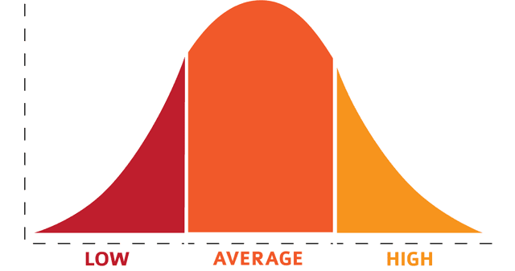
Understanding Intellectual Disability
Less intelligent
than average
More intelligent
than average
Second percentile
rank for IDD
Mean IQ = 100 with
Standard deviations of 15
Intellectual Developmental Disorder (formerly mental retardation) has a three part definition: (1) an IQ score of 70 or below (error of measurement +/- 5 points) with (2) concurrent deficits in adaptive functioning, and (3) an onset during the developmental period from birth to 18 years old.
I/DD are noted to have over 250 causes:
25% are syndromal (e.g., Down, Fetal Alcohol, Rhett, Fragile X, Cornelia de Lange)
75% are non-syndromal (e.g., problems during the birth process).
Current hypothesis centers on problems with synaptic pruning that is tied to learning and adaptation.

Slide 4
Degrees of Intellectual Disability and the Levels of Associated Support Required:
10% Moderate (35-49 IQ):
Limited Support
Individuals can learn skills, but may require additional support to navigate through everyday situations. n ls, but may require additional support to navigaveryday situations.
85% Mild (50-70 IQ):
Intermittent Support
Individuals require little intervention in order to function. They may need support during times of uncertainty or distress.
3% Severe (20-34 IQ) Extensive Support
Individuals may have some communication and self-help skills, but mainly rely on daily support to function around the clock.
2% Profound (Less than 20 IQ): Pervasive Support
Individuals require extensive and lifelong support, often institutionalized, in nearly every aspect of their routine.

Slide 5
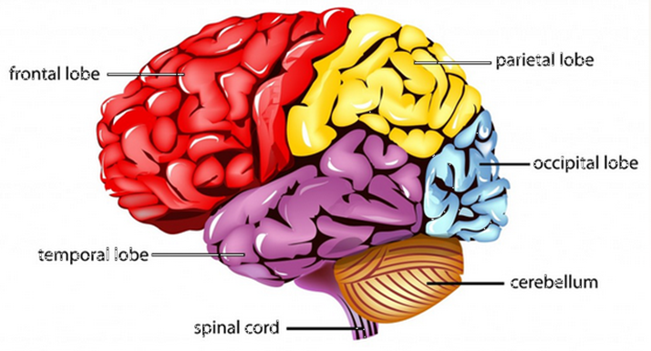
Regions of the Brain
The brain has three main parts:
Brainstem that controls vital physical functions and survival responses.
Limbic system that governs emotions. The “low road.”
Frontal cortex for higher-order thinking and executive functions: These include a sense of time and context, planning, thinking flexibly, decision-making, inhibiting and initiating action, self-monitoring, and empathic understanding. The “high road.”
Limbic system versus Frontal cortex: “The horse and the rider” metaphor.
5T

Slide 6
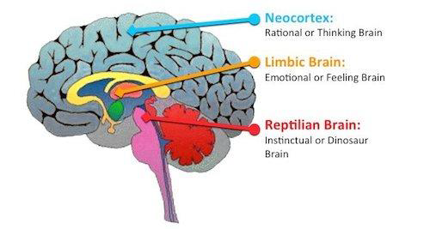
Parts of the Limbic System
Amygdala that detects threat (fight, flight, and freeze reactions)
Hippocampus for memory storage
Hypothalamus relays sensory information and activates the autonomic nervous and endocrine systems
6T

Slide 7
Categories of Intellectual Functioning
Verbal Comprehension:
General knowledge and reasoning skills. Related to formal and informal education.
Language is central our ability to label, organize and manage our internal experiences and the external environment.
Difficulty putting feelings and needs into words makes individuals prone to frustration, aggression, and depression.
Even small deficits in accessing language can have negative effects!
Perceptual Organization:
Visual-spatial skills.
Ability to create solutions, especially in novel situations.

Slide 8
Categories of Intellectual Functioning
Working Memory:
In-the-moment reasoning tied to attention, concentration, and short-term memory.
Important to learning, flexibility, planning, and self-monitoring.
Sensitive to anxiety and depression.
Related to trauma responses and anger management
Processing Speed:
Ability to work quickly and efficiently.
Sensitive to motivation and persistence.
PS may negatively effect overall cognitive functioning.

Slide 9
Adaptive Functioning
Based on performance of daily activities at a given age, rather than ability. That is, understanding an individual’s functioning through a “developmental lens” with age-equivalents.
Refers to how effectively people cope with common life demands across multiple environments.
Domains of Practical (e.g., hygiene), Conceptual (e.g., using cash and credit), and Social Skills (e.g., making requests).
Specific areas may include the following:
Self-care (e.g., grooming)
Expressive and Receptive Communication
Social and Community Activities
Independent living skills (e.g. housekeeping)
Health and safety awareness
Vocational abilities
Self-direction

Slide 10
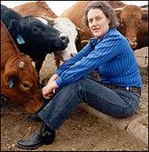
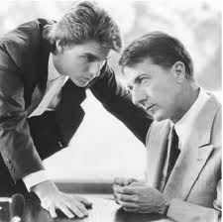
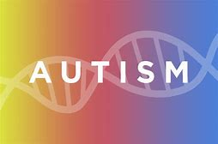
10J

Slide 11
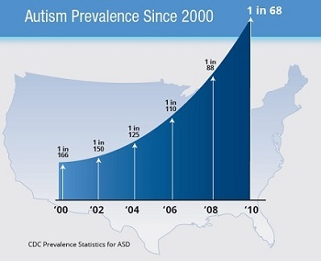
Statistics
About 5:1 male-to-female. In 2014, it occurred in 1 in 42 boys, as compared to 1 in 189 girls.
A Steady Increase in Prevalence:
birth year of 1992- rate 1 in 150
birth year of 1996-rate of 1 in 125
birth year of 2000-rate of 1 in 88
birth year of 2002-rate of 1 in 68
Autism is found across all cultures and
socioeconomic groups.
Notes:
A little over a year ago the CDC released new data about the prevalence of ASD

Slide 12
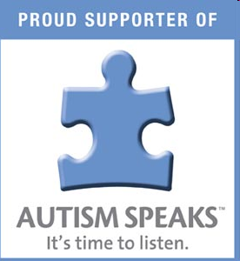
Why is the Prevalence of Autism Increasing?
Probably genuine rates and previous underestimates
Diagnostic changes with a broadening of categories
Better tools and identification process (i.e., ADOS)
More awareness (e.g., mental health providers, pediatricians, schools, media, parents)
Improved access to services (e.g., waivers) and associated treatments (e.g., Applied Behavior Analysis, speech therapy)

Slide 13
Autism
It’s called a spectrum condition because of its extreme complexity.
Functional capabilities and needs vary widely from person-to-person. For example, some can access language, transition in the daily routine, and perform self-care, while others require assistance.
Some may use rocking, flapping, spinning, etc. for self-regulation.
They may easily become overwhelmed in a crisis and engage in challenging behaviors that might be misinterpreted as disrespectful. These might include invading personal space, giggling, speaking loudly, and talking about unrelated topics.
Some may not feel or express physical pain (sensory integration dysfunction)
Some may process information better when avoiding eye contact, so may look like they don’t want to pay attention.

Slide 14
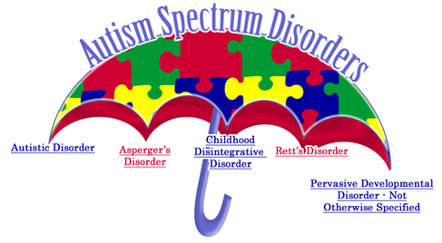
DSM-5 Changes in 2013
Distinctions can be difficult across the spectrum and with other disorders

Slide 15
Comorbid Conditions and Symptoms Associated with Autism Spectrum Disorder
Epilepsy-
EEG abnormalities
Gastro-intestinal Dysfunction
Aggression
AUTISM
SPECTRUM
DISORDER
Social Anxiety
ADHD
Impaired Social Communication/
Interactions
Restricted & Repetitive Behavior
Sleep Disturbance
Immune Dysfunction
Language Disorders
Intellectual Disabilities
OCD
Motor problems: Apraxia

Slide 16
Autism Spectrum Variations
‘Severely Affected’
Lower Functioning
Often Non-verbal
Intellectual Disability
Severe behaviors (e.g. self-injury)
Little to no social skills (‘in their own world’)
‘Less Noticeably Affected’
Higher functioning
Average to above average IQ
Verbal
Lack social nuances
Inability to see another’s perspective
Insistent on sameness

Slide 17
Autism Spectrum Disorder
Theory of the Mind or Mentalization:
Those with autism often have significant difficulty understanding and appreciating that others may have thoughts, feelings, opinions, intentions, and plans that are different from their own.
Difficulties with intuition, can result in the following:
Misreading body language (e.g., tone of voice, facial expression).
Misinterpreting social cues
Problems with reciprocation (i.e., give and take)
Difficulty understanding expectations
Painful awareness of social differences and challenges with "fitting in" socially may give rise to episodes of anxiety and depression.

Slide 18
Autism Spectrum Disorder
Cognitive Functioning:
Often rigidly cling to beliefs, convictions, or rules.
Autism is frequently misassociated with intellectual disability.
On the contrary, strong language skills can easily be misinterpreted as advanced communication/social skills, which can lead others to mislabel their actions as purposeful and manipulative.

Slide 19
Risk for Violence and
Autism Spectrum Disorders
Since the Sandy Hook tragic shooting, there is an increased need to clarify the relationship if any between autism spectrum disorder and violence.
Prevalence studies have not conclusively shown that individuals with ASD to be more violent than individuals without ASD. Actually, individuals with ASD are more likely to be a victim of crime rather than perpetrator.
There may be a small subgroup of individuals with ASD who are more likely to be serious offenders.
Of the individuals with ASD that are more likely to be violent, certain risk factors have been identified.
David Im, 2016. “Template to Perpetrate: An update on Violence in Autism Spectrum Disorder. www.harvardreviewofpsychiatry.org

Slide 20
ASD and Risk Factors for Violence
Comorbid psychopathology (depression, anxiety, psychotic, personality and substance use problems)
Deficits in social cognition including impairments in theory of mind and empathy
Emotional regulation problems
Other associated risk factors (e.g., younger age, male, higher parental income, social communication problems, sensory difficulties, repetitive behaviors, comorbid neurological problems, and sleep difficulties)
David Im, 2016. “Template to Perpetrate: An update on Violence in Autism Spectrum Disorder. www.harvardreviewofpsychiatry.org

Slide 21
ASD Risk for Violence
The Warning Signs
Studies of mass shooting episodes showed evidence of ASD in 6/75 cases (8%) which is 8 times higher than prevalence of under 1% found world-wide. Some common warning signs were found when studying these cases.
Increase in the intensity of preoccupations (particularly sinister/violent content).
Perceived grievance (i.e., sense of injustice, injustice collecting, need for fame, or revenge).
Evidence of planning an event for days, weeks, or even years (Instrumental aggression).
Allely et al. 2017. Violence is rare in autism: when does it occur, is it sometimes extreme? The journal of psychology: Interdisciplinary and Applied

Slide 22
ASD Risk Factors for Suicide
Sense of difference from others
No social cohesion (e.g., friendships)
History of victimization from bullying
Use of marijuana or alcohol for social bonding
Four Pillars of Risk Assessment
for Suicide in the General Population
Hopelessness
Aloneness
Self-Hatred
Inability to Cope (even through maladaptive strategies)

Slide 23
Protective Factors for Violence in ASD
Focus on individual needs and the environment
Skill building around self-awareness and interpersonal skills
Support (e.g., trusted person, advocates, feeling accepted/included)
Fardella e al. 2018. A qualitative investigation of risk and protective factors for interpersonal violence in adults on the autism spectrum. Journal of Disability and Society.

Slide 24
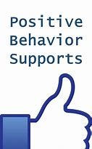
A comprehensive approach that views behaviors as goal-directed and interconnected with physiology, situational context, cultural factors, as well as a person’s thoughts and feelings.

Slide 25
Positive Behavior Support
Support for Positive Behavior
Support = Encouraging, increasing, and strengthening
Positive Behavior = desirable, adaptive, and prosocial
Avoids the use of aversive, humiliating, or stigmatizing interventions

Slide 26
Positive Behavior Support
Hallmark Strategies:
Minimize or eliminate environmental triggers
Proactive setting of expectations
Teaching acceptable behaviors
Building on existing appropriate behaviors
Improving quality of life
Consistency and fidelity with implementation

Slide 27
Positive Behavior Support
Terminology
Targeted Positive Behaviors:
To achieve, instill, increase, and maintain
Increase emotional regulation through coping strategies, self-soothing, healthy diversions, and opportunities to learn self-control.
Become more adaptive and self-reliant by building autonomy, mastery, confidence, and self-direction.
Increase prosocial skills and participation in community activities

Slide 28
Positive Behavior Support
Terminology
Behaviors of Concern: those to decrease or eliminate.
These include verbal outbursts, physical aggression, property destruction, perseveration, poor boundaries, and refusals.
Criteria for a Behavior of Concern:
Interferes with his or her growth, development, or progress.
Interferes with his or her ability to make decisions and to achieve goals.
Results in a psychotropic medication being prescribed to modify the behavior.
Poses a risk to the health and safety of the individual and others.

Slide 29
Positive Behavior Support
Learning the functions…
Setting Events and Vulnerabilities
Situations in the environment combined with individual’s deficits. Create positive setting events!
Antecedents (or Triggers)
What occurred immediately before the behavior?
Fast vs. slow precipitants? External (e.g., a conflict earlier in the day) vs. Internal antecedents (e.g., feeling lonely and disappointed)
The “universal trigger” is often “enforcing rules” rather than thinking flexibly when giving direction and guidance.
Precursors
What noticeable actions in body language came before the behavior of concern? (e.g., pacing, pressured speech, rolling their eyes, clinching their fists)
Maintaining Consequences
What occurred immediately after the behavior of concern?
How did the caregivers respond? Is there inadvertent reinforcement?

Slide 30
Better Understanding Why Individuals Engage in Maladaptive Behaviors Especially Those Seen with Intellectual Disability and Psychiatric Disorders (Robert Souvner, 1991)
Functional Assessment of Behavior
Functions
of
Maladaptive
Behavior
Communication
Modulates
Internal
Distress
Modulates
Physical
Distress
Socio-
Environmental
Control
Be aware that functions differ for each individual. Some might be readily apparent and others might not be noticeable.
Behaviors might serve multiple functions.

Slide 31
Becoming Aware of
Developmental Disability
Sensitivities to even everyday stimuli can be uncomfortable or even intolerable, especially with autistic features. For example, turn off sirens and flashing lights when possible or place canine partners out of sight.
Consider physical fragility.
Check for any special or assistive equipment. These could be signs of mobility issues.
There is often a higher probability of neurological compromise (e.g., seizure disorder) with developmental disabilities.
A person might not be aware of their own deficits!

Slide 32
Becoming Aware of
Developmental Disability
Look for mental health difficulties (e.g., unusual behaviors, poor reality testing, “fight or flight” responses related to past trauma)
Self-protective responses may not be intended as aggressive.
Don’t assume that the person is intentionally trying to be difficult, as some challenges might be out of their control. For example, memory deficits might lead to problems understanding multi-step directions.
Look for signs of psychosocial masking (e.g., nodding in agreement, politely saying yes) to adaptively conceal impairments.

Slide 33
Intelligence and Behavior
Intellectual impairment is often related to behavioral problems with delaying gratification, controlling impulses, and tolerating frustration.
The best approach is building on cognitive strengths and minimizing weaknesses. For example, providing information using pictures, rather than words, to someone with visual-spatial strengths and verbal limitations.

Slide 34
The Power of Acknowledging Perspectives Validation is Powerful
Active listening by being attuned (e.g., undivided attention).
Accurate reflection to defuse negative emotions.
Neutral and empathic validation only mean acknowledgement, not necessarily agreement.
In the Crisis Cycle, with developmental disabilities in the picture, sufficiently validate (i.e., repeated) before giving any corrective feedback, such as redirecting, limit setting, or finding solutions.
Remember any contextual factors (e.g., holidays).

Slide 35
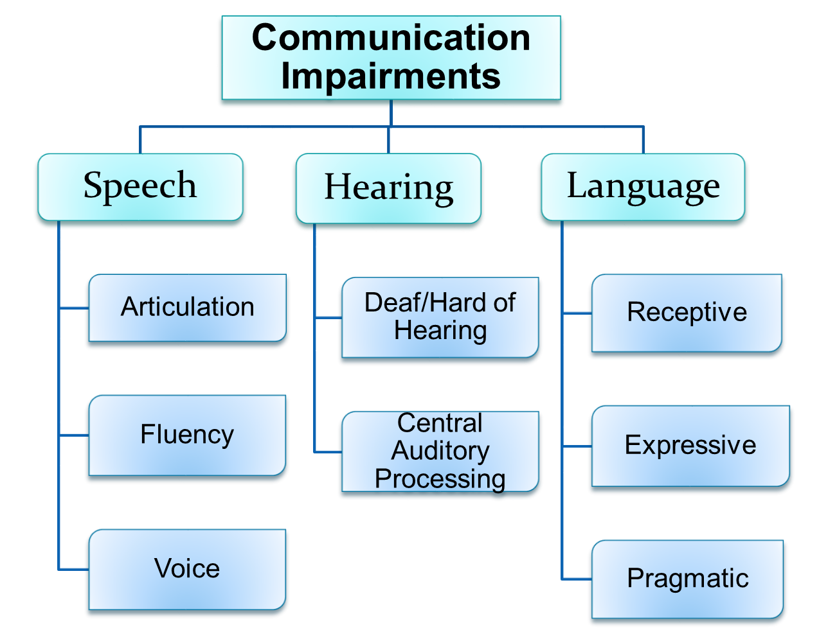

Slide 36
Communication Challenges
Some people with disabilities can understand even if they can not express themselves (expressive language disorder).
Is there a language barrier?
Does the individual need extra time to organize their thoughts or retrieve words?
Is there an anxiety issue preventing the individual from speaking?
On the contrary, some who speak may not understand or may say things out of context (receptive language disorder).
Is hearing an issue?
Does the individual process information slower?
Is there too much information being provided at once?
Is English the primary language?

Slide 37
Communication Tips
Language
Speak clearly and softly using short phrases.
Show interest and concern.
Give concrete directions in one or two steps at a time.
Describe what you will be doing beforehand.
Avoid slang expressions, idioms, and metaphors
(e.g., “knock it off,” “cut it out,” or “settle down”).
Watch for words that trigger agitation, such as “If/then” statements, as the person might not think contingencies are achievable.
It’s okay to ask the person to repeat themselves or to demonstrate (contextual grounding) something for you.

Slide 38
Communication Tips
Ask the person to repeat back information to check for understanding.
Try other ways to communicate, such as drawings, pictures, cues, gestures, signs, or an I-Pad.
Try to speak with the person directly even if a family or staff member is present. However, there might also be times to seek information from others at the scene, especially those who might know the individual well.
Always speak respectfully in the person’s presence. Use “person-first” language (e.g., An individual with disability).
Share what you learn about the person with others who will be assisting.

Slide 39
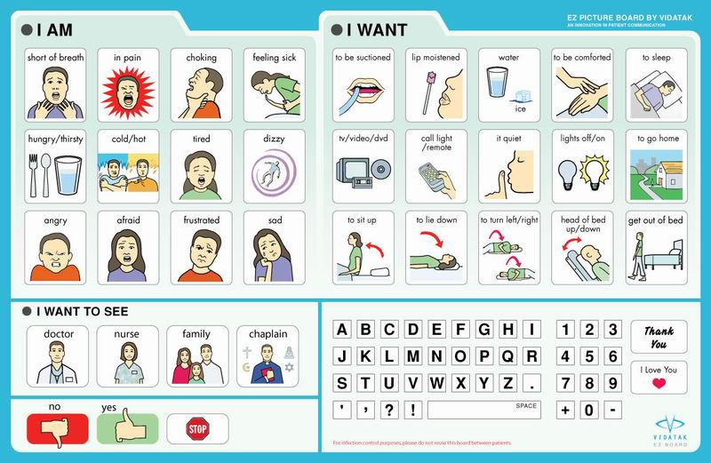

Slide 40
Applying Communication Tips in the Field
Choices
Offer two to three choices when possible provides the person with a sense of control. These choices may lead to a similar outcomes (e.g., de-escalation). Be mindful that overly negotiating may lead to confusion.
Reinforcement
Give verbal praise immediately and explicitly (within 30-60 seconds). Delays don’t reinforce the positive behaviors due to memory deficits.
Compassionate Inquiry
Give them a better sense of self (e.g., What does {positive behavior} say or tell us about you?)
Shaping
Reward "successive approximations” to the desired goal

Slide 41
Applying Communication Tips in the Field Setting and Reviewing Expectations
Allow them extra time to process and respond
Have realistic expectations.
Be consistent with language, especially between responders.
Rephrase questions or restate directives as needed.
Learning problems may interfere with understanding what constitutes “appropriate” behavior. It’s too vague and open to interpretation. Therefore, directives should be very specifically convey the expectation...

Slide 42
Applying Communication Tips in the Field
The Importance of Affirmative Language
Tell the person what you want them to do, rather than what you do not.
“Use an ‘inside’ voice,” instead of “Stop talking so loudly”
“Keep your hands down,” rather than “Don’t hit”
“Mouth closed,” in place of “Stop spitting”
“Walk slowly,” as a replacement for “Don’t go too fast”
Watch for engrams (a mechanism of memory in response to external stimuli). These “hot spots” that get activated in the brain cause people to only hear the triggering part of a message!

Slide 43
Asking the Right Questions!
The following case example illustrates the importance of asking the right questions and exploring all options….especially in a crisis situation.
Is the challenging behavior a symptom of a health condition, side effect of medications, or the result of skills deficits?
Mr. Jones has severe cognitive deficits. He is non-verbal. He has no history of being aggressive or destructive. One evening, he began ragefully throwing the furniture in his group home. The police were called due to staff being unable to control Mr. Jones’ violence. The police successfully deescalated Mr. Jones, however, due to group home policy, he was required to be assessed at the ED and the police were able to assist in this transport. At the local emergency room, Mr. Jones was seen by a crisis clinician, and then later admitted to a psychiatric unit with a diagnosis of psychosis.
After a thorough medical evaluation the following day, it was determined that Mr. Jones’ symptoms and behaviors were related to severe dehydration. The initial psychiatric diagnosis did not include the possibility that other factors, such as medical illness, contributed to his lack of behavioral control.

Slide 44
Video Clip

Slide 45
Positive Behavior Support
Caregiver Qualities
Supportive
Respectful
Strengths-based
Collaborative
Empowering
Give choices
Build self-esteem
Believe in them! (It’s a key factor for resiliency)

Slide 46
Positive Behavior Support
Proactive Versus Reaction Intervention Points

Slide 47
Benefits of Proactive versus Reactive
Notes:
How to help parents understand this concept and teach how to shift

Slide 48
Positive Behavior Support
Reactive Strategies
Caregivers’ actions after a behavior of concern occurs.
For limited use about 5 to 10% of the time.
These should be used to help situations from escalating.
For example, prompting alternative behaviors, using distractions, redirecting away from triggers, establishing control when there is harm to self or others, respite care, and hospitalization.
Reactive interventions are affected by state-dependent learning. We may lose up to 25 IQ points when upset.

Slide 49
Positive Behavior Support
Overarching Goal
Our aim is the presence of targeted adaptive and prosocial behaviors through instruction, not just the absence of challenging behavior.

Slide 50
Crisis Intervention Tips when Responding to those with
Developmental Disabilities
A process of “defusing” and “deflating” as we try to coach calmness without physical interventions when possible.
Strive for three practical goals: Safety, Connection, and Empowerment
General Techniques:
Show concern
Conceal your emotions like anger and fear
Give hope about generating solutions
Ground in current reality
Do not focus only on negative actions
Congratulate steps toward regaining control
Focus on the individual’s interests and goals in life

Slide 51
General Interaction Tips
After you announce yourself and share your identification:
Have only one person act as the primary “interactor.”
When the situation allows, take an empathic stance by using a warm or neutral tone. For example, “I’m here to help keep everyone safe”
Avoid correcting behaviors. Give directives for positive behavior instead.
Ask questions in a step-by-step manner and allow time for the individual to process and answer.
A delayed or absent response to your questions or commands may not necessarily reflect willful.

Slide 52
Interaction Tips
De-escalation Strategies
Ask the person or the responsible party how you can best assist. “What has helped in the past in situations like this?” “Do they have a crisis plan?”
Look for sensory aids and allow the person to hold a soothing item if safety is not jeopardized.
Tell them honestly what is likely to happen using everyday language.
Show the person what you want them to do if possible, rather than just stating it.

Slide 53
Interaction Tips
Things to Avoid if Possible
Avoid sudden and unpredictable movements.
Avoid stopping their repetitive behaviors (e.g., hand flapping) unless there is a risk of injury, as it they might be a means of self-soothing.
Ignore self-talk the person uses for coping unless it interferes in emergency procedures. This may sometimes include profanity or verbal threats.

Slide 54
In Closing
We appreciate your feedback: Please provide questions, comments, and case examples for us to share going forward!
Thank you for your attendance and participation!

