Slide 1
PRC Quarterly Meeting Restraints, Incident Reports & Data
April 30, 2021
Dr. Duzant NR PRC Liaison
Dr. Recinos SR prc liaison
Dr. Lloyd WR PRC liaison

Slide 2
Topics
Restraints
DDS Policy PR.004 Program Review Committees (revised on 2/1/2018)
Section D.2.c
Incident Reporting
DDS Policy I.D.PR.009 Incident Reporting (Revised December 30, 2014)
Section C (Critical Incident Defined)
Attachment A to I.D.PR.009 - DDS Incident Report Form 255
Attachment B to I.D.PR.009 – Incident Reporting Instructions for Completing 255
Attachment C to I.D.PR.009 - Incident Report - DDS Form 255 Definitions
Attachment D to I.D.PR.009 – DDS Restraint Log
Data
DDS Policy PR.003 Positive Behavior Program and Behavior Support Plans (revised on 2/1/2018).
Section D.5

Slide 3
Topic 1: Restraints

Slide 4
Restraints Mentioned in DDS Policies: PR. 002, 003 and 004 Revised on 2/1/18
In all 3 DDS Policies referenced here, restraints are mentioned and defined in the following manner:
“Mechanical restraint” means an apparatus used to restrict an individual’s movement, including any device, such as helmets, mitts or bedrails, used to prevent self-injury. Devices designed by a physical therapist and approved by a physician that are used to achieve proper body alignment or balance, and protective devices approved by a physician to address an individual’s medical condition are not mechanical restraints.
"Physical restraint" means a department-approved physical intervention used to restrict an individual’s movement to protect the individual or to prevent self-injury or injury to another person.
“Chemical restraint” means psychiatric medication administrated on an emergency basis to an individual, who is in danger of harming himself or herself or another person, when all other interventions have failed. Medications used for pre-sedation for medical or dental procedures are not considered to be chemical restraints.

Slide 5
PR. 004 – Restraint specifics found in Section D, "Implementation"
1. PRC Guiding Principles, b. PRC presentation for:
Initial use or modification of floor control.
Prone or face down restraint is strictly prohibited.
2. PRC Membership and Charge, c. Regional PRC reviews , makes recommendations, and approves the use of:
iii. Any behavior plan that contains the use of aversive procedures, including new behavioral strategies, or changes to previously approved BSP if they include an aversive procedure.
v. At the request of the individual’s Planning and Support Team, when either (1) emergency restraints have been used more than three times*** within a 30-day period, or (2) there is a pattern of emergency restraints (e.g., once a month for three months or other similar pattern).*** Three times is considered a minimum.

Slide 6
Request for Program Review Committee (PRC) Date to Review
Behavior Modifying Medication or Restraint or Aversive Procedure

Slide 7
Considerations when adding restraint to a Behavior Support Program
Review other interventions and measures previously attempted/used before adding restraint to a BSP. Fully explain the success or failure of less aversive measures to help staff, other clinicians, PRC members, licensing inspectors understand what led the team to the decision to use restraint. (Ex. Monthly Risk Reviews)
Review factors that may contraindicate the use of restraint for the individual:
A history of trauma and abuse (family, staff, law enforcement, medical professionals, institutions) and past responses to any type of restraint.
Notes:
FYI – some situational/environmental concerns that increase risk for restraint use:
Prolonged agitation during restraints (as this can be an indicator of a trauma response, sensory integration problems, etc.). This is a SIGNIFICANT risk and concern as it increases the body’s demand for oxygen (physical struggle, anxiety, and strong emotions).
Prolonged restraints (more than 10 minutes) are higher risk as they indicate increased agitation.
Pressure to neck, chest, or abdomen
Hot humid environment
Person complains of pain during restraint
Change in coloration during restraint indicates circulation problems which is a significant risk factor and requires immediate release. Note that indicators differ across complexions: darker skinned people become more pale; lighter skinned people get bluish/purplish; people of Asian dissent develop greenish tone.
Intoxication (alcohol or drugs) during restraint as this effects breathing and the brain’s control of breathing making it less likely for the person to reposition to allow effective breathing
Active psychotic state, delirium, or extreme arousal (mania)
Recent head injury or other significant injury
Prolonged restraint follows physical struggle or violence that caused fatigue
Person is small in stature
Recent insulin injection
Medical concerns that increase risk for restraint use:
Cardiac or Pulmonary conditions
Asthma or Emphysema
Chest deformities
Enlarged heart
Prescribed medications that obstruct breathing or cardiac system
High Blood Pressure
Obesity
Seizures or Seizure disorder
Sickle Cell Anemia
Diabetes
When to release restraint:
Best practice: agree to release the restraint after a specified number of minutes (as few minutes as possible; recommend less than 10) and then immediately give the individual space.
Do NOT use the “Until calm” release method unless team has conducted risk/benefit assessment and concludes this is best approach.

Slide 8
Situational and EnvironmentalConsiderations
Situational and environmental concerns that increase risk for restraint use:
Prolonged agitation during restraints (as this can be an indicator of a trauma response, sensory integration and sensory processing problems, etc.). This is a SIGNIFICANT risk and concern as it increases the body’s demand for oxygen (physical struggle, anxiety, and strong emotions).
Prolonged restraints (more than 10 minutes) are higher risk as they indicate increased agitation.
Pressure to neck, chest, or abdomen.
Hot, humid environment.
Person complains of pain during restraint.
Notes:
FYI – some situational/environmental concerns that increase risk for restraint use:
Intoxication (alcohol or drugs) during restraint as this effects breathing and the brain’s control of breathing making it less likely for the person to reposition to allow effective breathing
Active psychotic state, delirium, or extreme arousal (mania)
Recent head injury or other significant injury
Prolonged restraint follows physical struggle or violence that caused fatigue
Person is small in stature
Recent insulin injection
Medical concerns that increase risk for restraint use:
Cardiac or Pulmonary conditions
Asthma or Emphysema
Chest deformities
Enlarged heart
Prescribed medications that obstruct breathing or cardiac system
High Blood Pressure
Obesity
Seizures or Seizure disorder
Sickle Cell Anemia
Diabetes
When to release restraint:
Best practice: agree to release the restraint after a specified number of minutes (as few minutes as possible; recommend less than 10) and then immediately give the individual space.
Do NOT use the “Until calm” release method unless team has conducted risk/benefit assessment and concludes this is best approach.

Slide 9
Situational and Environmental Considerations, continued
Change in coloration during restraint indicates circulation problems which is a significant risk factor and requires immediate release. (Note that indicators differ across complexions: darker skinned people become more pale; lighter skinned people get bluish/purplish; people of Asian descent develop greenish tone.)
Intoxication (alcohol or drugs) during restraint as this effects breathing and the brain’s control of breathing making it less likely for the person to reposition to allow effective breathing.
Active psychotic state, delirium, or extreme arousal (mania).
Recent head injury or other significant injury.
Prolonged restraint follows physical struggle or violence that caused fatigue.
Person is small in stature.
Recent insulin injection.
Notes:
FYI – some situational/environmental concerns that increase risk for restraint use:
Medical concerns that increase risk for restraint use:
Cardiac or Pulmonary conditions
Asthma or Emphysema
Chest deformities
Enlarged heart
Prescribed medications that obstruct breathing or cardiac system
High Blood Pressure
Obesity
Seizures or Seizure disorder
Sickle Cell Anemia
Diabetes
When to release restraint:
Best practice: agree to release the restraint after a specified number of minutes (as few minutes as possible; recommend less than 10) and then immediately give the individual space.
Do NOT use the “Until calm” release method unless team has conducted risk/benefit assessment and concludes this is best approach.

Slide 10
Medical Considerations
Medical concerns that increase risk for restraint use:
Cardiac or Pulmonary conditions
Asthma or Emphysema
Chest deformities
Recent injuries, strains, sprains, or fractures.
Enlarged heart
Prescribed medications that obstruct breathing or cardiac system
High Blood Pressure
Obesity
Seizures or Seizure disorder
Sickle Cell Anemia
Diabetes
Notes:
FYI – some situational/environmental concerns that increase risk for restraint use:

Slide 11
When to release restraint?
Best practice: agree to release the restraint after a specified number of minutes (as few minutes as possible; recommend less than 10) and then immediately give the individual space.
Do NOT use the “Until Calm” release method unless:
The team has conducted a risk/benefit assessment and concludes this is best approach.
Specifically define calm for THAT individual.

Slide 12
Chemical restraint: Protocol for use
As with any restraint, the use of chemical restraint must be thoroughly justified through documentation.
The use of a PRN for behavioral reasons (defined as a “chemical restraint” above) requires the development of a detailed and well-thought-out protocol for its’ use.
A protocol must be developed with and approved by the prescribing psychiatrist.
The team RN must also review and approve the protocol.
Staff certified to pass medications are trained on the use of the PRN per the written protocol.
The protocol contains details on the criteria for initiating PRN use, notification of RN, administration, documentation of use and observations of the individual receiving the PRN (vitals), additional doses, and PRN discontinuation.
Look forward to and plan for titration.

Slide 13
Noting the hierarchy of restraint use:
It is important to outline the hierarchy of restraint use in the Behavior Support Plan.
Describe from least aversive to most aversive.
Least aversive used first, then move to next level with floor control and chemical restraint being the most aversive.
Examples:
Escort – Lower Figure 4 – Seated hold (Cradle, Basket) – Floor control
Provide guidance as to when to progress through the hierarchy.
Provide criteria for when to discontinue a restraint. Observable behavior, not just the absence of behavior.
When titrating restraint use, remove the MOST aversive first as not all need to be discontinued at once.

Slide 14
Topic 2: INCIDENT REPORTS

Slide 15
Types of Incidents
Injury
Unusual Incidents
Medication Error
Restraint
Notes:
This policy applies to individuals who receive funding or services from DDS and qualified providers who receive funding from DDS. It applies to all DDS operated, funded, or licensed facilities and programs. It DOES NOT apply to individual’s living in their own or family’s home.

Slide 16
Incident Reporting DDS Policy I.D.PR.009 Revised December 30, 2014
Incident Reports (255) are to be completed after:
Injury - Physical trauma sustained by an individual served by DDS (regardless of whether event causing injury was observed or resulting injury later discovered).

Slide 17
Incident Reporting DDS Policy I.D.PR.009 Revised December 30, 2014
Incident Reports (255) are to be completed after Unusual Incidents:
dangerous or life threatening to individual or others;
illegal;
requires police involvement;
involves fire setting;
requires assessment in emergency department;
is significant/extreme/worrisome behavior not addressed in BSP/guidelines;
involves other incidents not otherwise reported such as accidents without injuries, unplanned emergency room or hospital admissions not related to an injury, or similar incidents.

Slide 18
Incident Reporting DDS Policy I.D.PR.009 Revised December 30, 2014
Incident Reports (255) are to be completed after:
Medication Errors – See DDS Medication Error Report Form 255m (Revised Dec. 2014)

Slide 19
Incident Reporting DDS Policy I.D.PR.009 Revised December 30, 2014
Incident Reports (255) are to be completed after Restraints:
Includes both Emergency and PRC Approved Restraints
July 8, 2011 Exec. Brief lists interventions that were removed from Incident Report. NOTE: the removed restraints are those that are approved through HRC (mitts, helmet, specialized clothing, buckle guard, etc.)

Slide 20
Restraint Section of Incident Report
Notes:
2c Restraint:
Notice Restraint Date includes Final DATE OUT (this allows for submission of multiple restraints on the adjoined restraint log)
If you’re only reporting 1 behavioral event on the 255, you will include the time in & time out.

Slide 21
Restraint Section of Incident Report
Notes:
Restraint(s):
Check off the appropriate types of restraints (up to 4).
We will discuss the definitions of each

Slide 22
Restraint Section of Incident Report
Notes:
Behavior(s):
If the restraint log is being used, the behaviors will be listed for each restraint.
If only 1 behavioral event is submitted with the 255, you’ll include the behaviors that occurred to warrant the need for restraint.

Slide 23
Restraint Section of Incident Report
Notes:
Status:
EMERGENCY or PRC/HRC Approved
If an injury is caused by the restraint, this also requires RN follow up.
Monitoring by someone not involved in the restraint is required if it lasts 30 minutes (and monitoring should continue to occur at least every 30 minutes). Monitoring is when a person other than those involved in the restraint checks the person to make sure they’re still in the restraint correctly and for signs of distress. Keep in mind that staff administering restraint should ALSO be paying attention to signs of distress. Some aspects monitored:
Any signs of discoloration? If so, did you terminate the restraint?
Labored breathing? If so, did you terminate the restraint?
Any complains of pain during restraint? If so, was person released/repositioned?
If a mechanical or physical restraint is employed for 50 minutes, the person should be assisted to exercise that body part for 10 min every hour.

Slide 24
Restraint Section of Incident Report
Notes:
Person Applying is the staff restraining [including 2nd staff if there’s 2:1 needed for application of restraint]
In-charge is the lead staff on during restraint [this tends to be missing from incident reports]
Person removing is for mechanical restraint removal
Emergency restraint trauma check within 24 hours is done by RN to ensure no injuries sustained, skin integrity intact, no bruising, etc. Some agencies use a Body/Trauma Check form to attach to 255.
Summary/Comments section
Discuss PRE-cursor events and strategies used to calm the person prior to requiring restraint.
The level of supervision should be reflected clearly in the content of the summary and incident report. When this is missing, it raises a red flag that a call to AID for neglect may be indicated.
If additional staff are present to assist and ensure safety to the other individuals present, be sure they are represented on the report and their role is included in the summary.

Slide 25
DDS Restraint Log Instructions Attachment D to I.D.PR.009 – DDS Restraint Log
For use when:
PRC Approved Restraints are required regularly AND
The team agrees that use of the restraint log is appropriate [in lieu of completing a separate 255 for EVERY restraint].
At the end of each month (or less if team agrees), attach the restraint log to a 255 and submit as you would any 255.
The 255 includes a start date at the top & end date in the restraint section.
If an INJURY is caused by a restraint, a separate 255 must be completed per policy.
Notes:
Keep in mind that switching to a restraint log results in a delay in reporting and lack of documentation of detailed circumstances surrounding the restraint. The team will assess whether this is justified.
If a restraint log is considered appropriate, the team will agree upon a set time frame for submissions [of at least once per month].
Keep in mind that if an injury is caused by a restraint, the entire event must include a separate 255 (the 255 should represent BOTH the restraint AND the injury as well as the details that led up to the restraint)

Slide 26
Attachment D to I.D.PR.009 – DDS Restraint Log
Notes:
This is the example restraint log provided by DDS. Note the information documented with each restraint. The last column asks whether an injury was caused by the restraint. If SO, ensure a separate 255 is completed. Aseparate 255 must be completed if an injury is caused by the restraint because the report needs to include events surrounding the event and details about the interventions employed. It’s also important to consider whether an AID call is warranted upon review.

Slide 27
Standard Restraints on Incident Report
Standard PRC Approved or Emergency Restraints
Chemical
Escort
Floor Control – Supine (face up)
Lifted and Carried
Sitting Floor Control
Standing Restraint Holds
Notes:
Chemical – Medications (usually psychotropic) administered on a STAT or immediate/emergency basis, usually after other interventions including physical or mechanical restraints have failed to result in calm behavior and the individual is still in danger of harming himself or others.
i.e., PRN medications
Exclude: Medications used for pre-sedation for medical/dental procedures shall not be documented as chemical restraint.
Escort – Physical redirection used to move the individual when he or she is resisting. NOTE: This is moderate to severe resistance not simply to help get the individual from ‘Place A’ to ‘Place B.’
If no resistance, it should not be called an escort.
Floor Control – Supine (face up) - Individual is held on floor in a supine (face-up) position by at least two and up to seven staff holding the arms and legs, and head if needed to protect the person from injury. Special approval is required if more than seven people are involved in applying the restraint.
FACE DOWN RESTRAINTS are STRICTLY PROHIBITED for DDS-Funded Individuals
Lifted and Carried - Individual is lifted from behind by one to three staff holding the upper arms and/or wrists and legs if necessary and carried from one place to another.
Sitting Floor Control - The utilization of approved physical holding techniques based on an approved curriculum that require staff to hold the individual while sitting. Techniques such as Basket or Cradle Sitting Holds, etc.
Also includes Held by Arms (If Sitting)
Standing Restraint Holds - The utilization of approved physical holding techniques based on an approved curriculum that require staff to hold the individual in a standing position. Techniques such as Lower Figure 4 Standing Hold and Security Holds, etc.
Includes Held by Arms (if Standing)
Physical Isolation – An individual is separated from other individuals, usually in a room by him or herself, and staff is Physically Preventing the individual from exiting a room. Through such means as physically blocking a door, an individual is not allowed to leave until defined criteria are met.
DDS considers seclusion to be excessively punitive.
Any instances of physical isolation must be documented as a restraint.
This includes moving an individual in a wheelchair into an isolated space against his/her will when the individual is unable to independently control a wheelchair
DO NOT REPORT on a 255: If an individual is asked or told to go into a room alone and remain there and nothing physically prevents his or her leaving, even when a period of time or other criteria are given (i.e., if there is only verbal direction for the individual to go and remain in a room and no physical force or blocking occurred as part of the process).
This topic certainly warrants detailed discussion that is beyond the scope of this presentation on 255's. However, I want to add some brief caveats here.
While telling an individual to go into a room alone and remain there does NOT warrant a 255 for Physical Isolation, keep in mind the power differential between staff and individuals served. Being told to go to a room alone by someone in a position of control/power over you is NOT a recommended intervention for an adult. We serve many individuals who self-harm when they are upset. Telling them to go to their room alone without supervising them is NOT appropriate.
Our goal is to teach skills for self-regulation. Ideally, taking a break is voluntary and occurs BEFORE the individual has lost control by engaging in disruptive behavior. Suggesting at the onset of precursors, “would you like to take a break or a walk to cool down with me?” is very different than telling someone to go to their room alone. Many individuals want to step away when they need a break and can be afforded to right to be alone in that situation.
Keep in mind that once the person gets beyond their threshold of tolerance, they need interventions to reduce risk. Telling them to go be alone is isolating and can intensify the painfulness of the situation. We want to steer away from interventions that are likely to escalate feelings of isolation and increase likelihood of self-harm.

Slide 28
Non-Standard Restraints on Incident Report
Non-Standard Commissioner Approved - Use of either physical or mechanical restraint that is not currently identified as a DDS approved restraint and that has been submitted and approved for the individual by the commissioner review process.
Non-Standard Not-Approved - Temporary/emergency use of either physical or mechanical restraint that is not currently identified as a department approved restraint that has been submitted but has not yet received approval by the commissioner review process.
Notes:
These should occur very rarely as they do not fit within the standard restraint protocols.
Keep in mind that HRC reviews some mechanical restraints like mitts, helmet, specialized clothing, buckle guard, etc. Those are NOT considered to be in the 255’s restraint category and do NOT require a 255. Data is tracked separately. This change was made in 2011 and the 2011 executive brief discusses these details.
Non-standard commissioner approved:
This is a restraint NOT listed on the incident report that has been PRC approved (commissioner review process is PRC).
Ensure details of the restraint are included in the Summary/Comments section of incident report.
There have been occasions in which a non-standard restraint was approved by PRC.
EXAMPLE: use of a tray on a wheelchair to assist in keeping the individual in their seat. As with any restraint plan, a fade plan was developed with proactive teaching strategies to reduce the need for the restraint. Additionally, they must ensure the individual gets 10 minute breaks every hour.
Non-standard not-approved:
This is a restraint NOT listed on the incident report that has been submitted for PRC approval but has not yet been approved (commissioner review process is PRC).
Ensure details of the restraint are included in the Summary/Comments section of incident report.
There have been occasions in which a non-standard restraint was NOT approved by PRC.
In this case, the guardian/conservator/etc. may seek approval through a PAR or commissioner review.

Slide 29
Mechanical Restraints on Incident Report That Need Prior Approval
Body Board
Four-Point
B-Safety Belt
Safety Cuffs
!
Notes:
Recall that mechanical restraints that are currently able to be approved thorough HRC were removed from 255’s in 2011. Those are recorded through data and reported to HRC (for initial reviews) and/or PRC with an HRC representative (if psychiatric medications are prescribed also).
These 4 mechanical restraints are considered excessively restrictive. Use of these require prior approval through PRC. If not granted through PRC, they would require special review by the regional director and/or commissioner.
Body Board - Board used with body wrap to immobilize individual who is aggressive to self or others in a non-medical situation. Includes both body boards and body wraps.
Four-Point - Use of four safety cuffs (padded wrist cuffs with Velcro closures attached to long pieces of fabric) to restrain both arms and legs of the individual. These are always used with the person in a face-up position, always on a bed, and always with one arm upward (over the head) and the other arm downward (at the person’s side). Any variation in this positioning requires special approval. Additionally, this procedure shall be administered using approved procedures for use of four-point restraint (e.g., release, exercise, monitoring, etc.)
B-Safety Belt - Any waist belt with two-padded wrist cuffs and all Velcro enclosures used only to safely move or transport an individual. Two people (one on each side) should be present at all times that the belt is in use while the individual is standing or ambulating. (One example of this type device: Bergeron Safety Belt.)
Safety Cuffs - Use of less than four safety cuffs (padded wrist cuffs with Velcro closures attached to long pieces of fabric) to restrain both arms of the individual to protect the individual from harming self or others.

Slide 30
Aversive Listed on Incident Report
Physical Isolation – An individual is separated from other individuals, usually in a room by him or herself, and staff is Physically Preventing the individual from exiting a room. Through such means as physically blocking a door, an individual is not allowed to leave until defined criteria are met.
Physical Isolation involves caretaker(s) remaining present with the individual.
Physical isolation includes moving an individual in a wheelchair into a space against his/her will when the individual is unable to independently control the wheelchair.
Notes:
Staff DO NOT leave an individual alone during physical isolation. The person is isolated from other people served by DDS who may live in the home. NOT isolated from their caretakers.
Locking someone in a room and not allowing them to leave is seclusion and warrants a report to AID for possible abuse/neglect.
If an individual is in a wheelchair, moved by a caretaker against their will and unable to control the wheelchair, this must be properly documented as physical isolation.
A behavioral event is NOT REPORTED on a 255: If an individual is asked or told to go into a room alone and remain there and nothing physically prevents his or her leaving, even when a period of time or other criteria are given (i.e., if there is only verbal direction for the individual to go and remain in a room and no physical force or blocking occurred as part of the process).
While telling an individual to go into a room alone and remain there does NOT warrant a 255 for Physical Isolation, keep in mind the power differential between staff and individuals served. Being told to go to a room by someone in a position of control/power over you is NOT a recommended intervention for an adult. We serve many individuals who self-harm when they are upset. Telling them to go to their room ALONE without supervising them is NOT appropriate.
Our goal is to teach skills for self-regulation. Ideally, taking a break is voluntary and occurs BEFORE the individual has lost control by engaging in disruptive behavior. Suggesting at the onset of precursors, “would you like to take a break or a walk to cool down with me?” is very different than telling someone to go to their room alone. Many individuals want to step away when they need a break and can be afforded to right to be alone in that situation.
Keep in mind that once the person gets beyond their threshold of tolerance, they need interventions to reduce risk. Telling them to go be alone is isolating and can intensify the painfulness of the situation. PRC is not going to support an intervention that is likely to escalate feelings of isolation and likelihood of self-harm.

Slide 31
Critical Incident Defined Policy Procedure: I.D.PR.009
CRITICAL INCIDENT (requires immediate reporting):
Death that resulted from an injury. Also report the death following DDS procedure I.D.PR.001, Mortality Reporting, Reporting Deaths of Individuals
Severe injury that requires a hospital admission
Vehicle accident causing a severe injury
Missing person who has been reported to the police
Fire caused by the individual that required emergency response or involving a severe injury. Fires caused by staff, others, or cause unknown would be reported but not using the DDS 255 process
Police arrest of an individual
Victim of Aggravated Assault or Forcible Rape
Notes:
Per policy: all types of critical incidents except severe injuries will also be immediately reported to the appropriate DDS regional on-call manager. Severe injuries will be reported to the region during the next business day unless the injury results in a hospital admission.
The responsible program staff shall complete the DDS 255 or 255m Form (See Attachment A-F for instructions on form completion), fax a copy to the Regional Director or designee’s office not later than the next business day, insert the original 255 or 255m form in the individual’s case file, and send copies to the DDS region.
EXAMPLE: Even if a head hitting behavior or falling behavior is tracked in a BSP, if a fall/hit injury results a hospital admission (such as skull fracture), it is a critical incident.
A question was asked about whether missing persons ALSO requires the Missing Persons Form from the DDS manual to be completed…
We understand that both the critical incident 255 and the DDS Missing Person Form is needed once a formal missing person report is filed with law enforcement.

Slide 32
Critical Incident Defined Policy Procedure: I.D.PR.009
Critical Incident EXAMPLES pertaining to restraints:
Restraint that results in a severe injury because it requires the individual to be admitted to the hospital.
Chemical restraint that results in an overdose due to a med error and requires a hospital admission.

Slide 33
Data and Incident Report Timeframes
Reporting, Notification and Documentation of Non-Critical Incidents During Normal Business Hours:
The responsible program staff shall complete DDS Incident Report Form 255 or 255m during the same shift when the incident is observed or is discovered, shall notify the individual’s family and/or guardian, and shall forward the completed Form to the appropriate DDS Region no later than the next business day. (See Attachments A-F for forms, instructions).
Emails for sending incident report: DDS-NR.IncidentReports@ct.gov --- North Region DDS-SR.IncidentReports@ct.gov --- South Region DDS-WR.IncidentReports@ct.gov --- West Region
Notes:
The responsible program staff shall insert the original DDS Form 255 or 255m into the individual’s case file and forward copies to the appropriate DDS Region not later than the next business day after the day the incident was observed or discovered.

Slide 34
Family or Own Home 255 Timeframes I.D.PR.009-Attachment H
D. Implementation 1. The following process shall be used to report, notify and document all reportable incidents as defined (NOTE: Deaths resulting from a severe injury shall be documented according to this procedure but staff shall also follow reporting procedures detailed in procedure No. I.D.PR.001, Mortality Reporting: Reporting Deaths of Individuals.)
a. For all reportable incidents except use of planned restraint, staff shall:
i. Immediately notify the individual’s family
ii. Immediately notify the individual’s DDS case manager or broker and if not available, leave a voice mail message regarding the incident
iii. Complete the 255 OH/Fam Incident Report form (See Attachments A and B for form and instructions on website under DDS Manual in incident reporting section)
iv. Send or bring the completed form to the employer (individual, family or private agency) who shall keep the original and send the remaining copies/email to the DDS regional director’s or designee’s office immediately or the next working day following the incident.
Notes:
Thus far, we have discussed policy that does not pertain to family home or individuals living in their own home.
This is a snapshot in time for how we do things now. Goals are to share information to best support people to have the quality of life they want.
Paid providers, direct support, day program, etc. are responsible to report.
Reportable incidents per IDPR009 – H (this is from 2006, in revision now to be updated to better reflect – will take who knows how long):
Critical incidents
Injuries requiring treatment by a doctor
Non-PRC approved restraint
Emergency restraint

Slide 35
Topic 3: DATA

Slide 36
DDS Policy: PR.003 Positive Behavior Program and Behavior Support Plans Revised on 2/1/2018 Section D.5
5. To develop appropriate data collection concerning the outcomes of an individual’s behavior support plan, a behaviorist shall:
Record data on the individual’s behaviors of concern which are being targeted by (1) medication, and (2) aversive procedures. Describe how the individual’s behaviors of concern are manifested (i.e., indicate what behaviors a direct care worker might observe.)
Record data on the individual’s skills that are being built as an alternative to his or her behaviors of concern.
Review data periodically to determine if changes in the individual’s positive behavior support program are needed. The data shall be shared with all of the individual’s support staff and with any physician or APRN who has prescribed medication. Any change in medication or dosage shall be based upon an assessment of the individual’s longitudinal data.
Develop and graph comparisons between an individual’s intervention data versus his or her baseline data to determine whether the treatment is effective. Graphs that are easily readable allow an opportunity to evaluate treatment effects on dynamic behavioral changes.
Annotate interaction effects on the graphs, such as medication changes, emergent health issues, revisions in behavioral strategies, increased engagement in meaningful activities, or changes in significant persons in the individual’s life. An interpretive summary of the individual’s data should be included with any graphs.

Slide 37
Data driven solutions
If there are three emergency restraints in a 30-day period or a pattern in restraints, look beyond the numbers. Do an analysis of what are the common, and uncommon variables related to the restraints such as time of day, shift, staffing, environmental variables, precursors to the event and how it may have been avoidable.
Be prepared to discuss the facts of Who, What, Where and How
Knowing what led up to any emergency restraint can help avoid them
It may be useful to use phase line data for med changes & annotations
regarding medical changes, staffing changes, and/or significant
events (i.e., Pandemic restrictions, deaths of family members/housemate).

Slide 38
Type of Things to consider w/ Restraints
Changes in medical status (I.e., blood sugar levels, TSH, COVID-19, UTI, etc.)
Change in staffing (I.e., new staff, staff changes within shifts, etc.)
Seasonal changes and patterns in previous data
Recent changes in medications whether medical or psychiatric
Losses (I.e., housemates, staff, day program, activities, etc.)
Trauma history – It may not be advisable for some individuals to use hands on restraints depending on their trauma history.
Behaviors of Concerns - sexualized behavior, opportunistic,
Safety Concerns (Do you have enough staff to safely do an appropriate restraint, does the individual have medical issues that would recommend not using restraints)

Slide 39
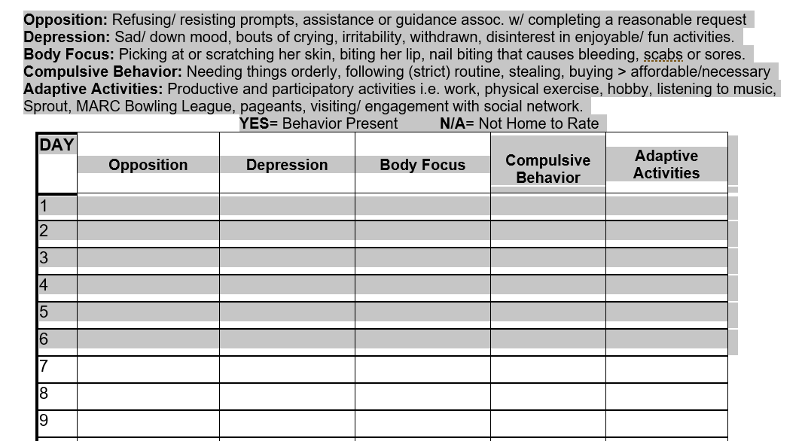
Data Sheets

Slide 40
Data sheets help fill in the gaps
Compare bx to restraints
What factors are in the data

Slide 41
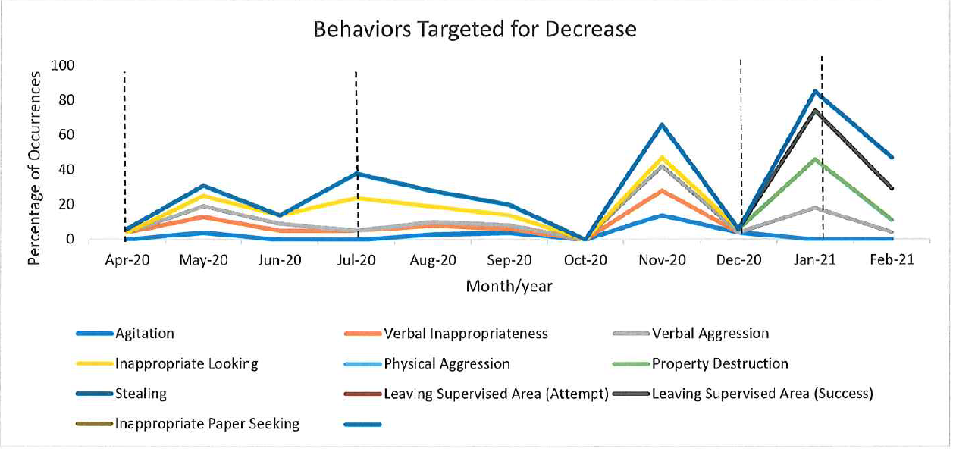
Graphs & Annotations
You can use lines to indicate major events or changes in the persons life
Also changes in medical status or medication changes to visually show change
f

Slide 42
Planned Restraints
Make sure the type of restraint used is an approved planned restraint using the least restrictive measures first.
Documentation of planned restraints on 255's are critical. You must fill out all necessary information: Time In/Out of the restraint, Restraint Type, Behavior Type, and if any injury was caused by the restraint.
There are follow up reports that may need to be completed particularly if injury was caused.
Restraint Type: If you first escorted the person prior to needing to use Floor control you would check both boxes.
Behavior Type: This indicates to others what behavior prompted the use for the planned restraint. Please make sure these align with what is listed in your behavioral support plan. If it was an emergency restraint you should still indicate the behavior as it may be something to be addressed in a guideline or plan if it becomes a pattern.

Slide 43
Choose how to display your data
Tables
Graphs

Slide 44
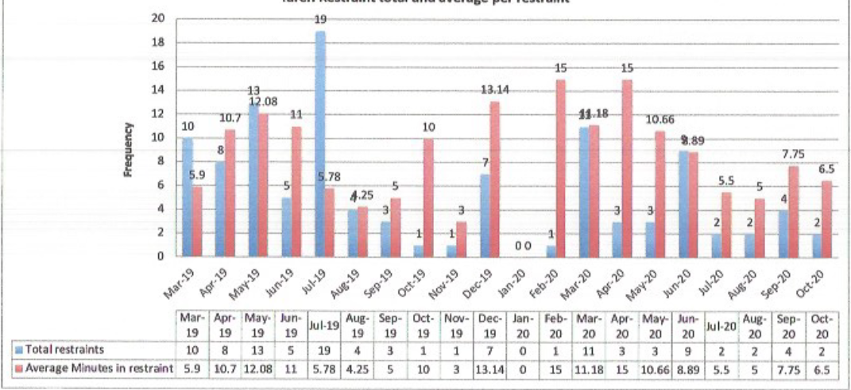
Restraint data: Frequency & Time

Slide 45
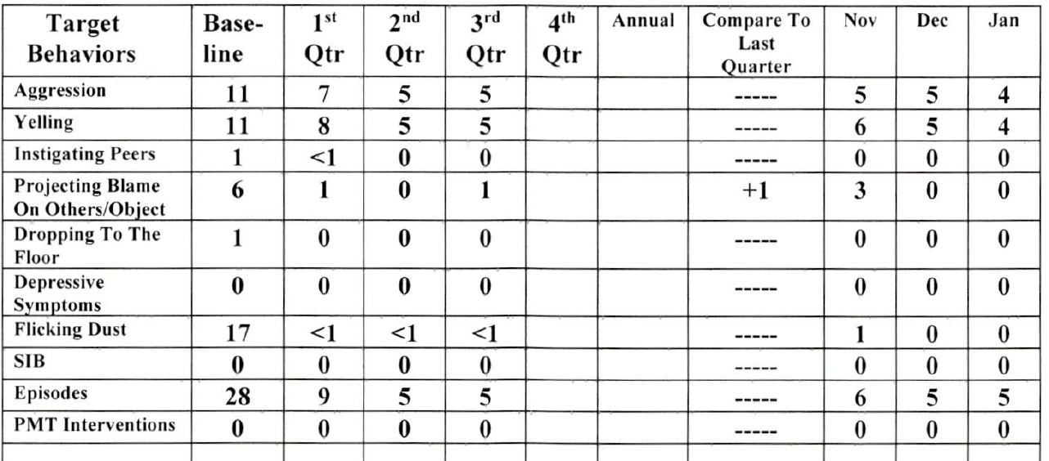
Review Planned Restraints Necessity
If Planned Restraint have not been used are they still necessary?
Removal of planned restraints may be an indicator that positive behavioral strategies in BSP may be working effectively.

Slide 46
Status Needs to be completed

Slide 47
Emergency Restraints
Complete all of the data on the 255
There should be some follow up with the team about what led to the restraint.
If the behavior leading up to the restraint is not in the behavioral support plan or the person is not followed behaviorally this may be considered unusual.

Slide 48
Common Errors on 255’s
Critical incidents that are not defined as Critical
Incidents that are critical but not marked as such
If a person went to the hospital, many agencies check off Behavior/Other
A large majority of injuries do not have the severity of injury checked off
Missing fields are a common error. These get sent back to either the agencies or the CMs.
The summaries do not match the fields
Missing summaries
Stats regarding incomplete 255’s from 1/1/21 to 4/29/21 in the North Region for Example:
104 incomplete from Private agencies
66 Incomplete from IFS
28 Incomplete from Self-Determination.

Slide 49
Reminder regarding Critical incident
Critical Incident: An incident, as defined below, which requires immediate reporting to the DDS regional director or designee:
Death that resulted from an injury. Also report the death following DDS procedure I.D.PR.001, Mortality Reporting, Reporting Deaths of Individuals
Severe injury that requires a hospital admission
Vehicle accident causing a severe injury
Missing person who has been reported to the police
Fire caused by the individual that required emergency response or involving a severe injury. Fires caused by staff, others, or cause unknown would be reported but not using the DDS 255 process
Police arrest of the individual
Victim of Aggravated Assault or Forcible Rape

