Slide 1
Mental Health Diagnoses & I/DD January 28, 2022
Presented by:
Rachel Duzant, Psy.D. Brooke Lloyd, Psy.D. Dawne Recinos, Psy.D. Diana Turner, Psy.D.
Notes:
Goals of presentation:
Gain familiarity with key components of major mental health diagnoses in IDD
Identify essential target behaviors to track for an individual’s current mental health concerns
Improve coordination and collaboration with prescribers
Identify appropriate referrals in light of presenting concerns

Slide 2
DSM-5 is the primary manual for diagnosing mental disorders in US.
Quality websites when referencing diagnoses, diagnostic criteria, medication adverse reactions, etc:
American Psychiatric Association (APA) www.psychiatry.org
National Institutes of Health (NIH) www.nih.gov
Epocrates https://online.epocrates.com
This Photo by Unknown Author is licensed under CC BY-NC
Notes:
In a couple months in March, the DSM-5 TR is coming out. That will REPLACE the DSM-5 (which we are discussing in this presentation).
While there are a number of changes coming, one worth mentioning now is that the diagnosis of Intellectual disability will be replaced with "intellectual developmental disorder".

Slide 3
Neurocognitive Disorder (Delirium; Mild or Major NCD)
Delirium – rapid onset; often completely resolves
Causes: Acute medical condition
Mild & Major NCD - impairments in complex attention, executive fxn, learning/memory, language, perceptual-motor, or social cognition
Causes: HIV, Dementia (Alzheimer’s, Vascular, Lewy Body), Amnestic Disorders, Acquired Brain Injuries, etc.
Tool to establish a baseline: NTG-Early Detection Screen for Dementia (NTG-EDSD), Public Domain: 8c1d0a_e9f3d7be07ce4f1d88c3e994925c96f6.pdf (filesusr.com)
Notes:
These are NOT due to the intellectual developmental disorder.
3 primary types in DSM-5:
Delirium has a rapid onset and is linked to a medical condition. This may completely resolve when the condition resolves. Example: of delirium caused by dehydration: there is impaired attention and lack of awareness. Additionally, the person may have either poor orientation to who they are or where they are, new speech problems, new memory problems or a perceptual disturbance (such as where the person is suddenly seeing things that aren’t there).
Mild & Major Neurocognitive disorders are impairments in complex attention, executive fxn, learning/memory, language, perceptual-motor, or social cognition that can occur at any age.
NCD can be caused by HIV, dementia (Alzheimer’s, Vascular, Lewy Body), amnestic disorders, acquired brain injuries, etc.
Each cause can have different associated features. For example, lewy body dementia tends to be associated with fluctuating cognition/attention/alertness, often includes visual hallucinations with significant detail, and people tend to have parkinsonism movement about a year after cog impairment sets in. There are also often associated REM sleep disorders and sensitivity to neuroleptic medications.
Be sure to look into typical associated features of the presenting cause of the NCD as these can give you important behavioral information to help the person.
For example, in someone with NCD due to Lewy Body Dementia, you want to prioritize health/hydration, maintain a consistent daily routine, prioritize sleep hygiene, prioritize healthy and regular eating (as they are more likely to lose weight and develop malnutrition).
Mild NCD
Includes mild cog decline (1-2 standard deviations from their pre-existing baseline)
Major NCD can be due to dementia like, amnestic disorder, etc.
Must interfere with independence.
Includes major cog decline (2 standard deviations from their previous mean)
Getting a baseline is extremely important here.
NTG-EDSD is a screening tool that is fairly easy to administer and offers the team a tool to monitor changes over time.
In particular, this measure is helpful for people at risk of developing dementia due to age or condition. People with Down Syndrome are more likely to develop early onset dementia. It is recommended to begin administering the NTG-EDSD at age 45 in people with down syndrome.

Slide 4
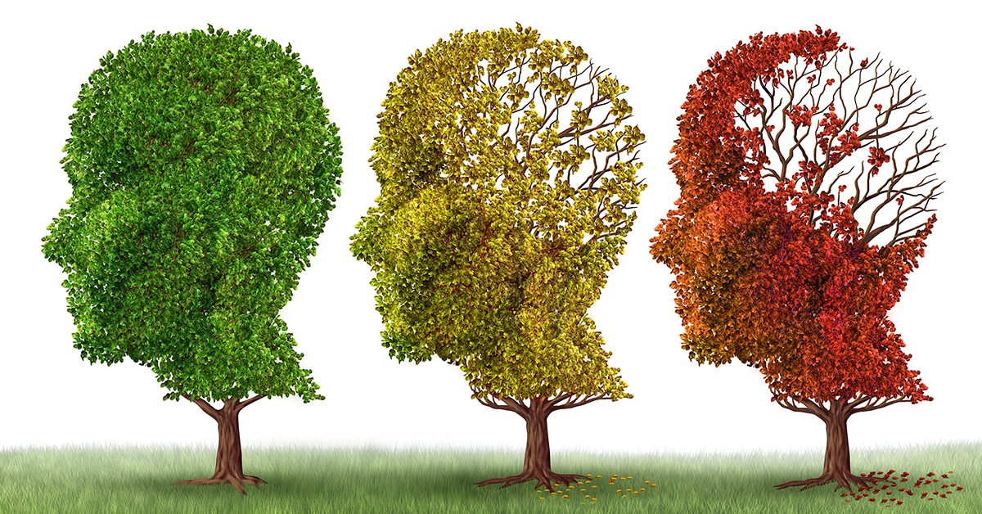
Behavioral Considerations for Dementia
Health is extremely important. Emphasize eating well, sleep routines, exercise, fun activities/puzzles that use thinking, etc.
Structured routines are essential: even on weekends and holidays (as getting off routine can be very de-stabilizing).
Maintain low stress with calming practices (relaxation, baths, etc.). Provide frequent reassurance. Stay away from stressful news programs.
Ensure instructions are simplified for the person’s needs.
Maintain reasonable brightness in the home and environment (shadows can increase distress of sundowning).
When the individual is upset, use distractions (rather than reasoning that relies on cognition/words) to help calm the individual. Be as flexible as possible.
This Photo by Unknown Author is licensed under CC BY-ND

Slide 5
Down Syndrome Insights
People with Down Syndrome have higher comorbidity of:
Dementia (often early onset; start screenings at age 45 or sooner!)
Late-onset Epilepsy occurs in 70-80% of people with comorbid Down Syndrome and Dementia
Autism Spectrum Disorder
Attention-Deficit/Hyperactivity Disorder (ADHD)
Depression
Schizophrenia (increased in males, decreased in females)
Bipolar disorder (increased in males, decreased in females)
Anxiety (increased in males, decreased in females)
Medical comorbidities (especially congenital heart disease)
Self-talk is extremely common (be careful not to mistake for hallucinations)
This Photo by Unknown Author is licensed under CC BY-ND
[McCarron, McCallion, Coppus, Fortea, Stemp, Janicki & Wtachman (2018); Startin (2020); Patti (2009)]
Notes:
People with Down Syndrome are more likely to have early onset Dementia. Many develop dementia in their late 40’s/early 50’s. This is why early screening is so important.

Slide 6
Schizophrenia Spectrum Disorders & Other Psychotic Disorders
When we think of psychotic disorders such as Schizophrenia and Schizoaffective we typically think of the positive symptoms that are observable such as hallucinations. But there is a triad of symptoms: 1) Positive symptoms 2) Negative symptoms 3) Cognitive Symptoms.
This Photo by Unknown author is licensed under CC BY-ND.
Notes:
If you have an individual on your case load with a psychotic disorder you can use any of the triad symptoms for tracking the effectiveness of medications, positive behavioral support plan or any other treatments the person in enrolled.

Slide 7
Positive symptoms
Think of these symptoms as something added to the person's typical experiences that others do not have the shared experience of having.
Hallucinations (Auditory, Visual, Olfactory, Tactile, Gustatory)
Delusions
Paranoia
Ideas of Reference
Thought Broadcasting
Loose Associations
This Photo by Unknown author is licensed under CC BY.
Notes:
Hallucinations can impact your five senses. Auditory hallucinations is the most common of the positive symptoms that is associated with the diagnosis with the risk of danger increase if those auditory hallucinations are command in nature. Of note, Tactile Hallucinations are very rare in Schizophrenia but are more likely when associated with substance abuse toxicity, withdrawal symptoms and intoxication. Ideas of Reference: People find significance to themselves and/or have a belief of linkage to their destiny from benign stimuli. This can be confused with loose associations which is more characteristic of a thought and communication pattern of creating links that are not existent.

Slide 8
Other causes for hallucinations that are not psychiatric
Lack of sleep/Insominia (AH)
Dementia (AH, VH)
Migraines (AH, VH)
Substance Abuse (i.e., cocaine/amphetamines TH)
Grieving/Mourning
Damage to the brain/epilepsy (OH)
Medication Side effects
Deficiencies in Vitamins
Diseases of the Ear
Stroke
Delirium
Auditory nerve disease
CNS disorders
Optic nerve disorders (VH)
Parkinson’s disease (VH)

Slide 9
Negative Symptoms
Think of this as what is subtracted or taken away from the person's experience with examples being:
Avolition
Flat Affect
Diminished interest
Lack of pleasure (Anhedonia)
Decrease social interest
This Photo by Unknown author is licensed under CC BY-ND.
Notes:
Although the positive symptoms are the symptoms that can typically result in a person being hospitalized the negative symptoms at times can impact the overall functioning of the person resulting in job loss, decrease in social supports due to the lack of initiative to reach out, and disruption in learning/education process.

Slide 10
Cognitive Symptoms
Disorganized Thought Process
Neologisms
Limited ability to plan in a step wise fashion
Disorganized speech
Intermingling of "true" memories and delusions
This Photo by Unknown author is licensed under CC BY.
Notes:
Cognitive symptoms the impact the person’s speech, social interactions, processing of information and decision making can be further problematic when compounded with ID. The process of thinking is disrupted in that the person is more distracted, incoherent at times, unable to explain their position due to thinking that is derailed and overall confusion. The content of the thoughts is disturbed by thoughts of persecution, paranoia, and again confusion as to why others are not reacting to the experiences they deem to feel so real.

Slide 11
Treatment & Changes
DSM-5 no longer carries the previous classification types of Paranoid, disorganized, catatonic, undifferentiated or residual.
Treatments range from cognitive rehabilitation, antipsychotics, individual or group therapies, social support, structure, ECT, and building trust.
Of most importance, ruling out other causes that are reversible, as they will not dissipate with inaccurate treatment.
Other issue: metabolic syndrome, psychomotor side effects (TD), lab abnormalities, Catatonia.

Slide 12
Depression to Mania Scale
MANIA
HYPOMANIA
Nornal Range: Doing well (happiness, joy)
Normal Range: Not so well (sadness, grief)
MILD to MODERATE DEPRESSIVE SYMPTOMS
MAJOR DEPRESSION
Notes:
The 2 types of major mood episodes are depressive episodes and manic episodes. All mood disorder diagnoses hinge on the severities of those.
However, someone with Bipolar I Disorder experiences intense mood shifts from full manic episodes to full major depressive episodes. This line represents those fluctuations.
The intensity of the fluctuations will tell you the type of mood disorder.
With Major depression, the person is only having depressive episodes (no climbing into the hypomania or mania).
But, with Bipolar, depending on the type, they are having episodes that go into mania and/or hypomania.

Slide 13
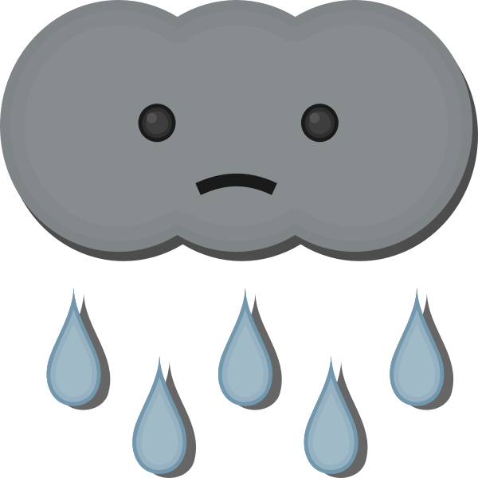
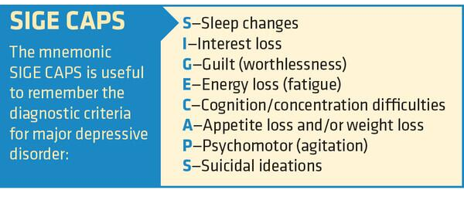
Mood Disorders: Depressive Episode Symptoms
Notes:
What does the dark blue from the last slide look like?
I find this mnemonic to be helpful to quickly recall the symptoms of major depression.
One modification would be to make it M-SIGECAPS since the person must have depressed mood or loss of interest/pleasure before considering whether they meet the criteria of having 5 or more of these symptoms.
DX criteria for reference:
Five (or more) of the symptoms have been present during the same 2-week period and represent a change from previous functioning; at least one of the symptoms is either (1) depressed mood or (2) loss of interest or pleasure. Note: Do not include symptoms that are clearly attributable to another medical condition.
M: Depressed most of the day, nearly every day as indicated by subjective report (e.g., feels sad, empty, hopeless) or observation made by others (e.g., appears tearful) 
S: Insomnia or hypersomnia nearly every day
I: Markedly diminished interest or pleasure in all, or almost all, activities most of the day, nearly every day (as indicated by subjective account or observation)
G: Feelings of worthlessness or excessive or inappropriate guilt (which may be delusional) nearly every day (not merely self-reproach or guilt about being sick).
E: Fatigue or loss of energy nearly every day
C: Diminished ability to think or concentrate, or indecisiveness, nearly every day (either by subjective account or as observed by others)
A: Significant weight loss when not dieting or weight gain (e.g., change of more than 5% of body weight in a month), or decrease or increase in appetite nearly every day
P: Psychomotor agitation or retardation nearly every day (observable by others, not merely subjective feelings of restlessness or being slowed down)
S: Recurrent thoughts of death (not just fear of dying), recurrent suicidal ideation without a specific plan, or a suicide attempt or a specific plan for committing suicide
The symptoms cause clinically significant distress or impairment in social, occupational, or other important areas of functioning.
The episode is not attributable to the physiological effects of a substance or to another medical condition. Note: The above criteria represent a major depressive episode.
The occurrence of the major depressive episode is not better explained by schizoaffective disorder, schizophrenia, schizophreniform disorder, delusional disorder, or other specified and unspecified schizophrenia spectrum and other psychotic disorders.
There has never been a manic episode or a hypomanic episode
What does this look like behaviorally?
Presentation​:
Crying​
Changes in Appetite and Sleep​
Irritability​
Agitation and Aggression​
Tiredness and Lethargy ​
Thinking​:
Negative beliefs about past, present, and future​
Feeling Worthless or Unlovable​
Perceptions of Helplessness and Hopelessness​
Loss of Enjoyment​
Suicidal Ideation​
Distractibility​
Psychomotor Slowing​
Emotions:​
Sadness​
Guilt​
Despair

Slide 14
Mood Disorders: Manic Episode Symptoms
Dig Fast (Mneumonic for Mania)
D: Distractibility – poor focus
I: Insomnia – decreased need for sleep (rested after only a few hours of sleep)
G: Grandiosity – inflated self-esteem
F: Flight of Ideas – complaints of racing thoughts
A: Activities – increased goal-directed activities
S: Speech pressured (more talkative)
T: Thoughtlessness – risk taking behavior (sexual, financial, travel, driving)
This Photo by Unknown Author is licensed under CC BY-NC
Notes:
What does the Bright Red section from the previous slide look like?
A distinct period of abnormally and persistently elevated, expansive, or irritable mood and abnormally and persistently goal-directed behavior or energy, lasting at least 1 week and present most of the day, nearly every day (or any duration if hospitalization is necessary).
During the period of mood disturbance and increased energy or activity, three (or more) of the below symptoms have persisted (four if the mood is only irritable) are present to a significant degree and represent a noticeable change from usual behavior.
1) Distractibility (i.e., attention too easily drawn to unimportant or irrelevant external stimuli), as reported or observed.
2) Decreased need for sleep (e.g., feels rested after only 3 hours of sleep)
3) Inflated self-esteem or grandiosity (this can be grandiose delusions that you’re about to sign with a record label for your hit single when you’ve really only recorded 30 seconds of the track on your computer; it can also be less delusional grandiose ideas that you’re sure you’re going to get a raise so you start spending too much money in advance).
4) Flight of ideas or subjective experience that thoughts are racing
5) Increase in goal-directed activity (either socially, at work or school, or sexually) or psychomotor agitation
6) More talkative than usual or pressure to keep talking
7) Excessive involvement in activities that have a high potential for painful consequences (e.g., engaging in unrestrained buying sprees, sexual indiscretions, or foolish business investments).
The mood disturbance is sufficiently severe to cause marked impairment in social or occupational functioning or to necessitate hospitalization to prevent harm to self or others, or there are psychotic features.
The episode is not attributable to the direct physiological effects of a substance (e.g., a drug of abuse, a medication, or other treatment) or another medical condition. Note: A full manic episode that emerges during antidepressant treatment (e.g., medication, electroconvulsive therapy) but persists at fully syndromal level beyond the physiological effect of that treatment is sufficient evidence for a manic episode and therefore a bipolar I diagnosis.

Slide 15
Adult Mood Disorders: Depressive
Major Depressive Disorder (MDD)
Recurrence (single episode or recurrent)
Severity (Mild/Moderate/Severe)
With Psychotic Features (if indicated)
Partial or Full Remission (if indicated)
There are a number of specifiers.
Persistent Depressive Disorder (PDD)
2 years or more of depressed mood for most of the day more days than not.
Notes:
PDD:
In DSM-IVTR, it was called Dysthymia. Now it’s PDD.
Depressed mood for most of the day, for more days than not, as indicated by either subjective account or observation by others, for at least 2 years.
During the two-year period of the disturbance, the individual has never been without the symptoms in Criteria A and B for more than 2 months at the time.
Can’t have manic or hypomanic episode in history
Sxs:
Poor appetite or overeating. – insomnia or hypersomnia. – low energy or fatigue. – Low self-esteem. – Poor concentration or difficulty making decisions. – Feelings of hopelessness

Slide 16
Adult Mood Disorders: Bipolar
Bipolar I Disorder
Bipolar II Disorder
Cyclothymic Disorder
Substance-Induced Bipolar Disorder
Bipolar and Related Disorder Due to Another Medical Condition
Other Specified Bipolar and Related Disorder
Unspecified Bipolar and Related Disorder

Slide 17
Notes:
Bipolar I:
Major depression AND full manic episode
Bipolar II:
Major Depressive episode AND hypomanic episode
Cyclothymic Disorder:
Cycling mood over 2+ years but haven’t met criteria for Bipolar I, Bipolar II, or Depressive disorder
Other Specified Bipolar & Related Disorder:
Fails to meet full criteria for various reasons such as:
Short-duration hypomanic Episodes (2-3) & major depressive episodes
MDEs & Hypomanic Episodes characterized by insufficient symptoms
Hypomanic Episode without MDE
Short Duration (less than 2 years) Cyclothymia
Uncertain Bipolar Conditions

Slide 18
Mood Disorder Insights
Cyclical – Pay attention to patterns/cycles. Increases in hypersexuality & elopement can be indicative of a manic/hypomanic episode.
Essential behavior to track: SLEEP
There are a number of techniques that can be used to improve sleep data (other than awake staff at night).
Wristwatch with app (Fitbit, Apple watch, generic brand sleep tracking watches like FitPro, etc.)
Sleep tracking mat placed under mattress that monitors sleep through movement, breathing, time out of bed, etc. (e.g., Whithings brand)
Be sure to note when sleep is made up through naps or sleeping in.
Mood Trackers
Subjective state of mood is important.
Use various techniques to help the individual track mood when possible such as:
Rating scales offered by staff,
Personal rating journals,
Phone/iPad/tablet mood trackers apps.

Slide 19
Sleep-Wake Disorders: Insomnia
Insomnia = Hyperarousal
Insomnia Disorder has 3 types:
Sleep onset insomnia
Sleep maintenance insomnia
Early morning waking
Causes:
Predisposing factors (genetics, “wiring”)
Precipitating factor (stressful event)
Perpetuating factors (behaviors that cause insomnia to persist)
Notes:
Sleep disorders (insomnia & breathing related sleep disorders) are MORE common in IDD than the general population.

Slide 20
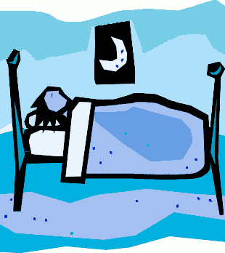
Sleep HYGEINE
Routine:
Develop consistent daily bedtime routine
Same wake/sleep time each day
Daytime preparation includes:
Stay away from caffeine after lunch.
Heavy physical activity in the early afternoon.
Outdoor time (natural sunlight) in the early afternoon.
No screen time (TV or Computer) after dinner (or use night mode)
A warm bath 1-2 hours before getting into bed.
Fan or Window A/C to keep the room cool.
Keep room dark (Avoid nightlights if possible).
Sensory: reduce light sensory touch (i.e., use tighter pajamas, heavy blankets)
This Photo by Unknown Author is licensed under CC BY-NC-ND

Slide 21
Breathing-Related Sleep Disorders: Sleep Apnea
Obstructive Sleep Apnea: upper airway blockage while sleeping
Warning Signs: loud snoring, gasping for air during sleep, insomnia
Risk Factors:
Down Syndrome -Use of sedatives -Family Hx
Overweight -Narrow airway/thick neck -Smoker
Advanced Age -Nasal congestion - Male
Treatment:
CPAP, ASV, BPAP, Dental appliances, Implantable devices
This Photo by Unknown Author is licensed under CC BY-SA-NC

Slide 22
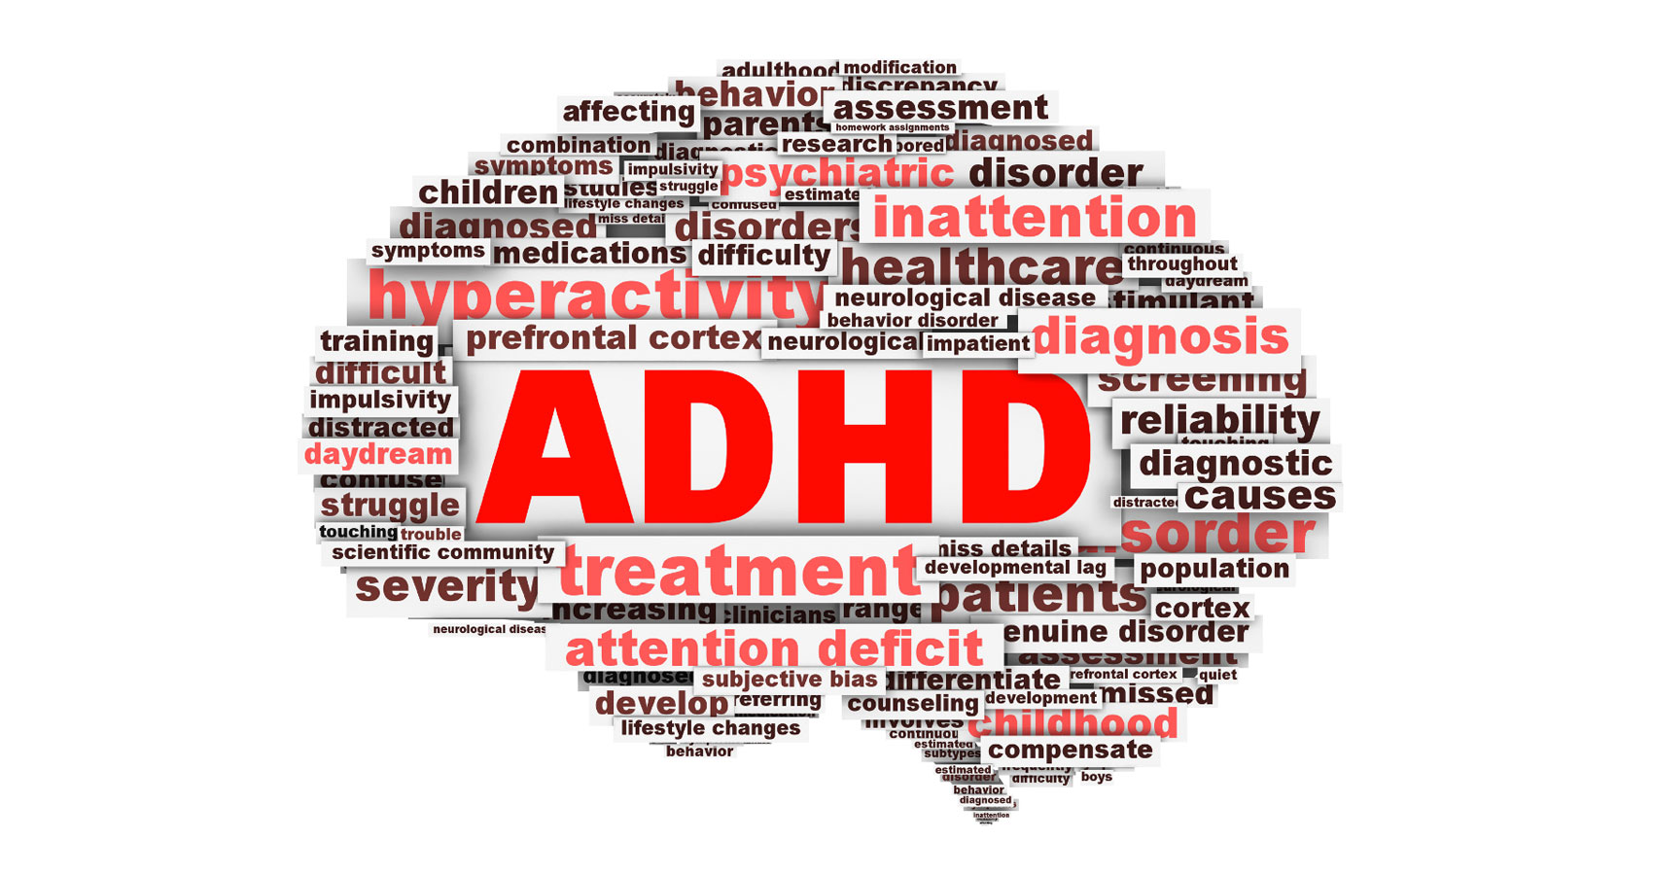
Attention Deficit Hyperactivity Disorder
Subtypes:
Predominantly Inattentive
Lack attention to detail
Difficulty sustaining attention and mental effort
Struggles with follow through and finishing
Difficulty organizing tasks/activities
Loses things
Easily distracted and forgetful
Predominantly Hyperactive-Impulsive
Fidgeting and squirming
Excess restlessness or movement
Difficulty being quiet, talks excessively
Blurts things out, difficulty waiting turn, interrupts/intrudes
Combined
This Photo by Unknown author is licensed under CC BY.

Slide 23
Adult
This Photo by Unknown Author is licensed under CC BY
ADHD symptoms often diminish over time or change in adulthood
Can be harmful to social relationships, work, and school performance
Hyperactivity can lesson with age- may become more internally restless
Talking incessantly but not interrupting as much
Inattention- simple mistakes, not noticing subtle cues, attention wanders
Forgetful- losing things, forgetting to pay bills, miss appointments
Impulsive decision making
Procrastination, poor productivity, difficulty with time management
Impulse buying
Excitement seeking to reduce “boredom”
Small frustrations seem intolerable

Slide 24
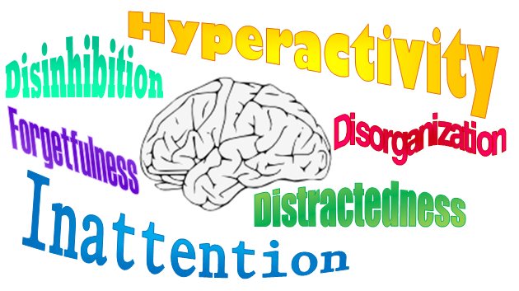
ADHD and IDD
ADHD can be under-diagnosed, misdiagnosed, under-recognized, and under-treated in people with IDD
Common co-morbidity for individuals with IDD
Youth with IDD are at very high risk for developing ADHD
Few studies on ADHD and people with IDD
Al-Khudairi, Perera, Solomou, & Courtenay (June 2019) study
64% of people with ADHD/IDD who were taking ADHD meds were on an antipsychotic compared to 93% of those with ADHD/IDD not on ADHD meds
This Photo by Unknown Author is licensed under CC BY-SA

Slide 25
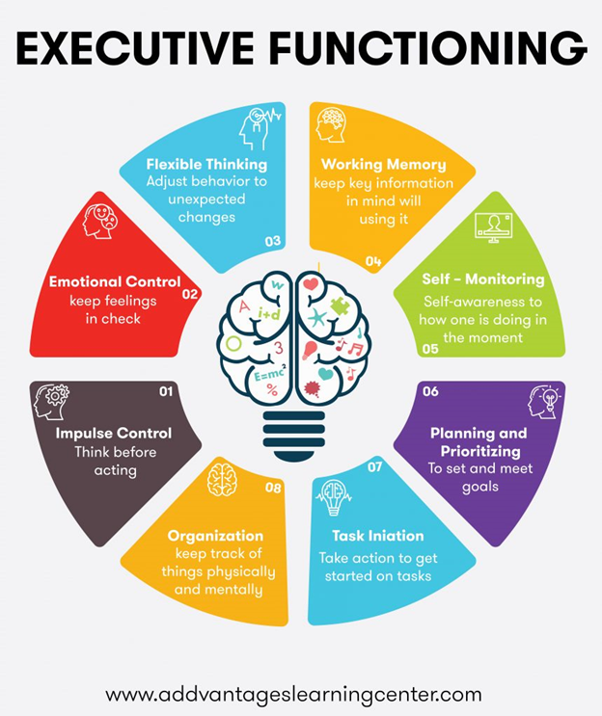

Slide 26
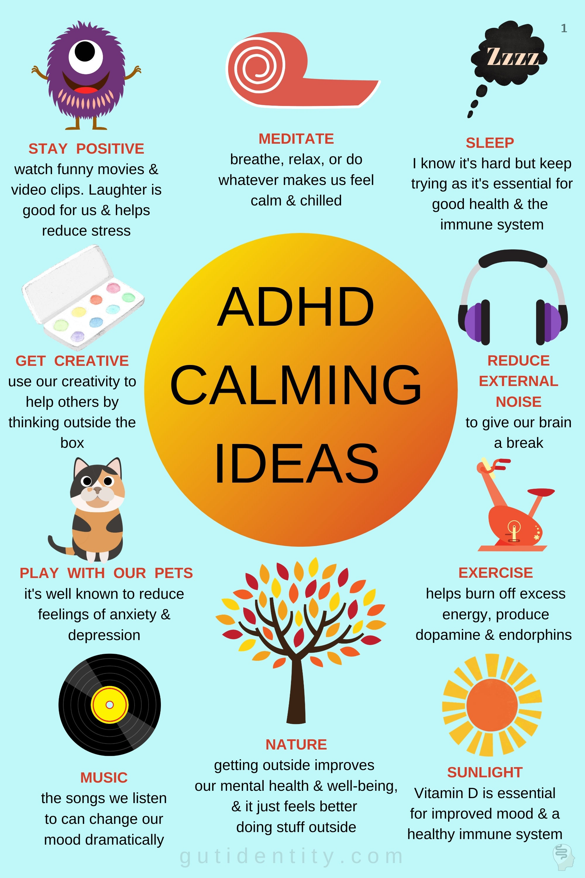
GutIdentity.com

Slide 27
Practical Strategies for Working with Someone with ADHD
Make sure you have individual’s attention
Tell a person what to do rather than what not to do or say “stop.”
Break longer tasks down into smaller chunks
Try to reduce environmental stimulation and distractions in the environment
Provide 1-2 step directions
Write things down
Improve organization (keeping things in same location, etc.)
Help prioritize things
Focus on one thing at a time
Provide immediate feedback and reinforcement
Allow frequent breaks for energy discharge
Alternate high and low activity/stimulation tasks
Teach Stop-Think-Act
Support eating healthy, getting enough sleep, managing stress
This Photo by Unknown Author is licensed under CC BY-NC

Slide 28
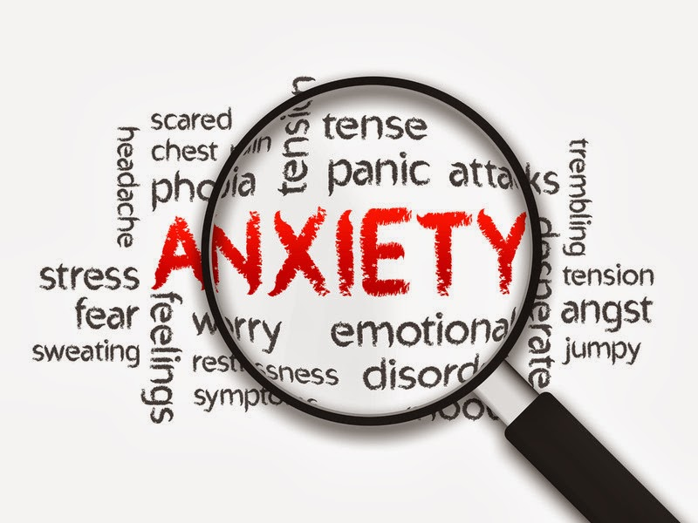
Anxiety Disorders
Disorders that share features of excessive fear and anxiety and related behavioral disturbance
Fear
Emotional response to real or perceived imminent threat
Fight-flight-freeze response
Thoughts of imminent danger
Escape behaviors
Anxiety
Anticipation of future threat
Muscle tension
Vigilance in preparation for future danger
Cautious or avoidant behaviors
This Photo by Unknown Author is licensed under CC BY-NC-ND

Slide 29
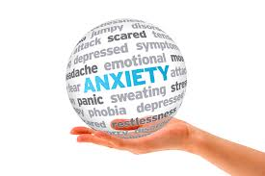
Common Anxiety Disorders
Arranged in order of typical age of onset
Differ from one another in the types of objects or situations that induce fear, anxiety, or avoidance behavior
Separation Anxiety
Selective Mutism
Specific Phobia
Social Anxiety Disorder
Panic Disorder
Agoraphobia
Generalized Anxiety Disorder
Substance/Medication-Induced Anxiety Disorder
“Others”
This Photo by Unknown Author is licensed under CC BY

Slide 30
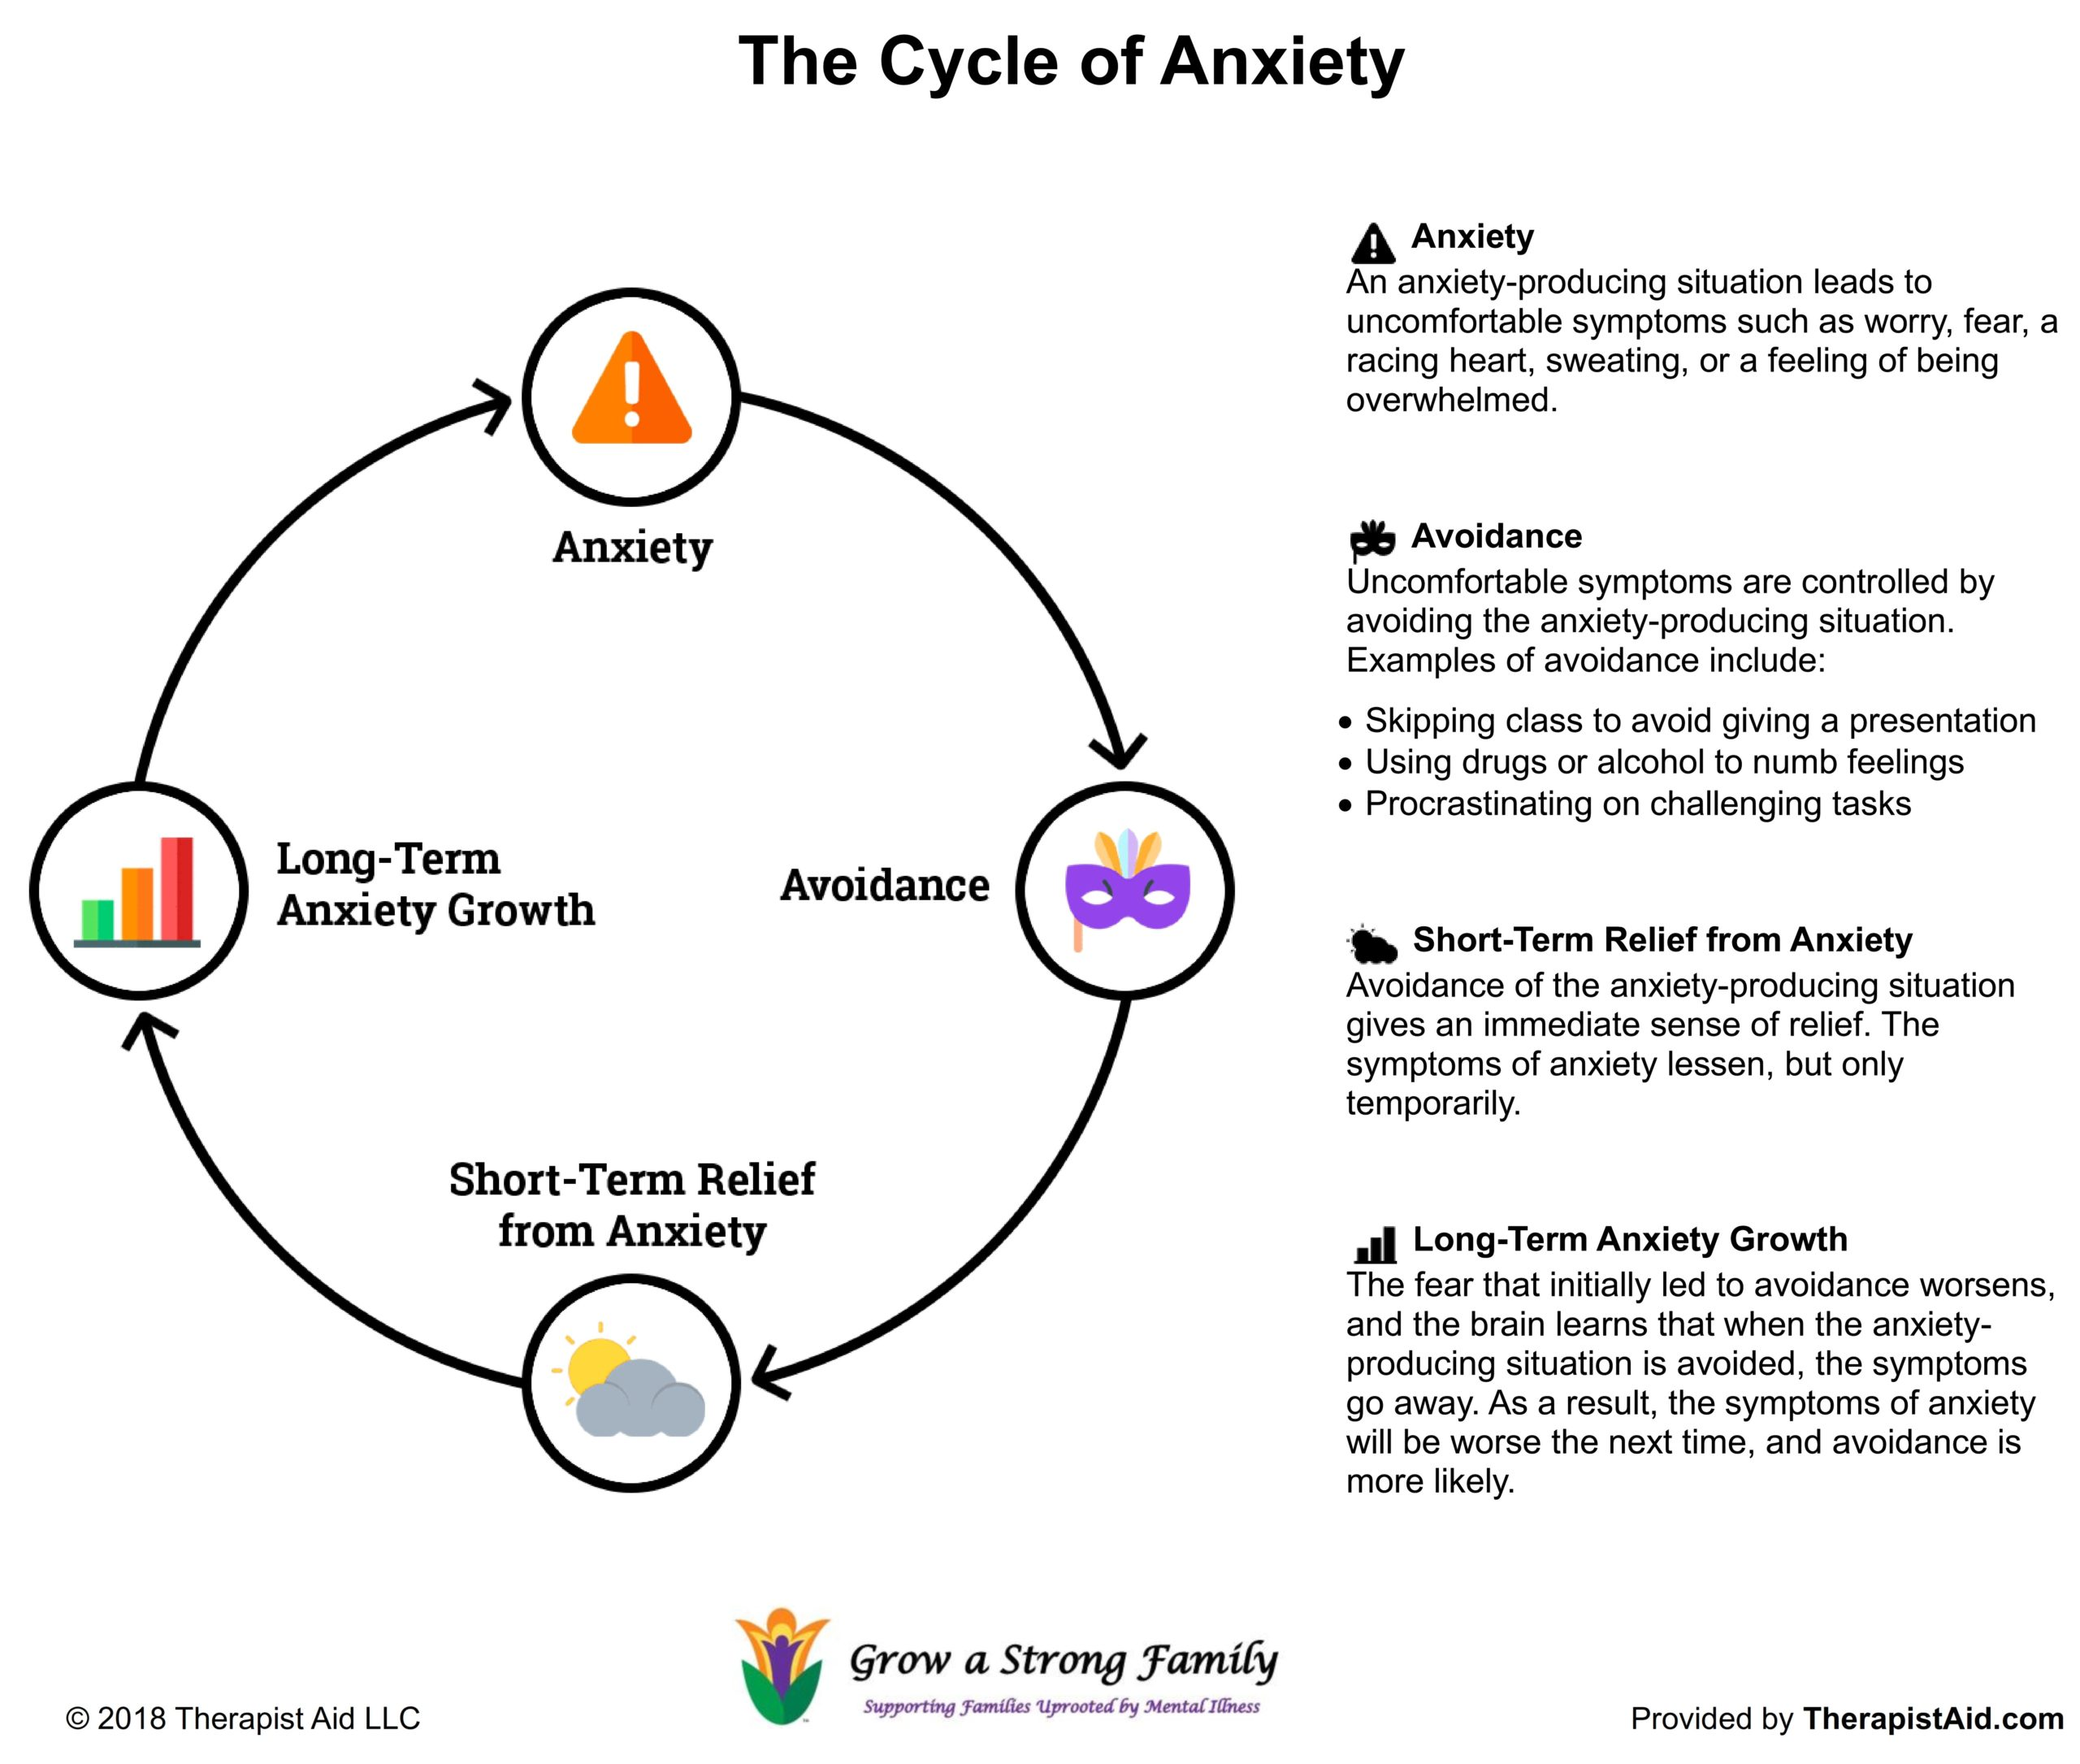
T
This Photo by Unknown author is licensed under CC BY-SA-NC.

Slide 31
Obsessive-Compulsive and Related Disorders
Obsessive-Compulsive Disorder (OCD)
Specific content of obsessions and compulsions varies but some common:
Cleaning-contamination obsessions and cleaning compulsions
Symmetry- symmetry obsessions and repeating, ordering, counting
Forbidden/taboo thoughts-aggressive, sexual, religious obsessions and related compulsions
Harm- fears of harm to oneself or others and related checking compulsions
Autism- may not have classic signs: repetitive behaviors, insistent on sameness, intense preoccupations
Body Dysmorphic Disorder
Hoarding Disorder
Trichotillomania (hair-pulling disorder)
Excoriation (skin-picking disorder)
Substance/Medication-Induced Obsessive-Compulsive and Other Related Disorder
“Others”
This Photo by Unknown Author is licensed under CC BY

Slide 32
Treatment for OCD
Exposure and Response Prevention
Avoid distress—> rituals and avoidance behaviors—> short term reduction in suffering--> convinced compulsion worked—> fear can generalize—> further compulsions
Exposure to anxiety-evoking stimuli and prevention from engaging in compulsive ritual
Can be modified for those with IDD and Autism
Control over life-predictability-want to feel safe and protect self/others from bad things- irony
Support in Home
Emphasizing staying on time and adhering to schedule/routine
"Let's keep on schedule" rather than "don't shower for too long"
Wash hands only to the "happy birthday song"
Check things once and then we leave
Immediately redirect compulsive behavior to an alternative activity
Use of coping skills
This Photo by Unknown Author is licensed under CC BY-SA

Slide 33
Anxiety Reduction Strategies Within a Home
Establish clear house rules and routines
Have consistent procedures for responding to problem behavior
Create a calm, supportive, relaxing environment
Proactively manage stressful periods like transitions, new people, new situations, changes, and unstructured time
Reassure he/she is safe and do things to increase sense of safety and security
Assure individual of things staff are doing to help keep him/her safe and protect him/her
Questions should be answered truthfully and at a level that he/she can understand
Allow person to exert control over environment and have choices as much as possible
Do not criticize regressive behavior
Reduce media exposure and staff conversations regarding anxiety-producing events
Teach relaxation and anxiety reduction strategies

Slide 34
Reducing Anxiety with Medical and Other Procedures
People can be very anxious with a new person, a new situation, equipment
Cautious, slow, gentle approach
Sequence of Least to Most Intrusive
State what going to do then allow plenty of processing time before doing it
Can go through routine prior to visit (check with provider)
Minimize time in waiting room (first appointment of day, first after lunch break)
Plan something special afterward
Bring familiar things that help individual feel comfortable or relax (headphones with preferred music, books, fidget item)
Auditory- One person talk at a time, state what doing before doing it
Tactile- warm up stethoscope, allow to wear own clothing if possible, allow person to do what he/she can for his/herself (i.e., place stickers on for EKG, help hold bandaid)
Visual- reduce light in room, have sunglasses to wear
Pain- difficulty expressing pain, look for behaviors that will signal, try to reduce pain as much as possible (may need numbing cream for blood draws, ice area, etc)

Slide 35
“Traumatized people feel chronically unsafe inside their bodies: The past is alive is the form of gnawing interior discomfort. Their bodies are constantly bombarded by visceral warning signs, and in an attempt to control the processes, they often become expert at ignoring their gut feelings and in numbing awareness of what is played out inside. They learn to hide from themselves.” (Bessel A. van der Kolk, The Body Keep the Score: Brain, Mind, and Body in the Healing of Trauma )
“Unlike other forms of psychological disorders, the core issue in trauma is reality.” (Bessel A. van der Kolk, Traumatic Stress: The Effects of Overwhelming Experience on Mind, Body, and Society)

Slide 36
What is Trauma?
In general, trauma can be defined as a psychological, emotional response to an event or an experience that is deeply distressing or disturbing.
When loosely applied, this trauma definition can refer to something upsetting, such as being involved in an accident, having an illness or injury, losing a loved one, or going through a divorce. However, it can also encompass the far extreme and include experiences that are severely damaging, such as sexual and physical assault.
Because events are viewed subjectively, this broad trauma definition is more of a guideline. Everyone processes a traumatic event differently because we all face them through the lens of prior experiences in our lives.
Because trauma reactions fall across a wide spectrum, categories of trauma have been developed. Among them are complex trauma, post-traumatic stress disorder (PTSD), and developmental trauma disorder.

Slide 37
Types of Trauma
Complex Trauma
Complex trauma happens repetitively. It often results in direct harm to the individual. The effects of complex trauma are cumulative. The traumatic experience frequently transpires within a particular time frame or within a specific relationship, and often in a specific setting.
Post Traumatic Stress Disorder (PTSD)
PTSD can develop after a person has been exposed to a terrifying event or has been through an ordeal in which intense physical harm occurred or was threatened. Sufferers of this PTSD have persistent and frightening thoughts and memories of their ordeal.
Developmental Trauma Disorder (Adverse Childhood Experiences)
Developmental trauma disorder is a recent term in the study of psychology. This disorder forms during a child’s first three years of life. The result of abuse, neglect, and/or abandonment, developmental trauma interferes with the infant or child’s neurological, cognitive, and psychological development. It disrupts the victim’s ability to attach to an adult caregiver.

Slide 38
Developmental Trauma
Chronic trauma (daily life) vs. single event.
Children are at increased risk because they are more vulnerable than adults and dependent on care givers. Source of comfort is also the source of danger. This is true for individuals with ID as well.
Impacts personality development and cognitive/emotional resources.
Impacts brain development. Self-preservation is more important than anything else. Informs trauma responses - fight, flight, freeze, submit (shame/hopelessness)
Triggers – response to signals known to represent threats/danger (i.e., time of day, events, tone of voice)
When danger is detected (real or imagined): “fire-alarm” starts the cycle of hyper-arousal/hypo-arousal.
Creates a small “window of tolerance” where learning can occur. (Dr. Dan Siegel, MD)
PROBLEM BEHAVIORS ARE SOLUTIONS!

Slide 39
Trauma and ID (slide reference: Karyn Harvey, Ph.D. – “Trauma Informed Interventions with Individuals with Intellectual Disabilities”)
Research has shown that people with ID are at greater risk of abuse and neglect than people in the general population.
Up to 90% of people with disabilities report being victims of abuse on multiple occasions.
As few as 37% of people with ID report abuse to authorities.
Causes for increased risk of trauma of individuals with ID include:
Difficulty reporting.
Considered less credible.
Greater emphasis on empathy to caregivers.
Increased parental/caregiver stress (greater disability=severe physical abuse/neglect).
Social trauma – bullying, name calling. Exclusion is processed in the brain as physical pain.
Institutionalization/foster care.
blogs.kcl.ac.uk

Slide 40
Symptoms of Trauma
Often, shock and denial are typical reactions to a traumatic event. Over time, these emotional responses may fade, but a survivor may also experience reactions long-term. These can include:
Anger
Persistent feelings of sadness and despair
Flashbacks
Unpredictable emotions
Physical symptoms, such as nausea and headaches
Intense feelings of guilt, as if they are somehow responsible for the event
An altered sense of shame
Feelings of isolation and hopelessness

Slide 41
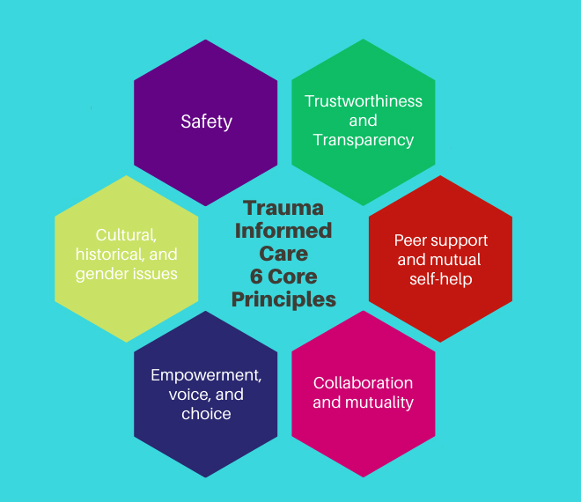
Treatment of Trauma – Trauma Informed Care Approaches
An approach in the human service field that assumes a person has more than likely has a history of trauma. Provides support vs. treating symptoms. Avoids re-traumatization.
Karyn Harvey, Ph.D. – Trauma Informed Interventions for People with ID includes the key elements of Safety, Connection, and Empowerment
Behavior
Emotion
Trauma

Slide 42
Additional Treatments to Address Trauma
Eye Movement Desensitization and Reprocessing (EMDR) therapy is used for PTSD and focuses directly on the memory, and is intended to change the way that the memory is stored in the brain, thus reducing and eliminating the problematic symptoms.
During EMDR therapy, clinical observations suggest that an accelerated learning process is stimulated by EMDR’s standardized procedures, which incorporate the use of eye movements and other forms of rhythmic left-right (bilateral) stimulation (e.g., tones or taps). While clients briefly focus on the trauma memory and simultaneously experience bilateral stimulation (BLS), the vividness and emotion of the memory are reduced.
Accelerated Resolution Therapy (ART) has many similarities to EMDR in that it that fosters rapid recovery by reprogramming how the brain stores traumatic memories and imagery. Even less verbally laden and reliant on memory visualization techniques.
It is informed by CBT, Exposure Therapy, and Guided Imagery approaches, among others, all of which, in their own right, can be used to address trauma.
Image: Boldsky.com

Slide 43
Medication considerations slide reference: psychiatryadvsor.com
Selective Serotonin Reuptake Inhibitors (SSRIs) and Selective Norepinephrine Reuptake Inhibitors (SNRIs) – may be used for depression and anxiety – Celexa, Lexapro, Prozac, Effexor, Cymbalta, Pristiq
Monoamine Oxidase Inhibitors (MAOIs) – may be used as antidepressants, for panic and social phobias – Marplan, Nardil
Antipsychotics or Second Generation Antipsychotics – may be used for sleep, nightmare, flashbacks, intrusive thoughts – Zyprexa, Seroquel, Risperdal
Beta-blockers – may be used for hyperarousal – Propranolol
Benzodiazepines – may be used but tend to worsen symptoms for people with trauma diagnoses

Slide 44
Image ID 2A7F7K7 www.alamy.com

Slide 45
What is personality disorder?
“Personality may be understood as the lasting characteristics that influence a person’s thoughts, feelings and behavior. It shapes a person’s view of themselves (their identity), other people and the world in general. It influences how they engage in relationships. Personality also underpins how people respond to situations (both emotionally and behaviorally) and how they cope with problems. Personality comprises an integrated system of traits and attributes that characterize the person.” (Zilla Webb, Intellectual Disabilities and Personality Disorder: An integrated approach.)
“A personality disorder is an enduring pattern of inner experience and behavior that deviates markedly from the expectations of the individual’s culture, is pervasive and inflexible, has an onset in adolescence or early adulthood, is stable over time and leads to distress or impairment” (DSM-5)

Slide 46
Personality Disorders as listed in the DSM-5
(slide content from “Overview of Mental Health and IDD” Power Point by Peter Tolisano, Psy.D., ABPP and Tracey Sondik, Psy.D.)
Cluster A: Odd disorders
Paranoid: Irrational mistrust and suspicion
Schizoid: Detached from social relationships and restricted emotions
Schizotypal: Odd beliefs and discomfort interacting socially
Cluster B: Dramatic, emotional or erratic disorders
Histrionic: Attention-seeking behavior and excessive emotions
Narcissistic: Grandiose and un-empathic
Antisocial: Exploitative, disregard for rights of others, even psychopathy (lack of empathy, deviance/criminal behavior)
Borderline: Instability in relationships, identity, and emotions.
Cluster C: Anxious or fearful disorders
Dependent: Excessive need for caring and reassurance
Avoidant: Socially inhibited and sensitive to negative evaluation
Obsessive-Compulsive: Rigid, controlling, and perfectionistic

Slide 47
Personality disorder in individuals with intellectual disabilities Slide content reference: Zilla Webb, Intellectual Disabilities and Personality Disorder: An integrated approach.
Some individuals with intellectual disabilities show the enduring patterns of inner experience and behavior that constitute personality disorder.
However, many people with intellectual disabilities who show problem behaviors will not have personality disorders.
Therefore it is important that the possibility that an individual has personality disorder is considered when assessing problematic behaviors.
An individual with intellectual disabilities may also have a personality disorder if they show a range of severe, persistent problems with managing their own behavior and relating to other people.

Slide 48
Problems experienced by individuals with intellectual disabilities and personality disorder Slide content reference: Zilla Webb, Intellectual Disabilities and Personality Disorder: An integrated approach.
Unhealthy self-image and low self-esteem
Emotional distress e.g. intense, changeable emotions
Interpersonal difficulties e.g. difficulty making and keeping friendships, conflict with other individuals
Difficulties with self-control and impulsivity including substance misuse and offending behavior
Distorted thinking e.g. black and white thinking
Problems with physical health e.g. poor treatment compliance
Co-morbid mental health problems e.g. depression, anxiety
Challenging behaviors e.g. verbal and physical aggression
Suicidal behavior and self-harm including self-injury and self-poisoning
Frequent crises e.g. placement breakdown and multiple admissions to the hospital
Difficulties engaging with services e.g. missed appointments
Creating tensions and disagreements within and between teams
Complex family and relationship networks, including people who may exploit or abuse the individual and may come into conflict with the services supporting them
Photo by: Pixabay

Slide 49
Treatment Approaches for Personality Disorders
Dialectical Behavior Therapy (DBT) - is a modified type of CBT. Its main goals are to teach people how to live in the moment, develop healthy ways to cope with stress, regulate their emotions, and improve their relationships with others. Initially used for BPD but has been adapted for use with other diagnoses and different age groups (i.e. –substance use, ID, teens, couples)
Julie Brown/Emotion Regulation Skills System for Cognitively Challenged Clients – a DBT-informed approach to teaching core emotion regulation and adaptive coping skills to individuals with ID of all ages.
Medications – there are no specific FDA- approved medications for “treating” personality disorders. If used, meds may help with symptoms associated with personality disorders, such as: depression, mood liability, transient psychosis, and anxiety.
Cognitive Behavior Therapy (CBT) – treatment premise is that thoughts-feelings-behaviors are all interconnected. Changing negative thoughts about self, others, world can alter mood and unwanted behavioral patterns.

Slide 50
References
McCarron, McCallion, Coppus, Fortea, Stemp, Janicki & Wtachman (2018) Supporting advanced dementia in people with Down Syndrome and other intellectual disability: Consensus statement of the international summit on Intellectual Disability and Dementia. Journal of Intellectual Disability Research, 62, p.617-624. doi: 10.111/jir.12500
Startin (2020). Health comorbidities and cognitive abilities across the lifespan in Down syndrome. Journal of Neurodevelopmental Disorders, 12, Abstract only.
Patti (2009). Parent/carer ratings of self-talk behaviour in children and adults with Down syndrome in Canada and the United Kingdom. Down Syndrome: Research & Practice, 12, Abstract only.
Tolisano & Sondik (2015). An Overview of Mental Health Issues concerning Individuals with Developmental Disabilities and Positive Behavioral Supports, PowerPoint presentation on 5/14/2015 in Waterford, CT.
Ali, Patel, Avenido, Bailey, Jabeen, & Riley (2011) Hallucinations: Common features and causes. 1011CP_Ali.pdf (mdedge.com)
Al-Khudairi, Perera, Solomou, & Courtenay (June 2019). Adults with intellectual disability and Attention Deficit Hyperactivity Disorder: Clinical characteristics and medication profiles. British Journal of Learning Disabilities, 47 (2), p. 145-152

