Slide 1

Welcome to
Community Companion Homes

Slide 2
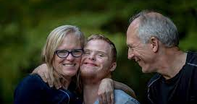

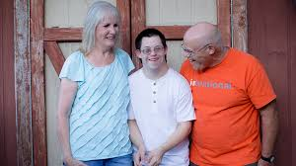



What is a
Community Companion Home? (CCH)

Slide 3

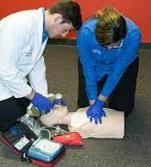


Training to become a
CCH Licensee

Slide 4


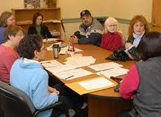
Responsibilities of a CCH
Licensee

Slide 5

Matching
Process

Slide 6


Who comprises the CCH Team?

