Slide 1

Pharmacy
Vendor Training
The Special Supplemental Nutrition Program for Women, Infants, and Children - Connecticut WIC Program
This institution is an equal opportunity provider.

Slide 2
Purpose of the WIC Program
Purpose of Training
Changes to Program Requirements in the last 4 Years
CT WIC Approved Food Guide
Appendix B - Minimum Inventory Requirements
Infant Formula Purchase Requirement
Other WIC Approved Food
Appendix C - Requirements for WIC Transactions
Product should be WIC approved, but isn’t scanning
Appendix D - Requirements For Pricing
Appendix E - Disqualifications, Civil Money Penalties and Fines
State Agency Established Sanctions
Appendix F - Monetary Claims
Vendor Complaint Process
EBT & Equipment Contractor Involvement
Cash Register Systems: Point Of Sale (POS) Stand Beside vs. Integrated
Requirements for Authorization
Program Integrity
Vendor Training Attendance

Slide 3

Purpose of the WIC Program
To serve nutritionally at-risk women, infants, and children up to age 5.
To show participants that good nutrition leads to better health.
To provide nutrition education and specific supplemental foods for good health and nutrition during critical times of growth and development.
To provide referrals for health care and other services.

Slide 4

Purpose of Training
To improve vendors' understanding of Program rules and requirements to enhance compliance and prevent errors.
Owner’s Responsibility for Training
You are responsible for training your store employees and cashiers before they handle WIC benefits.
You are responsible to inform and provide annual and regular training to existing store employees.
Owners are accountable for the actions of staff who handle WIC transactions.
Cashiers must be trained on transactions and owners/managers must be trained on minimum inventory requirements.

Slide 5
Changes to Program Requirements in the last 4 Years
All Connecticut WIC Program communications, bulletins, and official notices are now delivered via email.
Revised the WIC Vendor Agreement in October 2021, 2022, 2023, and 2024.
Changed the vendor training attendance process starting with Open Enrollment 2025.

Slide 6

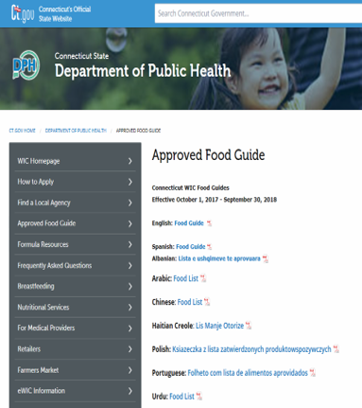

CT WIC Approved Food Guide
https://portal.ct.gov/DPH/WIC/Approved-Food-Guide
Use the WIC Vendor Food Card and WIC Shopper app for specific products and brand names for Connecticut WIC approved foods
Booklets available in English and Spanish
Available online in four other languages
Allow the purchase of all approved brands listed in the WIC Approved Food Guide
WIC Shopper App

Slide 7
Appendix B - Minimum Inventory Requirements
https://portal.ct.gov/-/media/departments-and-agencies/dph/dph/wic-2018/frvm/fy24/appendix-b.pdf
Infant Formula - any combination of 12.4-ounce powder/13-ounce concentrate
24 units of Similac Advance (blue can)

Slide 8
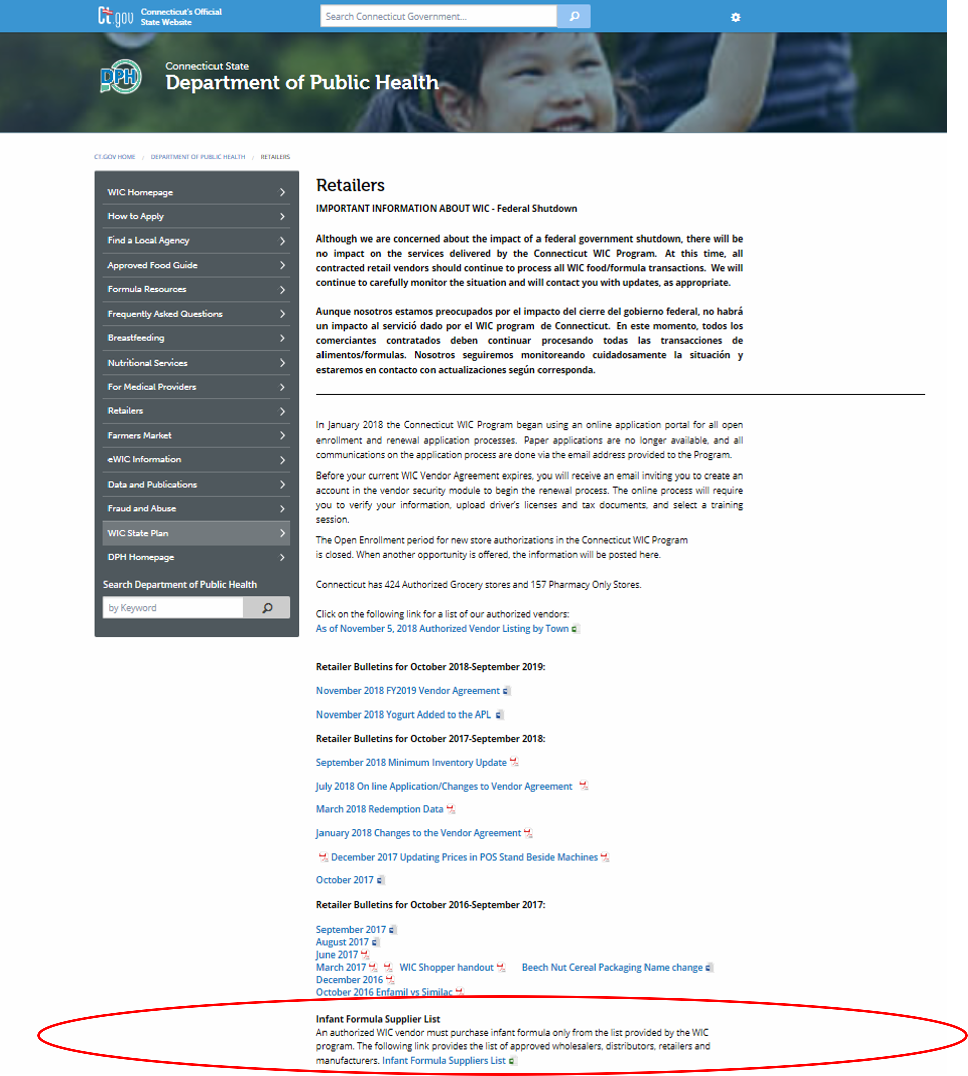
Infant Formula Purchase Requirement
Authorized vendors MUST purchase all infant formula ONLY from the WIC Program’s list of wholesalers, distributors, retailers and manufacturers.
This list is sent to authorized vendors on an annual basis.
The list can also be found under Retailers on our website.
https://portal.ct.gov/-/media/departments-and-agencies/dph/dph/wic-2018/frvm/fy24/infant-formula-supplier-list-3-2024.pdf

Slide 9
Appendix C - Requirements for WIC Transactions
Scan the actual Universal Product Code (UPC) that is affixed to all the items.
The scanner reads the UPC, which checks the APL to identify products.
Participant scans WIC card first, then provides any other form of payment.
Participant must enter their own PIN. Never ask for the customer’s PIN.
System checks the items against the participant’s benefits.
Keep all customer payment types confidential, do not confiscate a WIC card.
All food that was purchased must be taken at the time of the transaction.
Do not allow store credit or IOUs in exchange for items not taken at the time of transaction.
Provide the WIC customer with a receipt at the end of the transaction.
Self-checkout registers are allowed if vendor have programmed them to accept WIC.

Slide 10
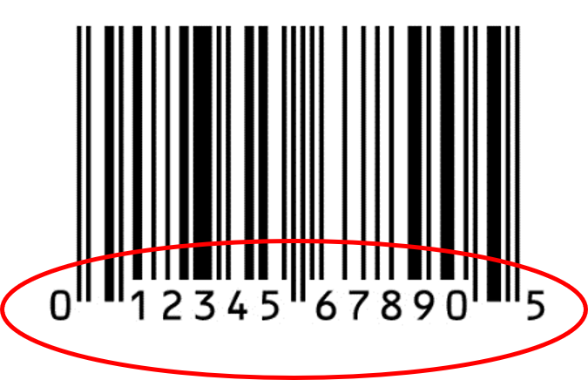
Product should be WIC approved but isn’t scanning
A WIC customer or store personnel can contact the State WIC Office.
The following information is needed:
  The entire UPC number (all the numbers or a photo of UPC bar code)
  Product Name or photo of the front of the product
  Size of container
  Send the information to:
  Email: ctwic@ct.gov
The product may be WIC approved; however, the UPC number is not listed in the WIC Program’s Approved Product Listing.
Once approved, products will be available for purchase in 48 hours.

Slide 11
Appendix D - Requirements For Pricing
Charge prices that are fair and competitive. Vendors must meet established competitive pricing criteria.
Must allow manufacturer coupons and sales if allowed for all other customers.
There is a maximum Not To Exceed (NTE) price. The maximum not to exceed prices are based on average vendor prices for WIC food items within a peer group and are used by the WIC Program to determine the reimbursement level for each food item.
Prices that are posted must match the prices that are charged to WIC customers.
Never seek payment for the difference between the price charged and the maximum price paid.
Never charge customers a surcharge or a fee.
Do not offer, or intend to offer, incentive items solely to WIC customers. Vendors cannot offer free food or merchandise to entice WIC customers to use their benefits at the store.

Slide 12
Appendix E - Disqualifications, Civil Money Penalties and Fines
Violations are determined by investigation, which includes on-site monitoring, transaction audits, inventory audits and undercover compliance buys. Sanctions are imposed in order to protect the integrity and the nutritional goals of the WIC Program.
Federal Mandatory Sanctions are as follows:
Permanent Disqualification - One Occurrence
Judicial conviction of trafficking in WIC benefits or selling firearms, ammunition, explosives or controlled substances in exchange for WIC benefits.
Disqualification 6 Years - One Occurrence
Administrative finding of buying or selling WIC benefits for cash (trafficking) or selling firearms, ammunition, explosives or controlled substances in exchange for WIC benefits.
Disqualification 3 Years - One Occurrence
Sale of alcohol or alcoholic beverages or tobacco products in exchange for WIC benefits.

Slide 13
Appendix E - Disqualifications, Civil Money Penalties and Fines, cont.
Disqualification 3 Years - Three or More Occurrences
Claiming reimbursement for the sale of an amount of a specific WIC food that exceeds the store’s documented inventory of that WIC food for a specific period of time. Example: Have to provide receipts to show that all foods sold were purchased for the store
Overcharging on WIC Benefits. Example: Changing prices in systems
Receiving, transacting and/or redeeming WIC benefits outside of authorized channels, including the use of an unauthorized vendor and/or unauthorized person. Example: Cannot move devices to another location
Charging for WIC food not received by the WIC customer. Example: Scanning other products
Providing credit or non-food items, other than alcohol, alcoholic beverages, tobacco products, cash, firearms, ammunition, explosives or controlled substances in exchange for WIC benefits. Example: Selling paper goods

Slide 14
Appendix E - Disqualifications, Civil Money Penalties and Fines, cont.
Disqualification One Year - Three or More Occurrences
Providing unauthorized food items in exchange for WIC benefits, including charging for WIC food provided in excess of those listed on the WIC benefits. Example: Selling sugared cereal
SNAP Disqualification or CMP
Disqualification from the Supplemental Nutrition Assistance Program or a civil money penalty in lieu of a SNAP disqualification when adequate WIC participant access exists. Example: 6-month disqualification from SNAP = 6-month disqualification from WIC

Slide 15
Appendix E - Disqualifications, Civil Money Penalties and Fines, cont.
State Agency Established Sanctions
Disqualification One Year - If Two or More Occurrences
Substitution of a WIC food item for another WIC food item not listed on the WIC benefit. Example: Selling juice instead of milk
Allowing a refund or exchange for WIC or non-WIC food items. Example: WIC purchase completed, but then allows a return
Scanning any UPC as a substitute, replacement or otherwise not actually affixed to the actual item being purchases. Example: Scanning a UPC codebook or reference sheet.
Not allowing the WIC customer to enter their own PIN on the PIN pad. Example: Cashier asks for PIN and inputs it for the WIC customer
$500.00 fine -Two or More Occurrences
Limiting WIC customers in their choice of WIC products. Example: Forcing a WIC customer to buy only the most expensive items, or only allowing the least expensive brand
Offering store credit or IOU to a WIC customer. Example: Performing a transaction, but the customer comes back later for the item

Slide 16
Appendix E - Disqualifications, Civil Money Penalties and Fines, cont.
State Agency Established Sanctions, cont.
$250.00 fine - Two or More Occurrences
Allowing the sale of a WIC food item that is spoiled or is sold to WIC customers after the expiration date, “sell by”, “best if used by”, “manufacturer suggested’, or other date limiting the sale or use of the food item. Example: Selling expired bread
Allowing the return of any WIC purchases other than for identical WIC food items that are damaged, spoiled, or has exceeded its “sell by”, “best if used by”, “manufacturer suggested’, or other date limiting the sale or use of the food. Example: Customer buys Lowfat milk, but vendor allows a return for whole milk
$125.00 fine-Two or More Occurrences
Not providing savings to WIC customers through coupons or store offered promotions. Example: Giving sale prices to cash customers, but not to WIC customers
Failure to attempt to provide any requested WIC approved food item within 48 hours that is on the participant’s benefits list. Example: WIC Customer requesting Low-fat Yogurt
Failure to provide a receipt at the end of the transaction showing the date of the transaction, product(s) purchased, and the remaining balance of available benefits.
Failure to cooperate with Federal, State, and Local WIC Program personnel during announced and unannounced on-site vendor monitoring. Example: Not allowing entry to the store when it’s open or not signing monitoring reports because of the result

Slide 17
Appendix F - Monetary Claims
The Connecticut WIC Program may make monetary claims against vendors that have committed certain types of redemption abuse in addition to any other sanctions applied against such vendors.
Those include but are not limited to:
Inventory Audits when a vendor cannot support all its redemptions
Overcharges or errors made on WIC transactions discovered during undercover compliance buys
Transaction Audits review of a vendor’s redemptions to determine if the vendor has overcharged the WIC Program
All monetary claims must be paid within fifteen days of the date of the notice. All remittances must be made with a certified bank check or money order and payable to Treasurer-State of Connecticut, Department of Public Health.
The WIC program may non-select a vendor for failure to pay a monetary claim within the required period of time.

Slide 18
Vendor Complaint Process
Vendors may file a complaint against WIC customers who abuse Program rules. Contact the State WIC Office with the last four digits of the card #. Example: Trying to exchange or purchase non-WIC items, is rude or has disruptive behavior.
Notify the State WIC Office if the customer does not know what food to buy and/or indicates that they do not know how to use the WIC card. Additional training may be needed.
Vendors may file a complaint against other vendors who suspect that WIC program rules are not being followed. Example: Vendor is giving non-food items or unapproved items
Contact the State WIC Food Resource and Vendor Management unit:
Email: ctwic@ct.gov Fraud: WICFraud.DPH@ct.gov Authorizations: DPH.ptwic@ct.gov
Phone: 860-509-8084 or 800-741-2142 (in Connecticut only)
Mail: Department of Public Health, WIC Program
410 Capitol Avenue, MS #11WIC, Hartford, CT 06106

Slide 19
EBT & Equipment Contractor Involvement
EBT Contractor Involvement
The EBT contractor that processes CT WIC transactions will handle the following:
Record redemptions
Make payments and adjustments through your bank
Equipment Contractor
You will receive information regarding the equipment contractor when you receive the authorization letter. The equipment contractor will handle the following:
Issues equipment and provides training
Handles equipment problems
Handles bank change information
Retrieves equipment when store is no longer an authorized vendor
Most vendors applying now will pay the cost of $75 per month per machine with a $50 per machine activation fee to the equipment contractor CDE.

Slide 20
Cash Register Systems: Point Of Sale (POS) Stand Beside vs. Integrated
Point of Sale (POS) Stand Beside equipment are devices that are separate from the store’s cash register systems that will process WIC transactions.
Point of Sale device
Hand-held scanner
PIN Pad
1 WIC device per register
There is no communication between devices within the same store. That means when a price is changed in one device, it must be changed in all devices.
Integrated Systems use the store’s cash register to process eWIC, SNAP, credit cards, debit cards, and other forms of payment.
Once authorized, vendors will receive a Transaction Manual on processing WIC transactions.

Slide 21
Requirements for Authorization
Must meet all selection criteria in the Vendor Agreement at all times.
Must meet and maintain the minimum inventory and pricing requirements. Vendor monitors do not have any discretion for excusing missing food items or items not being priced at the time of inspections.
If a monitoring visit is passed, the owner will receive an executed Agreement for approximately 18 months (ending September 30th of the next year after initial authorization). Example: 4/1/2025 – 9/30/2026. If you are a renewing vendor, the owner will receive an executed Agreement for 3 years beginning on October 1 of the current year.
If a monitoring visit is not passed, vendor will have another opportunity to pass.
Must meet competitive pricing criteria within the vendor’s peer group.

Slide 22

Program Integrity
The Food Resource and Vendor Management Unit is committed to improving the health of CT’s most vulnerable children by ensuring authorized vendors are in compliance with providing healthy foods during the critical stages of early childhood development.
Contact us anytime you feel additional training is needed or have questions regarding policies or procedures.
We look forward to our continued partnership in providing nutritious food to Connecticut families.

Slide 23
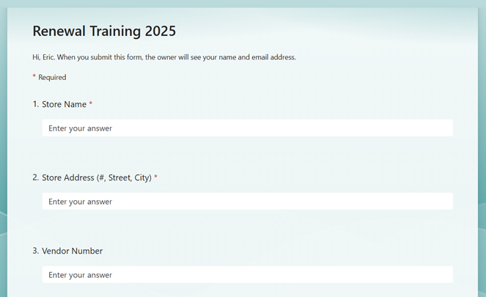
Vendor Training Attendance Requirements
To receive credit for attending today’s training you must do the following:
Click on the link that you see in the TEAMS chat.
Complete all the required fields (denoted with a red asterisk).
Please note: The Date of Training is today’s date, and the Time of Training is when the training class began.
I will only mark you as attended when your form is complete and the Submit button has been clicked.
You must submit this form, and I must see the submission prior to you leave this training class.
Contact Maria Reyes ( maria.reyes@ct.gov ) with any questions you might have.

