Slide 1
Figure 1 : Project Location
Original Garage
Stamford Transportation Center

Slide 2
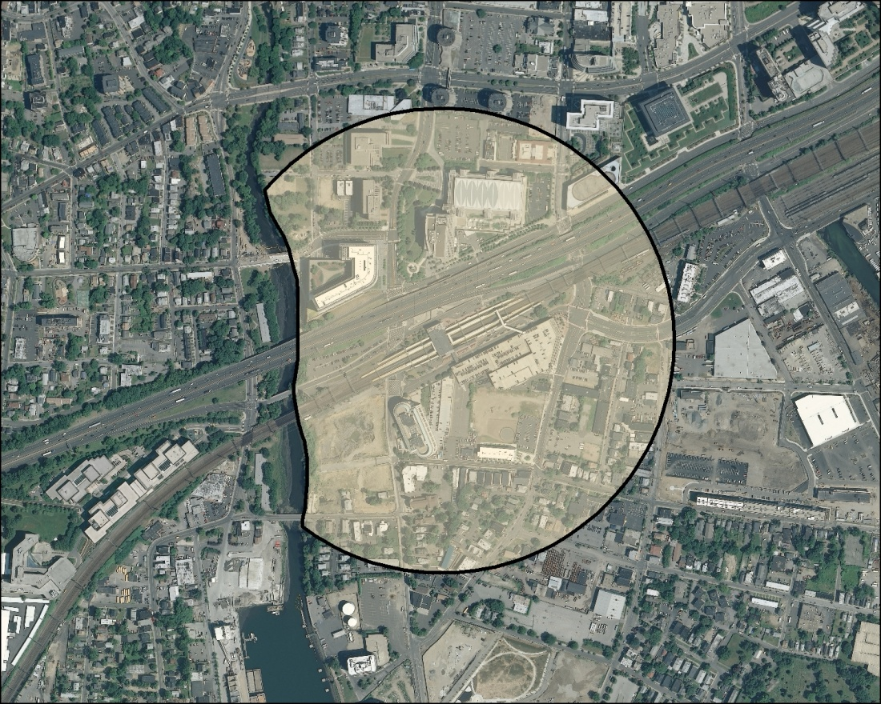
Project Limits
Acceptable Walking Distance
Note: Above project limits are approximate for graphical representation only. Maximum walking distance from proposed parking facility to Stamford Transportation Center not to exceed ¼ mile.

