Slide 1
Integrating the State Health Improvement Plan (SHIP) and the Facilities and Services Plan (the Plan)
Health Care Cabinet Meeting January 23, 2024
George Miller and Corey Rhyan, Altarum

Slide 2
What Is the SHIP?
A “roadmap for promoting and advancing population health and ensuring all people in Connecticut have the opportunity to attain their highest potential for health”
Published in 2021 as part of Healthy Connecticut 2025, a five-year state health planning initiative
Addresses issues raised in the 2019 State Health Assessment (SHA)
Focuses on equity and the social determinants of health (SDOH) rather than clinical services

Slide 3
SHIP Covers 6 Key Measures and 4 Priority Areas
Key Impact/Surveillance Measures
Obesity
Suicide
Drug overdose and substance misuse disorders
Domestic violence/sexual violence
Percent insured
Emergency room visits
Priority Areas (containing strategies designed to affect impact measures)
A: Access to health care
B: Economic stability
C: Healthy food and housing
D: Community strength and resilience

Slide 4
Approach
Expanding the Plan narrative to discuss relationships between facilities and services availability and healthcare access
Highlight identified gaps in access to care (Plan includes availability of acute hospital care, hospital emergency care, specialty hospital care, outpatient surgical care, and primary care)
Expanding analysis to include SDOH drivers and healthy equity measures including transportation, food, and housing
Address in the Plan how SDOH drivers influence the need for health care services and health outcomes
Identify in the Plan the role of healthcare providers in promoting SDOH initiatives
Address in the Plan how access to care can be influenced by economic stability and community strength and resilience
Addressing progress toward key strategies of the SHIP that align with the Plan
Recommending specific actions to address identified gaps in underserved communities

Slide 5
Example 1: Expanding the Plan Narrative
Strategy A6.4. “Explore options to expand Medicaid and subsidized insurance coverage to ineligible individuals that remain uninsured or underinsured (e.g., low income, parents
of HUSKY recipients, immigrants).”
Discuss impact of recent expanded coverage on needs for facilities and services

Slide 6
Example 2: Measuring Status of Initiatives
Strategy A1.1. “Expand affordable, quality broadband internet and cellphone access across the state, and seek public or subsidized broadband access program for geographic areas and lower income residents, so telehealth can be expanded.”
Plan can incorporate maps from Connecticut Broadband Mapping Hub to show extent of broadband adoption across the state
Plan can overlay with locations of HRSA primary care shortage areas to indicate need for better access

Slide 7
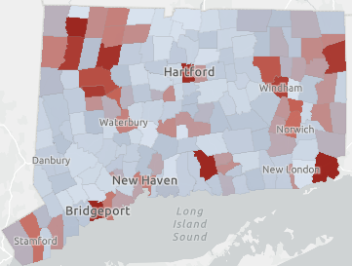
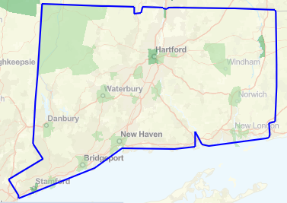
Example 2: Measuring Status of Initiatives
Primary Care Area
Health Professional Shortage Areas
Broadband Adoption Map

Slide 8
Questions

