Slide 1
Yale New Haven Health System
Northeast Medical Group (NEMG)
August 11, 2022
Richard Goldstein, MD, PhD, MHCM, FACS
Chief Medical Officer and President (Interim)
VP, Yale New Haven Health System
Aimee Derry, MHA
VP, Business Development

Slide 2
NEMG Formation
NEMG is a Non-Profit Medical Foundation launched around 2010
NEMG is an of affiliate of Yale New Haven Health System.
Originally comprised of approximately 200 clinicians
The CEO/President is a physician; NEMG is a physician-led organization
There is a formal Board of Directors of which the majority are physicians; the Chairman of the Board is a physician not employed by the Yale New Haven Health System
Current Board makeup: 7 physicians out of a total of 11 Directors

Slide 3
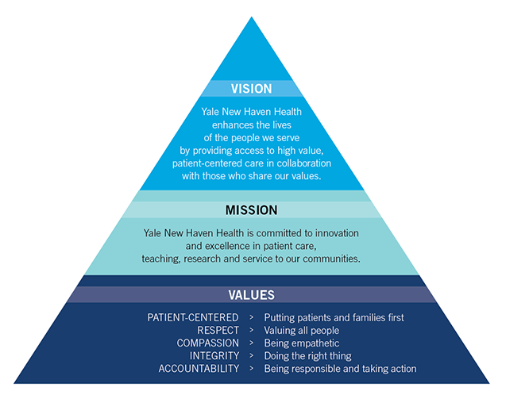
Vision, Mission and Values
Northeast Medical Group (NEMG) is committed to innovation and excellence in patient care, teaching and service to our communities
Our vision and values are also aligned with Yale New Haven Health (YNHH)

Slide 4
Northeast Medical Group
Clinical Depth & Breadth
Employed & PSA Clinicians¹
Physicians
APCs
41%
29%
37%
28%
18%
16%
9%
Primary Care |  | Community Based Specialists |  | Hospital Based Specialists |  | Hospitalists
Primary Care |  | Community Based Specialists |  | Hospital Based Specialists |  | Hospitalists
707 Physicians + 471 APCs = 1,178 Total Billing Clinicians
¹Notes:
Based on current FYTD22 August Roster
Source Document: NEMG Provider Roster July 2022
Data set includes Physicians (MD, DO, DPM) and APC (APRN, PA, NP)
Includes both employed and PSA clinicians (Unit of Measure: Headcount)

Slide 5
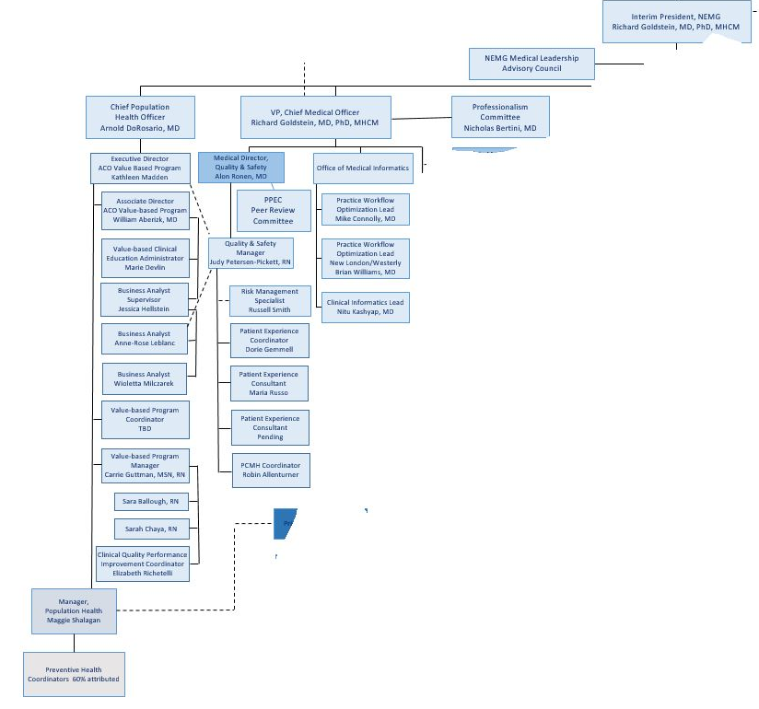
NEMG is able to focus considerable resources on Quality and Safety

Slide 6
Recent Quality Results for NEMG
Arnold DoRosario, MD
Chief Population Health Officer

Slide 7
NEMG Value Contracts:
2021 Membership
Medicare | Patients
Aetna | 7,608
Anthem | 6,789
ConnectiCare | 3,528
MSSP ACO | 26,050
United HealthCare | 13,242
WellCare | 1,255
Total | 58,472
Commercial | Patients
Aetna | 9,986
Anthem | 37,062
ConnectiCare | 7,505
Cigna | 13,155
Total | 67,708
126,180 Attributed Lives
Current Membership June 2021
Notes:
This was a membership for 2019. You can see we have almost an equal distribution between government programs (Medicare and Medicaid) and commercial.
They all are risk adjusted in their shared savings programs. That means if the population is sicker than average, there is more dollars needed to manage their care.
Similarly, if the population is less sick, less money is expected to be needed.

Slide 8
MSSP Quality Trends
Source: CMS Performance Year Financial and Quality Results Public Use Files (PUF) for PY2015-PY2020.
“Pay-for-Reporting” scores (automatically scored at 100% if fully reported) were removed from the first year of each ACO’s quality scores.

Slide 9
Most Recent Regional ACO Performances and NEMG
NEMG ACO vs 17 Regional ACOs:
#1 for Total Savings
#2 for Savings Rate
#2 for Shared Savings
#2 for Quality*
#3 for Enrollment Size
*excluding new ACO with P4R scoring
Based on publically reported data from CMS: https://data.coms.gov/medicare-shared-savings-program/performance-year-financial-and-quality-results

Slide 10

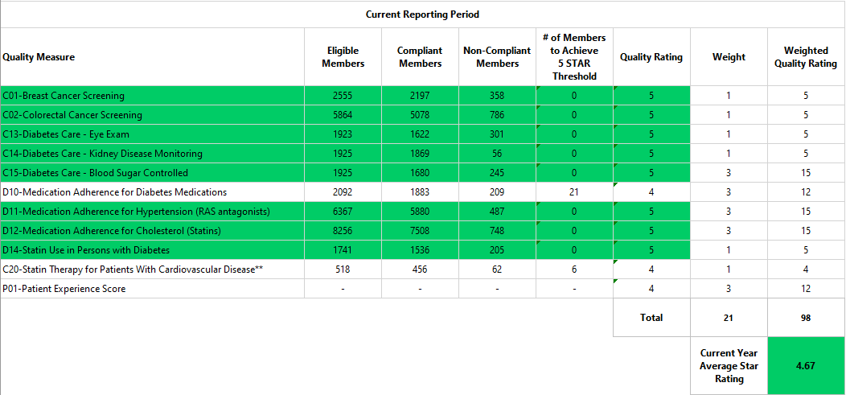
Calendar Year 2021
United Healthcare (UHC)
14,358 Membership

Slide 11
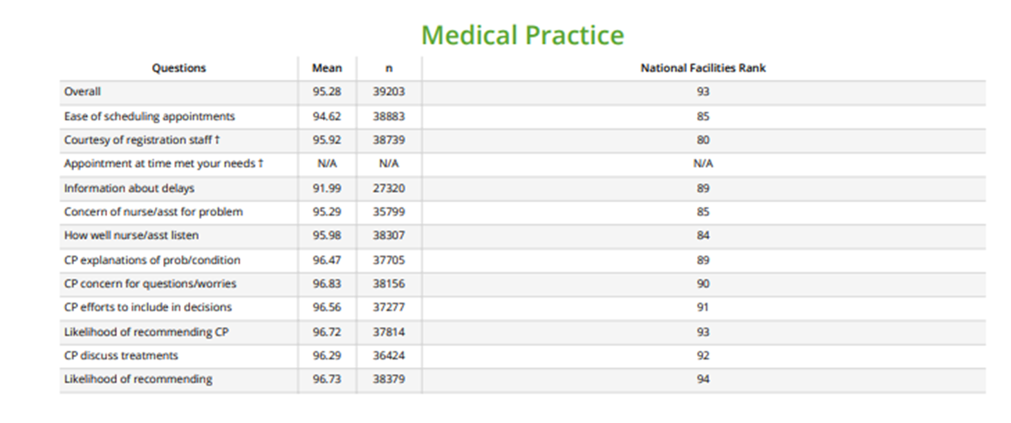
What do our patients think of us? Past 8 months of Press Ganey data for the NEMG Ambulatory Clinical Practices

Slide 12
In what ways do physicians find value in NEMG?
Practice Support:
Key drivers for burnout related to the Electronic Health Record
In-basket message support to better serve our patients
Innovative on-call support
Mentors and “coffee buddies” for new clinicians
A formal on-boarding programs
Malpractice Insurance is provided by the group
Bring best practices for safety to our physicians via our Insurance Captive (MCIC)
Opportunities for Teaching, Research, and On-going Education:
Educational opportunities through the Yale School of Medicine
Opportunities for clinical faculty appointments in the Yale School of Medicine
Recognition of the value of teaching
  Preceptorships
  Active education in how to be better teachers
Opportunities to participate in translational research
New research on risk factors and mortality in our populations

Slide 13
How do Physicians and/or Groups become part of NEMG?

Slide 14
Thank You
Questions?

