Slide 1
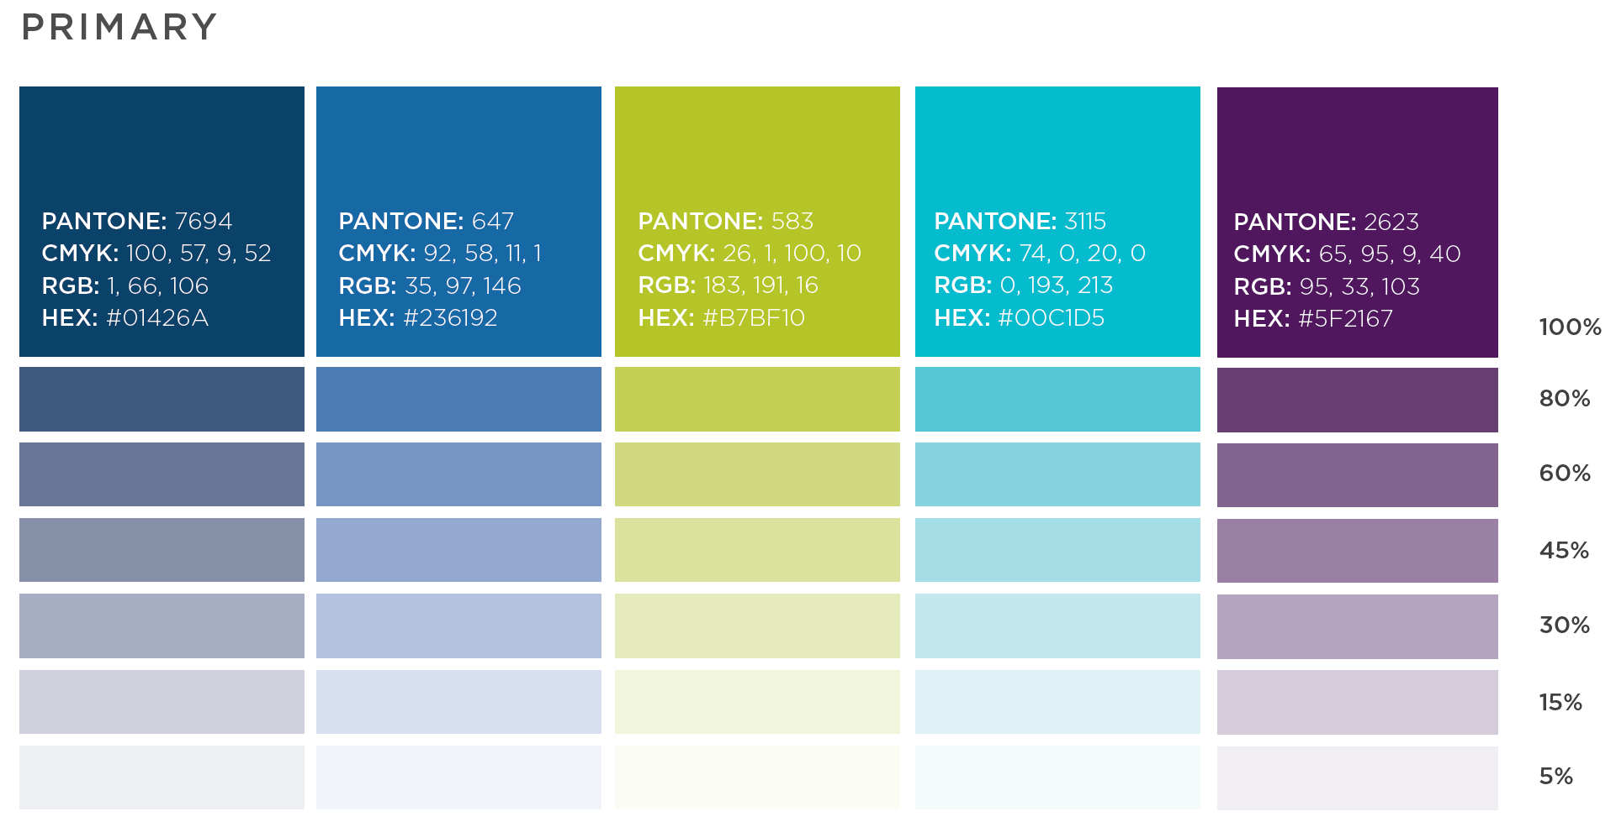
HCT2025
Preplanning Session
August 20, 2020
2:30-4:00 PM

Slide 2
Welcome & Introductions of Presenters
Mario H. Garcia, DPH

Slide 3
Agenda and Meeting Objectives
Meeting Objectives
  Provide an overview of where we are with HCT2025 – the Connecticut State Health Improvement Plan
  Provide an overview of the planning process for HCT2025.
Agenda
  Transition from SHIP 1.0 to SHIP 2.0
  SHIP 2.0: Healthy Connecticut 2025 (HCT2025)
  SHIP Planning Process
  Participant Preparation and Expectations
  Q&A

Slide 4
Transition from SHIP 1.0 to SHIP 2.0

Slide 5
What is a SHIP?
A State Health Improvement Plan (SHIP) is a strategic plan which provides guidance to health departments, community partners, and organizational/agency stakeholders for improving the health of the population.
A SHIP includes:
  Statewide health priorities identified from the State Health Assessment (SHA)
  Policy, systems, and environmental change strategies to address the priorities
  Designation of individuals and organizations responsible for implementing strategies
  Measurable outcomes
A SHIP is a collaborative process with multi-sector partners that aligns priorities and initiatives across communities to identify ways to build off them, remove barriers at the state level, eliminate redundancies, and coordinate efforts for maximum impact.

Slide 6
Draft Vision & Values
Draft Vision
Connecticut is a state where everyone can attain their optimal health and well-being without social or physical barriers.
Draft Values and Operating Principles
Health Equity: Focusing on structural racism and inherent bias as the root causes of the social drivers of health.
Collaboration: Promoting an interdisciplinary, multi-sector approach.
Asset-based: Building on and expanding from existing community strengths and initiatives.
Structural and Systemic Change: Using promising, community- and evidence-informed policy, systems, environmental change, and primary prevention strategies.
Transparency and Accountability: Sharing information and data in a meaningful and accessible way.

Slide 7

In Pursuit of Excellence
Public Health Department accreditation indicates that the agency meets
or exceeds rigorous public health standards as determined by the
Public Health Accreditation Board (PHAB)
PHAB requirements for accreditation are clear and not terribly prescriptive:
  PHAB requires the SHIP to be based on a comprehensive SHA;
  To engage broad partners including community;
  To outline the process for prioritizing identified health needs/issues;
  To describe goals and strategies for moving identified indicators (and by how much); and
  To describe the specific activities partners will undertake in working toward those goals (action plan).
PHAB requirements for implementation are likewise clear:
  PHAB requires that the SHIP be implemented, tracked, and reported on; and
  That the SHIP be a dynamic document that has flexibility in strategies and activities to accommodate changes in the environment.
Notes:
Focus on the why behind earning the star.

Slide 8
SHIP 2.0:
Healthy Connecticut 2025 (HCT2025)

Slide 9
Focus: Root Cause of Health Inequities (Structural Racism and Inherent Bias)
 | Priority Areas: Social Drivers of Health
 | A. Access to Healthcare Primary care, health/mental health care | B. Economic Stability Poverty, unemployment | C. Healthy Food and Shelter Housing quality/accessibility, healthy food access | D. Community Strength and Resilience Cohesion, safety, emergency response & preparedness
 | Goal and Objectives | Goal and Objectives | Goal and Objectives | Goal and Objectives
Key Impact/ Surveillance Measures | ◉ | ◉ | ◉ | ◉
Percentage of Children Who Are Obese/Obesity Suicide Rate Drug Overdose Deaths High School Students/Sexual Violence Percent Insured/ER Visits | Strategies (PSE & PP) | Strategies (PSE & PP) | Strategies (PSE & PP) | Strategies (PSE & PP)
Framework
for HCT2025:
The Connecticut State Heath Improvement Plan
PSE & PP: Policy, Systems, Environment, and Primary Prevention Strategies
Cross-Cutting Themes Addressed by PSE & PP Strategies:
Structural Racism/Inherent Bias
Transportation
Education
Notes:
Most importantly, they offer us the opportunity to step out of our traditional public health “lanes” (health conditions and/or indicators) in order to focus our efforts on fewer issues, leverage our multi-disciplinary expertise, and impact the key factors that influence health outcomes from the broader, common context within which our cross-sector agencies work.
NOTES:
Changed SDoH to Social Drivers of Health (based on feedback from the Community Discussions)
Added in emergency response and preparedness under D based on current reality in the community
HP2030
Attain healthy, thriving lives and well-being, free of preventable disease, disability, injury and premature death.
Eliminate health disparities, achieve health equity, and attain health literacy to improve the health and well-being of all.
Create social, physical, and economic environments that promote attaining full potential for health and well-being for all. Promote healthy development, healthy behaviors and well-being across all life stages.
Engage leadership, key constituents, and the public across multiple sectors to take action and design policies that improve the health and well-being of all.

Slide 10
Priority Areas for the SHIP
Began discussion on new framework 18 months ago with the SHIP Advisory Council
Conducted State Health Assessment (SHA) and identified 30 health conditions/risk factors
Preliminary Priorities identified at state-wide Coalition Summit in September 2019 aligning the 5 most critical conditions/risk factors to the social determinants of health that impact them the most
Gathered input via (6) community dialogue sessions held across the state in the spring of 2020 testing and validating outcomes from the Summit
Conducted a Coalition-wide Survey to ask for consensus on where we have solidified our focus for the Healthy CT 2025: State Health Improvement Plan (SHIP 2.0)

Slide 11
Priority Areas for the SHIP
These are the areas for which we will be developing Goals, Objectives and promising, community- and evidence-informed Strategies
Access to Health Care
  Primary Care
  Health/Mental Health Care
Economic Stability
  Poverty
  Unemployment
Healthy Food and Shelter
  Housing Quality/Accessibility
  Healthy Food Access
Community Strength and Resilience
  Cohesion
  Safety
  Emergency Response & Preparedness

Slide 12
Key Impact/Surveillance Measures
These are the data indicators we are hoping to impact via our identified priority areas:
Percentage of Children Who Are Obese/Obesity
Suicide Rate
Drug Overdose Deaths
High School Students/Sexual Violence
Percent Insured/ER Visits

Slide 13
Cross-Cutting Themes
These themes will be addressed across all priority areas via explicitly stated policy, systems, environmental change and primary prevention strategies (PSE & PP)
Structural Racism/Inherent Bias
Transportation
Education

Slide 14
Policy, Systems, Environment, and Primary Prevention (PSE & PP)
An approach to long-term, foundational change
Does not focus on program implementation
Seeks to reach populations and create sustainable change
Results are not often immediate, but have enduring impact
Notes:
Characteristics of PSE Change
Ongoing
Foundational: often produced behavior change over time
Community/Population level
Part of an ongoing plan
Long term
Sustaining
Characteristics of Event or Program
One time
Additive: often results in only short-term
Behavior change
Individual level
Not part of ongoing plan
Short term
Non-sustaining

Slide 15
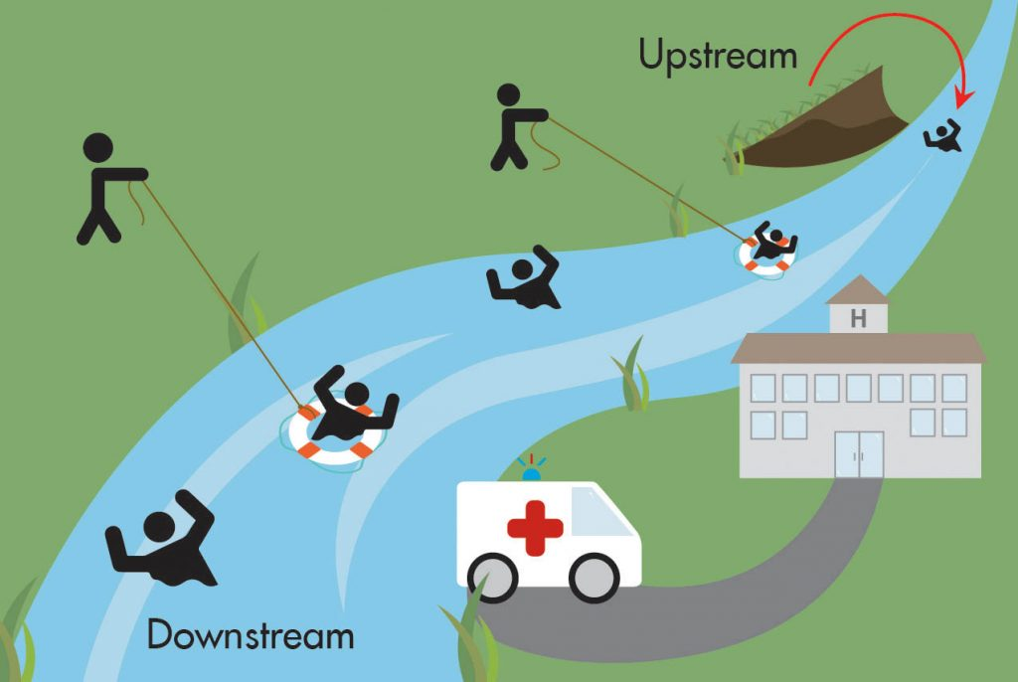
Upstream
Approach
Notes:
We are focusing on up stream.

Slide 16
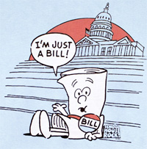
Policy Approach
Legislative Policy:
Federal, State, Local
Is written, debated, voted on, passed, implemented
Administrative Policy:
Public agencies issue guidance
Administrative rules that govern how laws are
implemented

Slide 17

Systems Approach
Changes within an organization to promote health
Organizational infrastructure changes including procurement
Community planning that incorporates
health
Building referral systems internally or externally
Reimbursing staff for prevention and health promotion activities
Notes:
Interventions or changes that leverage the functional components of an organization, institution, or system.

Slide 18
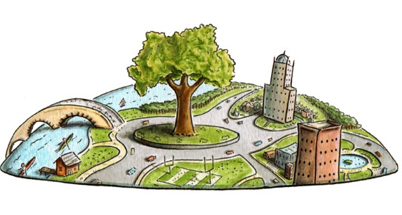
Environment Approach
Addresses the economic, experienced, or built/physical environment
Economic environment – financial incentives or disincentives to promote health
Experienced environment – safety, lighting in areas of high crime, stigma
Built environment – complete streets, recreational areas, zoning
Notes:
Interventions that involve changes to the economic, social, or built/physical environment.

Slide 19
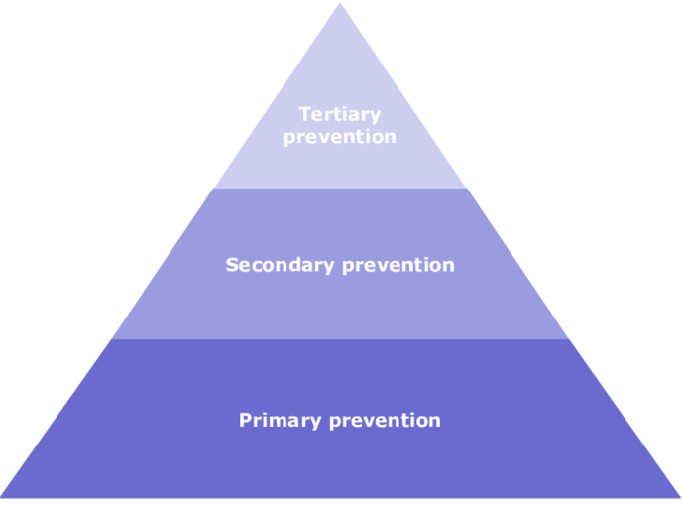
Primary Prevention
Primary prevention is concerned with preventing the onset of disease; it aims to reduce the incidence of disease. It involves interventions that are applied before there is any evidence of disease or injury.
The strategy is to remove causative risk factors (risk reduction), which protects health and so overlaps with health promotion.

Slide 20
Focus: Root Cause of Health Inequities (Structural Racism and Inherent Bias)
 | Priority Areas: Social Drivers of Health
 | A. Access to Healthcare Primary care, health/mental health care | B. Economic Stability Poverty, unemployment | C. Healthy Food and Shelter Housing quality/accessibility, healthy food access | D. Community Strength and Resilience Cohesion, safety, emergency response & preparedness
 | Goal and Objectives | Goal and Objectives | Goal and Objectives | Goal and Objectives
Key Impact/ Surveillance Measures | ◉ | ◉ | ◉ | ◉
Percentage of Children Who Are Obese/Obesity Suicide Rate Drug Overdose Deaths High School Students/Sexual Violence Percent Insured/ER Visits | Strategies (PSE & PP) | Strategies (PSE & PP) | Strategies (PSE & PP) | Strategies (PSE & PP)
Framework
for HCT2025:
The Connecticut State Heath Improvement Plan
PSE & PP: Policy, Systems, Environment, and Primary Prevention Strategies
Cross-Cutting Themes Addressed by PSE & PP Strategies:
Structural Racism/Inherent Bias
Transportation
Education
Notes:
Most importantly, they offer us the opportunity to step out of our traditional public health “lanes” (health conditions and/or indicators) in order to focus our efforts on fewer issues, leverage our multi-disciplinary expertise, and impact the key factors that influence health outcomes from the broader, common context within which our cross-sector agencies work.
NOTES:
Changed SDoH to Social Drivers of Health (based on feedback from the Community Discussions)
Added in emergency response and preparedness under D based on current reality in the community
HP2030
Attain healthy, thriving lives and well-being, free of preventable disease, disability, injury and premature death.
Eliminate health disparities, achieve health equity, and attain health literacy to improve the health and well-being of all.
Create social, physical, and economic environments that promote attaining full potential for health and well-being for all. Promote healthy development, healthy behaviors and well-being across all life stages.
Engage leadership, key constituents, and the public across multiple sectors to take action and design policies that improve the health and well-being of all.

Slide 21
SHIP Planning Process

Slide 22
Virtual Planning Process Overview
Planning for HCT2025 will be done virtually due to the COVID-19 pandemic.
We will be using a similar format to the planning done for the first SHIP, spread out over multiple virtual planning sessions.
There will be opportunities to work in smaller working groups and to come together as a large group to share work and provide feedback.
The process necessitates timely follow through in between virtual sessions.
Works best if participants can be consistent across all sessions.

Slide 23
Virtual Planning for HCT20205
1.5 hours
2 hours
1 hour
2.5 hours
2 hours
3 hours
2 hours
SHIP Planning Overview
(Pre-Planning Webinar)
Zoom/Online Tools Overview
SHA Findings
SDoH Priorities
SHIP Structure
Planning Process Overview
Time Commitment
Next Steps
Priority A
Draft Goals
Goals Feedback
Priority A
Revise Goals
Draft Objectives
Objectives Feedback
Priority A
Revise Objectives
Draft Strategies
Strategies Feedback
Electronically
Priority A
Finalize Strategies
Priority B
Draft Goals
Priority B
Revise Goals
Draft Objectives
Priority B
Revise Objectives
Draft Strategies
Priority B
Finalize Strategies
Priority C
Draft Goals
Priority C
Revise Goals
Draft Objectives
Priority C
Revise Objectives
Draft Strategies
Priority C
Finalize Strategies
Priority D
Draft Goals
Priority D
Revise Goals
Draft Objectives
Priority D
Revise Objectives
Draft Strategies
Priority D
Finalize Strategies
Participant Criteria:
Able to participate via Zoom (audio AND visual)
Available to participate in ALL sessions
Time Commitment
Per participant: 20 hours of sessions + homework
(assumes participation in only one (1) Priority Area)

Slide 24
Timeline
Aug |  | Sep |  |  |  |  | Oct
17-21 | 24-27 | 31-3 | 8-11 | 14-18 | 21-25 | 28-2 | 5-9 | 12-16 | 19-23 | 26-30
Nov | Dec | Jan | Feb
Preplanning Webinar (Joint Session)
Goals
Draft Goals (by Priority Area)
Goals Feedback (Joint Session)
Objectives
Finalize Goals and Draft Objectives (by Priority Area)
Objectives Feedback (Joint Session)
Strategies
Finalize Objectives and Draft Strategies (by Priority Area)
Electronic Feedback
Provide Feedback on Draft Strategies (electronically)
Compile Feedback
Finalize
Finalize Strategies (by Priority Area)
Write Draft SHIP
DPH Review, HRiA Revise
Graphic Design
Finalize
Launch
Print

Slide 25
Session |  |  | Participants | Day | Date | Time | Duration (hours)
Pre-Planning Session |  |  | All | Thu | 8/20/20 | 2:30-4:00 | 1.5
Draft Goals Sessions
 | Priority Area A: Access to Health Care |  | Working Group A | Mon | 8/24/20 | 1:00-3:00 | 2
 | Priority Area B: Economic Stability |  | Working Group B | Tues | 8/25/20 | 10:00-12:00 | 2
 | Priority Area C: Healthy Food & Shelter |  | Working Group C | Tues | 8/25/20 | 1:00-3:00 | 2
 | Priority Area D: Community Strength & Resilience |  | Working Group D | Wed | 8/26/20 | 10:00-12:00 | 2
Goals Feedback Session |  |  | All | Thurs | 8/27/20 | 11:00-12:00 | 1
Revise Goals & Draft Objectives Sessions
 | Priority Area A: Access | Priority Area A: Access to Health Care | Working Group A | Tues | 9/1/20 | 9:30-12:00 | 2.5
 | Priority Area B: Economics | Priority Area B: Economic Stability | Working Group B | Tues | 9/1/20 | 1:00-3:30 | 2.5
 | Priority Area C: Healthy Food & Shelter | Priority Area C: Healthy Food & Shelter | Working Group C | Wed | 9/2/20 | 1:00-3:30 | 2.5
 | Priority Area D: Community Strength & Resilience | Priority Area D: Community Strength & Resilience | Working Group D | Thurs | 9/3/20 | 9:30-12:00 | 2.5
Objectives Feedback Session |  |  | All | Thurs | 9/10/20 | 2:00-4:00 | 2
Notes:
Each participant will receive a document with the registration links for all meetings for their priority area.

Slide 26
Session |  | Participants | Day | Date | Time | Duration (hours)
Revise Objectives & Draft Strategies Sessions
 | Priority Area A: Access to Health Care | Working Group A | Mon | 9/14/20 | 1:00-4:00 | 3
 | Priority Area B: Economic Stability | Working Group B | Wed | 9/16/20 | 9:00-12:00 | 3
 | Priority Area C: Healthy Food & Shelter | Working Group C | Wed | 9/16/20 | 1:00-4:00 | 3
 | Priority Area D: Community Strength & Resilience | Working Group D | Thurs | 9/17/20 | 9:00-12:00 | 3
 | Strategies Feedback Individual feedback submitted electronically | --- | --- | Sep 21-25 | --- | ---
Finalize Strategies Sessions
 | Priority Area A: Access to Health Care | Working Group A | Mon | 10/5/20 | 1:00-3:00 | 2
 | Priority Area B: Economic Stability | Working Group B | Tues | 10/6/20 | 10:00-12:00 | 2
 | Priority Area C: Healthy Food & Shelter | Working Group C | Wed | 10/7/20 | 1:00-3:00 | 2
 | Priority Area D: Community Strength & Resilience | Working Group D | Thurs | 10/8/20 | 10:00-12:00 | 2

Slide 27
Participant Preparation and Expectations

Slide 28
Ready, Set, …
SHIP Planning
Able to participate via Zoom (audio AND visual)
Available to participate in ALL sessions and/or prep alternate participant for sessions
Review advance materials when provided
Complete work between sessions as directed
Bring institutional/organizational knowledge, priorities and perspectives
SHIP Implementation
Champion the SHIP within institution/organization
Facilitate ways of aligning priorities with specific, relevant areas of the SHIP

Slide 29
Questions?
If you have questions after today’s session, please email HCT2020.DPH@ct.gov

Slide 30
Thank you!

